Slide 1
EKOS
Enterprise Knowledge Operating System
An IR-first enterprise knowledge discovery and integrity platform
Information Retrieval Course Project · Aurelia Technologies (fictional, ~2,000 employees)

Slide 2
THE PROBLEM
Enterprises don't lack information.
They lack knowledge integrity.
Fragmentation
Decay
Silent conflict
The same policy fact is restated across a handbook, a formal policy, and informal notes — each slightly different.
Documents get superseded but not retired. Outdated guidance keeps getting cited as current.
Two departments define the same term differently. Two policies disagree. Search returns both and picks neither.
EKOS — Aurelia Technologies
2

Slide 3
WHAT EKOS ADDS
Four questions a search box can't answer
1
Where is the relevant knowledge?
2
How relevant is it — lexically and semantically?
3
How is it connected to everything else the org knows?
4
Can it be trusted — is it current, and does it conflict with anything?
EKOS — Aurelia Technologies
3

Slide 4
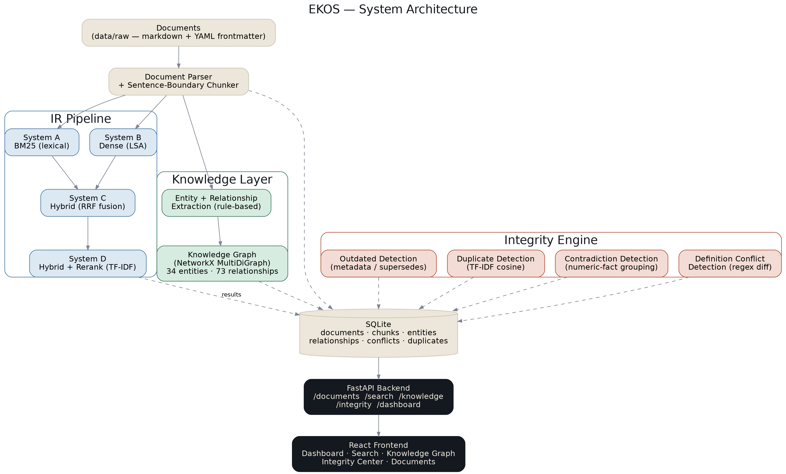
SYSTEM DESIGN
Architecture
EKOS — Aurelia Technologies
4

Slide 5
EVALUATION CORPUS
A controlled dataset, not a random one
21 documents · 24 chunks — HR, IT-Security, Finance, Engineering, Projects
for a fictional company, Aurelia Technologies
2
2
2
1
near-duplicate
passage pairs
factual
contradictions
outdated/superseded
version pairs
cross-department
definition conflict
Hand-labeled ground truth verified byte-exact against chunked text (automated test) — not asserted on faith.
EKOS — Aurelia Technologies
5

Slide 6
RETRIEVAL
Four systems, one evaluation set
A
B
C
D
BM25
Dense (LSA)
Hybrid (RRF)
Hybrid + Rerank
Lexical baseline
TF-IDF + SVD — sentence-transformers swap-in ready
Rank-based fusion, no tuned weights
TF-IDF cosine rescoring of top candidates
Network constraint: this sandboxed dev environment can't reach Hugging Face Hub — B and D run swappable no-network fallbacks (one-line config change to switch to real sentence-transformer models).
EKOS — Aurelia Technologies
6

Slide 7
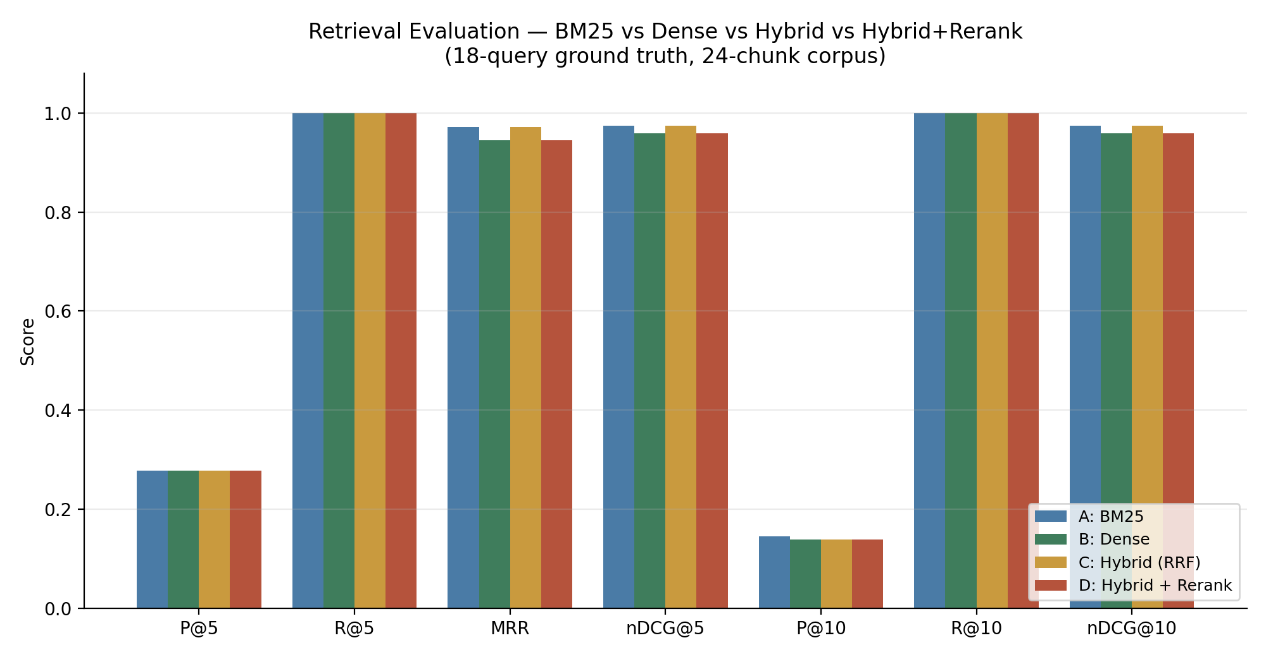
RETRIEVAL EVALUATION
Real numbers, honestly interpreted
EKOS — Aurelia Technologies
7

Slide 8
RETRIEVAL EVALUATION — FINDING
Why System D scores below System C
Query: “What is the company's reimbursement limit for expenses?”
Hybrid RRF ranks current Expense Policy v2 fractionally above superseded v1 (near-identical text, differ only in the dollar figure).
The TF-IDF reranker has no authority/recency signal — it reverses that order, ranking the superseded version first.
Not a bug in the reranking mechanism — the expected result of reranking on lexical similarity alone, when two candidates differ mainly in a fact that changed between versions.
This motivates the metadata-authority ranking boost and the integrity engine's outdated-detection component.
EKOS — Aurelia Technologies
8

Slide 9
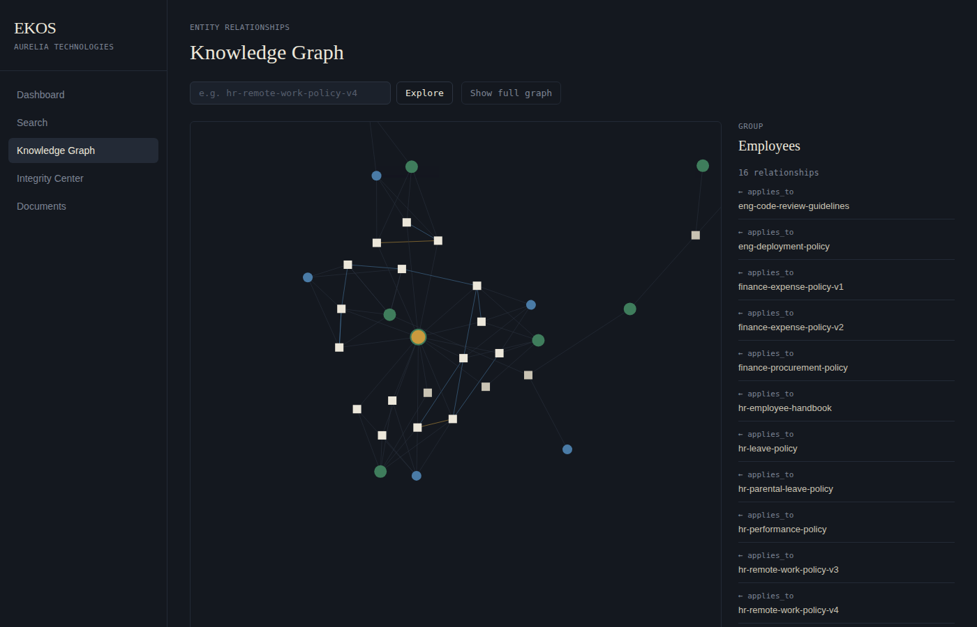
KNOWLEDGE LAYER
Knowledge Graph
34
Entities
73
Relationships
6
Relation types
owned_by · belongs_to · created_by
supersedes · applies_to · references
Extracted from document metadata + rule-based text-reference detection — no LLM. 4 real extraction bugs caught by manually inspecting the graph, not assumed correct.
EKOS — Aurelia Technologies
9

Slide 10
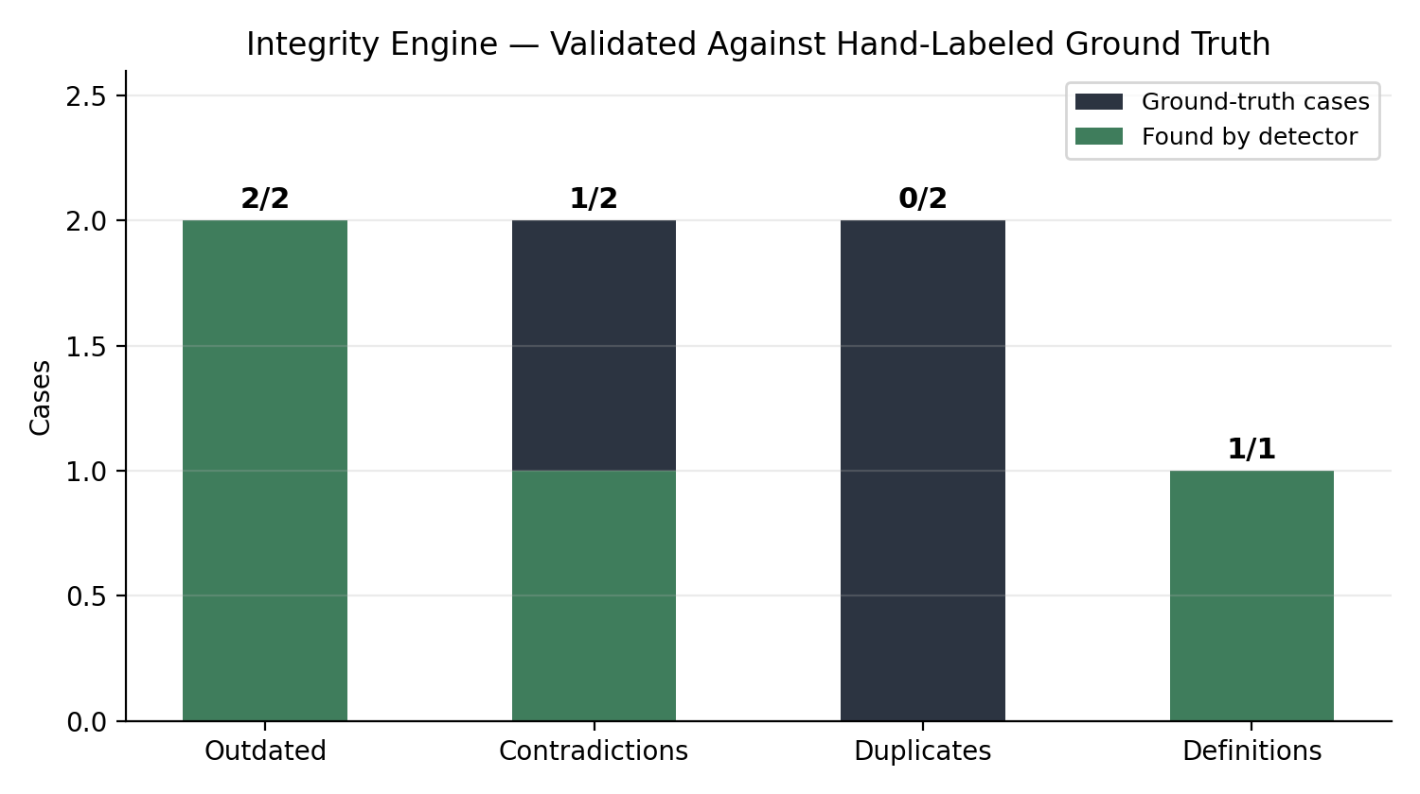
INTEGRITY ENGINE
Validated against ground truth
EKOS — Aurelia Technologies
10

Slide 11
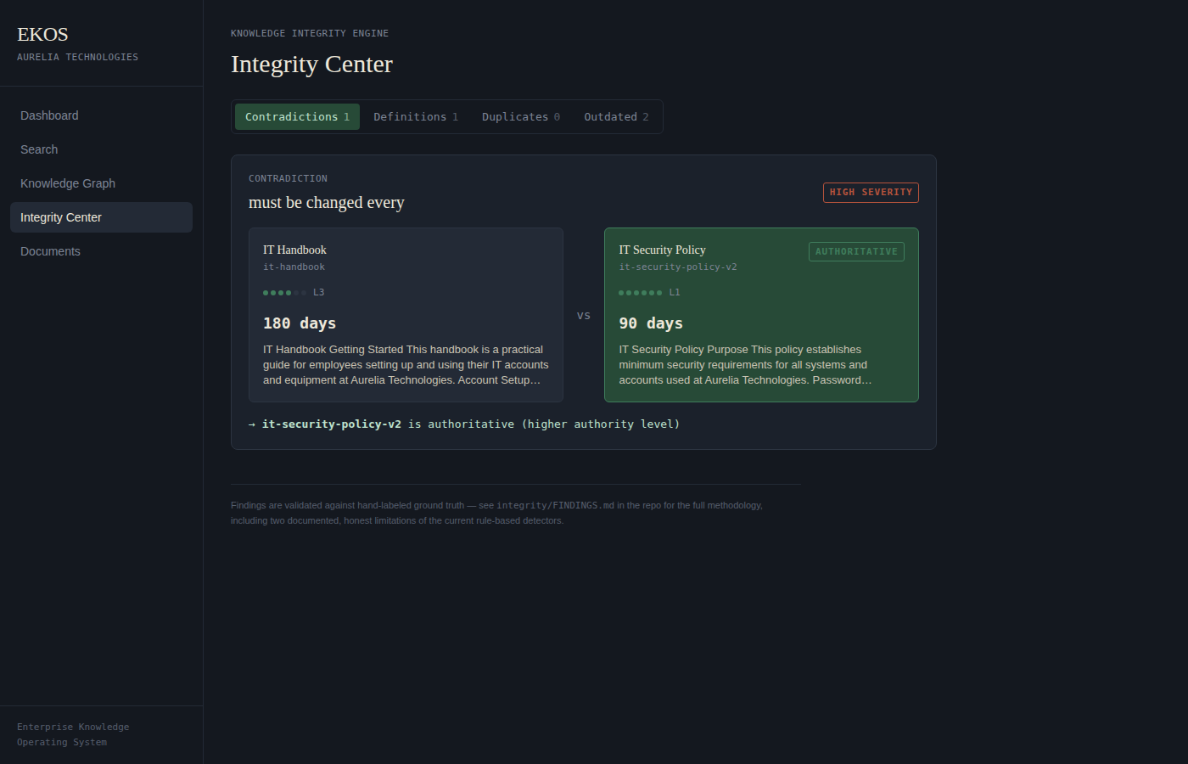
INTEGRITY ENGINE — THE CONFLICT CARD
Making the thesis visible
EKOS — Aurelia Technologies
11

Slide 12
INTEGRITY ENGINE — THE MOST IMPORTANT FINDING
Duplicate detection: 0/2, and why that's real
Both labeled duplicate pairs checked against every cross-document chunk pair in the corpus:
Labeled duplicate pair (Leave Policy / Handbook)
0.143
Labeled duplicate pair (Security / Device Policy)
0.181
Unrelated pair (Production Access / Access Control)
0.314
Unrelated pair (Incident Response SOP / Policy)
0.271
No threshold separates true duplicates from noise — not a tuning problem. These are genuine paraphrases sharing a fact but little vocabulary: exactly what lexical methods miss and sentence embeddings solve.
EKOS — Aurelia Technologies
12

Slide 13
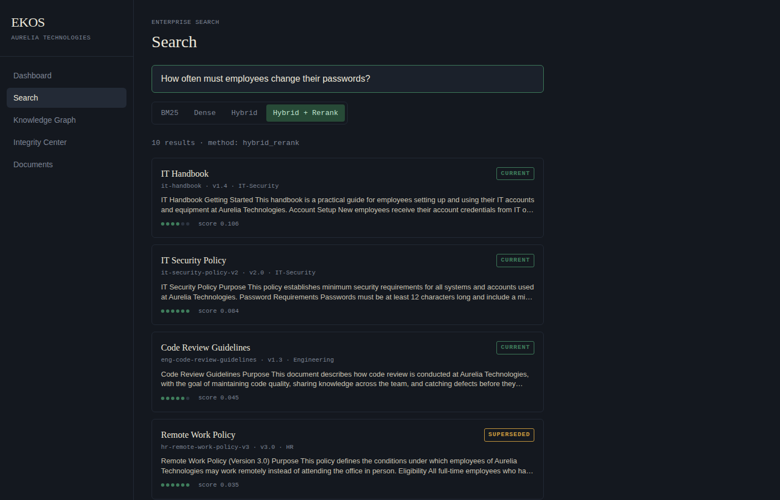
FRONTEND
Search across four retrieval methods live
EKOS — Aurelia Technologies
13

Slide 14
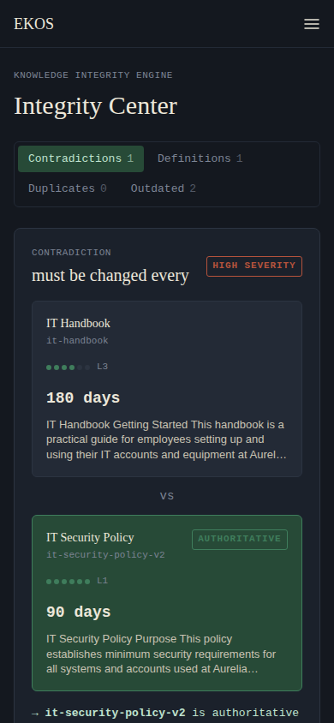
FRONTEND — VERIFIED, NOT ASSUMED
Caught real bugs with browser automation
Definition text in a numeric callout
Full sentences were rendering inside a large mono box sized for “90 days”-style facts. Fixed: callout only shows for numeric contradictions.
Mobile layout was broken
Fixed-width sidebar consumed most of a 390px viewport; stat labels overlapped. Fixed with a hamburger-drawer nav, re-verified via Playwright.
Both caught via real Playwright screenshots against the running app — not assumed correct from source review.
EKOS — Aurelia Technologies
14

Slide 15
HONEST LIMITATIONS
What's not done, and why
Dense encoder / reranker: no-network fallbacks, not sentence-transformers (swappable, one-line config)
Contradiction detection: numeric facts only — qualitative contradictions need LLM/NLI reasoning
Evaluation corpus is small (24 chunks) — recall saturates at 1.000 across all systems
No authentication on any endpoint — documented scope cut, not an oversight
No automated frontend test suite — verified via manual + browser-automation screenshots
EKOS — Aurelia Technologies
15

Slide 16
CONCLUSION
The clearest evidence for EKOS's thesis
is its own most honest finding
The integrity engine's 0/2 result on paraphrased duplicate detection isn't a failure of the system design — it's a precise, validated demonstration of exactly where lexical methods stop being sufficient and semantic understanding becomes necessary.
That's the same problem EKOS exists to solve for an organization's documentation in the first place.
EKOS — Aurelia Technologies
16

