Slide 1

Duplicate Provider Check

Slide 2
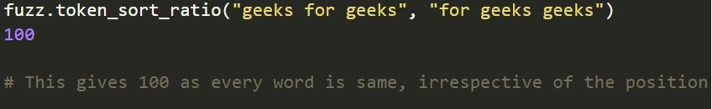
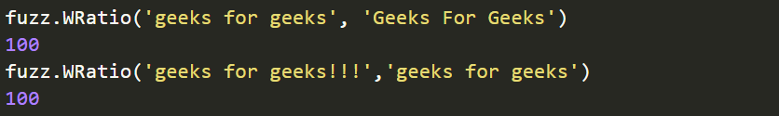
FUZZYWUZZY : A TOOL FOR NLP
fuzz.partial_ratio :
fuzz.token_sort_ratio:
fuzz.WRatio:

Slide 3
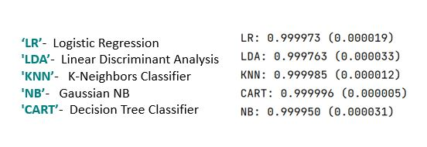
Comparison of different ML models
Accuracy (Standard deviation)

Slide 4
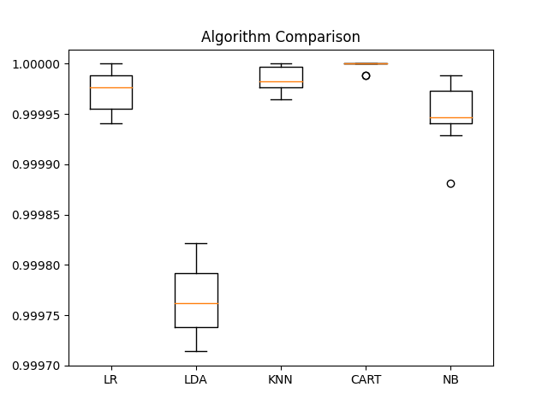
Boxplot Comparison

Slide 5
Basic Layout
INPUT
APPLYING NLP USING FUZZYWUZZY
GETTING COMPARISON SCORES
ML BASED
COLUMN CONSTANT
SCORE CONSTANT

Slide 6
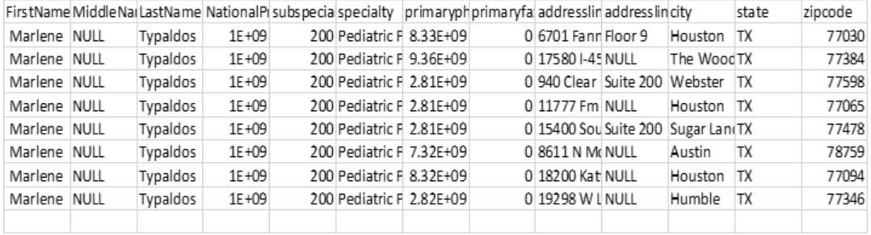
ML Based API
Giving the input
Gives the following rows as output

Slide 7
Constant Columns API
Classification metrics:
All the columns are considered

Slide 8
Constant Columns API
Giving the input
Gives the Output

Slide 9
Constant Score API
Classification metrics:
Cells are considered matching if the comparison score comes greater than 90
An Extension can be added to give weights to certain preferred columns.

Slide 10
Constant Score API
Giving the input
Output

Slide 11
Comparing the Algorithms

Slide 12
Changing the first and the last name, rest being the same
Input
Output:
ML based:
No matching rows
Column Constant:
No matching rows
Score constant:

Slide 13
Keeping First and the last name same, rest all different
Input
Output:
ML Based:
No matching row
Column Constant:
No matching row
Score Constant:
No matching row

Slide 14
API Layout

Slide 15
AUTHORIZATION OF TOKEN
INPUT :
POSTMAN
TOKEN GENERATED
PROVISION:
Client_name
Client_id client_secret
AUTHENTICATION:
Client_id client_secret
CORRECT DETAILS
AUTHORIZED
NOT THE CLIENT
DETAILS ARE MISSING
Client not verified!
Could not Verify Client Details

Slide 16
VALIDITY OF TOKEN
INPUT :
POSTMAN
ColumnConstant
TOKEN VALIDITY
YES
PROVISION:
Client_name
Client_id client_secret
ScoreConstant
OUTPUT
NO
MLBased
TOKEN IS INVALID
AUTHENTICATION:
Client_id client_secret
TOKEN GENERATED

