Slide 1
Hotel Booking Cancellation Analysis understanding and addressing booking cancellations patterns.
Now our presentation begins

Slide 2
Table of contents
01
02
03
04
05
06
Introduction
Dataset preview
EDA process
visuals
suggestions
Future aspects

Slide 3
Why We Selected This Project?
We chose this project to help hotels understand why guests cancel bookings.
Cancellations can cause problems, like lost revenue, empty rooms, and unpredictable occupancy rates, which affect overall planning and staffing.
By finding patterns and reasons behind cancellations, hotels can make smarter decisions to reduce them, keep rooms filled, and create a better experience for guests.
This analysis can help hotels identify the types of bookings that are most likely to be canceled and the times of year when cancellations peak.
With this knowledge, hotels can adjust their policies, create targeted promotions, and improve their flexibility, ultimately leading to more reliable bookings, higher revenue, and stronger customer relationships.

Slide 4
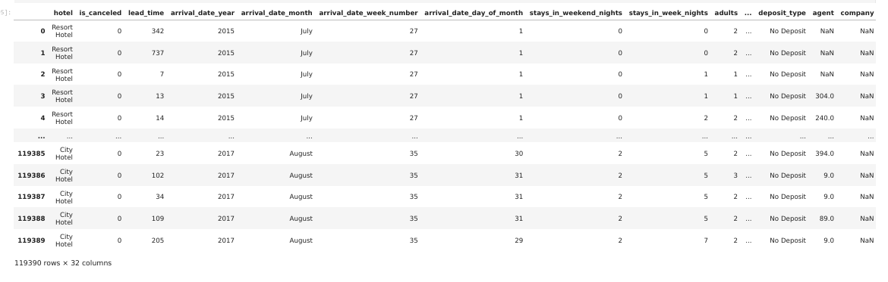
Dataset overview

Slide 5



Key Performance Indicators
The average length of stay is 3.4 days, reflecting a positive trend in guest retention and potentially lower cancellation rates.
The average lead time is 104 days, indicating a longer planning period for bookings.
The average daily rate (ADR) is $101.8, reflecting a solid pricing strategy and revenue management.

Slide 6
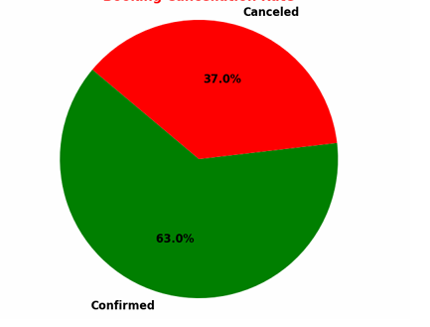
Overall Cancellation Rate
The pie chart indicates a cancellation rate of 37%, which is notably high and raises concerns about guest commitment and potential revenue loss.
A 37% cancellation rate could significantly affect overall revenue and occupancy rates, making it crucial to address the underlying causes.

Slide 7
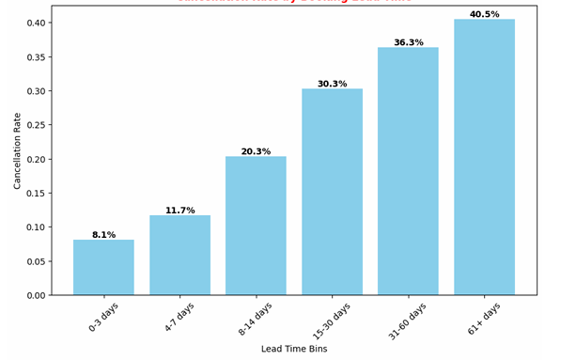
Cancellation Rate by Lead Time
61+ Days: The cancellation rate is 40.5%, meaning that many long-term bookings still get canceled.
31-60 Days: Cancellation rate is 36.6%, suggesting that mid-range bookings face moderate cancellation risks, warranting improved guest engagement.
15-30 Days: At 30.3%, this group shows a relatively lower risk of cancellation compared to longer lead times, reflecting better commitment among guests.
8-14 Days :The cancellation rate is 20%, showing that many bookings in this timeframe are still at risk of being canceled.
4-7 Days: With a cancellation rate of 11%, this segment demonstrates a lower tendency for cancellations, suggesting stronger commitment as the stay approaches.
0-3 Days: A cancellation rate of 8.1% indicates that last-minute bookings are the least likely to be canceled, reflecting higher guest commitment.

Slide 8
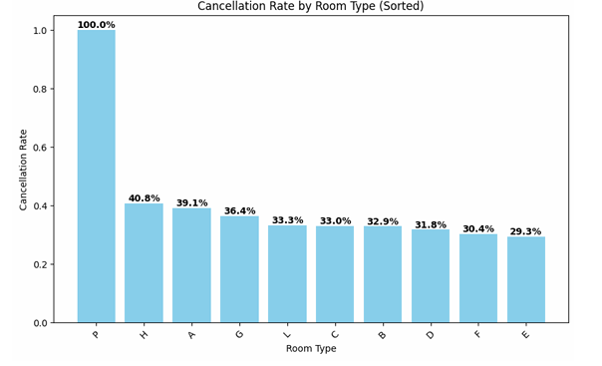
Cancellation Rate by Room Type
Room Type P:Has a 100% cancellation rate, meaning every booking for this room type was canceled. This might indicate issues specific to this room type.
Room Type H: The cancellation rate is 40%, showing that this room type also has a fairly high risk of cancellations.
Other Room Types: These have a cancellation rate of 35% or more, which is still a high cancellation rate.

Slide 9
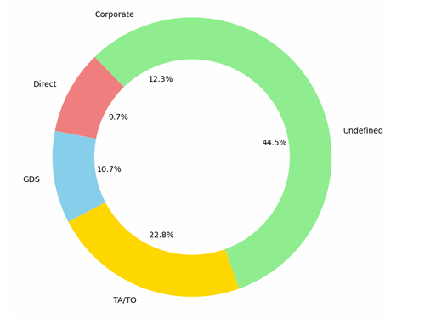
Cancellation Rate by Booking Source
Undefined (44.5%): Nearly half of cancellations come from unknown sources, indicating gaps in tracking or categorizing bookings accurately..
Travel Agents/Tour Operators (22.8%): A significant share of cancellations comes from bookings made through travel agents or tour operators.
Corporate (12.3%): Corporate bookings have a moderate cancellation rate, which might indicate some fluctuation in business bookings.
Global Distribution System (GDS) (10.7%): Cancellations through third-party platforms make up a smaller portion but still have an impact.
Direct (9.7%): Direct bookings have the lowest share of cancellations, showing more stability in these bookings.

Slide 10
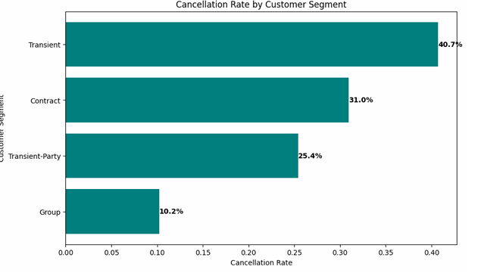
Cancellation Rate by customer type
Transient (40.7%): A big part of cancellations comes from individual travelers. This means we need to find better ways to keep these customers happy and coming back.
Contract (31.0%): About one-third of cancellations are from customers with contracts. This could mean there are issues with our agreements or that these customers aren’t fully satisfied.
Transient Party (25.4%): Cancellations from groups of individual travelers are also significant. We should focus on understanding what these groups need to reduce cancellations.
Group (10.2%): Although group bookings make up a smaller percentage of cancellations, it's still important. We need to provide special attention and communication to these groups to help lower cancellations.

Slide 11
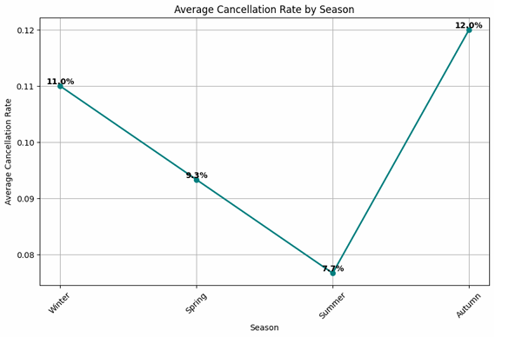
Cancellation Rate by seasonality
Autumn (12%): Autumn, which includes September, October, and November, has the highest cancellation rate. This might be due to changing weather and the end of the travel season, making people reconsider their plans.
Winter (11%): Winter (December, January, and February) also has a high cancellation rate. Travelers may face unpredictable weather or holiday changes, leading to more cancellations during these months.
Spring (9.3%): Spring (March, April, and May) has a moderate cancellation rate. While the weather is often nice, school schedules and events during this time can lead to last-minute changes in travel plans.
Summer (7.7%): Summer (June, July, and August) has the lowest cancellation rate. Many families travel during these months, which means they are less likely to cancel their plans.

Slide 12
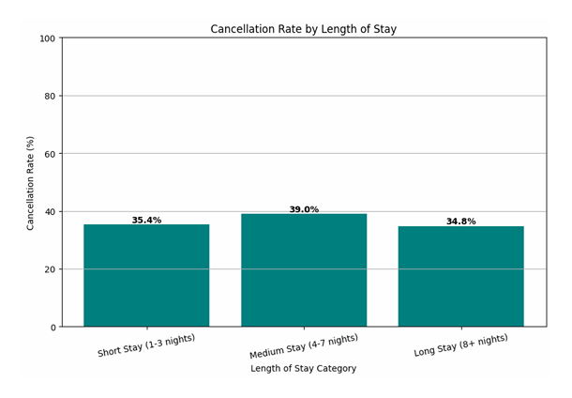
Cancellation Rate by length of stay
Medium Stay (4-7 nights) – 39%: Medium-length stays have the highest cancellation rate. This could be because week-long stays require a bigger commitment, and travelers may reconsider due to unexpected costs, time conflicts, or other obligations that arise.
Short Stay (1-3 nights) - 35.4%: Short stays also show a high rate of cancellations. Travelers booking for a brief stay might have flexible or spontaneous plans, which makes it easier for them to cancel at the last minute if something changes.
Long Stay (8+ nights) - 34.8%: the cancellation rate for long stays is still significant. Planning a longer trip can be challenging, and travelers sometimes cancel if their plans don’t fully come together or if unexpected issues arise.

Slide 13
Strategies to Reduce Hotel Cancellations
Offer Discounts for Early Bookings: Give discounts or rewards to guests who book in advance. This helps reduce last-minute cancellations and ensures more bookings are kept.
Create Seasonal Deals: During off-peak seasons, like fall or winter, offer special non-refundable packages to attract guests and keep rooms filled.
Improve Room Types with High Cancellations: For rooms that often get canceled, like Room Type P, consider stricter booking policies or special offers to make guests more likely to keep their reservations.
Encourage Direct Bookings: Reward guests for booking directly on your website instead of through third-party sites. Direct bookings often have fewer cancellations.
Give Loyal Guests Flexible Options: Loyal or repeat guests usually cancel less, so offer them flexible booking options and rewards to encourage them to come back.
Tighter Policies for Group and Corporate Bookings: Use stricter deposit policies for groups or corporate bookings since these can sometimes have higher cancellation rates.
Focus on Individual Travelers: Individual travelers have the highest cancellation rates, so give them targeted offers or extra support to help them stick to their bookings.
Promote in Low-Cancellation Seasons: Push more marketing and family-friendly packages during summer, which has fewer cancellations, to attract guests who are likely to keep their bookings.
Improve Booking Source Data: Work on getting clear information about where each booking is coming from. This will help reduce cancellations from “undefined” sources.
Highlight Benefits of Longer Stays: Encourage longer stays by offering package deals or room upgrades to guests booking multiple nights, making them less likely to cancel.
Listen to Customer Feedback: Gather feedback from guests who canceled their bookings to learn why. Use this information to update your policies and make improvements.

Slide 14
Future aspects
Better Prediction Models: Use smarter technology to predict when people might cancel their bookings ,considering factors like weather or guest habits.
Flexible Pricing: Adjust room prices based on cancellation patterns by season, room type, and how early guests book, to encourage fewer cancellations.
Detailed Customer Groups: Group customers more accurately to understand what each type needs, especially those with higher cancellation rates.
More Data Sources: Add data from other areas, like competitor bookings or economic trends, to get a full view of why guests cancel.
Live Data Tracking: Use real-time data to watch booking trends and make quick changes to policies, pricing, or promotions.
Personalized Guest Experience: Use data to understand guests’ preferences better, creating a tailored experience that makes them more likely to stick with their booking.
Learning from Other Industries: Look at how airlines or events handle cancellations to find new ideas for hotels.
heir bookings to learn why. Use this information to update your policies and make improvements.

Slide 15

About the creator
My Analytical Role:
Data Collection & Cleaning
Exploratory Data Analysis (EDA)
Insightful Visualization
Future Directions
Aryan Verma
Data Analyst & Project Lead
About the project:
I led this project from data collection and cleaning to analysis and visualization, uncovering key insights in hotel booking cancellations. My role covered the entire process, ensuring accuracy and relevance in every detail.
“Data tells the story. I just bring it to life.”

Slide 16
Thank You for Your Attention!

