Slide 1


AQI
PREDICTION
GROUP MEMBERS
TUSHAR SHARMA 1024030676
ARYAN SHARMA 1024030679
TAASHVI AGGARWAL 1024030681
MAITHLI ARORA 1024030687
ANSHIKA BANSAL 1024030689
MICROSOFT AI FOR EARTH
AI FOR ENGINEERS-UCS321

Slide 2

PROBLEM STATEMENT
The Challenge :
Environmental Risk:
Rising pollution levels pose significant threats to human health and urban sustainability.
Modeling Challenge:
AQI prediction requires capturing relationships among pollutants like PM2.5, PM10, NO₂, CO, SO₂, and O₃.
Data Quality Issues:
Missing readings and sensor inconsistencies necessitate robust preprocessing strategies.
Core Objective:
Predict Air Quality Index (AQI) using historical pollutant concentrations.
Target Variable Definition:
AQI (Continuous Value)
Higher AQI → Poorer Air Quality

Slide 3

DATASET
Source:
Kaggle
Description:
Air Quality Data in India (2015–2020) By CPCB
Features:

Slide 4


DATA PRE-PROCESSING
FILTERING DATA
MISSING VALUES
DATA CLEANING
The rows which had NULL values in place of AQI column were dropped as the Dataset had large size.
Approx 3-16% values per coulmn were missing
Missing values were replaced by Median.
FINAL DATASET
DATA SPLIT
Out of 16 Features ,6 Pollutants that affect most to AQI were used for training
80% Data for training and 20% for testing

Slide 5
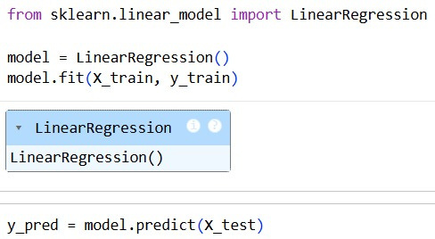
BASELINE MODEL
Linear regression - first approach to establish performance floor.
Models AQI as a weighted linear sum of pollutant features. Assumes additive ,proportional relationships between predictors and target.
LO

Slide 6
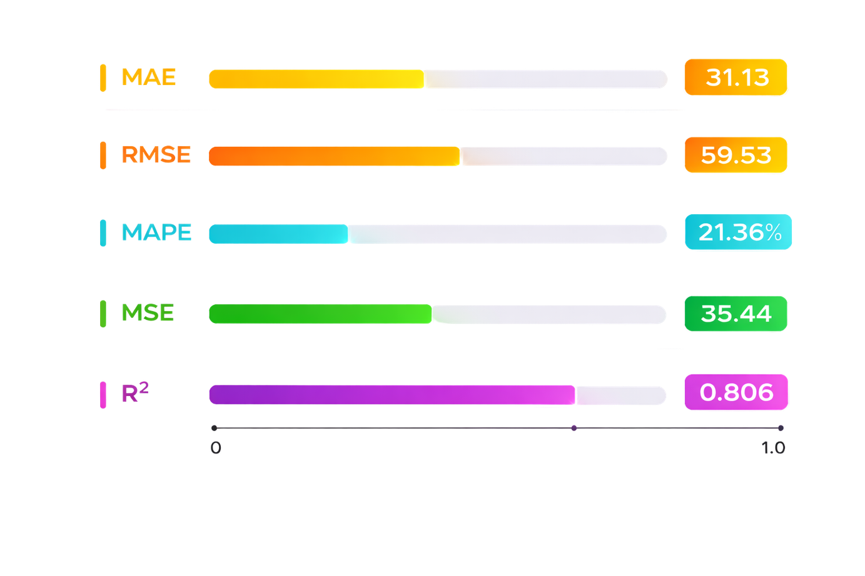
LINEAR REGRESSION RESULTS

Slide 7
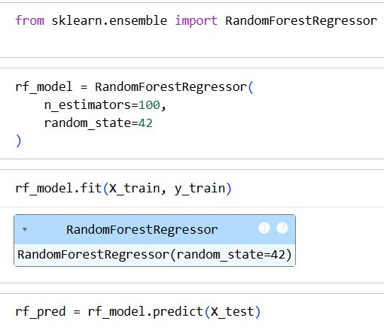
MODEL IMPROVEMENT
Random Forest - uses many decision trees to make better prediction.
AQI depends on complex ,non linear relationships between pollutants . It builds multiple trees ,each tree makes a prediction and the final output is the average of all the predictions.

Slide 8
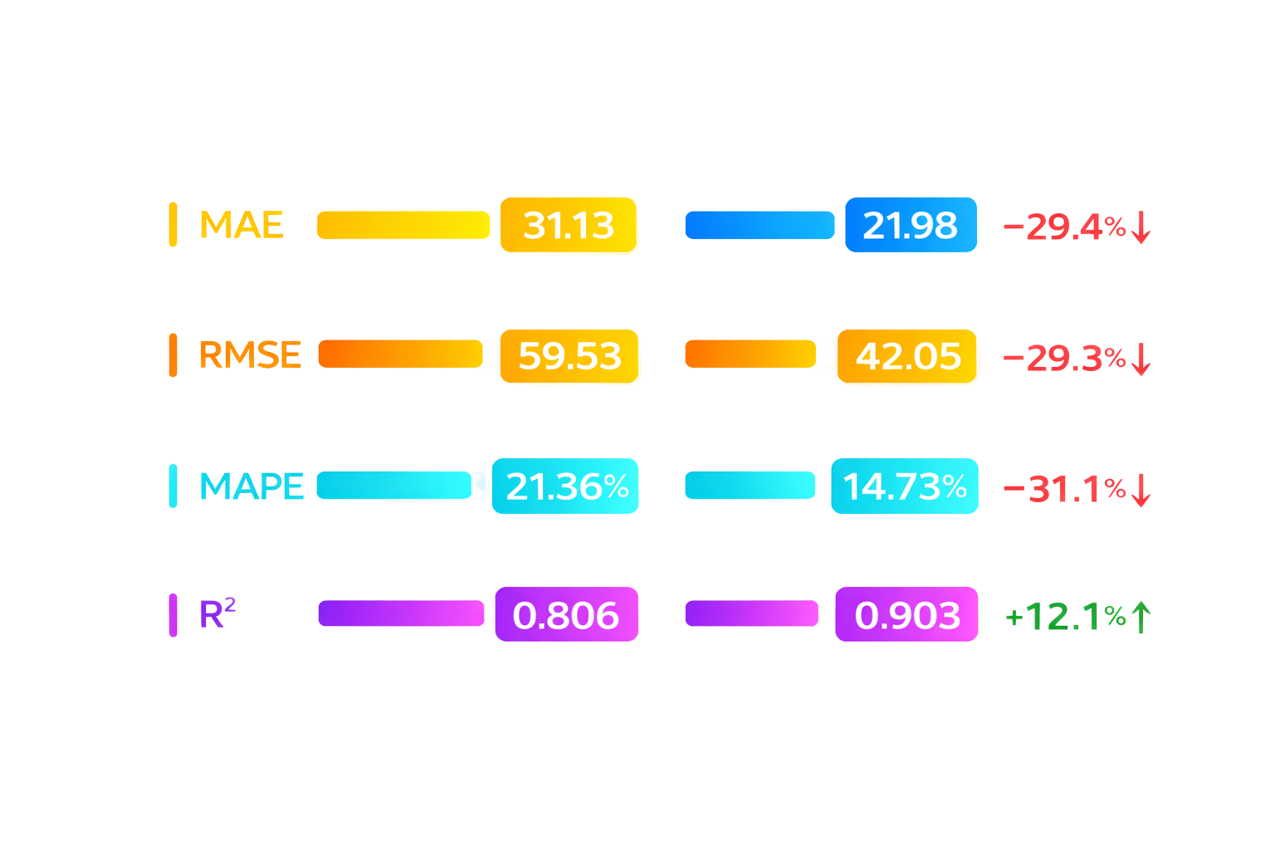
RESULTS COMPARISON

Slide 9
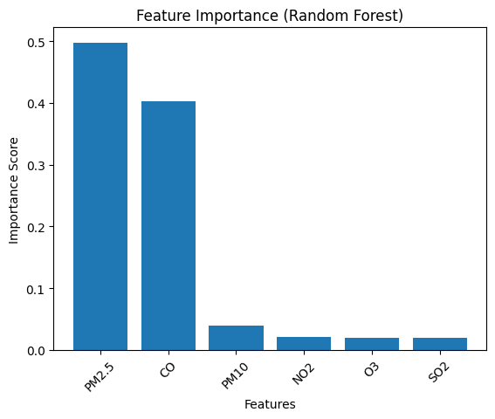
IMPACT OF EVERY POLLUTANT
Particulate matter (PM2.5 and PM10) & Carbon Monoxide have the most significant impact on AQI values globally, often acting as the primary driver for "poor" or "severe" air quality readings.

Slide 10
CONCLUSION
Linear Regression established a solid baseline
Random Forest enhanced performance by reducing errors
Improved R² indicates better goodness of fit
Prediction errors reduced substantially
Model explains ~90% AQI variability
Model captures non-linear pollutant relationships
Suitable for AQI estimation & monitoring

