Slide 1
ADVANCED SQL

Slide 2
OBJECTIVES
Define terms
Write single and multiple table SQL queries
Define and use three types of joins
Write noncorrelated and correlated subqueries
Understand and use SQL in procedural languages (e.g. PHP, PL/SQL)
Understand triggers and stored procedures

Slide 3
PROCESSING MULTIPLE TABLES
Join–a relational operation that causes two or more tables with a common domain to be combined into a single table or view
Equi-join–a join in which the joining condition is based on equality between values in the common columns; common columns appear redundantly in the result table
Natural join–an equi-join in which one of the duplicate columns is eliminated in the result table
The common columns in joined tables are usually the primary key of the dominant table and the foreign key of the dependent table in 1:M relationships

Slide 4
PROCESSING MULTIPLE TABLES
Outer join–a join in which rows that do not have matching values in common columns are nonetheless included in the result table (as opposed to inner join, in which rows must have matching values in order to appear in the result table)
Union join–includes all columns from each table in the join, and an instance for each row of each table
Self join–Matching rows of a table with other rows from the same table

Slide 5
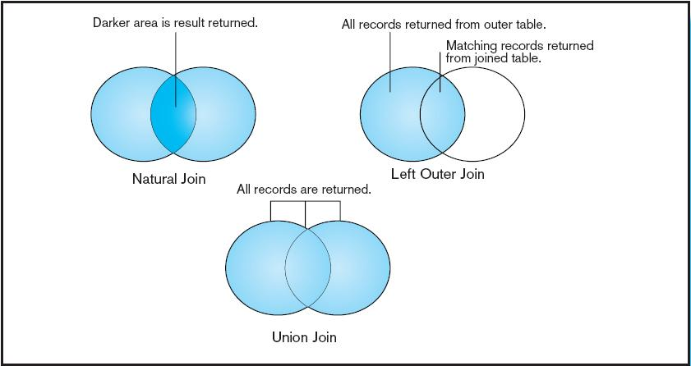
Figure 7-2
Visualization of different join types with results returned in shaded area

Slide 6
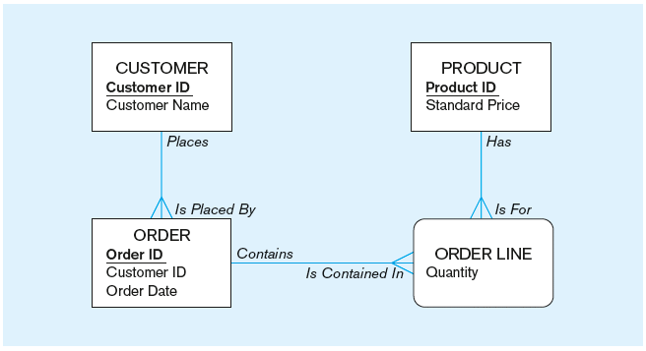
THE FOLLOWING SLIDES CREATE TABLES FOR THIS ENTERPRISE DATA MODEL

Slide 7
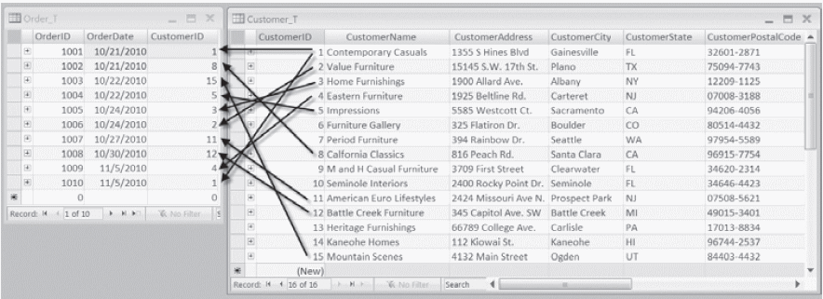
Figure 7-1 Pine Valley Furniture Company Customer_T and Order_T tables with pointers from customers to their orders
These tables are used in queries that follow
Chapter 7
Copyright © 2014 Pearson Education, Inc.

Slide 8
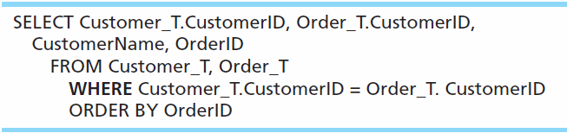
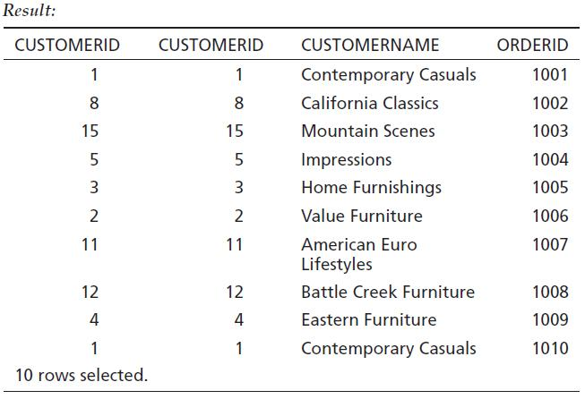
EQUI-JOIN EXAMPLE
For each customer who placed an order, what is the customer’s name and order number?
Customer ID appears twice in the result

Slide 9
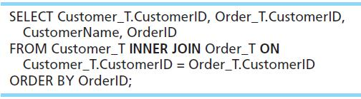
EQUI-JOIN EXAMPLE – ALTERNATIVE SYNTAX
INNER JOIN clause is an alternative to WHERE clause, and is used to match primary and foreign keys.
An INNER join will only return rows from each table that have matching rows in the other.
This query produces same results as previous equi-join example.

Slide 10
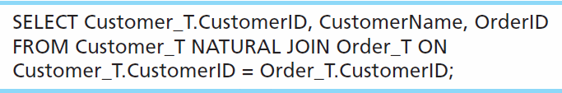
NATURAL JOIN EXAMPLE
For each customer who placed an order, what is the customer’s name and order number?
Join involves multiple tables in FROM clause
ON clause performs the equality check for common columns of the two tables
Note: from Fig. 7-1, you see that only 10 Customers have links with orders
➔ Only 10 rows will be returned from this INNER join

Slide 11
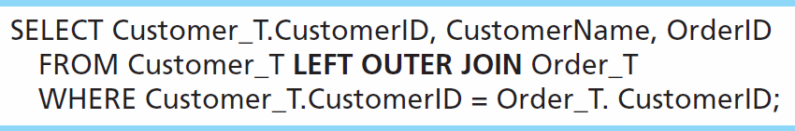
OUTER JOIN EXAMPLE
List the customer name, ID number, and order number for all customers. Include customer information even for customers that do have an order.
LEFT OUTER JOIN clause causes customer data to appear even if there is no corresponding order data
Unlike INNER join, this will include customer rows with no matching order rows

Slide 12
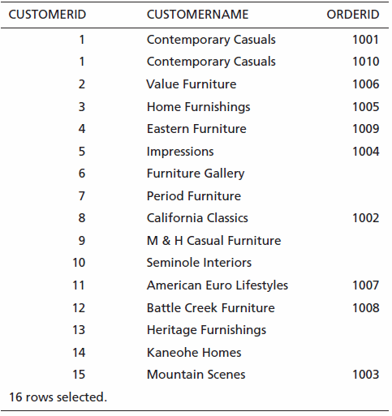
Outer Join Results
Unlike INNER join, this will include customer rows with no matching order rows
Chapter 7
Copyright © 2014 Pearson Education, Inc.

Slide 13
Syntax-LOJ
SELECT columns FROM left_table LEFT OUTER JOIN right_table ON left_table.common_column = right_table.common_column;
Consider two tables: Employees && Departments.
SELECT Employees.EmployeeName, Departments.DepartmentName FROM Employees LEFT OUTER JOIN Departments ON Employees.DepartmentID = Departments.DepartmentID;
  A Left Outer Join returns all records from the left table and the matched records from the right table. If there is no match, the result is NULL on the side of the right table.

Slide 14
Syntax-ROJ
SELECT columns FROM left_table RIGHT OUTER JOIN right_table ON left_table.common_column = right_table.common_column;
Consider two tables: Employees && Departments.
SELECT Employees.EmployeeName, Departments.DepartmentNameFROM EmployeesRIGHT OUTER JOIN DepartmentsON Employees.DepartmentID = Departments.DepartmentID;
  A Right Outer Join returns all records from the right table and the matched records from the left table. If there is no match, the result is NULL on the side of the left table..

Slide 15
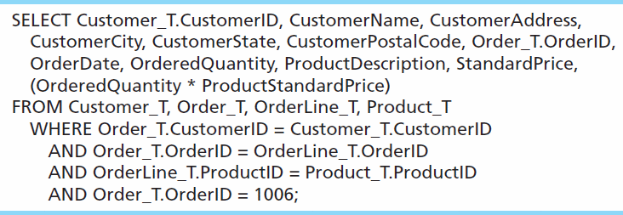
MULTIPLE TABLE JOIN EXAMPLE
Assemble all information necessary to create an invoice for order number 1006
Four tables involved in this join
Each pair of tables requires an equality-check condition in the WHERE clause, matching primary keys against foreign keys

Slide 16
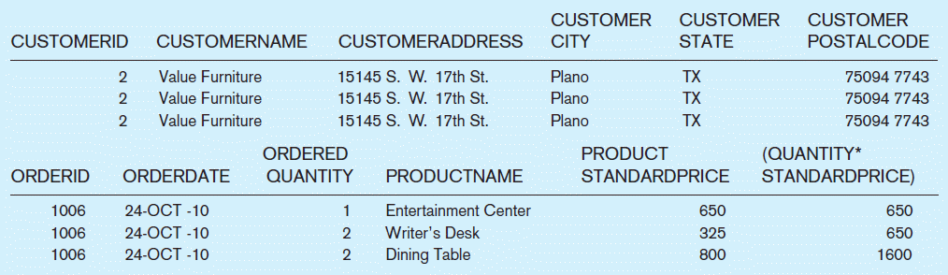
Figure 7-4 Results from a four-table join (edited for readability)
From CUSTOMER_T table
From ORDER_T table
From PRODUCT_T table

Slide 17
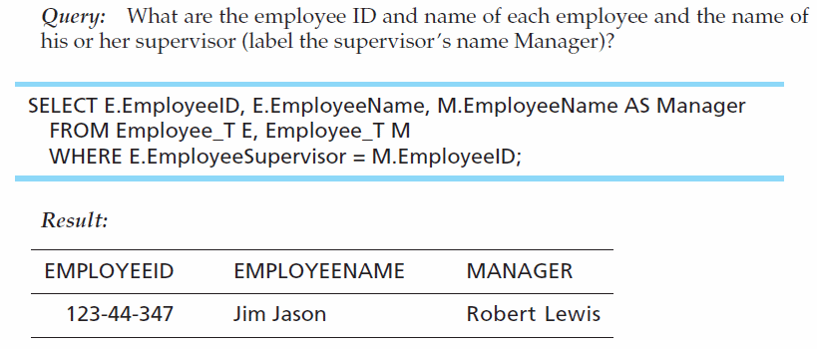
SELF-JOIN EXAMPLE
The same table is used on both sides of the join; distinguished using table aliases
Self-joins are usually used on tables with unary relationships

Slide 18
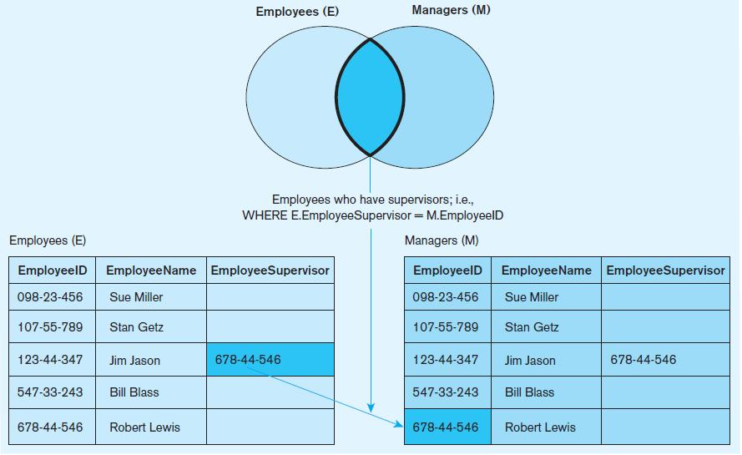
Figure 7-5 Example of a self-join

Slide 19
PROCESSING MULTIPLE TABLES
USING SUBQUERIES
Subquery–placing an inner query (SELECT statement) inside an outer query
Options:
  In a condition of the WHERE clause
  As a “table” of the FROM clause
  Within the HAVING clause
Subqueries can be:
  Noncorrelated–executed once for the entire outer query
  Correlated–executed once for each row returned by the outer query

Slide 20
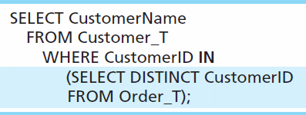
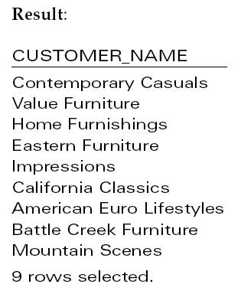
SUBQUERY EXAMPLE
Show all customers who have placed an order
The IN operator will test to see if the CUSTOMER_ID value of a row is included in the list returned from the subquery
Subquery is embedded in parentheses. In this case it returns a list that will be used in the WHERE clause of the outer query

Slide 21
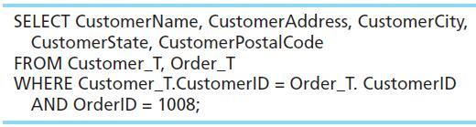
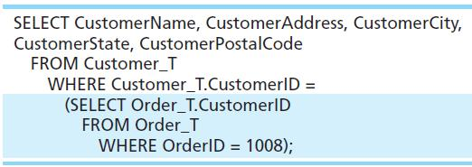
JOIN VS. SUBQUERY
Some queries could be accomplished by either a join or a subquery
Join version
Subquery version

Slide 22
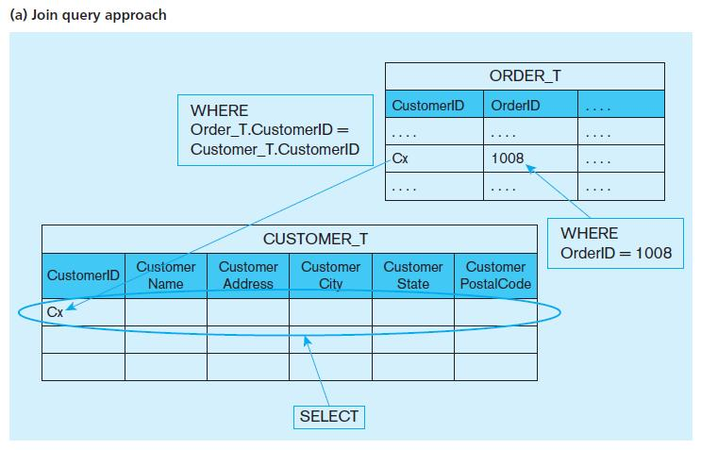
Figure 7-6 Graphical depiction of two ways to answer a query with different types of joins

Slide 23
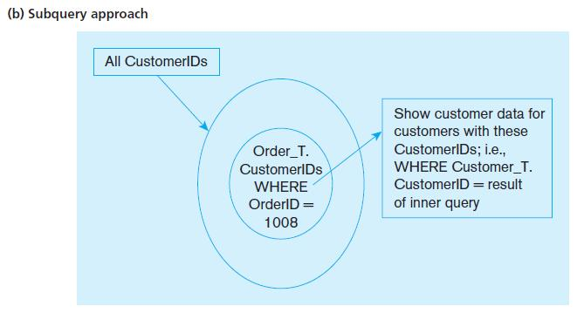
Figure 7-6 Graphical depiction of two ways to answer a query with different types of joins

Slide 24
CORRELATED VS. NONCORRELATED SUBQUERIES
Noncorrelated subqueries:
  Do not depend on data from the outer query
  Execute once for the entire outer query
Correlated subqueries:
  Make use of data from the outer query
  Execute once for each row of the outer query
  Can use the EXISTS operator

Slide 25
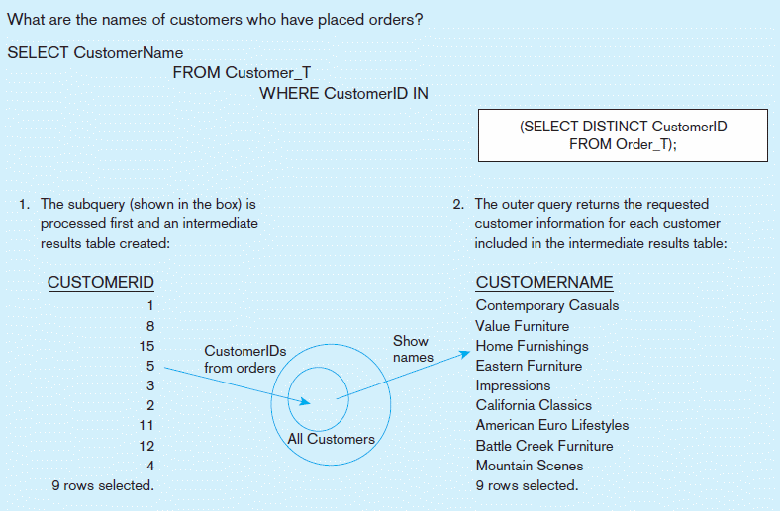
Figure 7-8a Processing a noncorrelated subquery
A noncorrelated subquery processes completely before the outer query begins
Chapter 7
Copyright © 2014 Pearson Education, Inc.

Slide 26
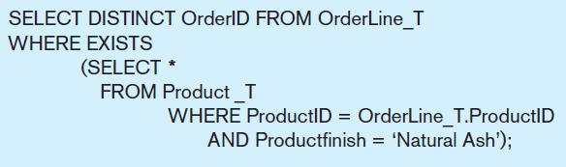
CORRELATED SUBQUERY EXAMPLE
Show all orders that include furniture finished in natural ash
The EXISTS operator will return a TRUE value if the subquery resulted in a non-empty set, otherwise it returns a FALSE
➔ A correlated subquery always refers to an attribute from a table referenced in the outer query
The subquery is testing for a value that comes from the outer query

Slide 27
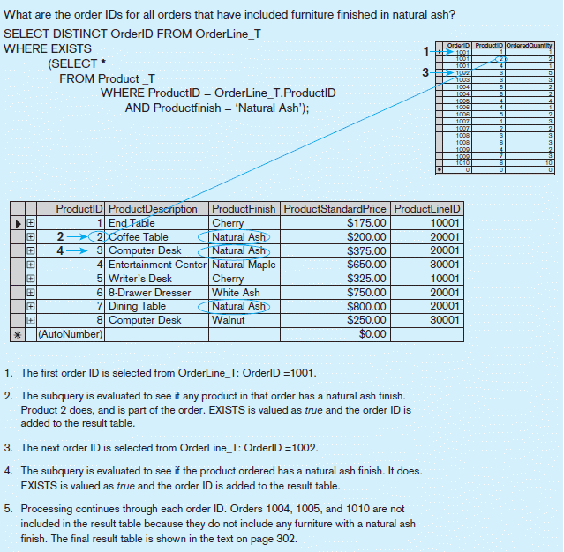
Figure 7-8b Processing a correlated subquery
Subquery refers to outer-query data, so executes once for each row of outer query
Note: only the orders that involve products with Natural Ash will be included in the final results
Chapter 7
Copyright © 2014 Pearson Education, Inc.

Slide 28
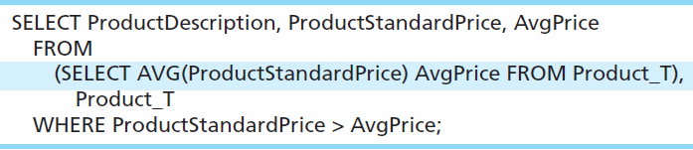
ANOTHER SUBQUERY EXAMPLE
Show all products whose standard price is higher than the average price
One column of the subquery is an aggregate function that has an alias name. That alias can then be referred to in the outer query
Subquery forms the derived table used in the FROM clause of the outer query
The WHERE clause normally cannot include aggregate functions, but because the aggregate is performed in the subquery its result can be used in the outer query’s WHERE clause

Slide 29
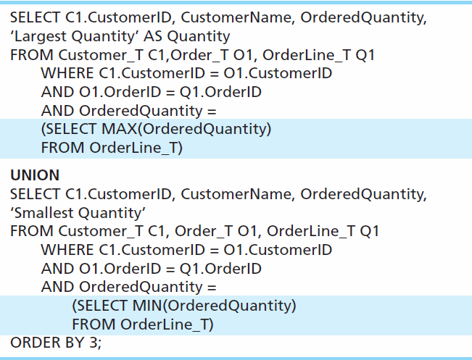
UNION QUERIES
Combine the output (union of multiple queries) together into a single result table
First query
Combine
Second query

Slide 30
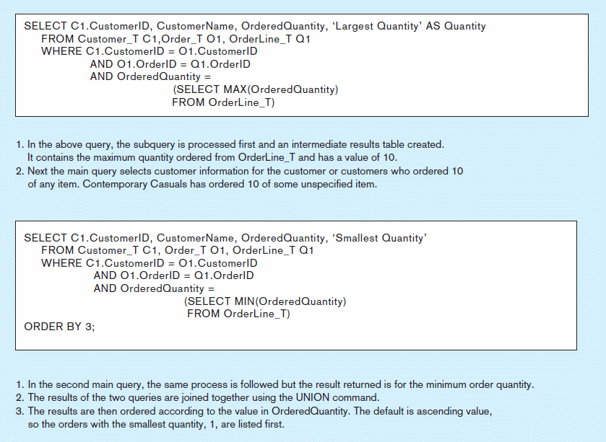
Figure 7-9 Combining queries using UNION
Note: with UNION queries, the quantity and data types of the attributes in the SELECT clauses of both queries must be identical
Chapter 7
Copyright © 2014 Pearson Education, Inc.

Slide 31
TIPS FOR DEVELOPING QUERIES
Be familiar with the data model (entities and relationships)
Understand the desired results
Know the attributes desired in result
Identify the entities that contain desired attributes
Review ERD
Construct a WHERE equality for each link
Fine tune with GROUP BY and HAVING clauses if needed
Consider the effect on unusual data

Slide 32
QUERY EFFICIENCY CONSIDERATIONS
Instead of SELECT *, identify the specific attributes in the SELECT clause; this helps reduce network traffic of result set
Limit the number of subqueries; try to make everything done in a single query if possible
If data is to be used many times, make a separate query and store it as a view

Slide 33
GUIDELINES FOR BETTER QUERY DESIGN
Understand how indexes are used in query processing
Keep optimizer statistics up-to-date
Use compatible data types for fields and literals
Write simple queries
Break complex queries into multiple simple parts
Don’t nest one query inside another query
Don’t combine a query with itself (if possible avoid self-joins)

Slide 34
GUIDELINES FOR BETTER QUERY DESIGN (CONT.)
Create temporary tables for groups of queries
Combine update operations
Retrieve only the data you need
Don’t have the DBMS sort without an index
Learn!
Consider the total query processing time for ad hoc queries

Slide 35
ENSURING TRANSACTION INTEGRITY
Transaction = A discrete unit of work that must be completely processed or not processed at all
  May involve multiple updates
  If any update fails, then all other updates must be cancelled
SQL commands for transactions
  BEGIN TRANSACTION/END TRANSACTION
    Marks boundaries of a transaction
  COMMIT
    Makes all updates permanent
  ROLLBACK
    Cancels updates since the last COMMIT

Slide 36
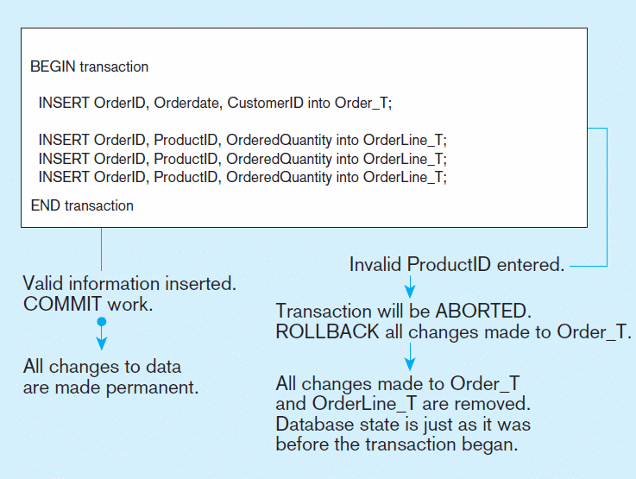
Figure 7-10 An SQL Transaction sequence (in pseudocode)
Chapter 7
Copyright © 2014 Pearson Education, Inc.

Slide 37
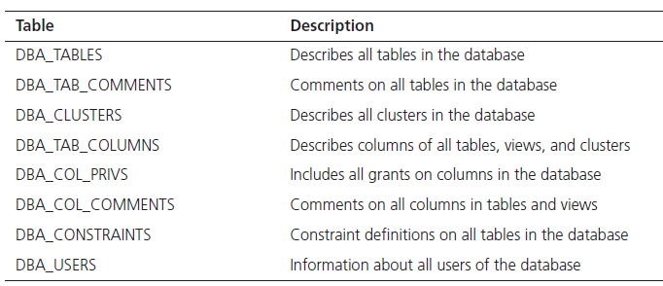
DATA DICTIONARY FACILITIES
System tables that store metadata
Users usually can view some of these tables
Users are restricted from updating them
Some examples in Oracle 11g

Slide 38
TRIGGERS AND ROUTINES
Triggers–routines that execute in response to a database event (INSERT, UPDATE, or DELETE)
Routines
  Program modules that execute on demand
Functions–routines that return values and take input parameters
Procedures–routines that do not return values and can take input or output parameters

Slide 39
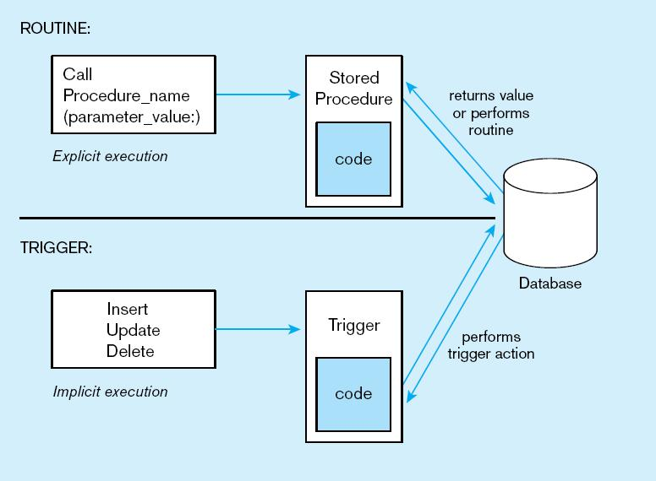
Figure 7-11 Triggers contrasted with stored procedures (based on Mullins 1995)
Procedures are called explicitly
Triggers are event-driven
Source: adapted from Mullins, 1995.
Chapter 7
Copyright © 2014 Pearson Education, Inc.

Slide 40
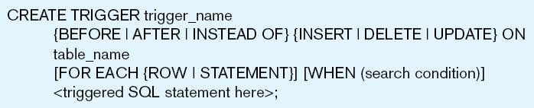
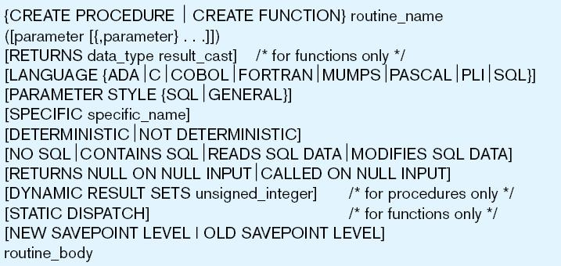
Figure 7-12 Trigger syntax in SQL:2008
Figure 7-13 Syntax for creating a routine, SQL:2008
Chapter 7
Copyright © 2014 Pearson Education, Inc.

Slide 41
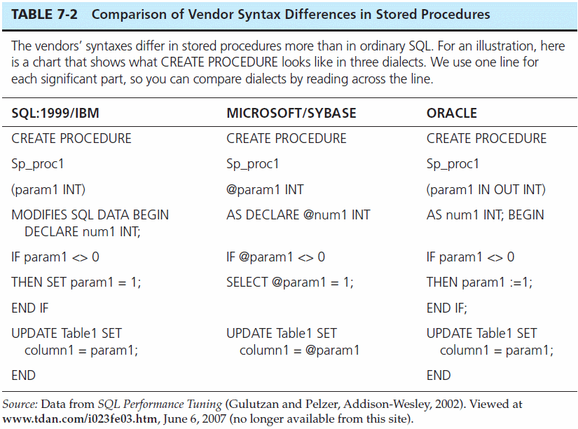
Chapter 7
Copyright © 2014 Pearson Education, Inc.

Slide 42
EMBEDDED AND DYNAMIC SQL
Embedded SQL
  Including hard-coded SQL statements in a program written in another language such as C or Java
Dynamic SQL
  Ability for an application program to generate SQL code on the fly, as the application is running

Slide 43
REASONS TO EMBED SQL IN 3GL
Can create a more flexible, accessible interface for the user
Possible performance improvement
Database security improvement; grant access only to the application instead of users

Slide 44

All rights reserved. No part of this publication may be reproduced, stored in a retrieval system, or transmitted, in any form or by any means, electronic, mechanical, photocopying, recording, or otherwise, without the prior written permission of the publisher. Printed in the United States of America.
Copyright © 2014 Pearson Education, Inc.

