Slide 1

IST 659 Final Project: Hospital Emergency Transportation System
Joel Barnes, Aaron Rofe, Rafe Burns, Arya Patil, Ricky Wan

Slide 2
Project Overview
This project is designed to provide a solution for organizing and managing emergency medical transport. It facilitates the assignment of drivers, EMTs, and vehicles as soon as a 911 call is received, helping ensure that patients are transported quickly and efficiently to a hospital. The system also maintains detailed records of each emergency event, including transport logistics and medical staff involvement. With this structure in place, hospital personnel can better track activity and respond to patient needs with greater coordination.

Slide 3
Project Goals
Enable automated assignment of drivers, EMTs, and vehicles upon emergency call intake to reduce response time and ensure efficient dispatching.
Maintain comprehensive records of patient pickups, drop-offs, assigned staff, and hospital destinations to improve traceability and reduce administrative errors.
Equip hospital staff with reliable transport data to better manage workloads, identify coverage gaps, and allocate resources more effectively.

Slide 4
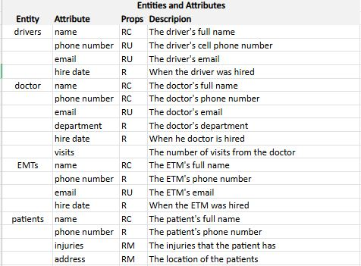
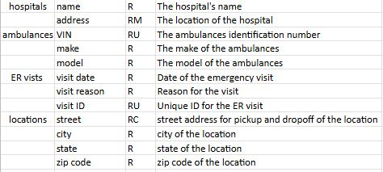
ERD Data Requirement
Notes:
-Entity Relationship Diagram Model
-8 Entities
-

Slide 5
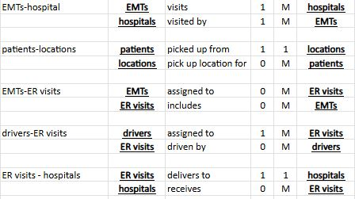
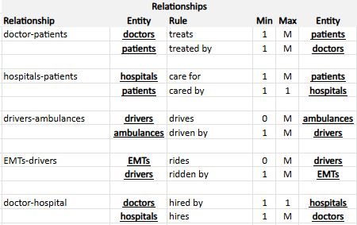
ERD Data Relationships

Slide 6
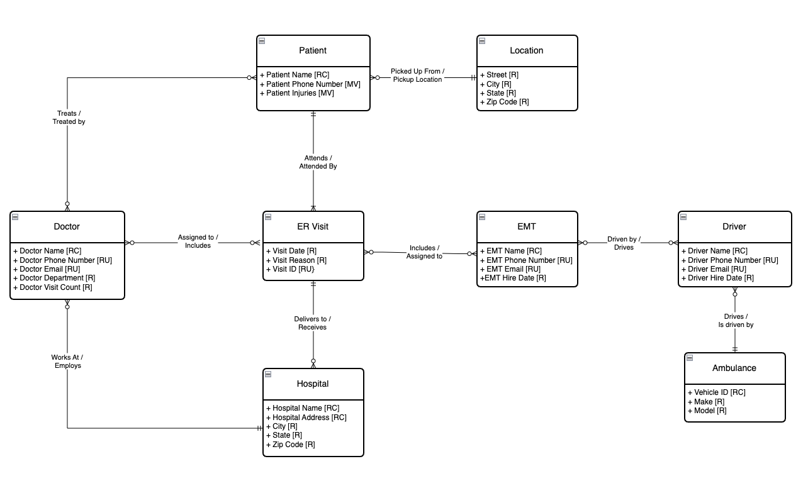
Conceptual Model
Notes:
Present relationships regarding each cell

Slide 7
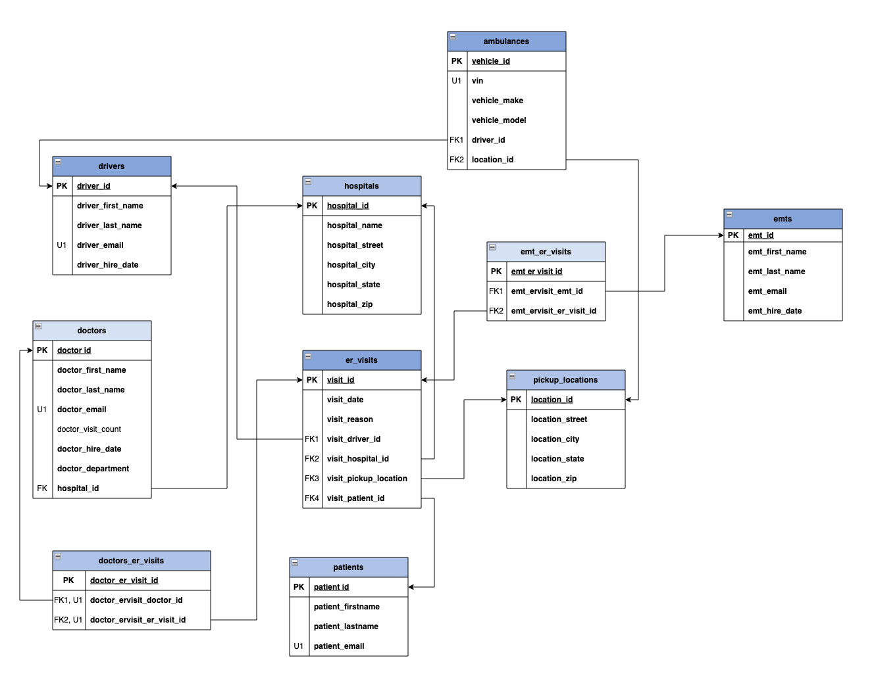
Logical Model

Slide 8
Function, Stored Procedure, and Trigger
Function – Number of Doctor Visits
Function to calculate the total number of visits that a doctor has been assigned
Stored Procedure – Inserts data into visits table
Stored Procedure to easily insert new data into the visits table
Trigger – Updates doctor table after data is inserted in visits table
Trigger to automatically update the number of visits a doctor has been assigned in the doctor table
Utilizes the previously created function

Slide 9
User Story
As an admin, I would like to make a list of what EMTs and drivers are picking up each patient, so it is easier to identify who is in which ambulance at all times.
As an admin, I would like to have ambulances’ real time location so picking up nearby patients can be more efficient and effective.
As an admin, I would like a history table of the doctor visits so that if a patient comes for another visit with a similar issue, it can speed up the treatment process

Slide 10
Thank you professor Joe!

