Slide 1
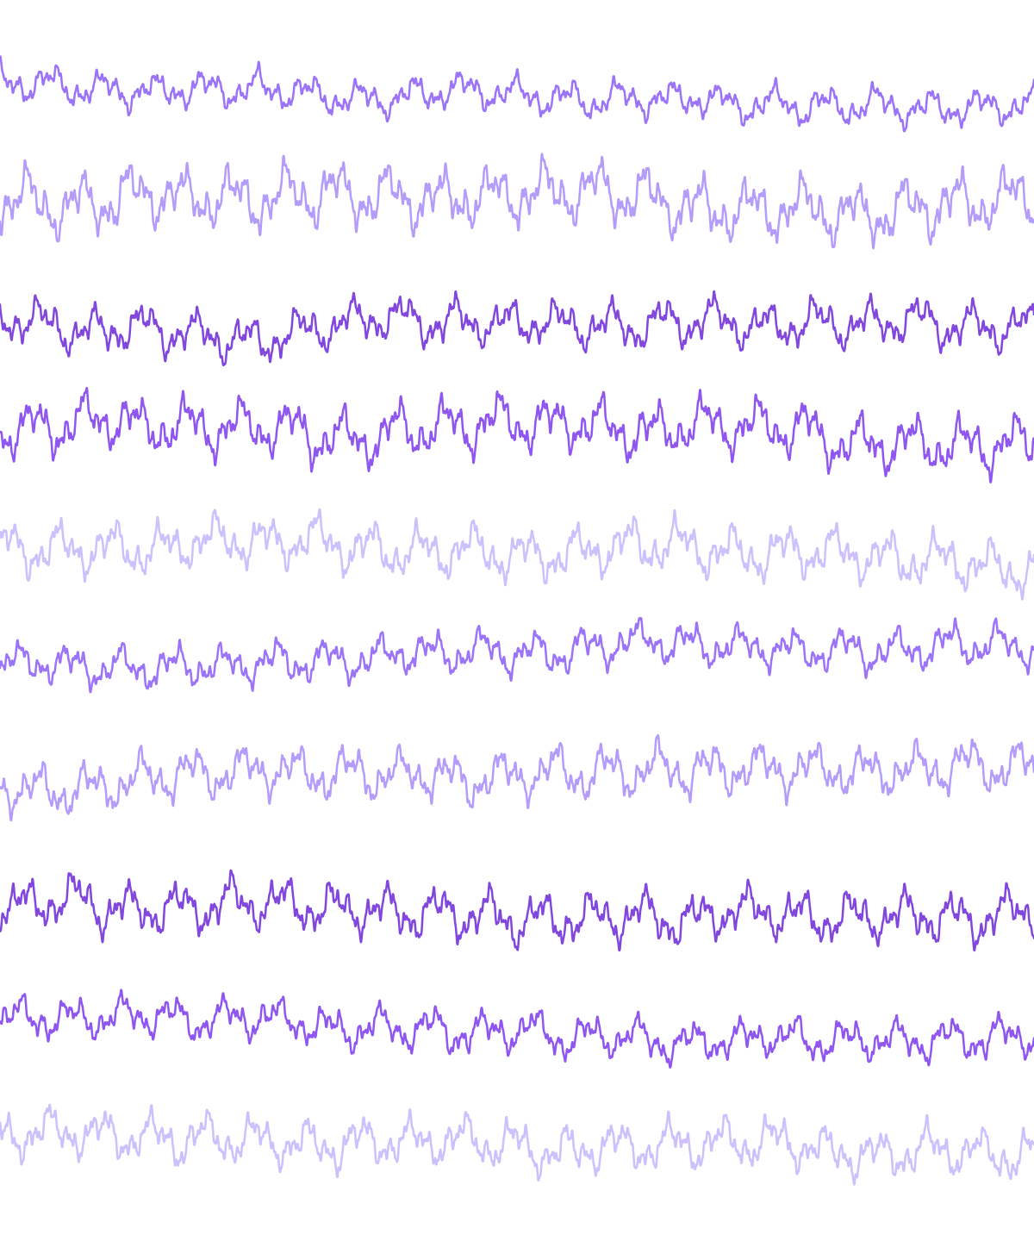



PROBLEM STATEMENT
The Clinical Bottleneck in Epilepsy Diagnosis
RAW MULTI-CHANNEL EEG SIGNAL
Data Overload
Continuous EEG monitoring generates massive, multi-hour files containing millions of raw data points per patient.
Physician Fatigue
Neurologists suffer severe diagnostic fatigue manually scrolling to locate brief 5-10 second seizure events.
The Risk
This manual workflow creates a dangerous bottleneck, increasing human error and delaying emergency triage.
10 simultaneous channels — a seizure hides in seconds of signal like this, buried across hours of recording.

Slide 2
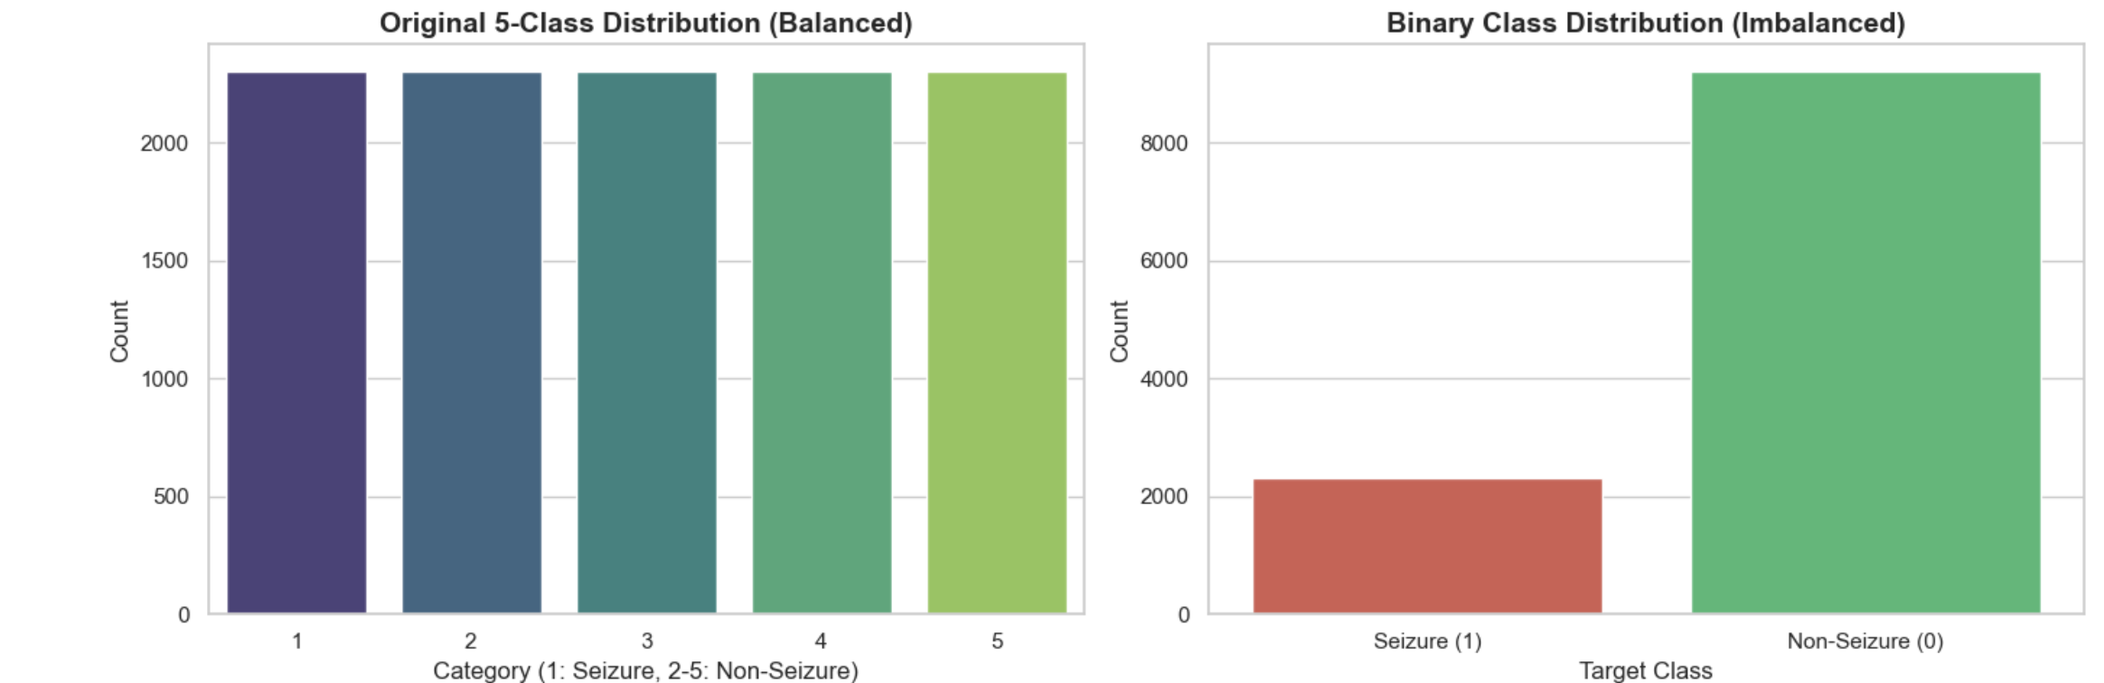



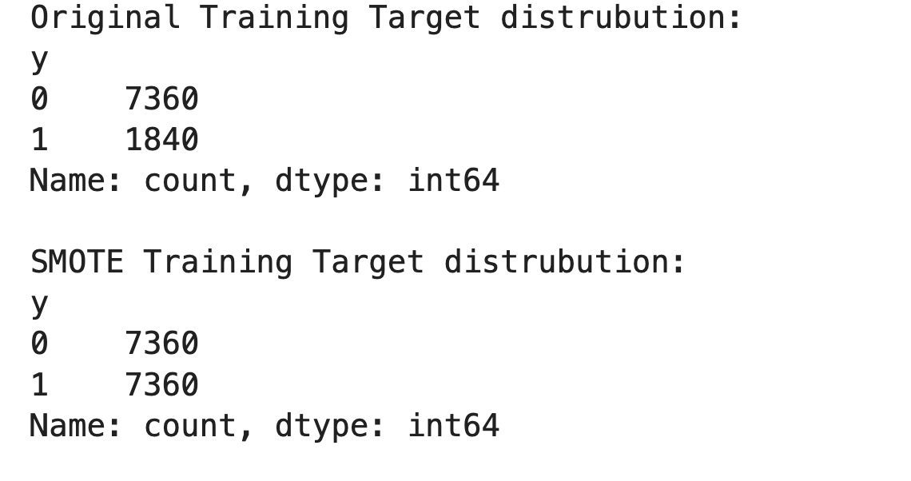

OVERALL SOLUTION APPROACH
Signal Processing & Data Engineering
BEFORE — IMBALANCED (80:20)
The Dataset
Processed clinical 178 Hz continuous EEG data from the University of Bonn.
Target Engineering
Converted the original 5 clinical classes into a strict binary target: Seizure (1) vs. Non-Seizure (0).
Addressing the Bias
AFTER — SMOTE BALANCED (50:50)
Binarization created a severe 80:20 class imbalance between the two target classes.
SMOTE Application
Applied Synthetic Minority Over-sampling Technique (SMOTE) to establish a perfect 50:50 training ratio, preventing majority-class bias.

Slide 3



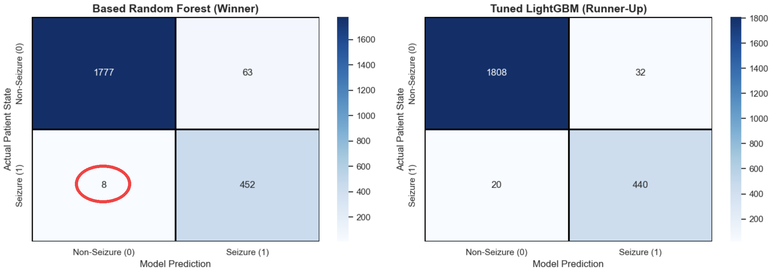
KEY FINDINGS
Model Evaluation & Prioritizing Clinical Safety
Baseline Failure
The Winning Model
Clinical Safety First
Pre-SMOTE baseline models completely failed in a clinical setting, missing >90% of actual seizures due to class imbalance.
The Base Random Forest (trained on SMOTE-balanced data) achieved the absolute highest clinical safety & outperformed Light GBM and SVM.
Random Forest achieved >98% Recall, missing only 8 seizures out of thousands of test samples.
Highlighted: Random Forest's 8 false negatives - the lowest miss-rate among all models tested

Slide 4

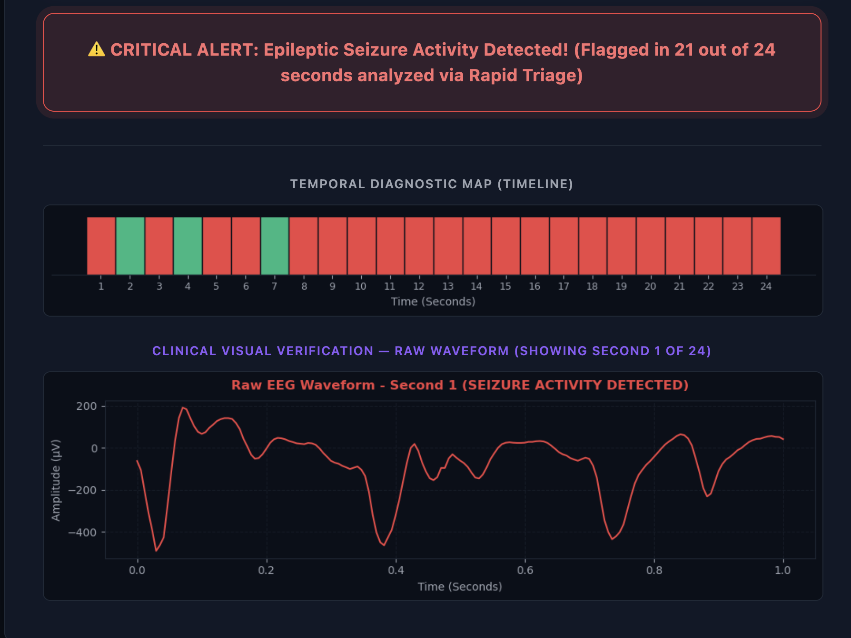
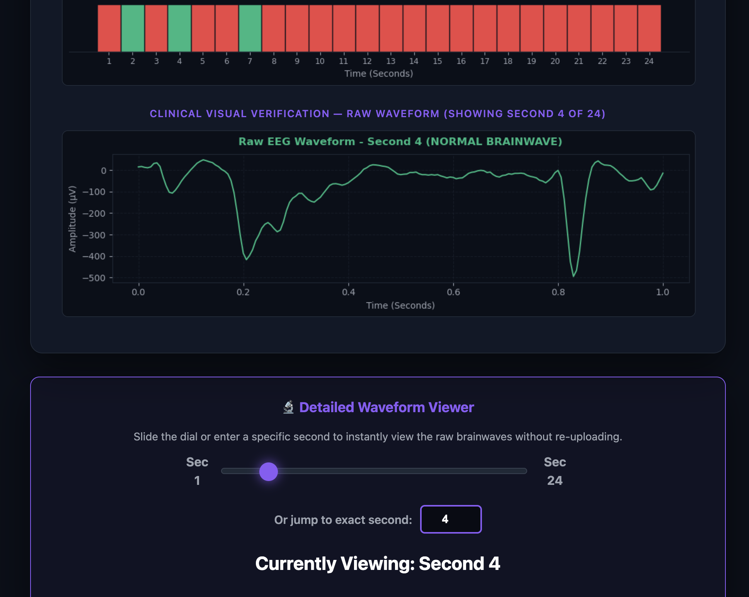



PROJECT UI & CLOUD ARCHITECTURE
NeuroPulse AI: Live Cloud Deployment
LIVE DASHBOARD — SEIZURE ALERT & TIMELINE
AWS Infrastructure
Deployed on an AWS EC2 instance using a lightweight Python Flask backend.
Scalable Batch Processing
Segments multi-hour files into 1-second chunks to prevent server memory crashes during uploads.
Temporal Diagnostic Map
Translates hours of data into a color-coded timeline (Red = Seizure, Green = Normal) for instant visual triage.
Red segments flag seizure activity; green confirms normal brainwaves — clinicians verify instantly with the raw waveform scrubber.
AJAX Waveform Viewer
Uses headless Matplotlib to render raw waveform graphs instantly for clinical verification without page reloads.

Slide 5


JUSTIFICATION OF THE OVERALL PROJECT
Clinical Impact & Value Proposition
Operational Efficiency
Patient Safety
Workflow Transformation
Saves valuable hours of physician time, significantly reducing hospital operating costs.
By maximizing Recall and minimizing False Negatives, the system ensures critical neurological emergencies are never overlooked.
Transitions Intensive Care Units (ICUs) from manual scrolling to automated, real-time triage.

Slide 6



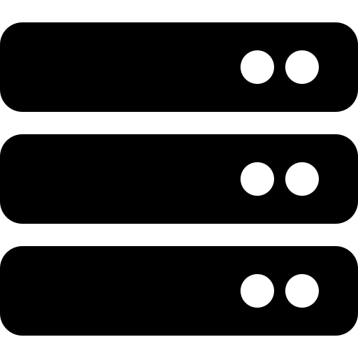
FURTHER IMPROVEMENT AREAS / NEXT STEPS
Future Scope & Scalability
Live IoT Integration
EDF Medical Standard Integration
Upgrade the ingestion pipeline to support live WebSocket streaming directly from hospital IoT EEG caps.
Future iterations will support direct uploads of the standard European Data Format (.edf). This was intentionally excluded from the current prototype to prevent pipeline complexity and maintain focus on the core predictive engine, but it is the logical next step for true hospital interoperability.
Multi-Class Diagnostics
Enterprise Architecture
Expand the model's capabilities to classify specific seizure subtypes, e.g., Grand Mal vs. Petit Mal.
Scale the AWS backend using a Gunicorn and Nginx cluster to support multi-hospital, high-traffic deployment.

