Slide 1
MARITIME SURVEILLANCE • UNSUPERVISED MACHINE LEARNING
Dark Fleet AI Monitor
Real-time detection of illegal maritime evasion using live AIS satellite streaming and density-based anomaly detection
Presented by: Arya Patil | Capstone Project

Slide 2

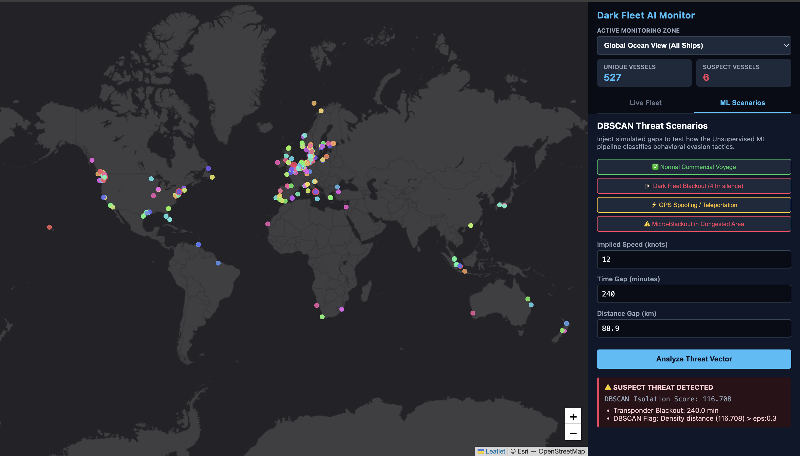


PROBLEM STATEMENT
Going Dark: How Illegal Fleets Evade Detection
Transponder Blackouts
Ships physically disable their AIS transmitter during restricted-water passage or illegal ship-to-ship transfers, creating massive temporal data gaps.
GPS Spoofing (“Teleportation”)
Software broadcasts mathematically fabricated coordinates — making a ship inside a restricted zone appear to be in international waters.
The Big Data Bottleneck
The global ocean generates tens of thousands of pings per second — far too fast for manual cross-referencing, and enough to crash a naive database.
DARK FLEET AI MONITOR
02

Slide 3



SYSTEM ARCHITECTURE
Live Data Ingestion & Streaming Pipeline
A full-duplex WebSocket architecture replaces static CSV files with a continuous global satellite feed.
FastAPI WebSocket Backbone
Auto-Healing Async Loop
Dynamic Bounding Boxes
The Python backend holds a persistent WebSocket connection directly to the AISStream.io global satellite network.
asyncio monitors the stream; if the satellite feed drops, the system tears down and rebuilds the connection within 5 seconds — zero downtime.
The app subscribes to specific geographic regions (e.g. Singapore Strait). Switching regions safely severs and re-subscribes without memory leaks.
DARK FLEET AI MONITOR
03

Slide 4

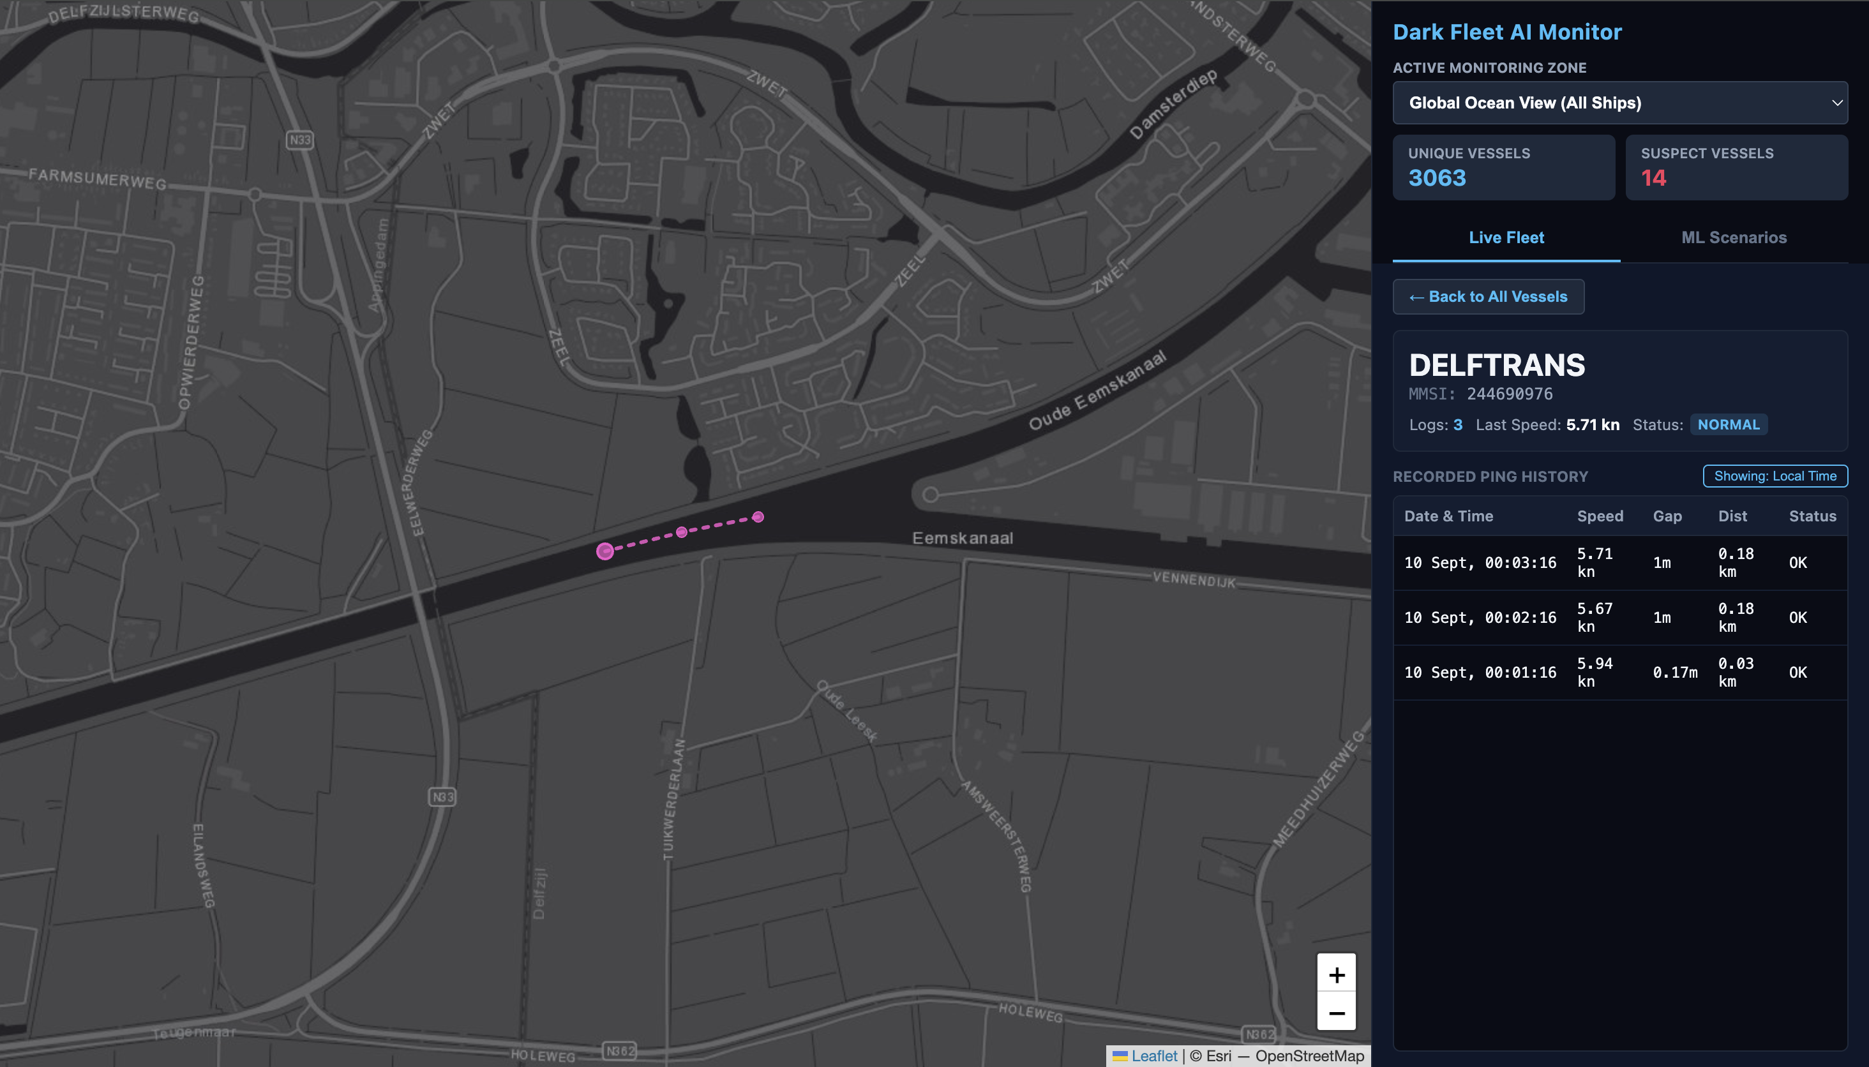


FEATURE ENGINEERING
The Physics of Evasion
Spherical Haversine Distance
Because the Earth is curved, straight-line math fails over long distances — Haversine calculates true physical distance between consecutive pings.
Time Delta
The system subtracts the UNIX timestamp of the previous ping from the current one to find the exact blackout duration in minutes.
Implied Kinematic Speed
Distance ÷ time = implied speed. A 50,000-ton cargo ship “traveling” at 102 knots mathematically proves its GPS is being spoofed.
DARK FLEET AI MONITOR
04

Slide 5




MACHINE LEARNING
Unsupervised Anomaly Detection Pipeline
Evasion tactics constantly mutate, so there is no clean “illegal” label to train against — the system instead learns normal physics and flags what breaks it.
StandardScaler
K-Means Profiling
DBSCAN Density Check
Anomaly Flag
→
→
→
Normalizes speed, time, and distance so no single feature dominates the calculation.
Assigns incoming telemetry to historical maritime behavioral clusters.
Compares new pings against pre-computed “core points” of normal routing density.
If isolation score exceeds eps = 0.3, the vessel is instantly flagged as a threat.
0.85
ε = 0.3
50
Silhouette Score
DBSCAN Epsilon Threshold
Ping Rolling Window / Vessel
DARK FLEET AI MONITOR
05

Slide 6


ENGINEERING CONSTRAINT
Architecting for a Free-Tier Cloud
Render's free tier provides just 0.1 CPU and 512MB RAM — surviving a live global stream on it demands extreme memory discipline.
Stateless Ephemeral Memory
50-Ping Rolling FIFO Queue
Frontend Throttling
Instead of logging every ping to PostgreSQL, the system uses high-speed in-memory Python dictionaries with O(1) lookup time.
Only the last 50 pings per vessel are retained — ping 51 evicts ping 1, capping working memory at under 20MB per vessel.
A custom throttle decouples WebSocket message receipt from DOM rendering, updating the Leaflet.js map every 300ms for fluid performance.
<20MB
512MB
300ms
Max working memory / vessel
Total RAM on free-tier host
Map render throttle interval
DARK FLEET AI MONITOR
06

Slide 7
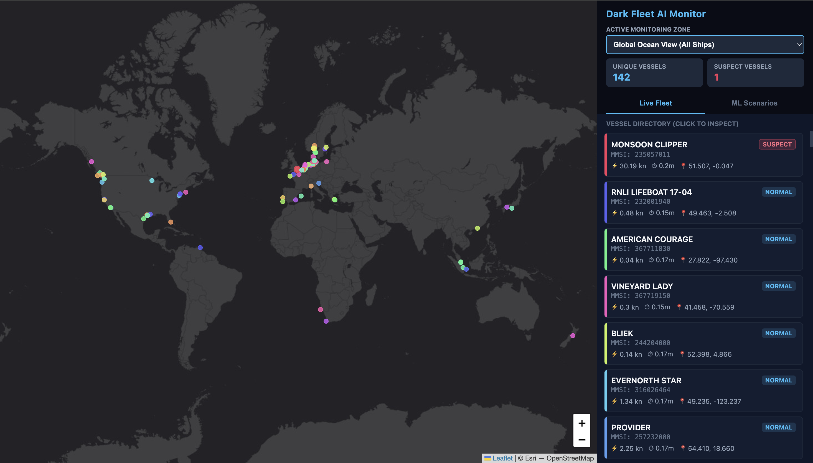
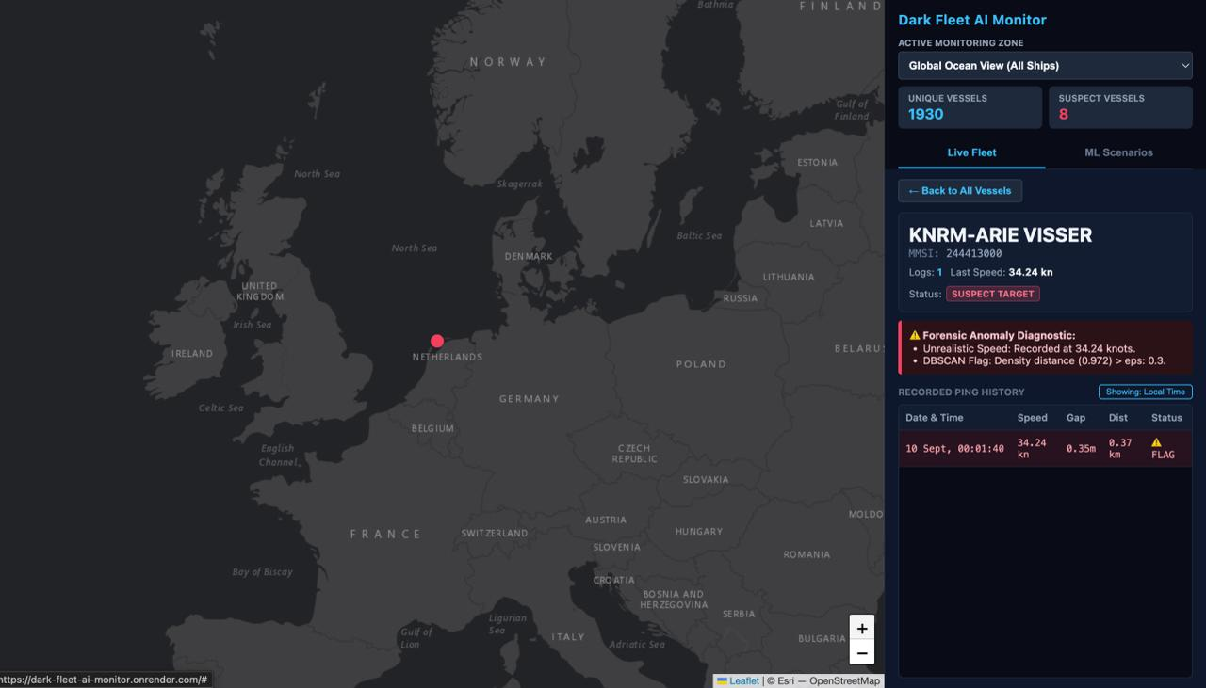
LIVE DEPLOYMENT
Real-Time Fleet Monitoring in Production
Persistent Forensic Inspector — flagged vessels retain their “SUSPECT” badge and algorithmic reasoning even after normal readings resume.
Live Fleet Directory — click-to-inspect vessel list with real-time speed, gap, and status.
DARK FLEET AI MONITOR
07

Slide 8


FUTURE SCOPE
From Prototype to Production
Stateful Migration
Upgrade from ephemeral dictionary memory to an Oracle Cloud ARM VM running distributed PostgreSQL or Redis — maintaining a permanent historical ledger of flagged vessels.
Multi-Modal Sensor Fusion
Integrate Sentinel-1 Synthetic Aperture Radar imagery — when a transponder blackout is detected in a geographic polygon, automatically trigger a satellite scan to physically verify the dark vessel's presence.
DARK FLEET AI MONITOR
08

