Slide 1

Recommendation System for
Movies
Team:
Aria
Manognya
Dheeraj

Slide 2
Contents:
Introduction
Dataset
Pre-processing
Recommendation Part:
a) Based on Overview Similarity.
b) Based on Genres.
c) Based on Association.
Prediction Part
Model Comparison
Results
References

Slide 3
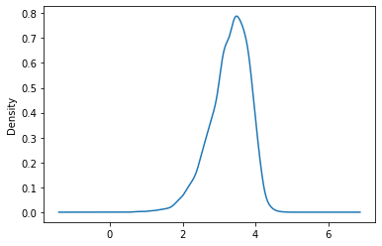
Our Dataset:
Provided by MovieLens - The Dataset can be found at https://grouplens.org/datasets/movielens/latest/
Movies data
Ratings data
Metadata
Distribution of rating

Slide 4
Pre-processing:
Considering movies, which are rated at least 5 times.
Dropping features which are not useful in analysis, most of them are nominal.
While doing prediction, null values are removed.
Zero values are filled with median

Slide 5
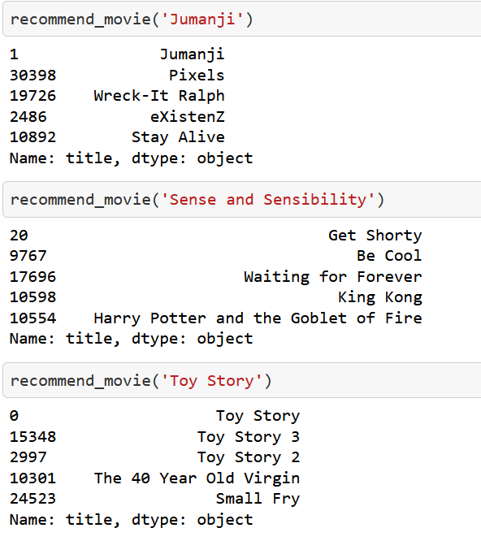
Recommend based on Overview Similarity:

Slide 6
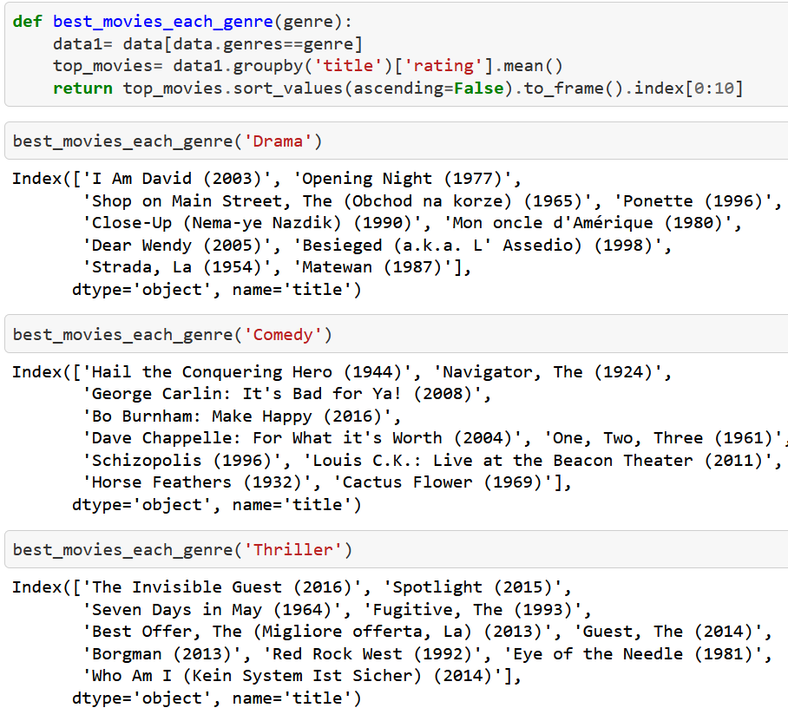
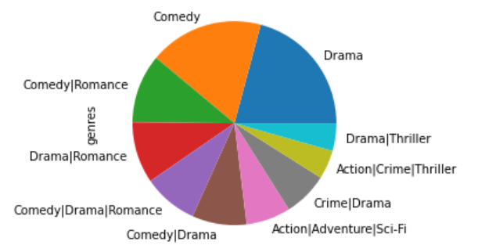
Recommend Based on Genres:
Genre Distribution

Slide 7
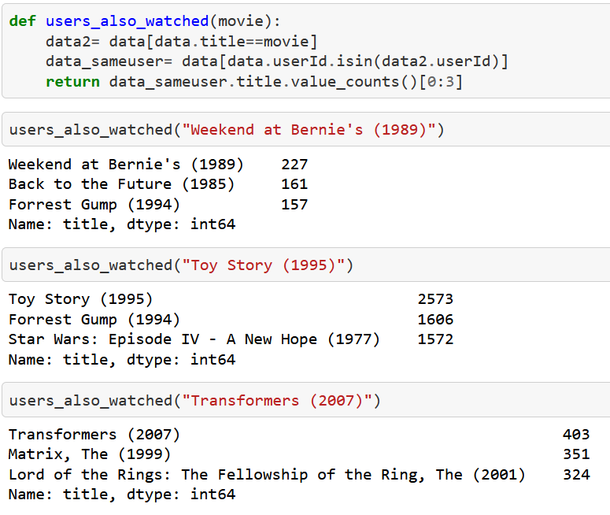
Recommendation Based on Association

Slide 8
Prediction Part
We are using movie meta data to predict vote_average(rating).
Tools used:
Matplotlib and seaborn for visualization
Pycaret for comparison of models and model creation

Slide 9
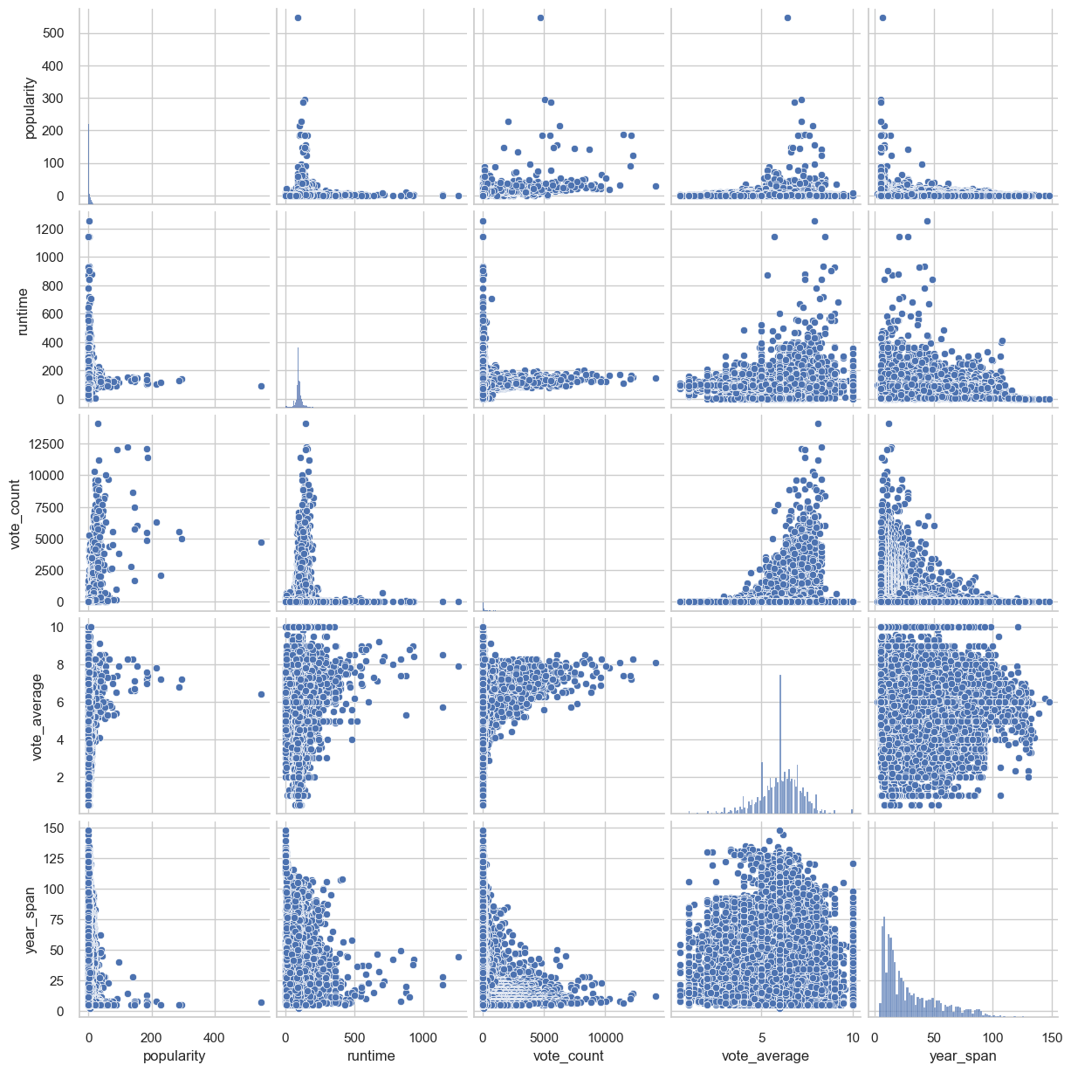
Pair Plot

Slide 10
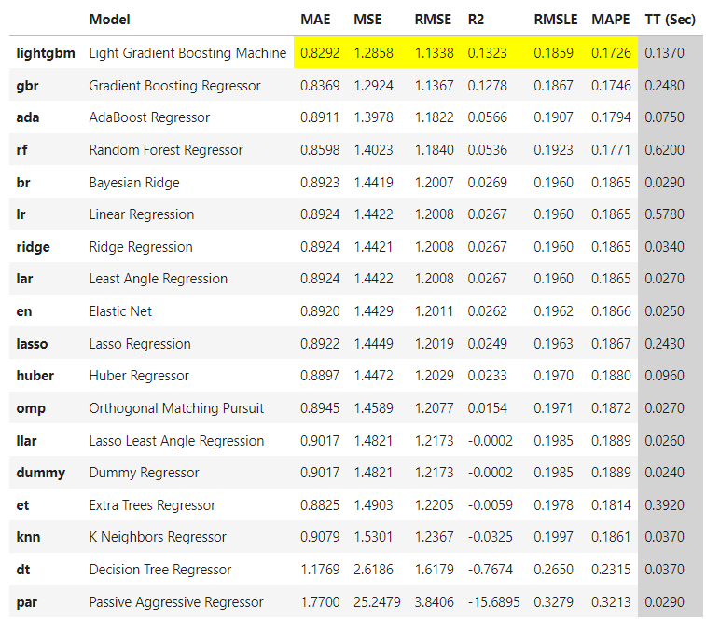
Model Comparison

Slide 11
Model Selection:
Top 3 models are selected and hyperparameter tuning is done.
After hyper-parameter tuning, Gradient boosting Regressor stands as best.
GradientBoostingRegressor(learning_rate=0.05, max_depth=7, max_features=1.0,
min_impurity_decrease=0.2, min_samples_leaf=5,
min_samples_split=10, random_state=3487,
subsample=0.85)

Slide 12
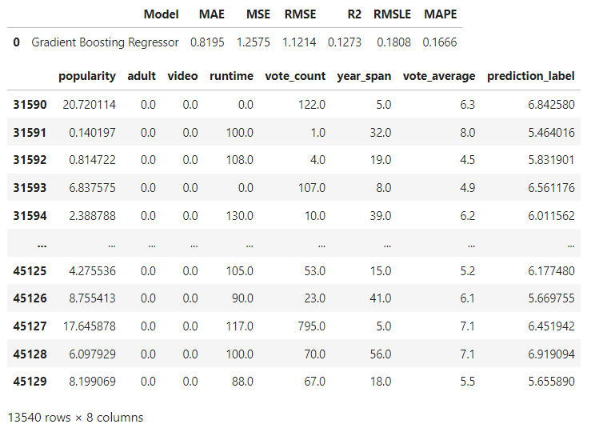
Prediction Over Test Data:

Slide 13
Results:
The Recommendation works as expected. We have created recommendation systems based on similarity, genre and association. And coming to prediction of vote_average, the trained model works with an MSE of 1.257 and R2 of 0.12.

Slide 14
References:
[1] https://www.kaggle.com/code/ibtesama/getting-started-with-a-movie-recommendation-system
[2] Yang, H. (2018). Data preprocessing. Pennsylvania State University: Citeseer.
[3] Huang, C. H., Yin, J., & Hou, F. (2011). A text similarity measurement combining word semantic information with TF-IDF method. Jisuanji Xuebao(Chinese Journal of Computers), 34(5), 856-864.
[4] Guo, G., Zhang, J., & Yorke-Smith, N. (2013, August). A novel Bayesian similarity measure for recommender systems. In IJCAI (Vol. 13, pp. 2619-2625).
[5] https://pycaret.gitbook.io/docs/
[6] Gain, U., & Hotti, V. (2021, February). Low-code AutoML-augmented data pipeline–a review and experiments. In Journal of Physics: Conference Series (Vol. 1828, No. 1, p. 012015). IOP Publishing.

