Slide 1

DATA ANALYTICS
Final Project
Turning raw data into actionable insights using Data Analytics

Slide 2

PROJECT TITLE
STUDENT PERFORMANCE &
BEHAVIOR ANALYSIS
Python-Based Data Analytics Project to Explore the factors associated with academic performance
Presented by - Arya R
Tools: Python | Pandas | NumPy | Matplotlib | Seaborn

Slide 3
Agenda Slide
Project Objectives
Filtering Data
Statistical Summary
Data Sources & Collection
Aggregating Data
Correlational Analysis
Dataset Overview
Exploratory Data Analysis
Visualizations
Data Cleaning & Preprocessing
Univariate Analysis
Project phases
Data Pre-Processing Overview
Bivariate Analysis
Key Insights
Derived columns
Multivariate Analysis
Recommendations and Conclusion

Slide 4
Project Objectives
Understand the structure and quality of the student dataset
Student academic performance is influenced by several factors such as study habits, attendance, previous academic performance and behavioral characteristics. This project analyzes student performance and behavioral data to identify important patterns, relationships and factors associated with academic outcomes.
Using Python, Pandas, NumPy, Matplotlib, Seaborn, and Plotly, the analysis covers data cleaning, exploratory data analysis, statistical analysis, visualization and insight generation.
Clean and preprocess the data for reliable analysis
Explore demographic, academic and behavioral patterns
Generate actionable insights and recommendations

Slide 5

Data Source & Collection
Dataset Information
Dataset name : Students Performance Dataset
SOURCE
  Kaggle
  Dataset Link : https://www.kaggle.com/datasets/mahmoudelhemaly/students-grading-dataset/data?utm_source

Slide 6
Dataset Overview
Total number of Values : 115000
Number of Rows : 5000
Number of Columns : 23
Academic
Behavioral
Background
  Midterm Score
  Final Score
  Assignments
  Quizzes
  Study Hours
  Attendance
  Stress
  Sleep
  Extracurricular Activities
  Gender
  Department
  Parent Education
  Family Income
  Internet Access
  Projects
  Participation
  Total Score
  Grade

Slide 7
Data Cleaning & Preprocessing
The raw dataset was systematically cleaned and prepared for analysis by checking data types, identifying missing values and duplicate records, and applying appropriate preprocessing techniques. Relevant transformations and derived features were then created to improve the quality and usability of the data. This process converted the raw student data into a reliable, analysis-ready dataset for further exploration
Remove duplicates and errors
Handle missing values
Normalize and standardize data

Slide 8
Data Pre-Processing Overview
Metric
Status
Missing values
1,025 null values handled
Duplicates
0 duplicates
Data Type Correction
Corrected
Data Validation
Validated
Outlier Validation
Validated

Slide 9
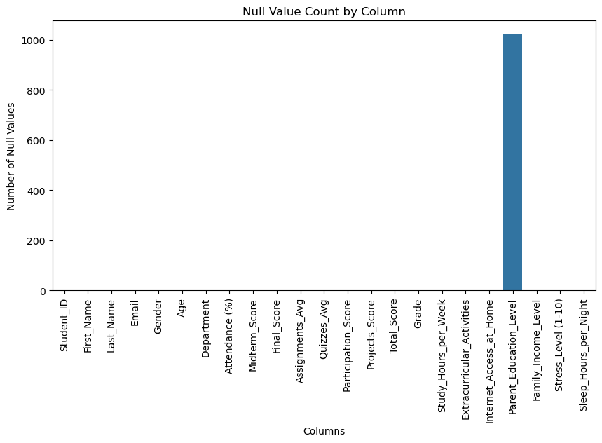
Missing Values by Column
Key Findings
• Only Parent_Education_Level has missing values.
• 1,025 values are missing, which is 20.5% of records.
• All other columns are complete and need no treatment.

Slide 10
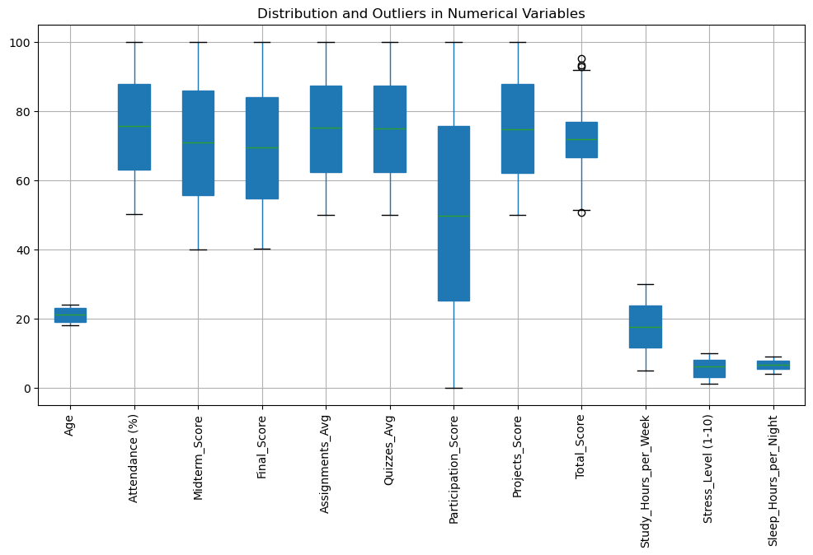
Outlier Detection
Key Findings
• Most numerical variables have reasonable ranges.
• Total Score has a few outliers above about 93 and below about 51.
• These are valid scores within 0 to 100, so they were kept.

Slide 11
Derived columns
New derived columns were created to improve the analysis
and provide better insights into student performance and behavior
Full Name
Performance Category
Age Group
Stress Category
Attendance Status
Sleep Category

Slide 12
Filtering Data
1
Filtering based on Total Score
3
Filtering based on Internet Access
Top Performers: 16 students were identified as top performers by filtering records with a Total Score above 90
2,520 students have internet access, while 2,480 do not, enabling comparison of academic and study patterns
2
Filtering based on Gender
4
Filtering based on Sleep and Stress
2,449 female students and 2,551 male students were identified for further comparative analysis
313 students had ≤5 hours of sleep and stress levels ≥8, enabling analysis of their academic performance

Slide 13
Aggregating Data
Aggregate by department
To compare academic performance and attendance across departments
Aggregate by Grade
To compare student distribution, academic performance, and attendance across grades
Academic performance and Average Sleep
To compare average sleep duration across performance categories
Gender wise Average Score
To compare average academic performance between male and female students

Slide 14
Exploratory Data Analysis
Patterns were explored at three levels, supported by groupby, pivot tables, correlation and statistical summaries.
Univariate
Bivariate
Multivariate
One variable at a time: frequency counts, percentages, mean, median, std, quartiles
Two variables: categorical vs numerical group means, and numerical vs numerical correlation
Three or more variables: pivot tables and multi-measure groupby summaries
9
19
7
12
Categorical variables profiled
Groupby summaries
Pivot tables
Variables in correlation matrix

Slide 15
Pivot Table Analysis
Pivot Table (Rows x Columns: Value) | Purpose | Key Finding
Department x Gender: Avg Total Score | Compare overall performance across groups | Gender gaps are 0.29 points or less; Business highest, CS lowest
Department x Grade: Student Count | See how grades are spread within each department | Grade C is most common (557 to 592); Grade A is rare (2 to 5)
Department x Gender: Avg Final Score | Compare final exam results by group | Highest: Business females (70.68); lowest: Mathematics females (68.61)
Department x Internet Access: Avg Attendance | Check if home internet relates to attendance | Gaps are under 2 points; largest in Business (76.70 vs 74.79)
Gender x Extracurricular: Avg Total Score | Test if activities relate to scores | Differences are 0.12 points or less
Age Group x Gender: Avg Stress | Compare stress levels by age and gender | Stress rises slightly with age (5.39 to 5.62); gender gaps are small
Age Group x Gender: Avg Sleep | Compare sleep patterns by age and gender | Males sleep slightly more in every age group (about 6.4 to 6.6 hours)

Slide 16
Groupby Analysis
Groupby (Group: Measure) | Purpose | Key Finding
Gender: Avg Total Score | Compare performance by gender | Almost identical (Female 71.64, Male 71.66)
Department: Avg Total Score | Compare performance across departments | Business highest (71.92), CS lowest (71.43)
Grade: Avg Total Score | Check that grades reflect scores | Falls steadily from 91.28 (A) to 57.55 (F)
Grade: Avg Attendance | Test if better grades mean higher attendance | No: Grade A 72.86% vs Grade F 76.80%
Performance Category: Avg Stress and Sleep | See if stress and sleep differ by performance | Stress 5.42 to 5.75; sleep 6.92 h (Excellent) to 6.48 h (Very Poor)
Parent Education / Family Income: Avg Total Score | Check the effect of family background | Education 71.45 to 71.98; income 71.54 to 71.71
Department: Final Score and Study Hours | Compare final results and effort across departments | Final 69.01 to 70.09; study hours 17.22 to 17.76
Gender: Avg Sleep | Compare sleep by gender | Male 6.57 h vs Female 6.45 h (about 7 minutes)

Slide 17
Correlation & Statistics
Analysis | Purpose | Key Finding
Correlation: Study Hours vs Total Score | Test for a linear link between study time and score | r = -0.01, no linear relationship
Correlation: Attendance vs Total Score | Test for a linear link between attendance and score | r = -0.01, no linear relationship
Correlation matrix and heatmap | Find which variables relate most to Total Score | Projects (0.60) and Final (0.59) strongest; behavior near 0
Descriptive summary: describe() | Overview of count, mean, spread, min and max | Total Score averages 71.65 with a std of 7.23
Mean, median and standard deviation | Check central tendency and spread | Mean and median are close; Participation has the highest std (28.99)
Coefficient of variation | Compare spread across variables on one scale | Participation (58%) and Stress (52%) highest; Total Score among the lowest
Quartiles and IQR | Describe the middle 50% and detect outliers | Q1 66.53, Q3 76.71, IQR 10.18; 4 outliers, all kept

Slide 18
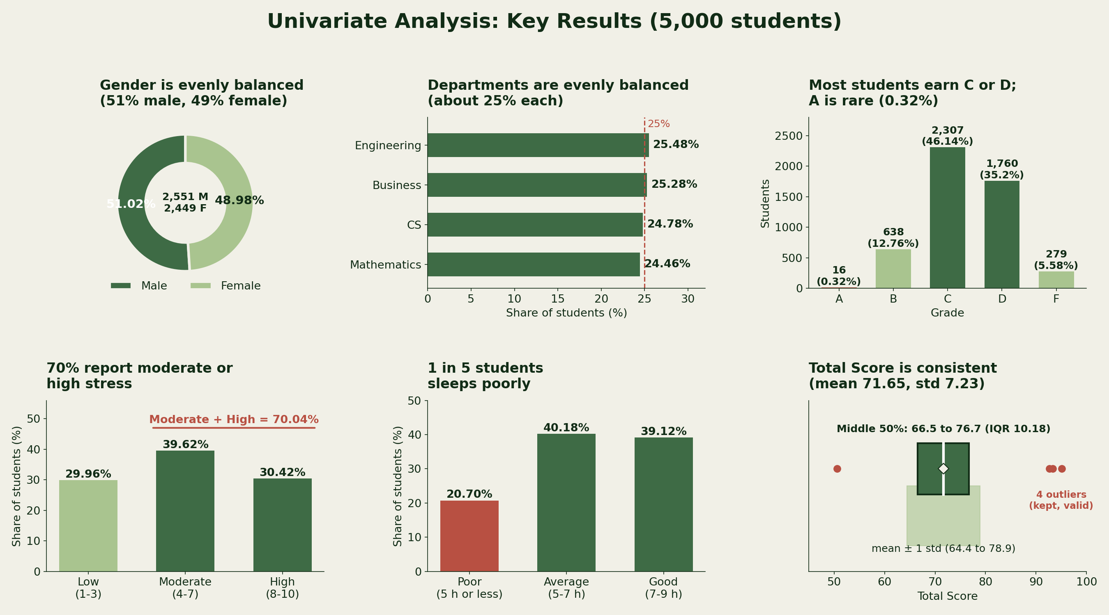
Univariate Analysis
Key Takeaways
Gender and departments are evenly balanced
Most students earn C or D; A is rare (0.32%)
70% students- moderate or high stress
1 in 5 students sleeps poorly
Total Score is consistent

Slide 19
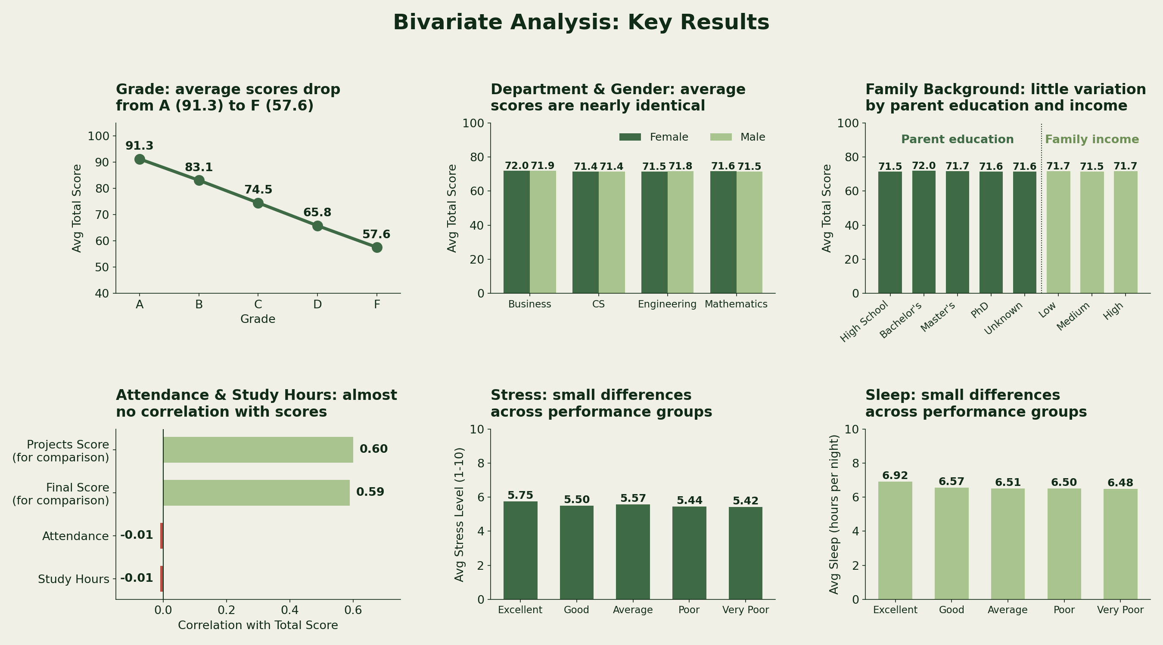
Bivariate Analysis
Key Takeaways
Grade: Average scores drop from A (91.3) to F (57.6).
Department & Gender: Average scores are nearly identical.
Family Background: Parent education and income have little impact on average scores.
Attendance & Study Hours: Almost no correlation with scores.
Stress & Sleep: Small differences across performance groups

Slide 20
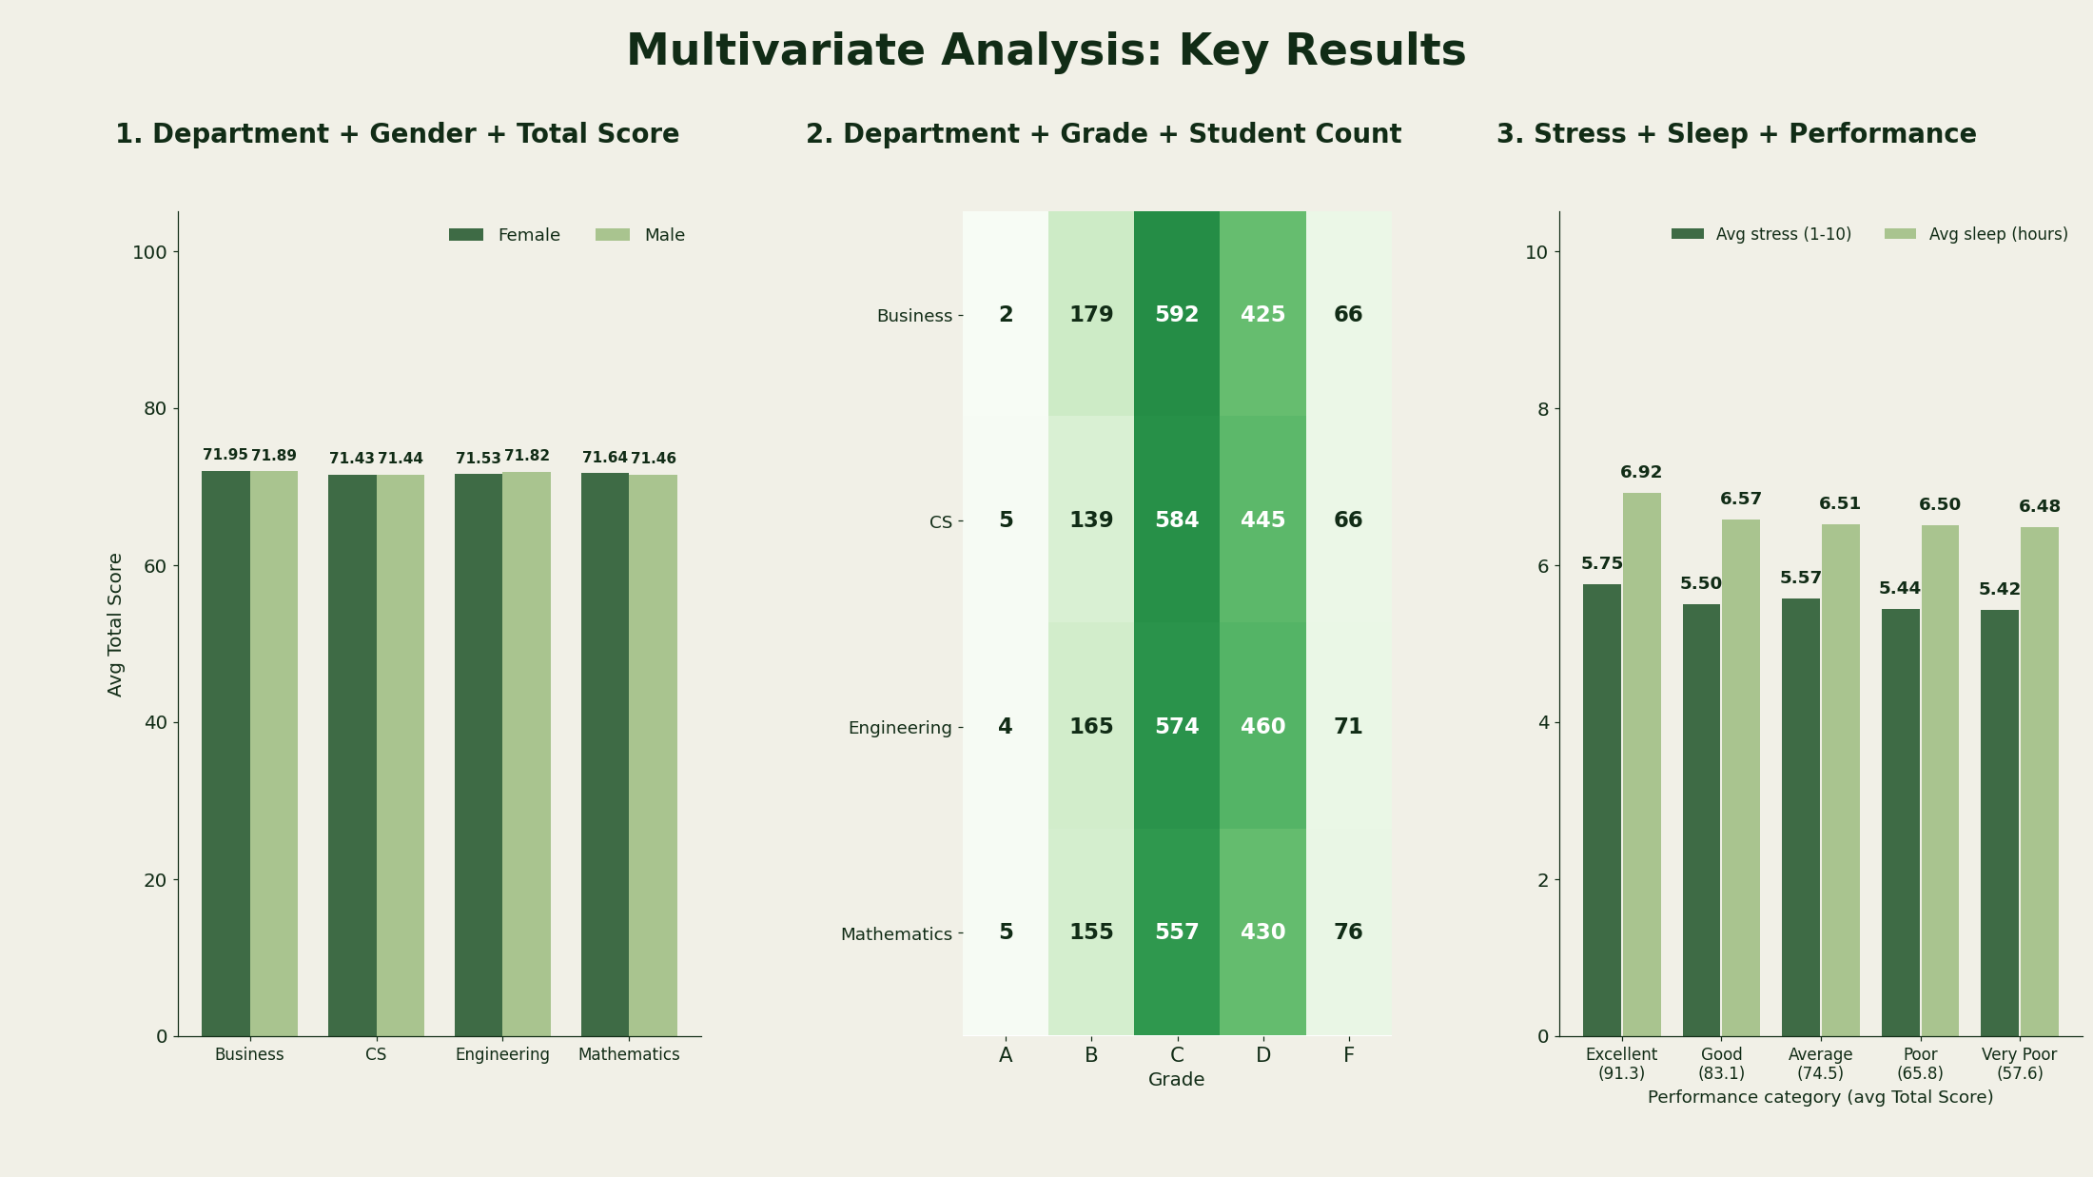
Multivariate Analysis
Key Takeaways
Overall: Department, gender, stress, and sleep have little effect on scores in this dataset
Excellent group: Only 16 students are in this group, so their results should be interpreted carefully

Slide 21
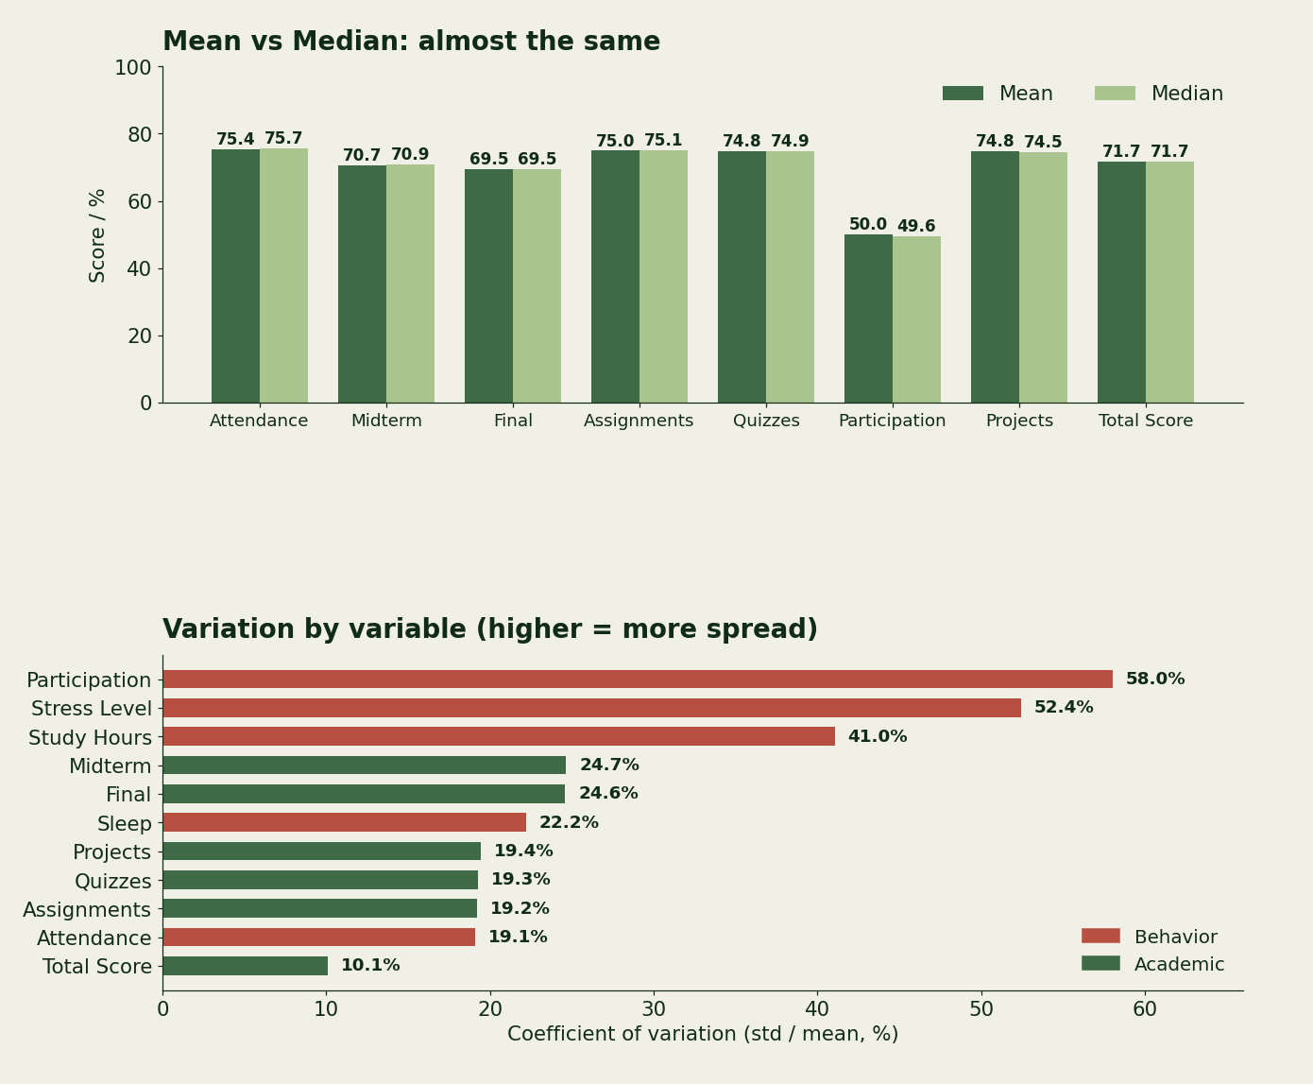
Statistical Summary
10.18
4
IQR of Total Score
IQR outliers, all retained
Key Takeaways
Mean and median are almost the same
Assignments, quizzes, and projects average around 75
Total Score has the least variation
Participation has the most variation
Behavioral factors varies more than academic factors

Slide 22
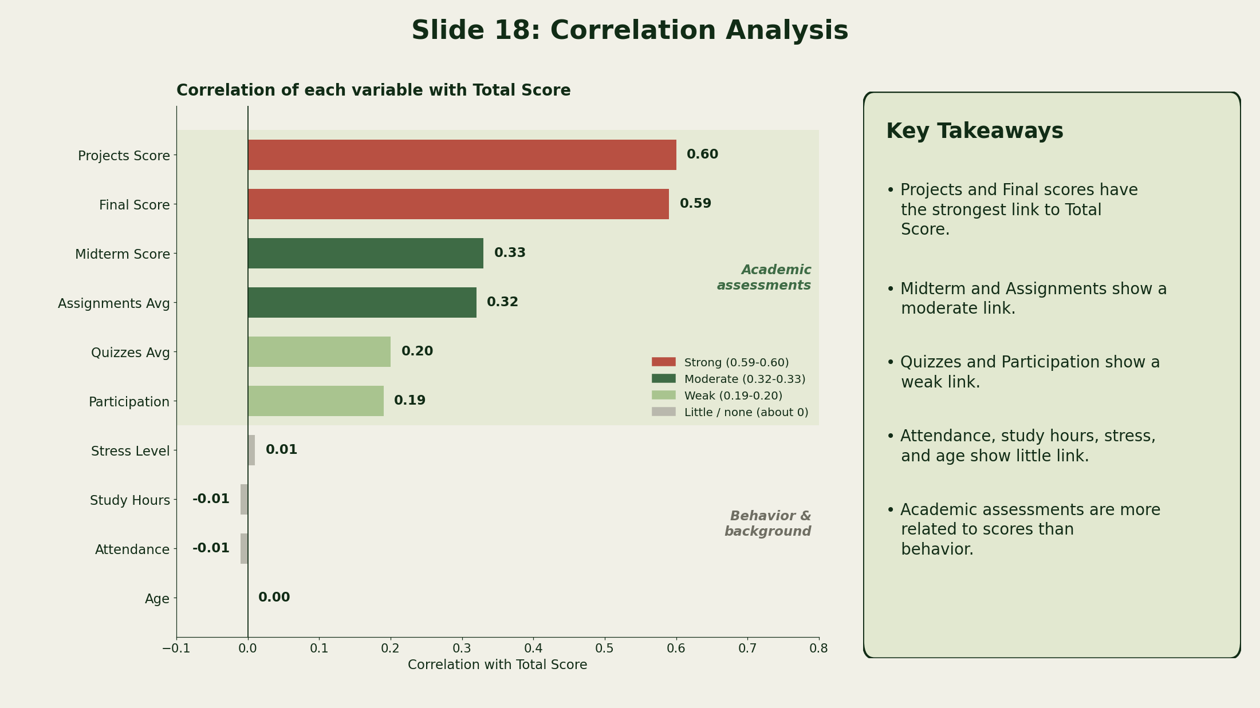
Correlation Analysis
Key Takeaways
Projects and Final scores have the strongest link to Total Score
Midterm and Assignments show a moderate link
Quizzes and Participation show a weak link
Attendance, study hours, stress, and age show little link
Scores depends more on Academic assessments than behavioral factors

Slide 23
Visualizations
Visuals built with Matplotlib, Seaborn and Plotly, each with titles, labels and colour schemes
Distributions
Comparisons
Relationships
- Bar plot
- Horizontal bar
- Pie chart
- Histogram
- KDE plot
- Count plot
- Violin plot
- Grouped bar
- Line plot
- Stacked % bar
- Box plots
- Scatter plot
- Regression plot
- Correlation heatmap
- Pairplot
- 2x2 subplots
- Interactive Plotly

Slide 24
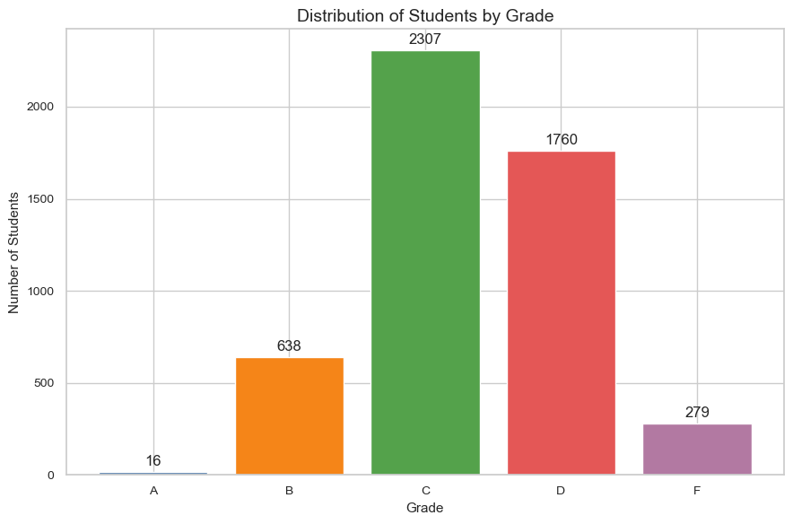
Students by Grade
Key Findings
• Grade C is the largest group (2,307), followed by D (1,760) and B (638).
• Grades A (16) and F (279) are much smaller.
• Only 0.32% of students earned an A.

Slide 25
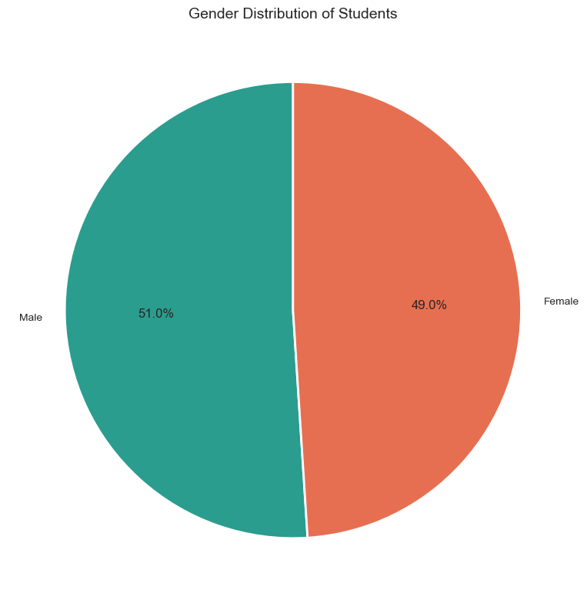
Gender Distribution
Key Findings
• Gender is fairly balanced: Male 51.02%, Female 48.98%.
• Male students are slightly more numerous (2,551 vs 2,449).
• Balanced groups allow fair gender comparisons.

Slide 26
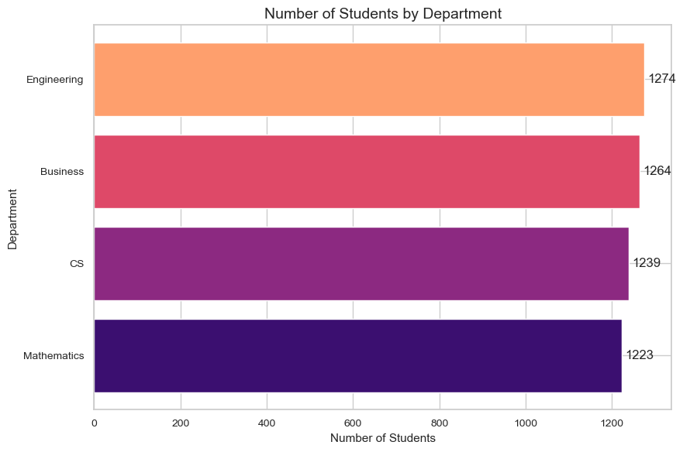
Students by Department
Key Findings
• Engineering has the most students (25.48%).
• Mathematics has the fewest (24.46%).
• The gap is small: each department holds about a quarter of students.

Slide 27
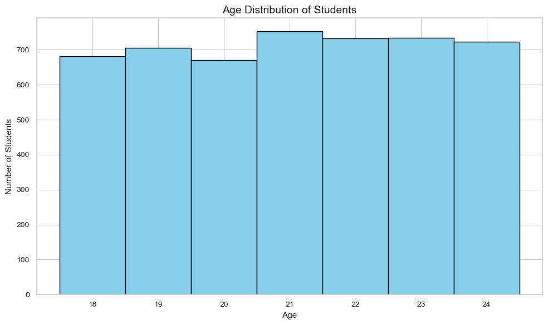
Age Distribution
Key Findings
• Students are spread fairly evenly across ages 18 to 24.
• No strong concentration at any single age.
• The dataset has a broad and balanced age range.

Slide 28
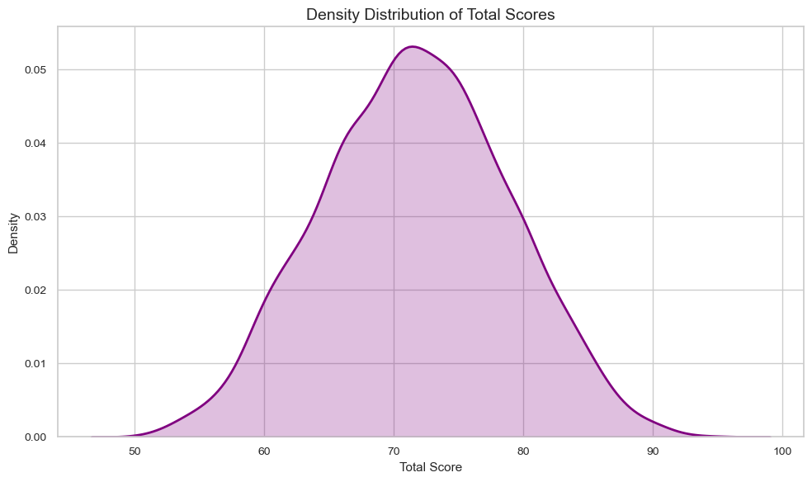
Total Score Density
Key Findings
• Density peaks at around 70 to 75.
• Few students score near the lower or upper extremes.
• Scores run from the low 50s to the mid 90s, so most students perform at a moderate level.

Slide 29
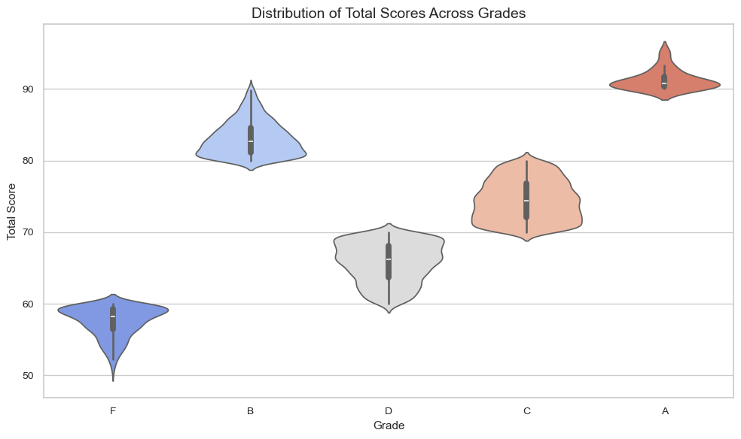
Total Score by Grade
Key Findings
• The violin plot clearly separates the grades.
• Scores follow the order A > B > C > D > F.
• Typical scores: A about 91, B 83, C 75, D 66, F 58.

Slide 30
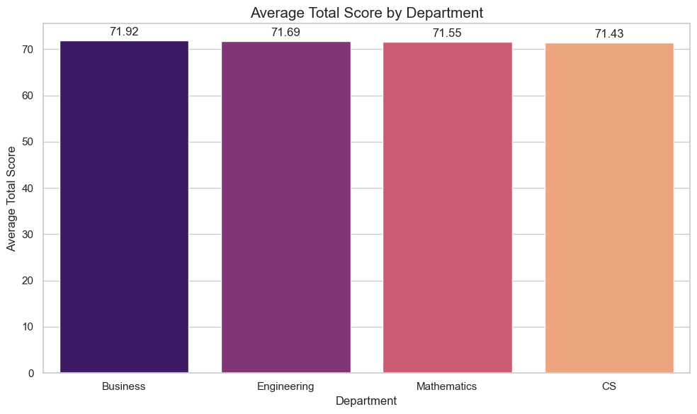
Avg Score by Department
Key Findings
• Business is highest at 71.92.
• CS is lowest at 71.43.
• The gap is only about 0.49 points, so departments perform similarly.

Slide 31
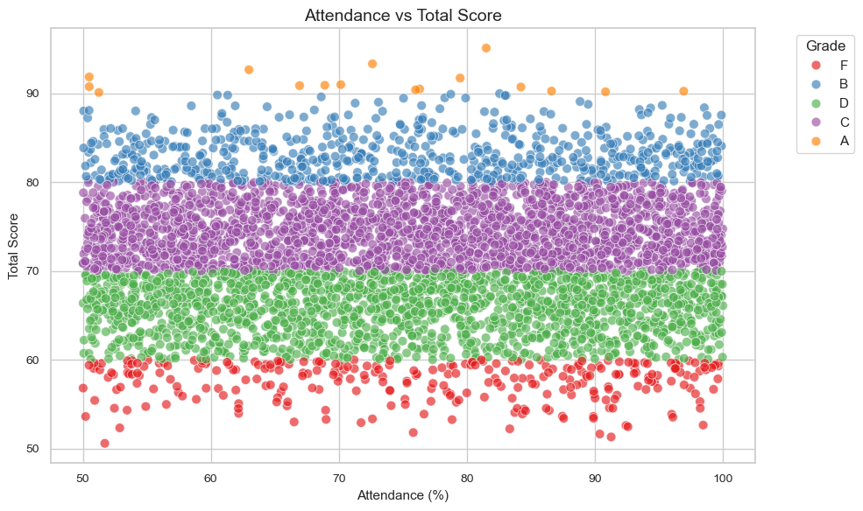
Attendance vs Total Score
Key Findings
• No strong linear relationship between attendance and Total Score.
• Low and high attendance students appear at every score level.
• Points form horizontal grade bands, not an upward trend.

Slide 32
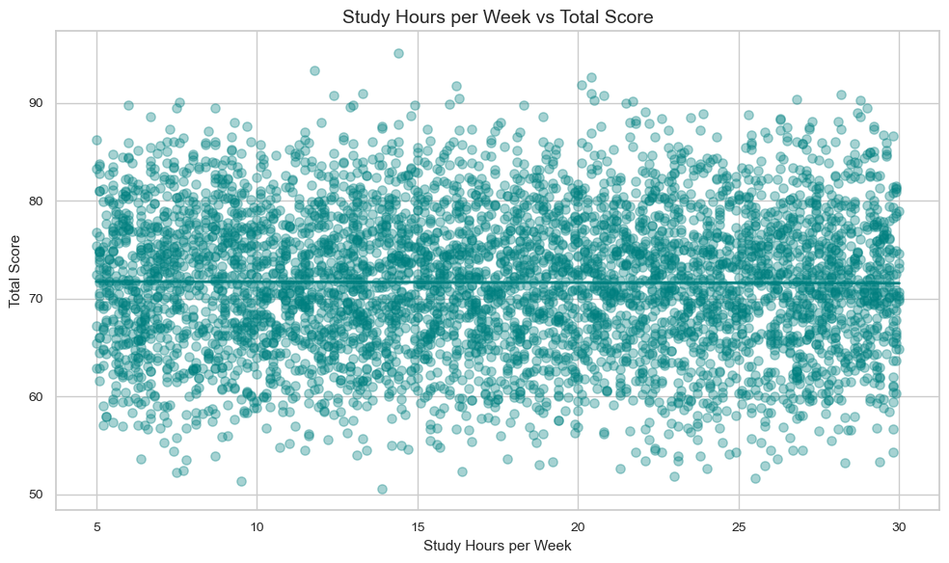
Study Hours vs Score
Key Findings
• The relationship is very weak.
• Points are widely scattered and the regression line is almost flat.
• Reported study hours alone do not explain differences in Total Score.

Slide 33
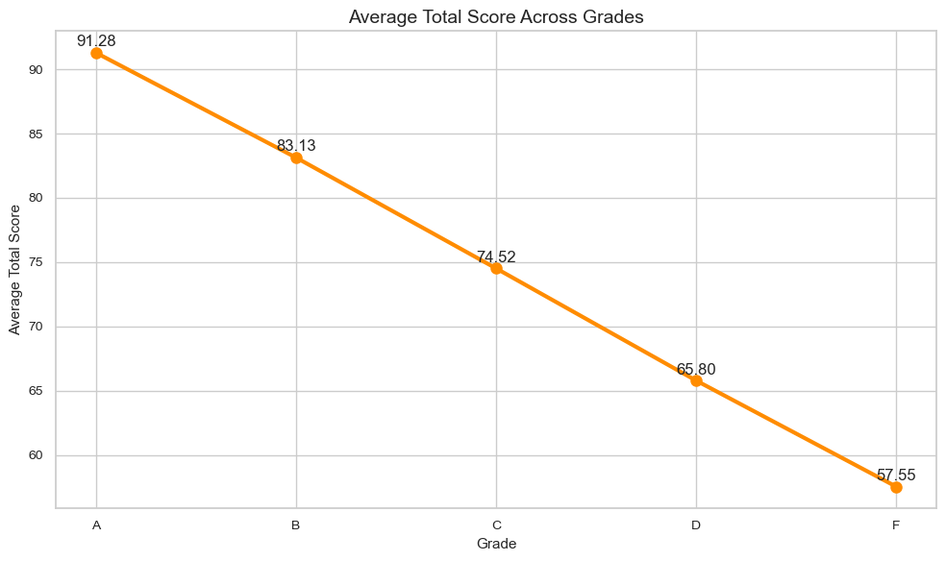
Avg Score by Grade
Key Findings
• Average score declines clearly and consistently from Grade A to Grade F.
• It falls from 91.3 (A) to 57.6 (F).
• Each grade step drops by about 8 to 9 points.

Slide 34
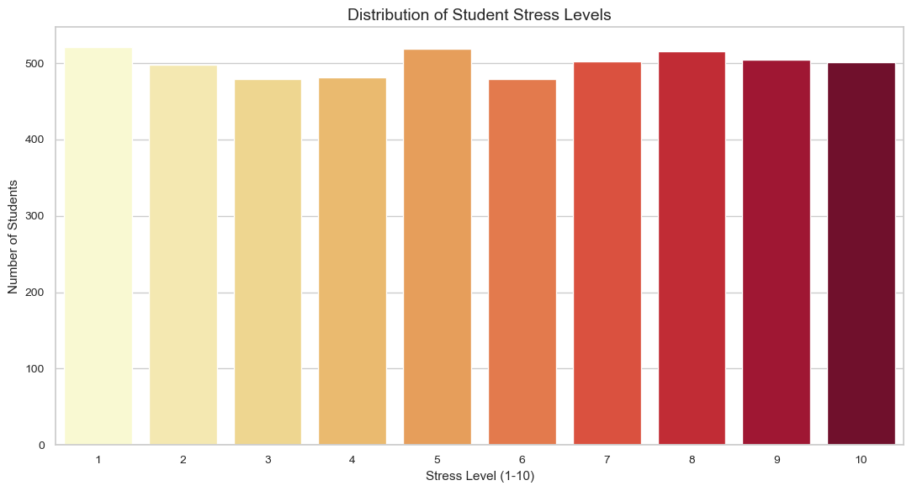
Stress Level Distribution
Key Findings
• Students are spread across all ten stress levels.
• No single stress level dominates.
• This allows behavior patterns to be compared across stress conditions.

Slide 35
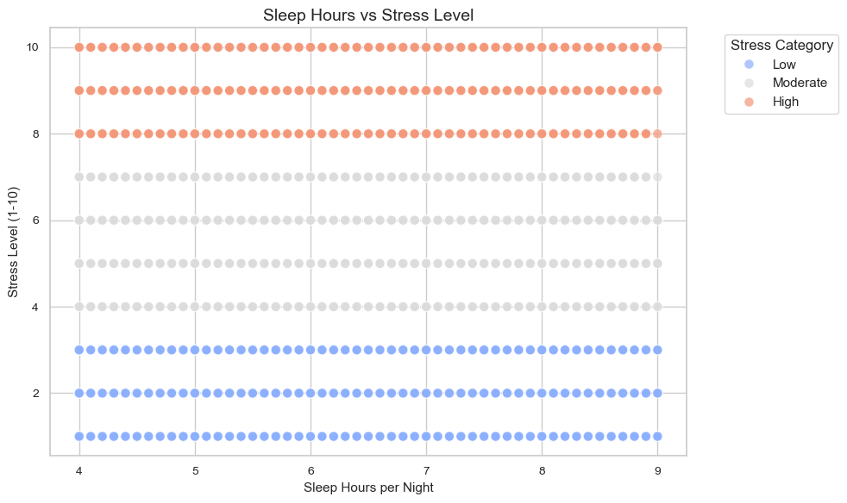
Sleep Hours vs Stress
Key Findings
• Points spread evenly across 4 to 9 sleep hours and stress levels 1 to 10.
• No visible trend between sleep and stress.
• Stress categories form clear bands: Low (1-3), Moderate (4-7), High (8-10).

Slide 36
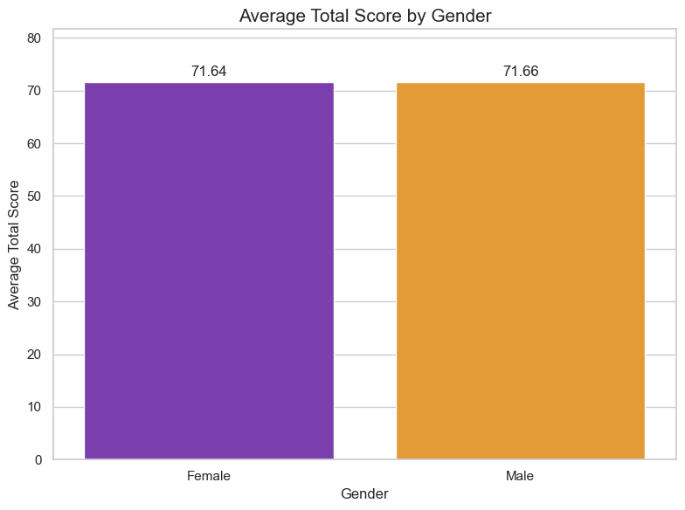
Avg Score by Gender
Key Findings
• Average scores are almost identical for male and female students.
• The difference is only 0.02 points.
• Gender does not separate academic performance in this dataset.

Slide 37
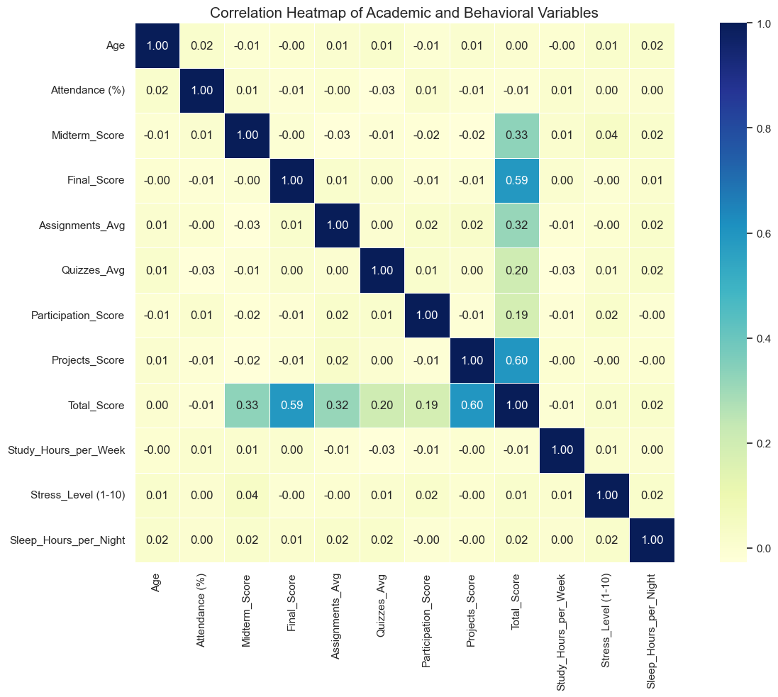
Correlation Heatmap
Key Findings
• The strongest links with Total Score are the academic assessments (Projects 0.60, Final 0.59).
• Demographic and behavioral variables show very weak linear relationships with Total Score.

Slide 38
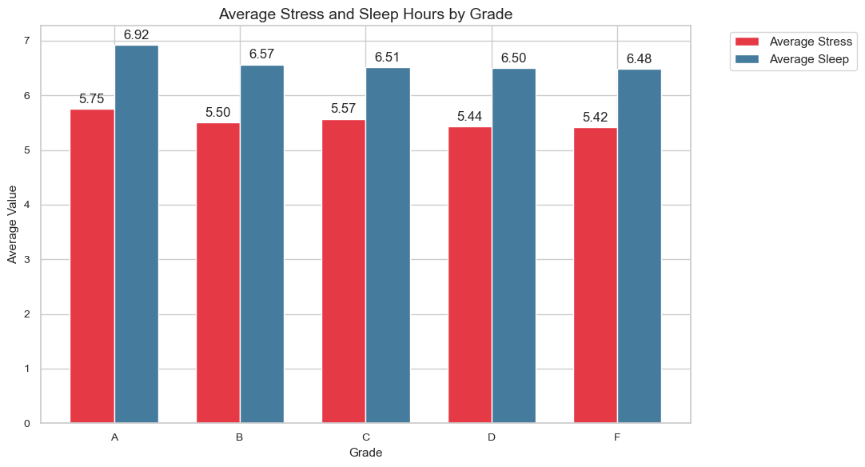
Stress & Sleep by Grade
Key Findings
• Grade A students sleep the most (6.92 h); Grade F the least (6.48 h).
• Average stress ranges only from about 5.42 to 5.75.
• No strong pattern between grade and stress or sleep.

Slide 39
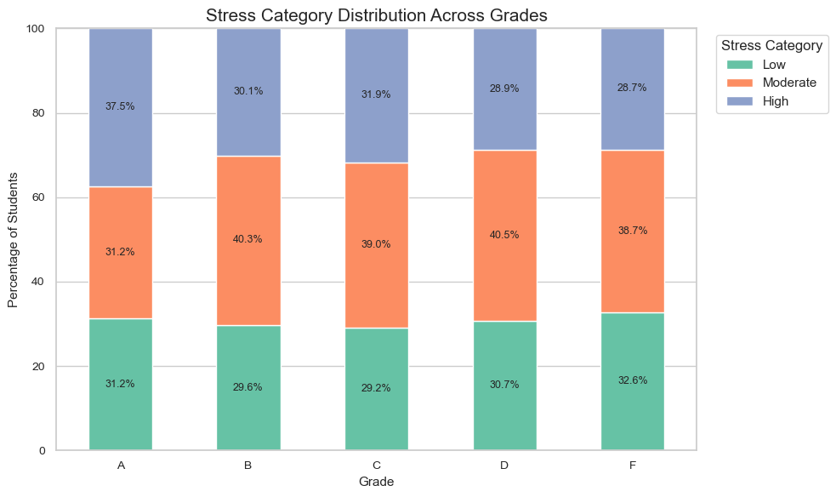
Stress Category by Grade
Key Findings
• The mix of Low, Moderate and High stress is similar across grades B to F.
• Grade A shows the highest High-stress share (37.5%), but only 16 students are in that group.
• No clear link between stress category and grade.

Slide 40
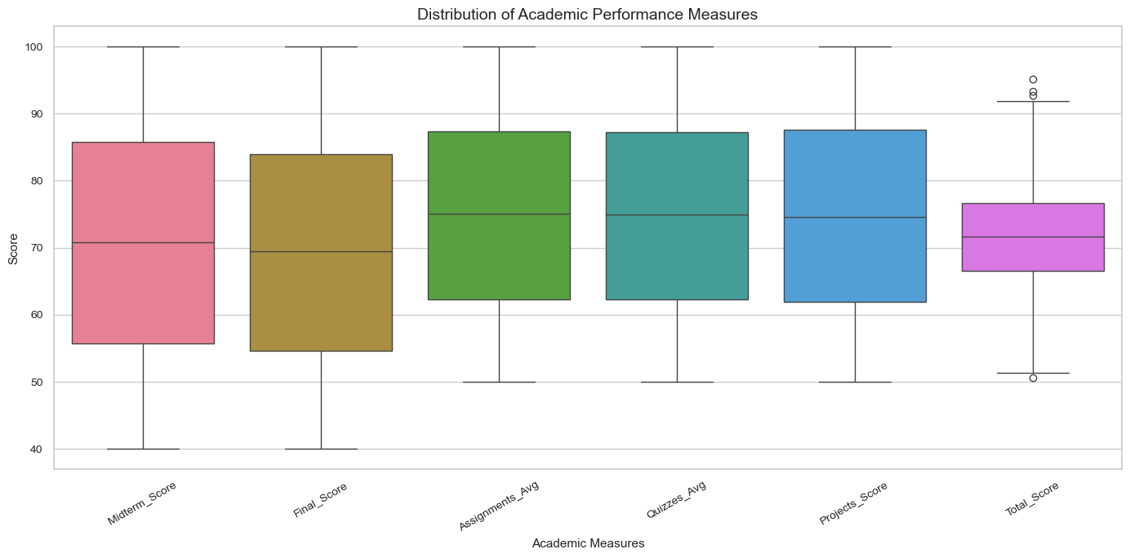
Academic Measures Boxplot
Key Findings
• Midterm and Final scores have the widest spread (about 40 to 100).
• Assignments, Quizzes and Projects have higher medians (about 75).
• Total Score is the most compact, with only a few outliers.

Slide 41
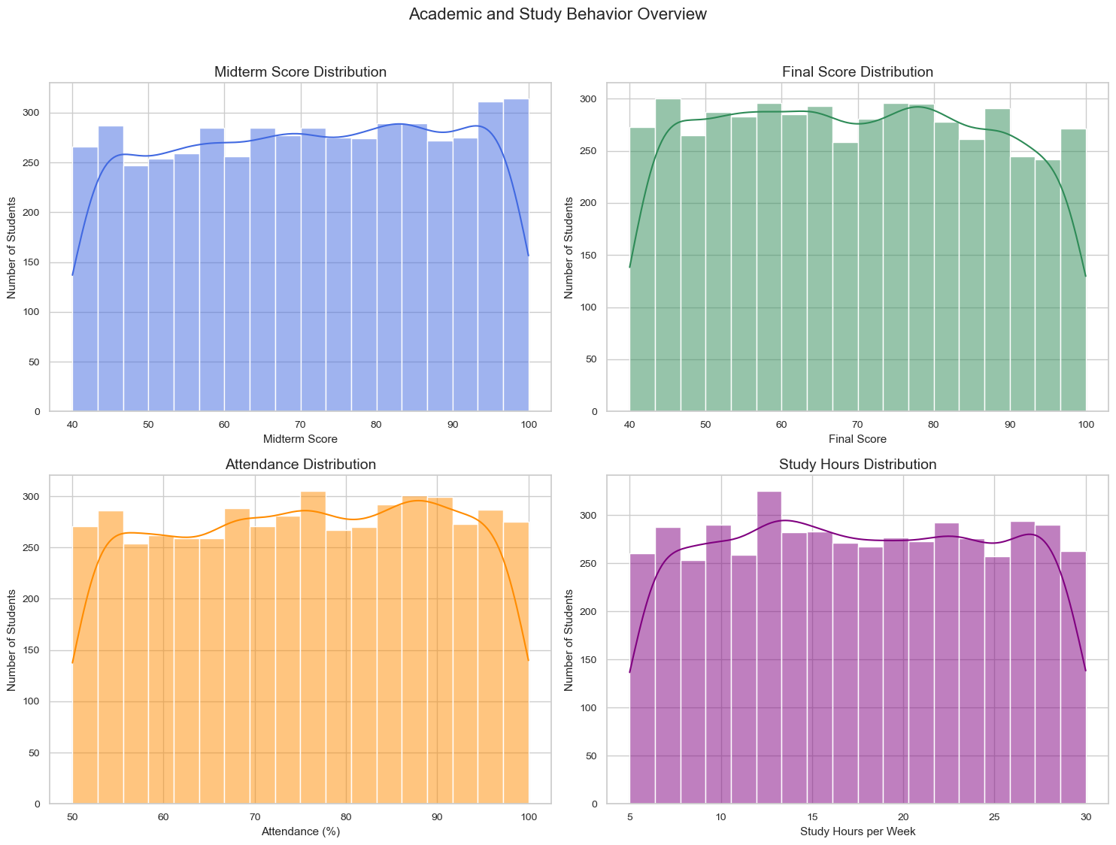
Performance Subplots
Key Findings
• Midterm, Final, Attendance and Study Hours all vary considerably across students.
• Attendance is spread broadly across its range.
• Students show varied performance on both midterm and final assessments.

Slide 42
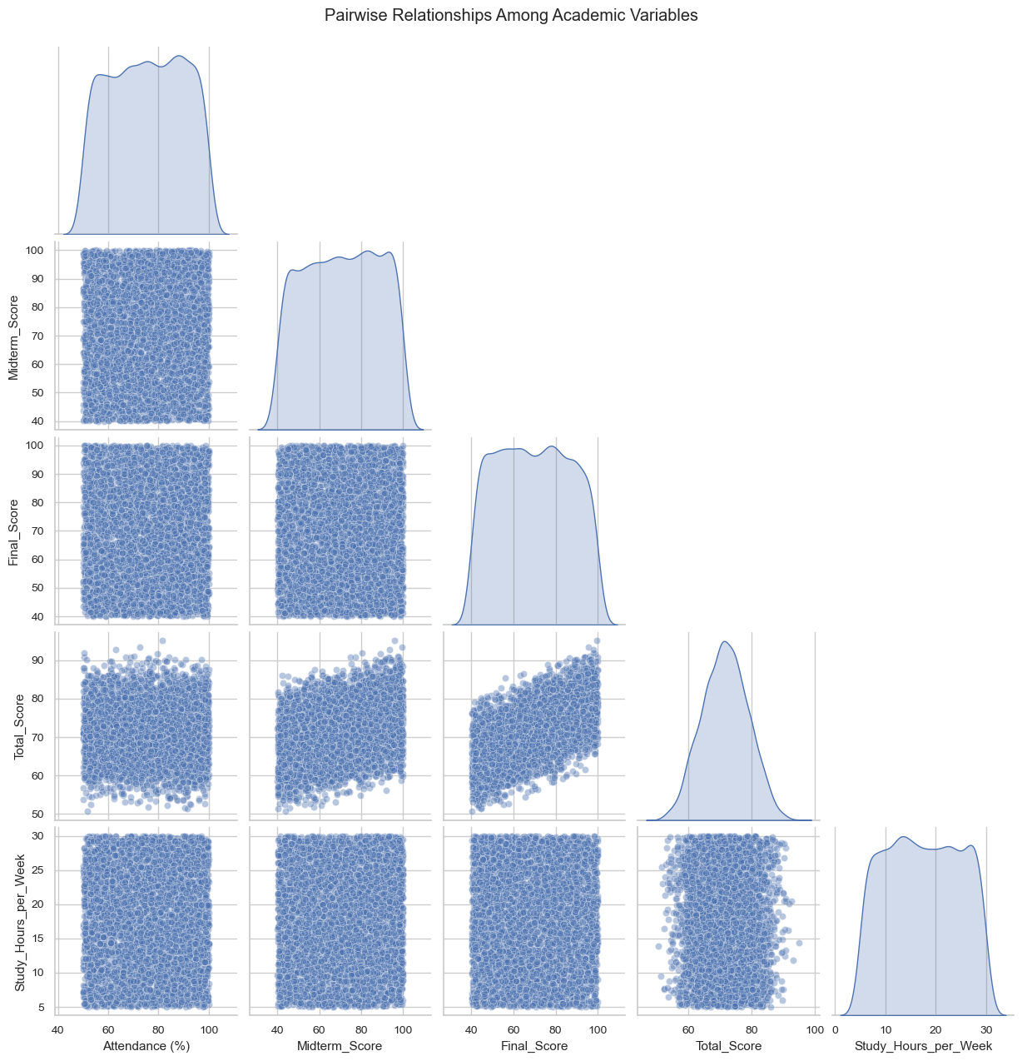
Pairplot
Key Findings
• The strongest relationships are among Midterm, Final and Total Score.
• Attendance and Study Hours show considerably weaker relationships.
• Academic assessments relate to Total Score more than behavior does.

Slide 43
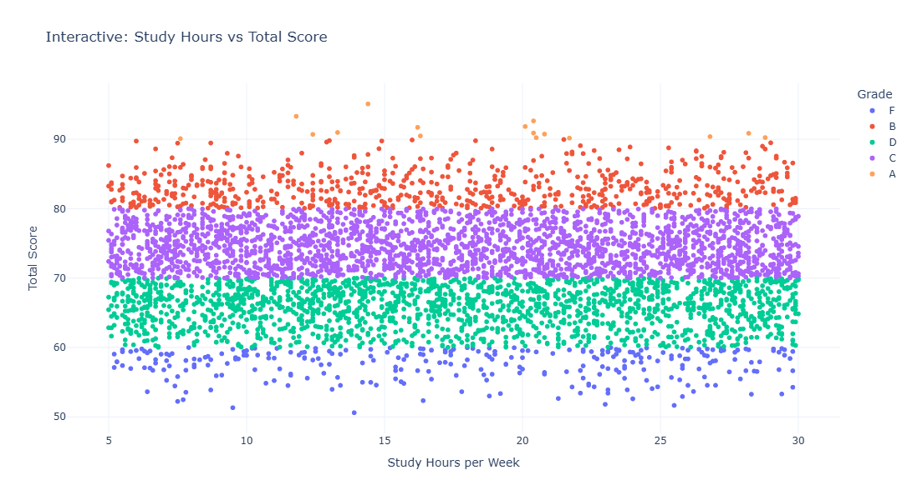
Interactive: Study Hours
Key Findings
• The interactive plot shows the same pattern as the static scatter.
• No strong upward trend between study hours and Total Score.
• Hovering reveals each student's name, department, attendance, stress, sleep and grade.

Slide 44
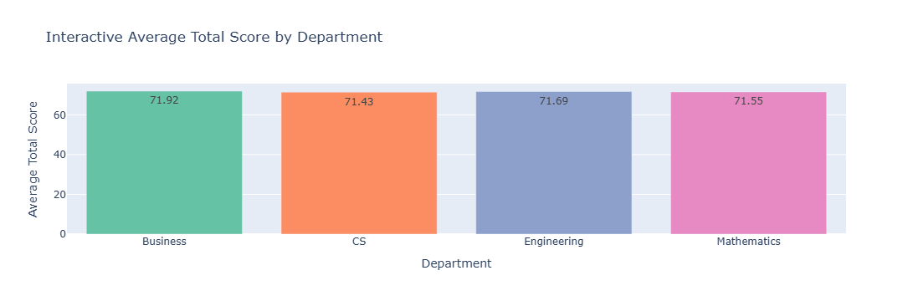
Interactive: Departments
Key Findings
• Department averages range only from 71.43 to 71.92.
• Business 71.92, Engineering 71.69, Mathematics 71.55, CS 71.43.
• Department differences are small compared with differences between grades.

Slide 45
Project Phases
TASK 1
TASK 2
TASK 3
TASK 4
Problem Definition & Dataset Selection
Data Cleaning & Pre-processing
EDA & Visualizations
Insights, Recommendations & Conclusion
• Defined the problem & objectives
• Selected a relevant dataset
• 5,000 records & 23 features
• Handled missing values
• Verified duplicates
• Validated data quality
• Corrected data types
• Created derived features
• Prepared analysis-ready data
• Univariate, bivariate & multivariate analysis
• 7 pivot tables & 19 groupby summaries
• Mean, median, std, CV & IQR
• 12-variable correlation matrix
• 20+ visualizations
• Derived 8 key insights
• Recommendations to support students
• Next steps for deeper analysis
• Conclusion summarizing the findings

Slide 46
Key Insights
1. Grade Matters Most
2. Projects Lead the Way
Grade the strongest indicator of overall academic performance
Projects show the strongest link with overall performance
3. Final Exams Matter
4. Gender Makes Little Difference
Final exam scores are also strongly linked to Total Score
Male and female students have nearly identical scores
5. Department Has Limited Impact
6. Attendance Isn’t a Strong Driver
Average scores remain close across departments
Attendance shows almost no link with Total Score
7. Study Time Isn’t Everything
8. Well-being Shows Small Differences
Study hours show very little relationship with scores
Stress and sleep levels change only slightly across performance groups

Slide 47
Recommendations
Recommendations
Next Steps
Focus on Projects – Use more practical projects to strengthen learning and performance
Support Final Exam Preparation – Provide revision plans and practice assessments
Identify Struggling Students Early – Monitor students with consistently low grades
Encourage Consistent Academic Work – Give regular assignments, quizzes, and feedback
Monitor Student Well-being – Keep track of stress and sleep as supporting factors
Build an Early-Warning System – Identify students who may need academic support.
Track Performance Over Time – Compare student progress across semesters.
Explore More Factors – Analyse factors such as learning methods, motivation, and family support.
Create Personalized Support – Use student-level insights to plan targeted interventions.
Collect More Data – Add future-semester data to validate and improve the findings.

Slide 48
Conclusion
This analysis highlights the key academic and student factors linked with performance and shows how data can support early identification, targeted support, and better learning outcomes
5,000
29
20
8
Records analysed
Columns after cleaning
Visualizations
Key insights
Thank you

