Slide 1
Northeastern University College of Engineering Department of Electrical and Computer Engineering EECE 2560: Fundamentals of Engineering Algorithms Fall 2024
Project : NBA GM - Simulating the Role of an NBA General Manager
Names: Abhi Yarlagadda, Aryash Jain, Cesar De Oleo

Slide 2
Introduction
Objectives and Goals:
To simulate the NBA draft experience for users acting as a General Manager.
To enable strategic player selection based on attribute-based algorithms.
Project Scope:
A C++ draft simulation and a Python GUI displaying draft results and player data.
Python code run using command line prompt sent by C++ program at the end.
Notes:
Overall structure explain?

Slide 3
Literature Review
Summary of Relevant Existing Work:
NBA draft simulators and GM simulation games such as NBA 2K have been on the internet for years.
Relation to Previous Work:
Custom sorting algorithms allow for user-specific functionality
Users are kept engaged with a tactile, interactive GUI.

Slide 4
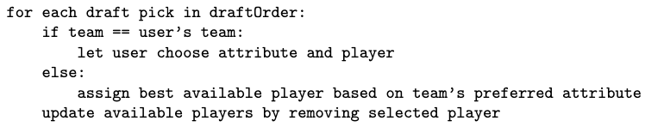
Methodology
Description of Methods and Techniques Used:
Greedy Algorithm for team assignment and randomization for draft order.
Pseudo Code for Techniques Used:

Slide 5
Methodology (cont.)
Time Complexity Estimation:
read_NBA_data(): reads csv file of player data and stores in a vector. (O(n))
sortByAttribute(): sorts vector by specified attribute using insertion sort. (O(n²))
createDraftOrder(): creates a vector with all the teams in draft order. (O(n))
userMakesPick(): logic for user to pick a player. (O(1))
teamMakesPick(): logic for team to pick a player (O(1))
Overall Time complexity: O(n²)
Notes:
Overall time complextiy?

Slide 6
Methodology (cont.)
Data Structures Utilized:
Vectors: used to store metadata such as team names and list of NBA players
Hash Maps: used to keep track of drafted players and their teams.
Structs: used to store player and team metadata.

Slide 7
Analysis and Results
Key Findings:
Figures in the next slide outline how the program runs
Interpretation of Results:
Successfully able to let the user pick a player given that they select an attribute beforehand.
Successfully ensure that no player is accidentally picked twice by handling the deletion of drafted players from the players vector.

Slide 8
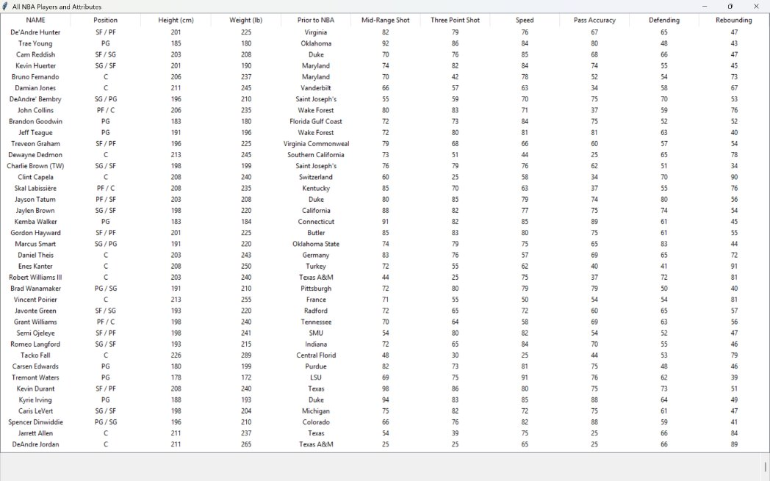

Slide 9
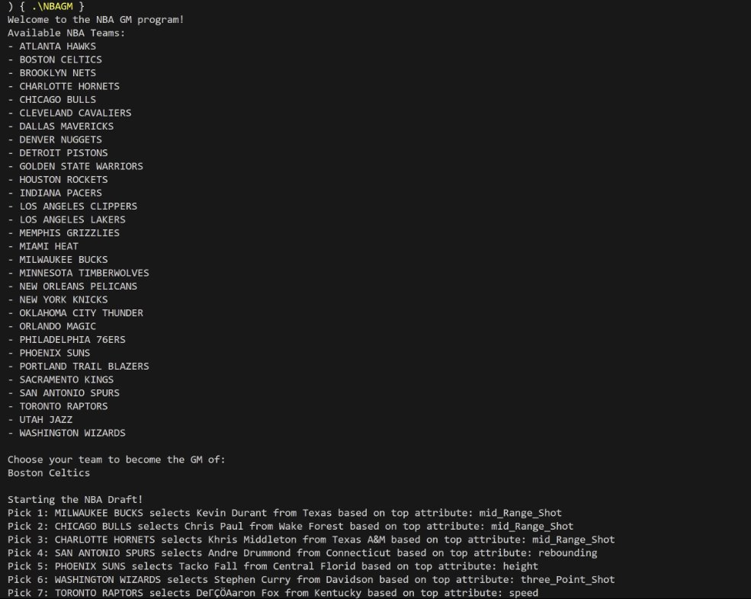

Slide 10
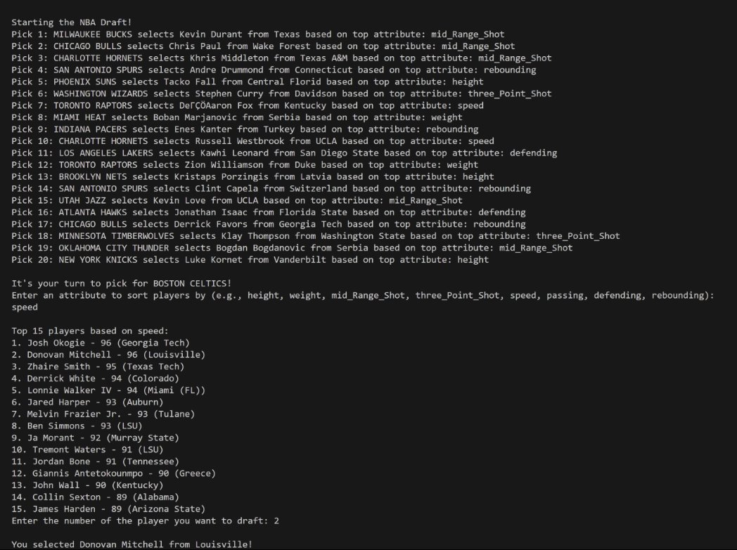

Slide 11
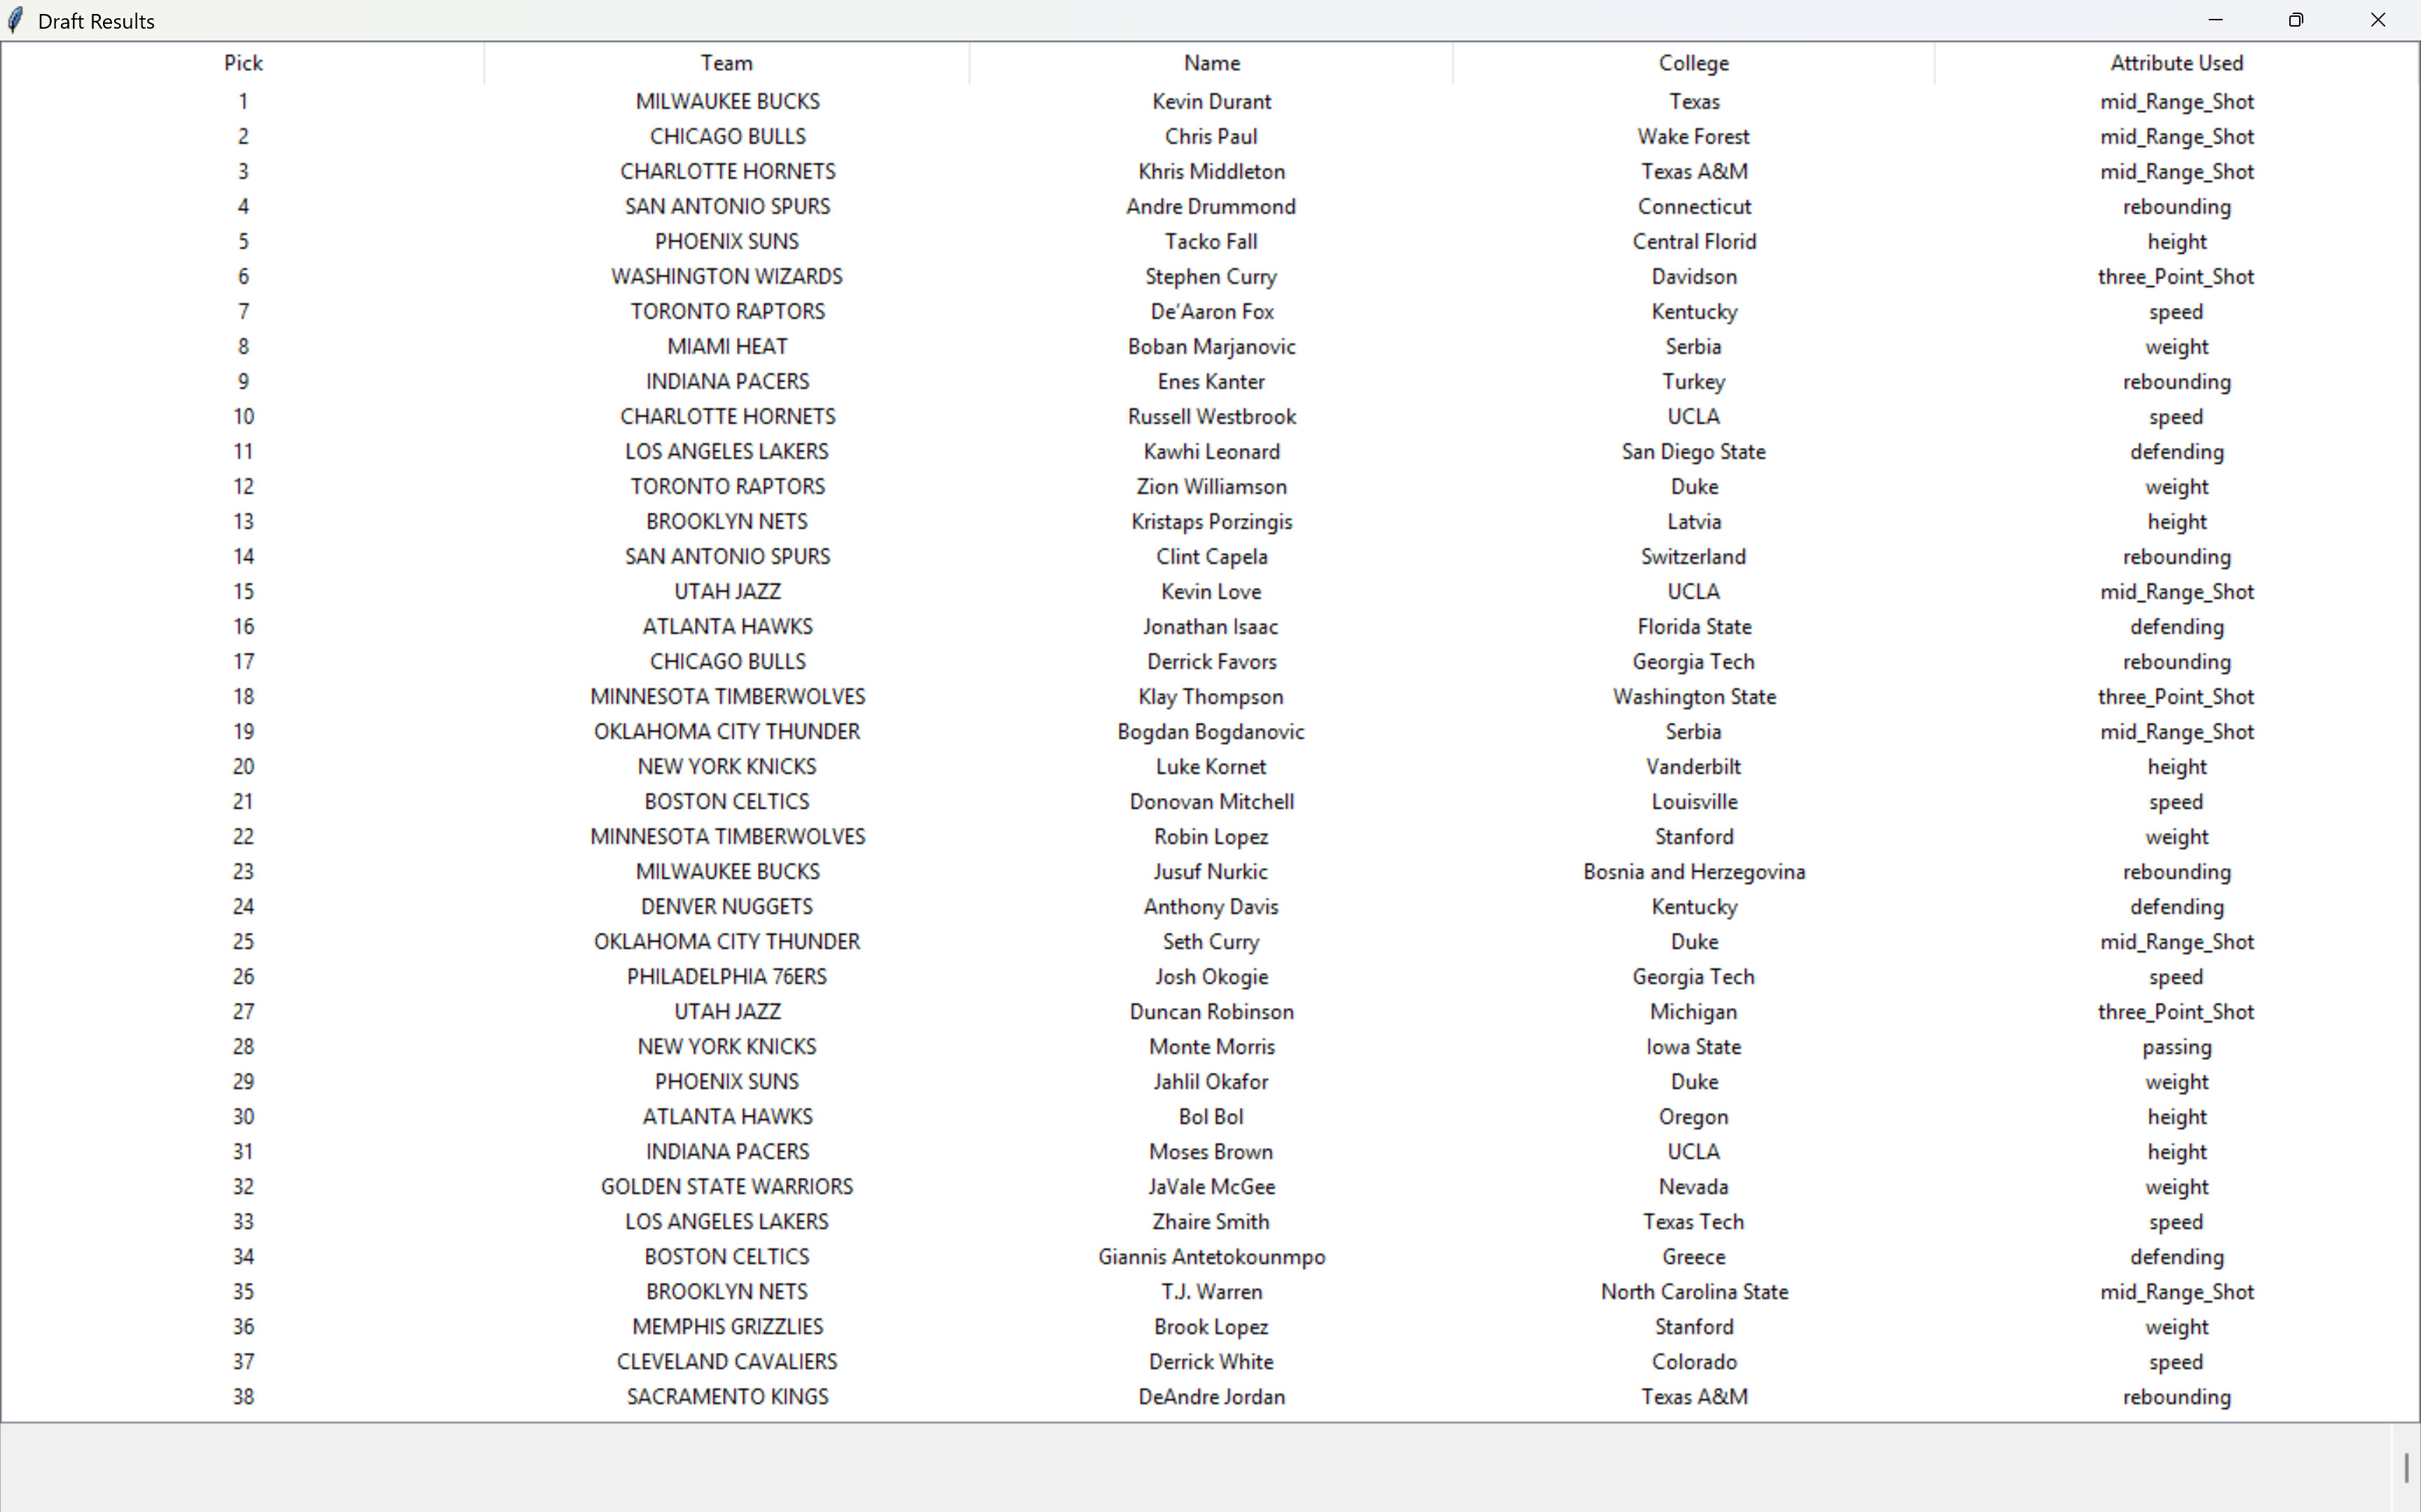

Slide 12
Discussion
Implications of Findings:
Potential use as a tool for learning NBA draft strategies.
Project Limitations:
Dataset is limited to only current players as well as only a select number of attributes.
Randomization can be inaccurate at times, creating predictable/lopsided draft orders.

Slide 13
Conclusion
Conclusions from the Project:
Successfully implemented the draft simulation and created an intuitive GUI.
Recommendations for Future Work:
Add algorithm that allows for consideration of multiple attributes.
Optimize dataset to regularly update players list.
Additional features such as option to fast forward to user picks.

Slide 14
References
List of All Cited Sources
NBA 2K21 - Player Attributes - Google Sheets u/dagtrix
Notes:
Questions?

