Slide 1
Task 4 – Interactive Dashboard Design
Dataset: Sales & Financial Data | Tool: Power BI

Slide 2
Objective
Design an interactive dashboard for business stakeholders using Power BI.
Track KPIs like Sales, Profit, and Growth.
Enable interactivity using slicers and filters.
Create an engaging, decision-making dashboard.

Slide 3
KPIs Tracked
- Total Sales
- Total Profit
- YoY Growth %
- Returns %
- Profit by Category
- Sales by Region

Slide 4
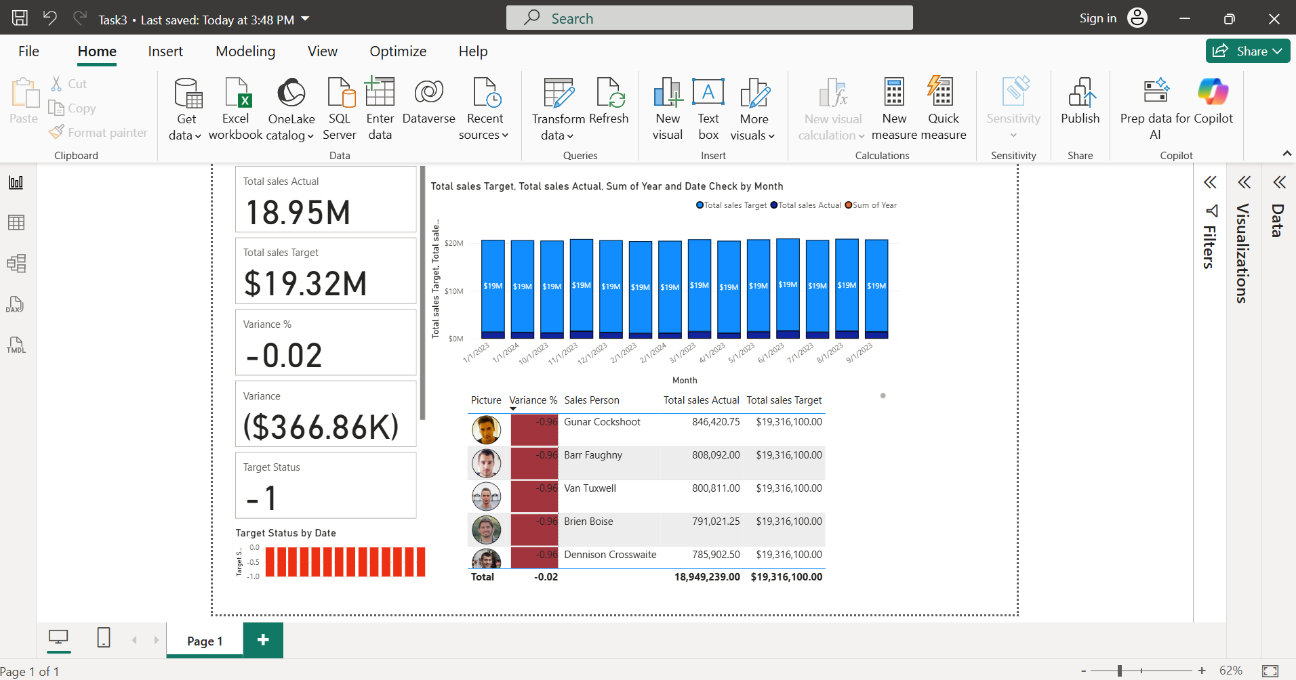
Dashboard Snapshot
Screenshot of the Power BI Dashboard goes here.

Slide 5
Key Business Insights
- Sales increased by 25% YoY.
- Office Supplies had the highest profit margin.
- Consumer Segment led in total revenue.
- Return rate dropped by 10% vs previous year.
- East region showed steady profit growth.

