Slide 1
CSCI-5840 ADVANCED NETWORK MANAGEMENT & AUTOMATION
Enterprise Network Automation & Observability Platform
End-to-End Infrastructure-as-Code, Real-Time Telemetry Data Lake & Network Source of Truth (Labs 1–4)
Lab 1: Fabric & IPAM
• Arista cEOS-lab Migration
• OSPFv2/v3, BGP & RIPv2
• Dual-Stack DHCPv4/v6 IPAM
Lab 2 & 3: Telemetry NOC
• InfluxDB 7-Day Data Lake
• Telegraf SNMP & gRPC Ingest
• Grafana NOC & NetworkX Flow
Lab 4 & 5: NSoT & IaC
• Django NSoT Web Portal
• Live eAPI Config Pull & Diff
• Multi-Vendor Jinja2 (4 OSs)
Author: Kavyashree Mahadevaiah (aryastark11) | Repository: github.com/aryastark11/advnetman

Slide 2
LAB 1 • TOPOLOGY, PROTOCOLS & IP ADDRESS MANAGEMENT
Lab 1: Multi-Vendor Network Virtualization & IPAM Architecture
Arista cEOS Fabric Migration: Replaced baseline Linux FRR containers with production-grade Arista cEOS (v4.33.10M) across all 5 routers (R1–R5) and 4 switches (S1–S4).
Hierarchical Core/Edge Design: Dual-chassis Distribution layer (R1-R2), ASBR Core (R3-R4), PE WAN Gateway (R5), Access switches (S1-S2), and Core switches (S3-S4).
Dynamic Routing Protocols: OSPFv2/OSPFv3 Area 0 core backbone, iBGP AS 65001 mesh, eBGP AS 65001 -> AS 65002 / AS 65100 peering, and RIPv2 on distribution subinterfaces.
Comprehensive Dual-Stack IPAM: Structured IPv4/IPv6 IPAM scheme (ipam.csv), dual-stack DHCPv4/DHCPv6 server pools on R2, and SLAAC autoconfiguration for hosts H1–H4.
Automated Network Management & Source of Truth Framework | Slide 2 of 6

Slide 3
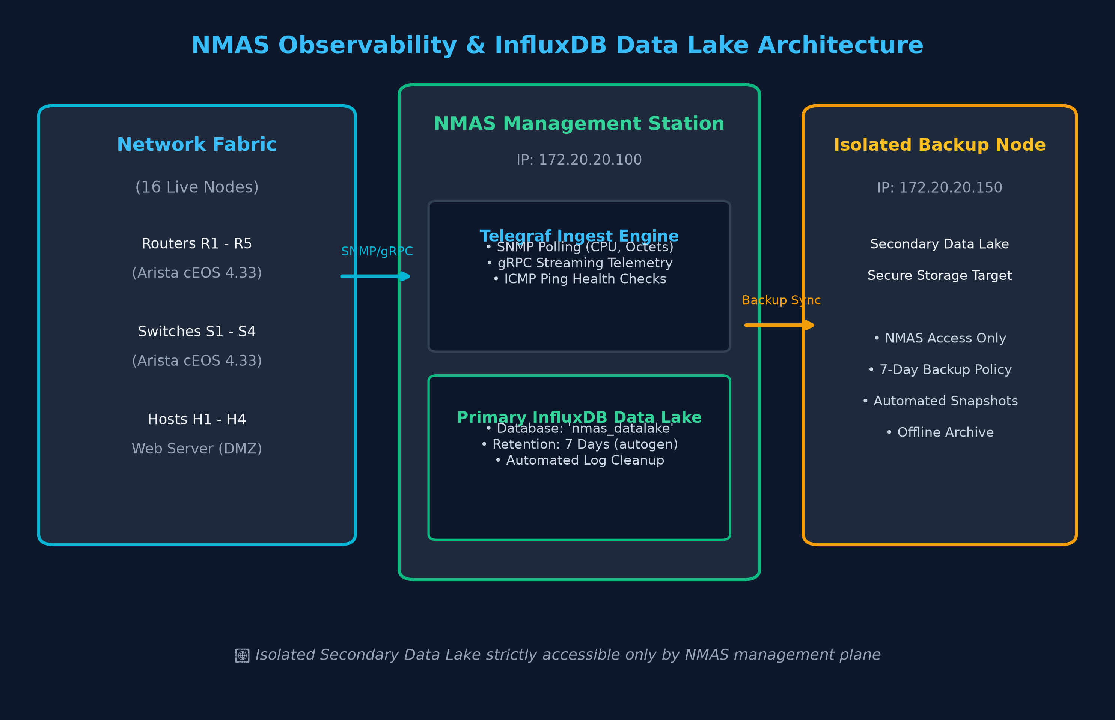
LAB 2 • CENTRALIZED OBSERVABILITY, DATA LAKE & BACKUP RETENTION
Lab 2: NMAS Telemetry Engine & InfluxDB Data Lake
Centralized NMAS Station: Dedicated Network Management & Automation Station node (172.20.20.100) orchestrating data collection, health checks, and backup pipelines.
InfluxDB Time-Series Data Lake: High-throughput InfluxDB v1.8 data lake on port 8086 with automated 7-day retention policy (autogen) and automated cleanup of records older than 7 days.
Telegraf Collector Pipeline: Automated SNMP polling across 9 cEOS switches/routers (CPU load, memory, interface in/out octets, drop counters) and gRPC streaming telemetry ingest.
Isolated Secondary Backup Node: Standalone backup server (172.20.20.150) receiving automated data lake snapshots, strictly isolated and accessible exclusively by NMAS.
Automated Network Management & Source of Truth Framework | Slide 3 of 6

Slide 4
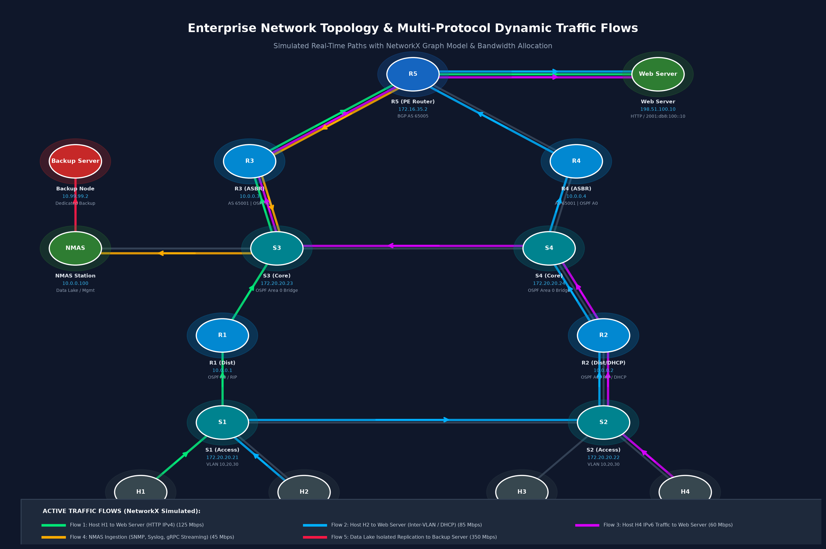
LAB 3 • NETWORK OPERATIONS CENTER (NOC) & NETWORKX TRAFFIC SIMULATION
Lab 3: Real-Time Grafana NOC & Dynamic Traffic Visualization
Grafana NOC Master Dashboard: Operational on http://localhost:3000/d/nmas-noc-master. Visualizes live SNMP CPU gauge dials, interface throughput (bps), packet error rates, and ICMP ping latency.
Dynamic Traffic Flow Simulation: Python NetworkX + Matplotlib dynamic simulator rendering animated multi-tier traffic flows (GIF / HTML) with color-coded link utilization thresholds (Green <50%, Yellow 50-80%, Red >80%).
gRPC Streaming Telemetry: Continuous sub-second metric streaming directly into the data lake, providing instantaneous fault detection over traditional polling.
Bidirectional Navigation: Embedded top navigation banner and dashboard link returning directly to the Django NSoT portal on localhost:8000.
Automated Network Management & Source of Truth Framework | Slide 4 of 6

Slide 5
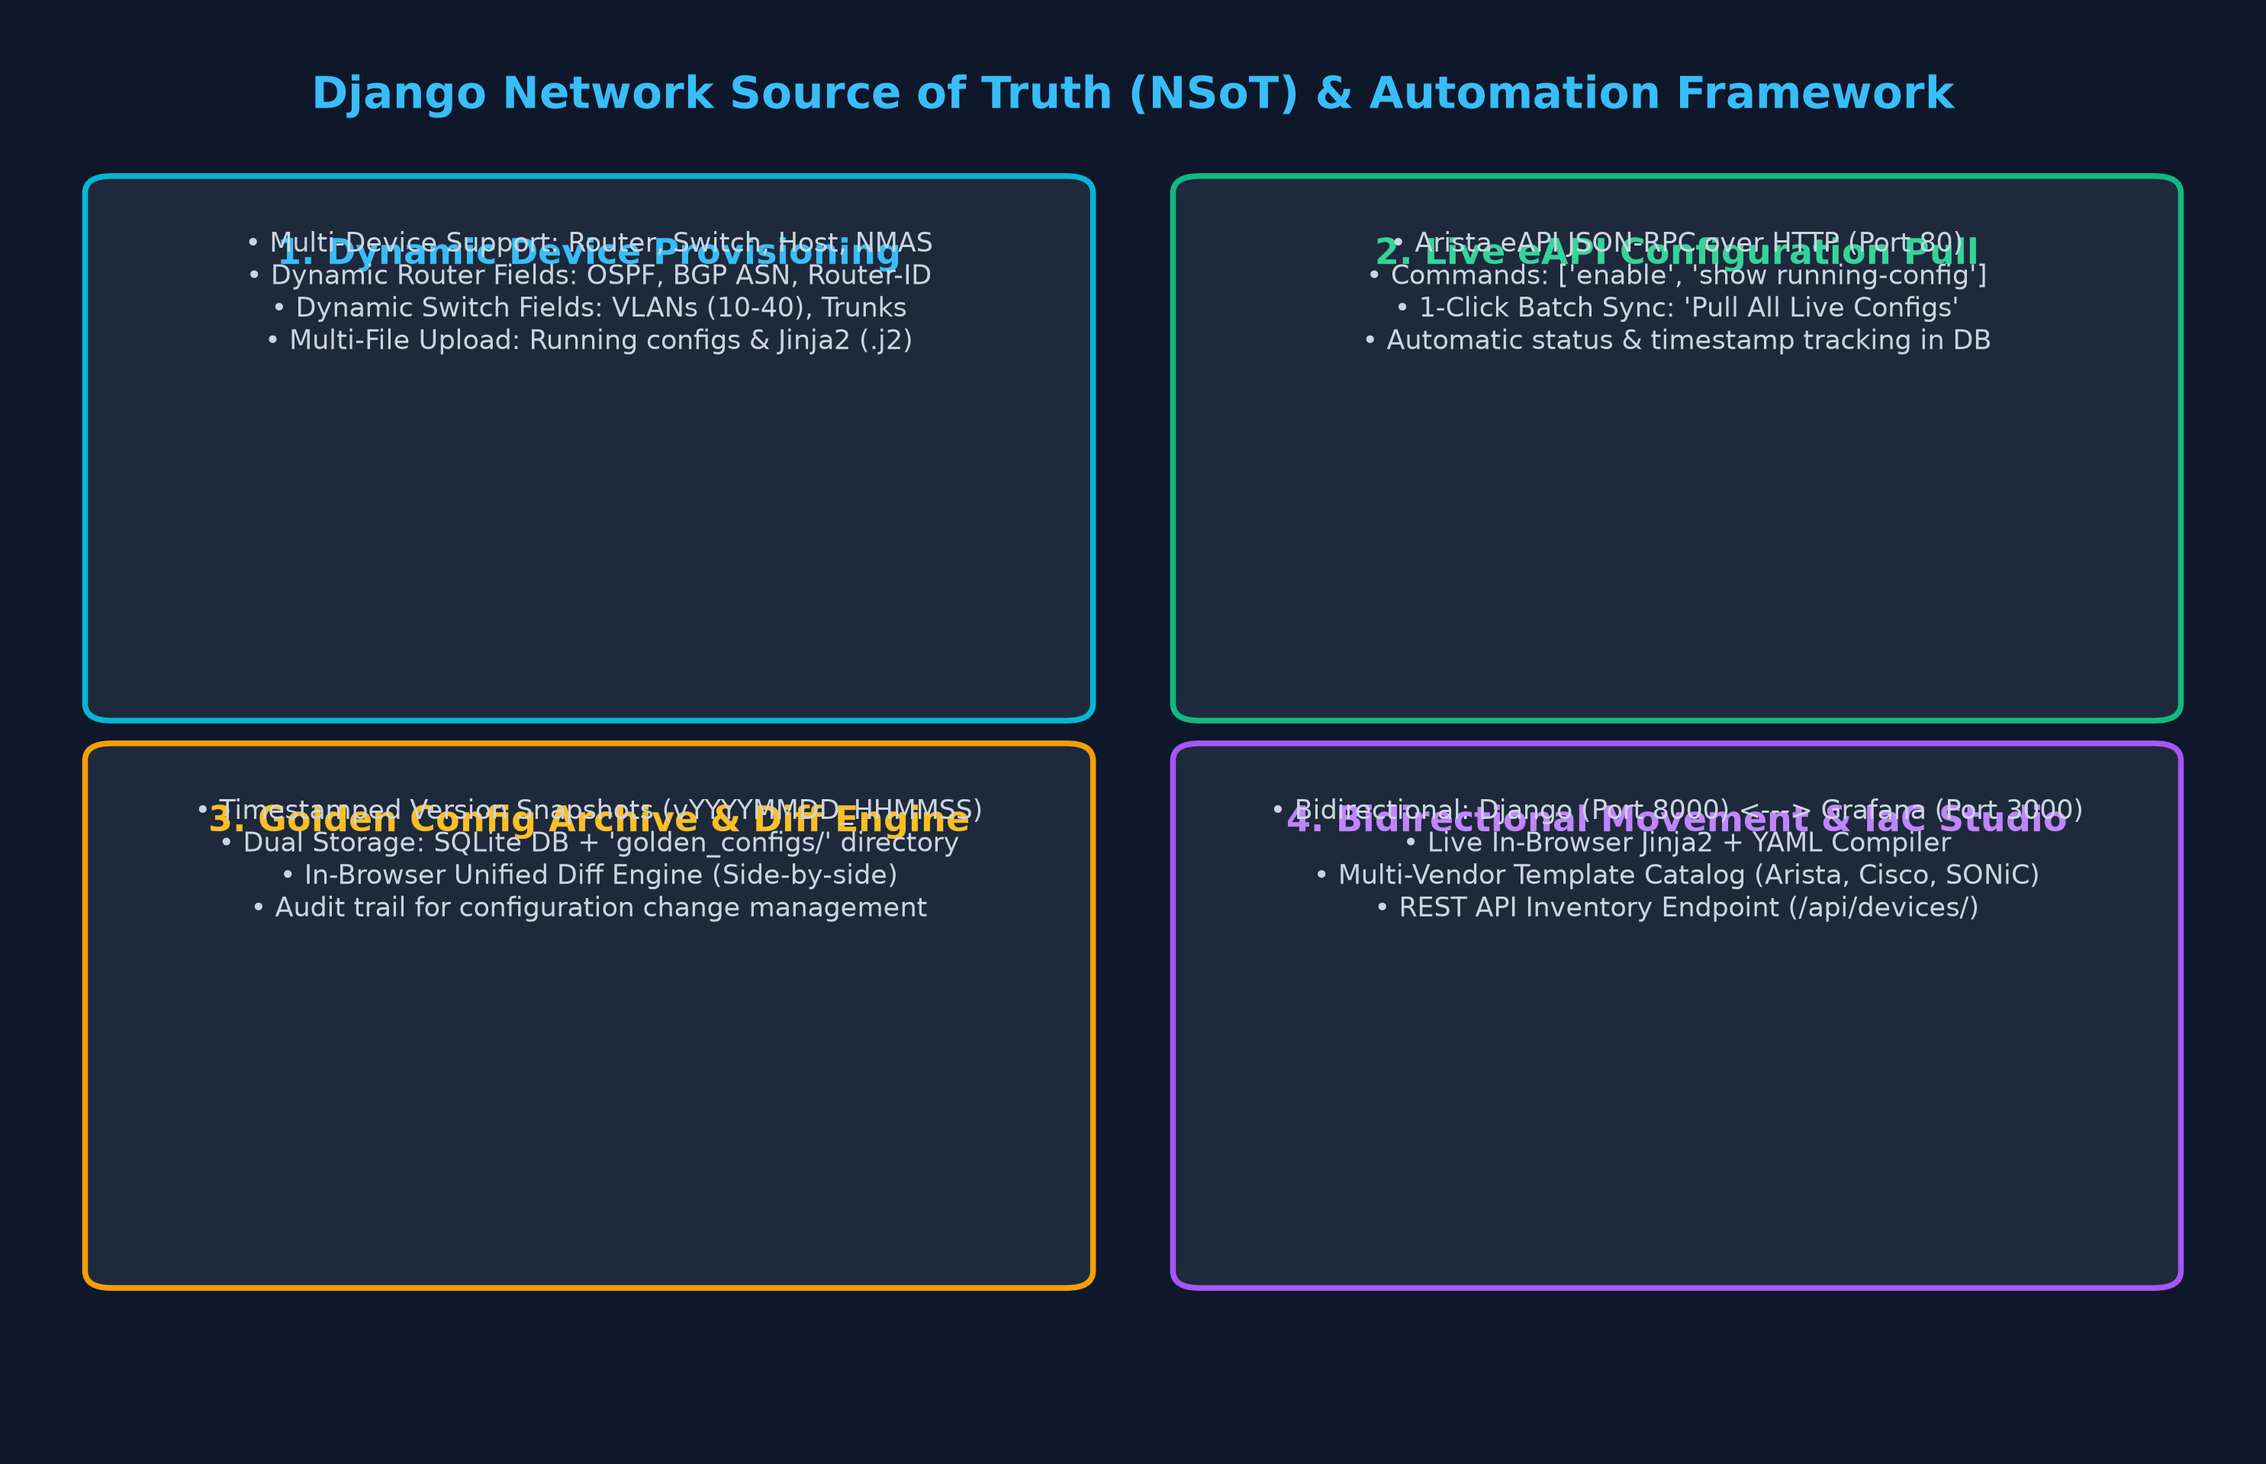
LAB 4 & 5 (PART 1) • DJANGO NSOT PORTAL, LIVE EAPI PULL & GOLDEN CONFIGS
Lab 4 & 5: Django Network Source of Truth (NSoT) Web Platform
Full-Stack Django Portal (Port 8000): Single Source of Truth managing 16 network nodes with KPI cards, role filters (Router, Switch, Host, NMAS, Server), and search.
Live eAPI Configuration Pull: Real-time Arista JSON-RPC eAPI client pulling live running configurations directly from physical/container nodes with batch 'Pull All' capability.
Dynamic Device Provisioning Form: Interactive onboarding with vendor profiles, IPAM fields, router routing protocols (OSPF, BGP ASN, Router-ID), switch VLANs, and dual file uploads (.cfg & .j2).
Golden Configuration Archive & Diff: Timestamped version snapshots (vYYYYMMDD_HHMMSS) stored in SQLite DB and filesystem (golden_configs/) with in-browser Unified Diff comparator.
Automated Network Management & Source of Truth Framework | Slide 5 of 6

Slide 6
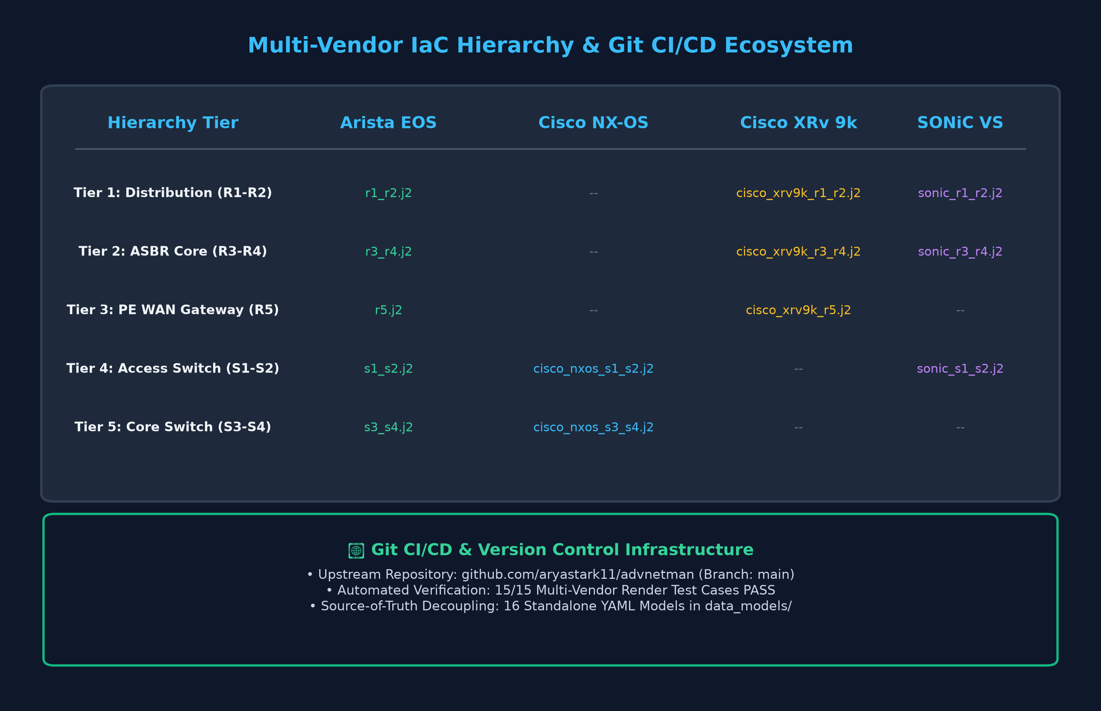
MULTI-VENDOR EXTRA CREDIT • ARISTA, CISCO NX-OS/XRV, SONIC & CI/CD
Multi-Vendor IaC Templates, Git CI/CD & Future Roadmap
Hierarchical Jinja2 Templates (Extra Credit): 13 multi-vendor templates across 4 platforms (Arista cEOS, Cisco NX-OS 9000v, Cisco IOS-XRv 9000, SONiC VS) for all 5 network tiers.
Decoupled YAML Data Modeling: 16 standalone data models in data_models/ separating network business logic from syntax, enabling cross-vendor portability.
Git CI/CD Version Control: Production-ready repository live on GitHub (github.com/aryastark11/advnetman) on branch main with automated 6/6 test verification suite.
Future Roadmap: Next phases: Closed-loop self-healing automation, automated pre-change validation with Batfish, and gNMI telemetry streaming.
Automated Network Management & Source of Truth Framework | Slide 6 of 6

