Slide 1

Swipe-Based Recruitment System with Compatibility Algorithm and Career Guidance
Team Members:
1. Rishit Rajan Shukla- 2023BCSE07AED244
2. Devansh Khare – 2023BCSE07AED237
3.Aryavardhan Singh Shekhawat – 2023BCSE07AED260
Name of the Mentor: Ms. Swetha C.B.
5CS1990/5IT1990 Design Project -1

Slide 2

Agenda
Introduction
Review of literature (Refer minimum of 10 Recent Journal / Conference papers)
Observations from the literature review (Brief description as points)
Limitations from the literature review (Brief description as points)
Problem Definition & Proposed Methodology
Problem Statement
Proposed Research / Methodology
Hardware Requirements
Software Requirements
References ( Min. of 10 papers)
Plagiarism Report

Slide 3
Introduction
Recruitment in traditional job portals is time-consuming and inefficient.
Existing systems often rely on keyword searches, ignoring deeper candidate-job compatibility.
Our project proposes an AI-powered recruitment app with a swipe-based interface inspired by dating apps.
The system integrates a compatibility algorithm that matches resumes with job postings using AI and NLP.
Career guidance is provided to underqualified candidates by recommending resources for upskilling.

Slide 4
Review of literature
S.No | Author Name, Journal, Publication Year | Research/ Methodology | Performance Metrics | Advantages | Disadvantages
1. | X. Zhang et al., IEEE Access, 2021 | Resume + Job embeddings, FAISS retrieval, reranking model. | Accuracy, scalability, retrieval speed | Captures deep semantic similarity, scalable, near real-time. | Needs large infra, resume standardization, low transparency
2. | M. Gupta et al., IEEE Transactions on Knowledge and Data Engineering, 2024 | Nash Social Welfare optimization, envy-free algorithms. | Match fairness, precision, recall. | Reduces bias, ensures fairness, balances candidate/employer needs | Complex to implement, may reduce efficiency, parameter tuning
3. | S. Li et al., Elsevier Expert Systems with Applications, 2023 | Reinforcement learning, feedback-driven adaptation. | Matching accuracy, learning efficiency. | Learns from interactions, benefits both sides, adaptive. | Domain-specific, costly, requires feedback loop.
6. | A. Kumar et al., ACM Transactions on Information Systems, 2022 | Graph Neural Networks + Attention mechanisms. | Precision, recall, nDCG. | Models complex relations, contextual, interpretable. | Heavy computation, scaling issues, limited off-the-shelf.
5. | P. Roy et al., Springer AI & Society, 2023 | NLP-based resume & job parsing, AI recommendation. | User engagement, recommendation accuracy. | End-to-end support, personalized, improves UX. | More candidate-focused, weak mutual logic, API reliance.

Slide 5
Review of literature
S.No | Author Name, Journal, Publication Year | Research/ Methodology | Performance Metrics | Advantages | Disadvantages
6. | Y. Chen et al., IEEE Access, 2025 | OCR + NLP + ML for resume parsing and job similarity. | Match relevance, precision, recall. | Full pipeline, upskilling suggestions, improved relevance. | OCR accuracy issues, resume quality sensitive, static.
7. | R. Singh et al., IEEE Access, 2025 | Survey (2010–2023) job recommendation methods. | Coverage of methods, identified gaps. | Comprehensive, shows strengths/weaknesses, gaps. | No new model, no deployment focus, limited mobile view.
8. | L. Wang et al., Springer Neural Computing and Applications, 2024 | Transformer + skill embeddings + attention. | Accuracy, skill relevance. | Skill-focused, interpretable, strong performance. | Large datasets needed, costly, complex for SMEs.
9. | H. Patel et al., Elsevier Information Processing & Management, 2024 | Behavioral-semantic fusion, session-based model. | Adaptation speed, accuracy, precision. | Tracks evolving preferences, fuses signals, real-time. | High storage, compute heavy, balancing signals hard.
10. | J. Brown et al., ACM SIGIR Conference Proceedings, 2023 | LLMs + Reinforcement learning for job generation. | Personalization, nDCG, precision. | Cutting-edge LLM, feedback-based, highly personalized. | Expensive, experimental, low scalability.

Slide 6
Observations from the Literature Review
Most existing recruitment systems focus heavily on matching efficiency but do not provide career guidance for underqualified candidates.
Advanced AI methods like embeddings, GNNs, transformers, and reinforcement learning have significantly improved the accuracy and personalization of job recommendations.
Few papers address reciprocal fairness between employers and candidates, which is critical for mutual satisfaction in recruitment.
Many solutions require large-scale datasets and high computational resources, making them difficult for small organizations to adopt.
Dynamic and real-time adaptation of recommendations (preference drift) is still a growing research area, showing gaps in practical recruitment platforms.

Slide 7
Limitations from the Literature Review
Most systems lack real-time adaptability and fail to keep up with evolving candidate preferences.
Heavy reliance on large datasets and computational power makes many solutions impractical for small and medium enterprises.
Few approaches provide transparency or explainability, making it hard for users to trust AI-driven matches.
Limited focus on career guidance or upskilling suggestions, leaving underqualified candidates unsupported.
Fairness-focused models often trade off efficiency for equity, which reduces practical usability in fast-paced recruitment environments.

Slide 8
Problem Statement / Scope of the Project
Current job recommendation systems use static resume-text matching and lack adaptability.
They are one-sided, focusing only on candidates and not on employer preferences.
Existing models are web-based, not optimized for mobile or interactive use.
Career guidance features are limited and not linked to real growth paths.
There is a need for a mobile-first, AI-driven recruitment app combining compatibility matching, mutual selection, and skill guidance.
NEED - There is a strong need for an AI-powered recruitment system that ensures accurate matching, fairness, and career guidance to improve hiring outcomes for both candidates and employers.

Slide 9
Proposed Idea / Solution
A mobile-first recruitment app with a swipe-based interface for intuitive interaction.
An AI-powered compatibility algorithm that matches resumes with job postings using embeddings and NLP.
Automatic resume forwarding whenever a candidate swipes right on a company.
A career guidance module suggesting resources and courses for underqualified candidates.
A fair and scalable system ensuring equal opportunities for candidates and employers with future AI integration.

Slide 10
Objectives of the Idea / Solution as Design Project
To simplify and modernize recruitment through an engaging and user-friendly app.
To enhance match accuracy using AI, embeddings, and NLP rather than simple keyword searches.
To support candidates’ career growth by suggesting pathways for underqualified applicants.
To create fairness in recruitment, ensuring balanced benefits for candidates and employers.
To design a scalable framework capable of integrating future AI advancements (e.g., transformers, reinforcement learning).

Slide 11
Proposed Research / Methodology
1. User & Data Layer (System Initialization)
Registration & Data Collection: Candidates and Employers register, upload resumes and post jobs.
Resume Parsing: Use NLP to extract candidate skills, education, and experience details.
2. AI Core Processing
Compatibility Algorithm: Apply AI (embeddings + contextual analysis) to match resumes and job roles.
Threshold Check: Filter candidates/jobs with a high compatibility score for the swipe interface, otherwise direct underqualified candidates to career guidance (Step 4).
3. Interaction & Confirmation
Swipe Interaction: Candidates and Employers swipe right/left on recommended profiles/jobs.
Match & Exchange: On a mutual right swipe, automatically confirm the match and forward the resume/exchange contact details.
4. Value-Add & Optimization
Career Guidance: Suggest resources and courses for underqualified candidates to upskill.
Feedback Loop: Dynamically refine the AI recommendation model based on all swipe history and successful match data.

Slide 12
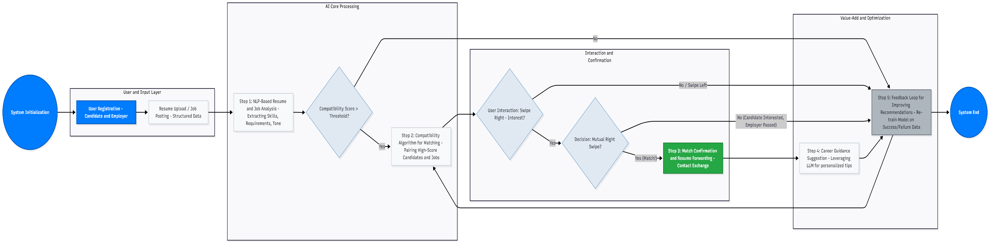
Methodology Flowchart

Slide 13
Hardware Requirements
Development PC: i5/ Ryzen 5+, 16 GB RAM, 512 GB SSD, Windows/macOS/Linux
Testing Devices: Android 10–14, iPhone 11+ (iOS 16+)
Backend (Server): 4–8 cores CPU, 8–32 GB RAM, 100–500 GB SSD

Slide 14
Software Requirements
Frontend: Android/iOS or Flutter; swipe UI, login & profiles
Backend: Node.js/Python + PostgreSQL/MongoDB; REST APIs; secure login
Compatibility: Resume parsing, matching algorithm, career guidance
Cloud & Tools: AWS/GCP/Azure; Android Studio/Xcode; Git; testing tools

Slide 15
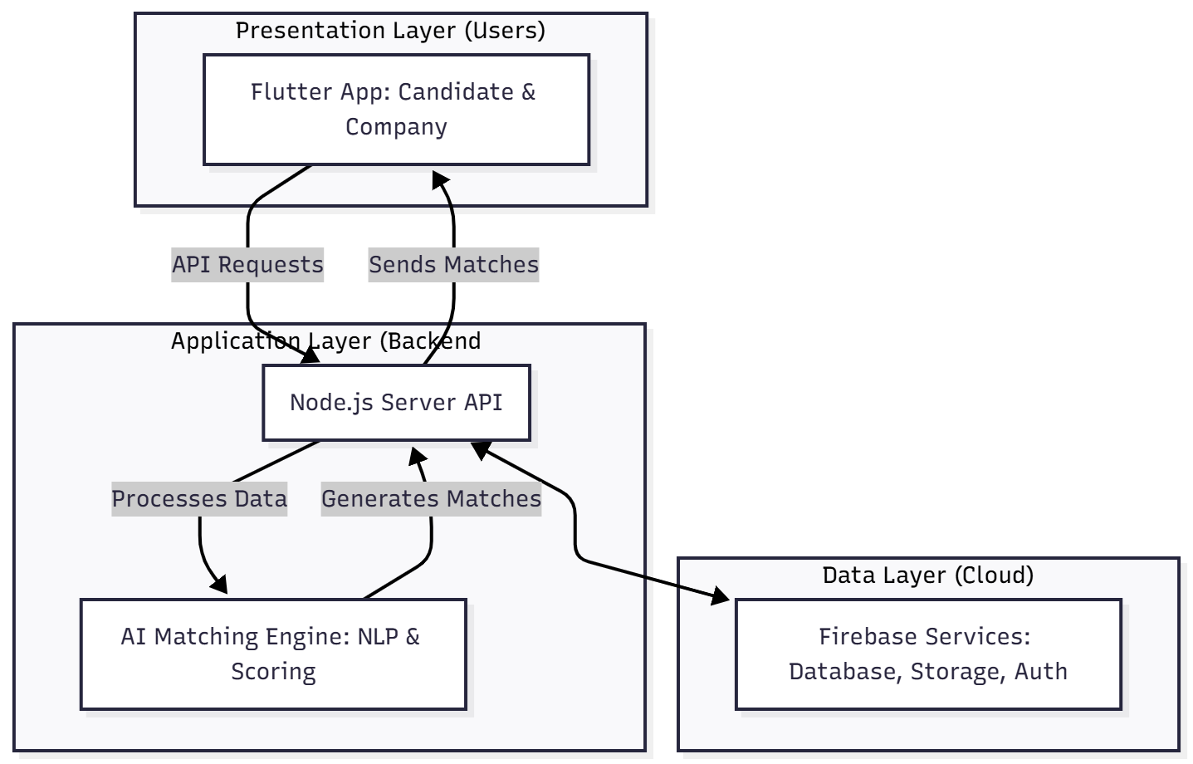
Process / Flow / Design Diagram

Slide 16
Proposed Modules
User Module (Candidates): Swipe, resume upload, career guidance.
Employer Module: Swipe candidates, job posting, profile filtering.
Compatibility Module: Embedding-based AI matching.
Career Guidance Module: Upskilling suggestions.
Database Module: Resume & job storage

Slide 17
Novelty of the Proposed Idea / Project
Combines swipe-based recruitment with AI compatibility scoring.
Includes career guidance, bridging the gap for underqualified candidates.
Ensures fairness and transparency in recruitment.
Designed to be scalable and mobile-first.

Slide 18
Conclusion
The proposed system introduces a swipe-based recruitment platform that simplifies the hiring process for both candidates and employers.
AI-based compatibility scoring helps match candidates with suitable job opportunities more efficiently.
The system enables real-time interaction and communication between matched users through integrated chat functionality.
By combining modern UI design with intelligent matching, the platform improves user engagement and recruitment efficiency.
This approach demonstrates how technology can transform traditional recruitment into a faster and more interactive experience.

Slide 19
References
Authors, Year, Title of the Paper, Journal / Conference, Volume and Page Details, DOI (Samples are given below)
Kong, W., & Agarwal, P.P. (2020). Chest imaging appearance of COVID-19 infection. Radiology: Cardiothoracic Imaging, 2(1).
Li, Y., & Xia, L. (2020). Coronavirus Disease 2019 (COVID-19): Role of chest CT in diagnosis and management. American Journal of Roentgenology, 1–7.
Mooney, P. (2020). Kaggle chest x-ray images (pneumonia) dataset, https://github.com/ieee8023/covid-chestxray-datase
Parnian Afshar., Shahin Heidarian., Farnoosh Naderkhani., Anastasia Oikonomou., Konstantinos, N. Plataniotis., & Arash Mohammadi. (2020). COVID-CAPS: A capsule network-based framework for identification of COVID-19 cases from X-ray images, Pattern Recognition Letters, 138, 638–643
Singhal, T. (2020). A review of corona virus disease-2019 (COVID-19). Indian Journal of Pediatrics, 87, 281– 286.

Slide 20
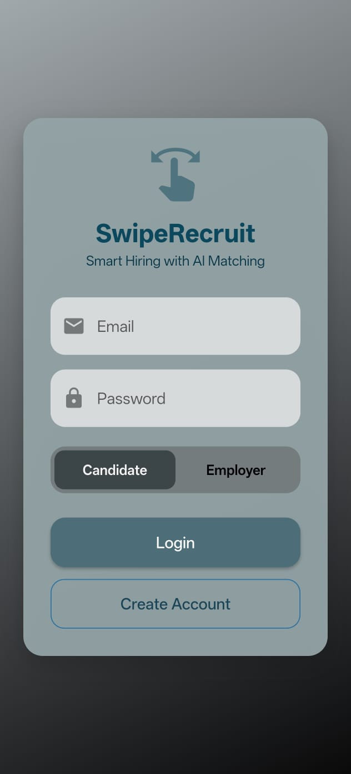
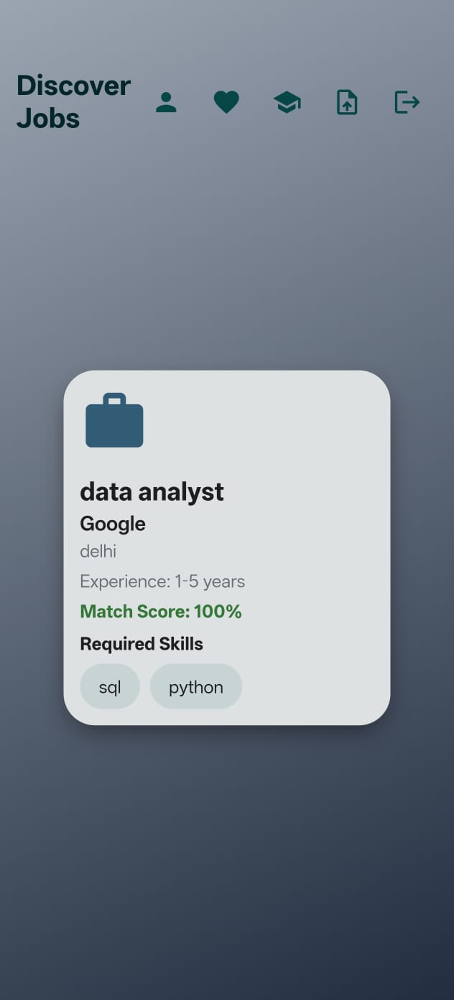
Implementation
1.User Authentication System
• Email & Password based authentication • Role selection (Candidate / Employer) • Firebase Authentication integration • Secure login & session handling
2.Candidate Swipe Interface
• Real-time job feed from Firestore • Swipe right = Like job • Swipe left = Reject job • Compatibility score calculated via NLP logic • Mutual like creates a match

Slide 21
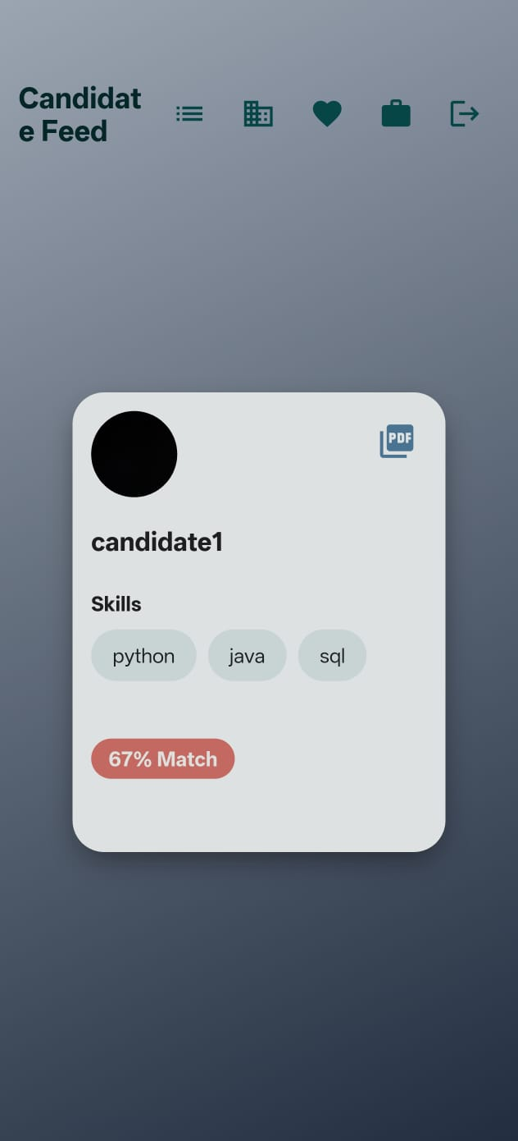
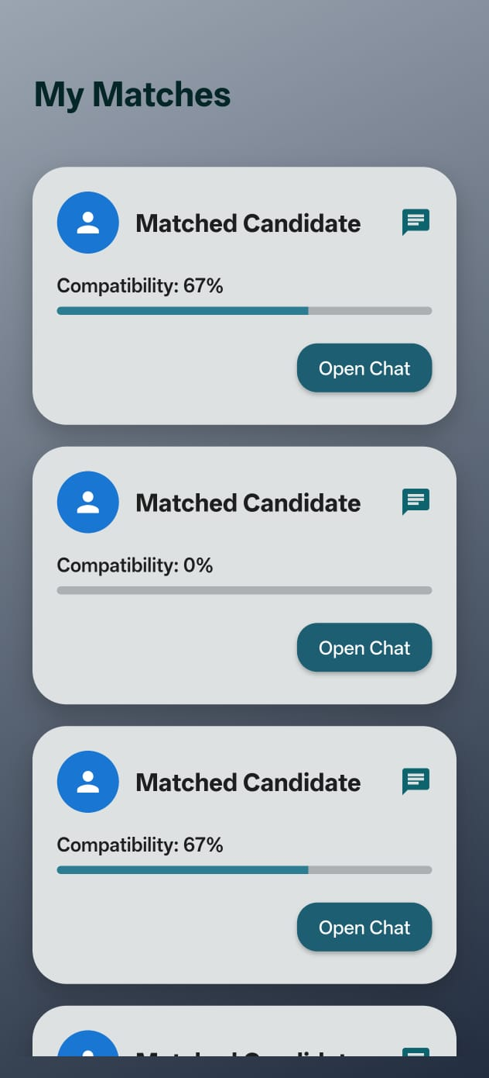
3.Employer Swipe Interface
• Fetches candidate profiles from Firestore • Swipe right = Shortlist • Swipe left = Reject • Mutual swipe creates match • Real-time database update
4. My Matches Screen
• Displays all mutually matched candidates and employers
• Shows compatibility score for each match
• “Open Chat” button allows real-time communication between matched users

Slide 22
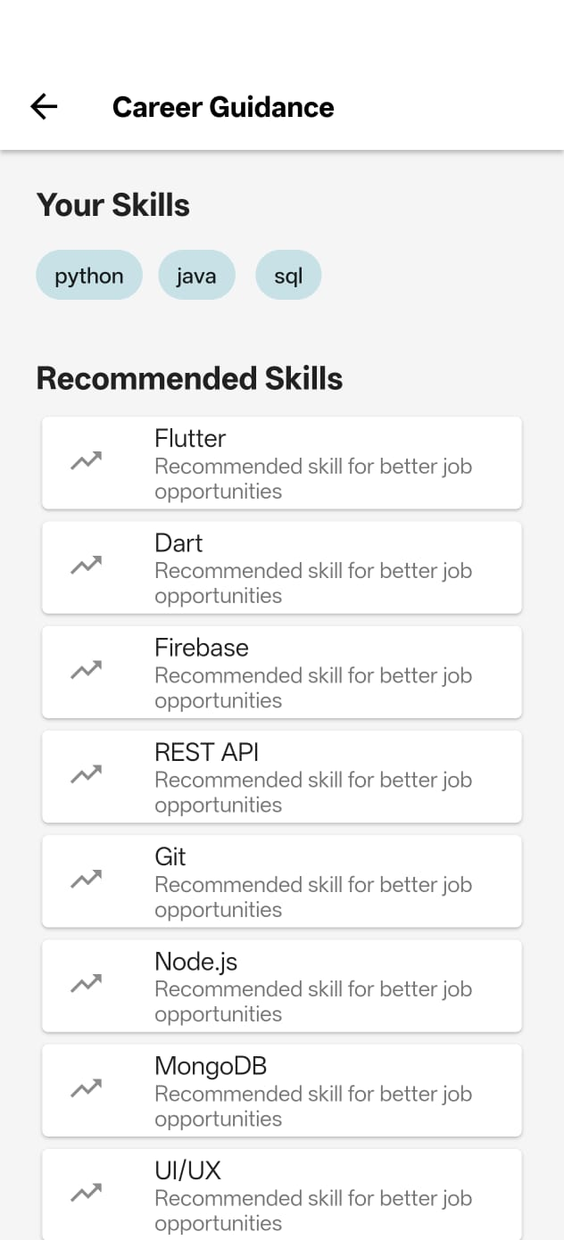

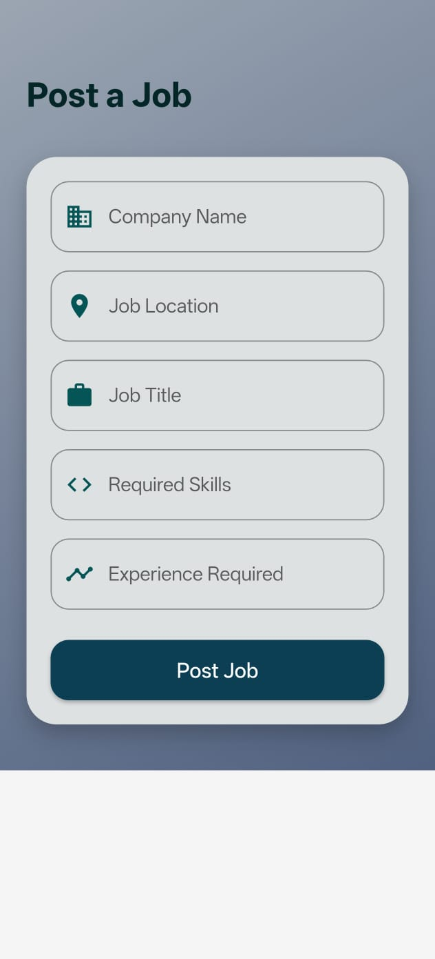
5.AI-Based Career Guidance
• Skill gap identification • Suggested learning resources • Career improvement recommendations • Future integration with NLP resume parsing
6.Resume Upload & Storage
• Resume stored in Firestore • Linked using candidateId • Timestamp stored using server time • Extendable to NLP skill extraction
7.Employer Job Posting System
• Employers can create job listings • Required skills stored as array • Experience requirement added • Stored in Firestore jobs collection

Slide 23
Survey Paper (If any)

Slide 24
Plagiarism Report

