Slide 1
Shell Bootcamp 2024 3 Reflections for Week
Achint Tiwary
Date : 30-Aug-2024

Slide 2

About Me
Life is never made unbearable by circumstances, but only by the lack of meaning and purpose. ~ Victor Frankl
Please share an image / visual that best represents you

Slide 3

My learnings from this week!

Slide 4
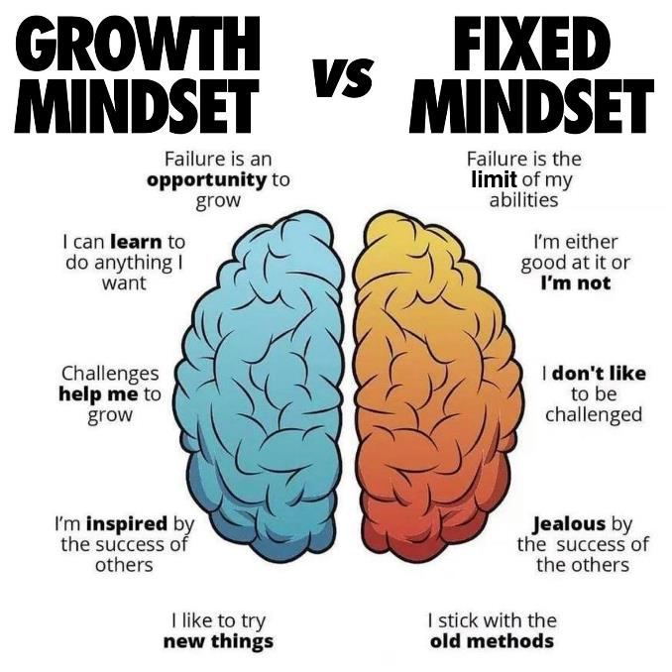
Learning 1 | My takeaways
Soft Skills Day 1: 26th August 2024
Types of performers (CART Analogy)
POWER technique
Etiquettes
Neuroplasticity (Fixed mindset Vs Growth mindset)
What is means to be a professional

Slide 5

Learning 2 | My takeaways
Soft Skills Day 2 and Day 3: 27th August 2024 to 28th August 2024.
Email etiquettes
Stakeholder management
Tucker Model
Self Orientation
Grooming
Presentation skills
Team work

Slide 6
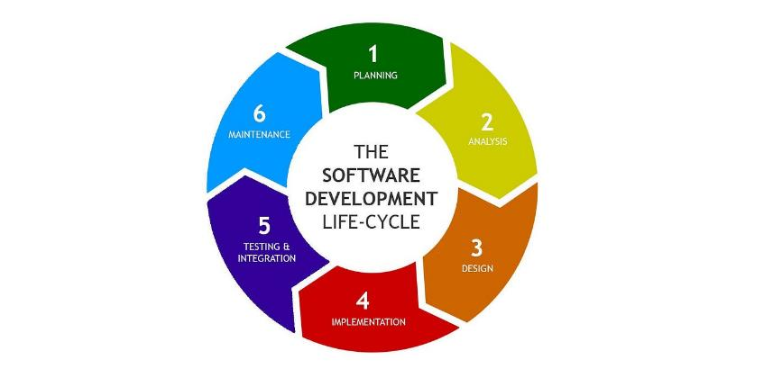
Learning 3 | My takeaways
Technical Boot Camp Day 4 and Day 5: 29th August 2024 to 30th August 2024
Business Analytics
SDLC and its models
Requirement Analysis
Requirement Management
Requirement Elicitation
[Add a graphic that provides evidence of what you learned]

Slide 7

Relevance of learnings for my organization

Slide 8
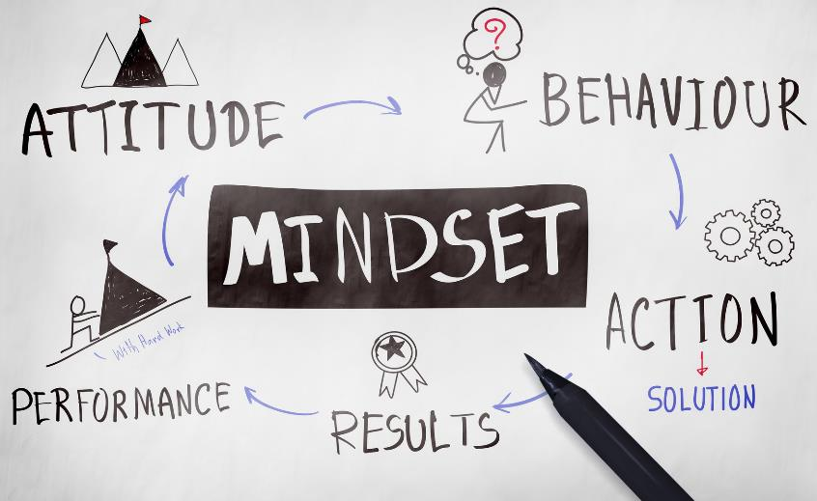
Learning 1 | Relevance for Shell
Shell can apply Day 1 learnings by using the CART analogy to identify and support top performers, while aiding others in reaching their potential.
The POWER technique could be incorporated into communication training for clarity and effectiveness. By promoting a growth mindset and professional qualities, Shell enhances employee performance, innovation, and productivity, leading to better problem-solving, increased efficiency, and a more engaged workforce, ultimately driving Shell's success
[Add a graphic that provides view of how Shell implements this learning]

Slide 9

Learning 2 | Relevance for Shell
GTKYs method held in Shell emphasizes on Shell’s communication and network capabilities. They follow a safe and open culture for everyone to feel included.
Stakeholder management is highly relevant for Shell due to the complex and multifaceted nature of its operations, which involves internal and external stakeholder.
[Add a graphic that provides view of how Shell implements this learning]

Slide 10
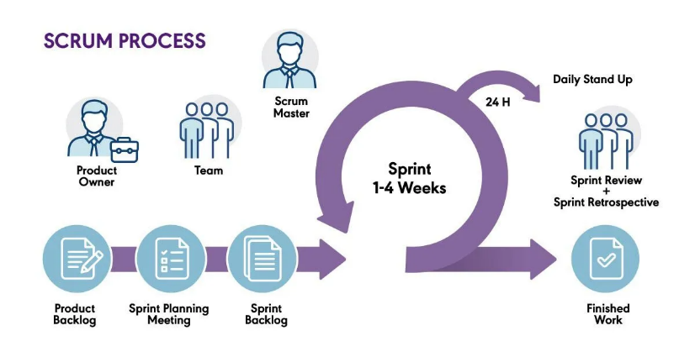
Learning 3 | Relevance for Shell
Agile methodology provides several advantages, such as cost savings, quality enhancement, faster timelines, risk reduction, greater flexibility, and ongoing improvement. According to my Team Lead, Shell uses a Scrum-based Agile approach, which greatly boosts the efficiency and effectiveness of its workflows.
The knowledge I've gained in SRS and BRD documentation will help me understand and potentially create these documents during my time at Shell.
[Add a graphic that provides view of how Shell implements this learning]

Slide 11

Challenges in implementing learning

Slide 12

Challenge faced while implementing Learning 1
Challenge faced: Interacting with other people has been a challenge for me always at the start.
Solution: Games and interactive sessions were conducted to resolve this.
https://github.com/arychin/Shell-training

Slide 13
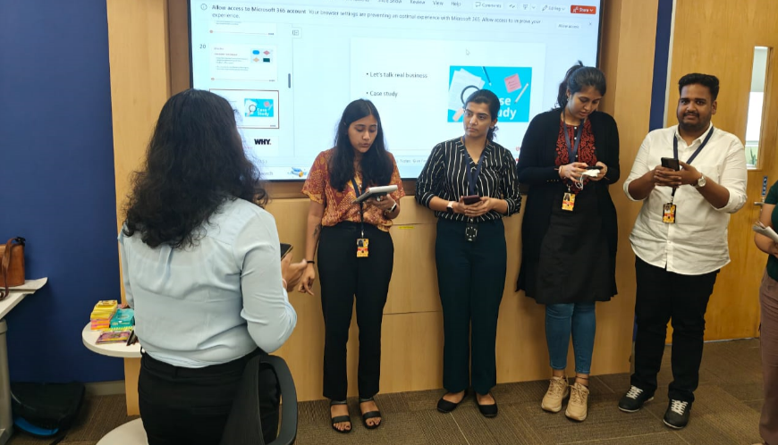
Challenge faced while implementing Learning 2
Challenge: Managing stakeholders was a difficult and somewhat uninteresting subject to tackle. The presentation activity demanded that we carefully read the material and tailor our presentations based on audience analysis.
Solution: Nitya’s engaging activities and comprehensive teaching approach made it easier to overcome these challenges.
https://github.com/arychin/Shell-training
[Add a graphic that provides evidence of what you did to overcome this challenge]

Slide 14
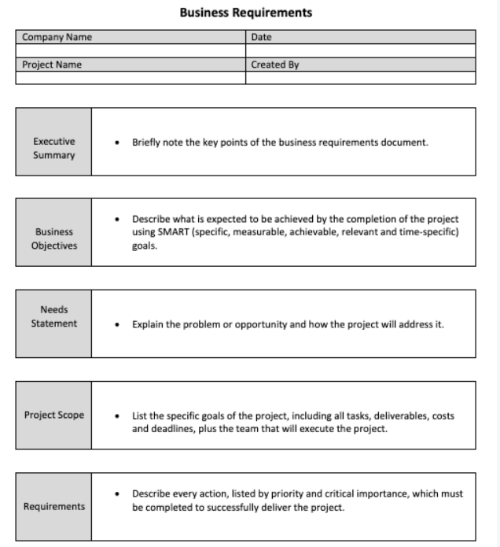
Challenge faced while implementing Learning 3
Challenge Faced: It was our first rodeo with Business Requirement Specification.
Solution: Engaging team activity to document both the SRS and BRD document made it easier to understand.

Slide 15

Action Plan

Slide 16
My Action Plan for this Week
Actions
Timeline
Status
Reading and reviewing all the notes and activities done during Soft Skills bootcamp
1. Reviewing the concepts covered in Business Analytics
Gaining a clear understanding of the Agile process and SCRUM workflow
Saturday: Brush up concepts of Business Analytics and SDLC Models.
Sunday: Go through the SCRUM framework and practice a few soft skills
Status of the same by the end of the week

Slide 17

Learning is also Fun!

Slide 18
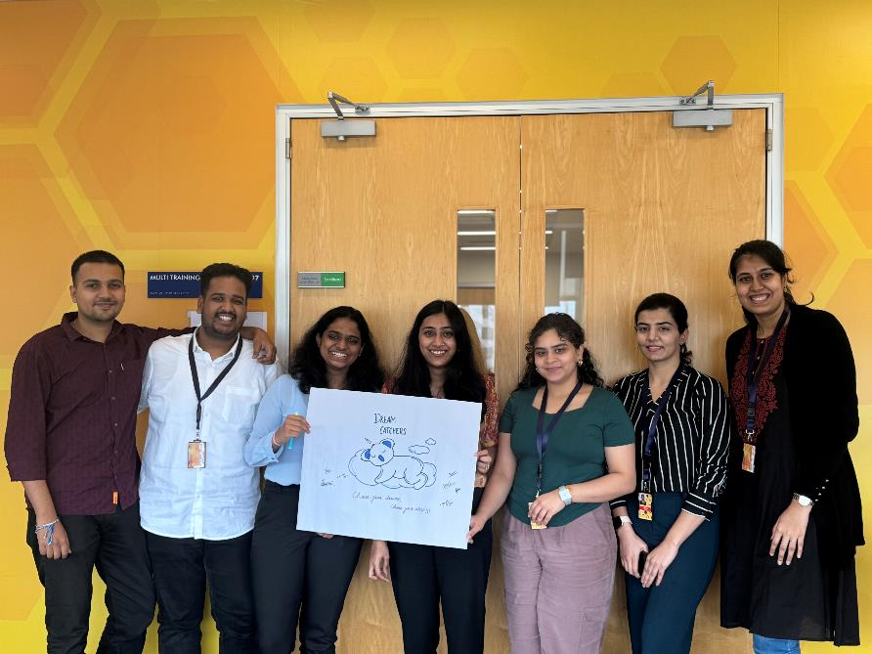
Learning is also Fun!
[Add a graphic or a picture of how you/your team enjoyed the new learning]
Nitya Ma’am's Engaging Approach: Nitya Ma’am was a lively and engaging instructor who made the soft skills sessions enjoyable and memorable. She even took the time to interact with us individually.
Creative Activity for Engagement: The activity of designing a product logo, name, and tagline centered around the theme of sleep was a clever way to shake off drowsiness and spark our interest in the topics even more.

Slide 19

Summary
Understanding Core Concepts: This week, I gained a solid grasp of critical ideas such as the Power Interest Grid, neuroplasticity, teamwork, and the essential components of delivering effective presentations. I also explored business analytics, the role of a product owner, and the Software Development Life Cycle (SDLC) and its various models. I believe this knowledge will be valuable in both my career and personal growth.
Looking Ahead: As I anticipate learning about the Scrum Agile model, gaining practical experience with Azure DevOps, and understanding testing practices, I recognize how important these topics are for my future as a Software Engineer. They are crucial for enhancing my expertise in software development.
Building on Knowledge: The insights I've gained about documentation, software models, and the functions of a Business Analyst this week have provided a strong foundation for the upcoming material. These concepts are closely linked with software engineering and will be key as I progress in my learning journey.

Slide 20
Thank You

