Slide 1
Project Presentation of IOHE
On
SarthiX
Arydeep Sah 2210991395
Gaurav Anand 2210991570
Ashish Kumar 2210991401
Harshvardhan Singh 2210991647
Supervised By: Dr. Ajay Kumar
Department of Computer Science and Engineering,
Chitkara University, Punjab

Slide 2
Introduction
2.1 Background
Absence of proper shipment distribution mechanism
Income instability for drivers
No transparent bidding mechanism
Permit expiration leads to penalties
Limited real-time shipment tracking
2.2 Problem Statement
Develop a digital driver–shipper marketplace
Introduce transparent real-time bidding system
Provide automated permit notifications
Improve compliance and operational efficiency
.
2

Slide 3
Software and Hardware Requirement Specification
3.1 Methods
SarthiX is being developed using Agile methodology — focusing on iterative development, responsiveness to change, and constant user input. The project has a number of sprints for design, development and testing of separate system modules like user authentication, enabled bidding management or shipment tracking, permit notification system. This continuous integration and testing help assure the reliability and scalability of the platform.
3.2 Programming/Working Environment
Programming Language: React Javascript — Vite + React as frontend Backend & Database: Supabase (PostgreSQL backend as a service) Authentication: Clerk (Secure user authentication & role management)
Classical functionality: Define Models, (Validator) Rules and Communication by using REST API for Client- Server ↔ Interaction Architecture: Client-Server Architecture Model
3.3 Requirements to run the application
Operating System: Windows 10 / Linux / MacOS RAM: Minimum 8GB Processor: Intel i5 or equivalent Software Dependencies: Node.js, npm, Supabase configuration, Clerk setup Browser: Latest versions of Chrome, Firefox, or Safari

Slide 4
Keywords
Logistics management system, Driver–Shipper marketplace, Real-time bidding system, Shipment tracking, Permit management, Automated permit notification, Transportation technology, Web-based platform, React.js, Supabase, Clerk authentication, Client-server architecture, Role-based access control, Digital freight platform, Supply chain optimization, Compliance monitoring, Load allocation system.
4

Slide 5
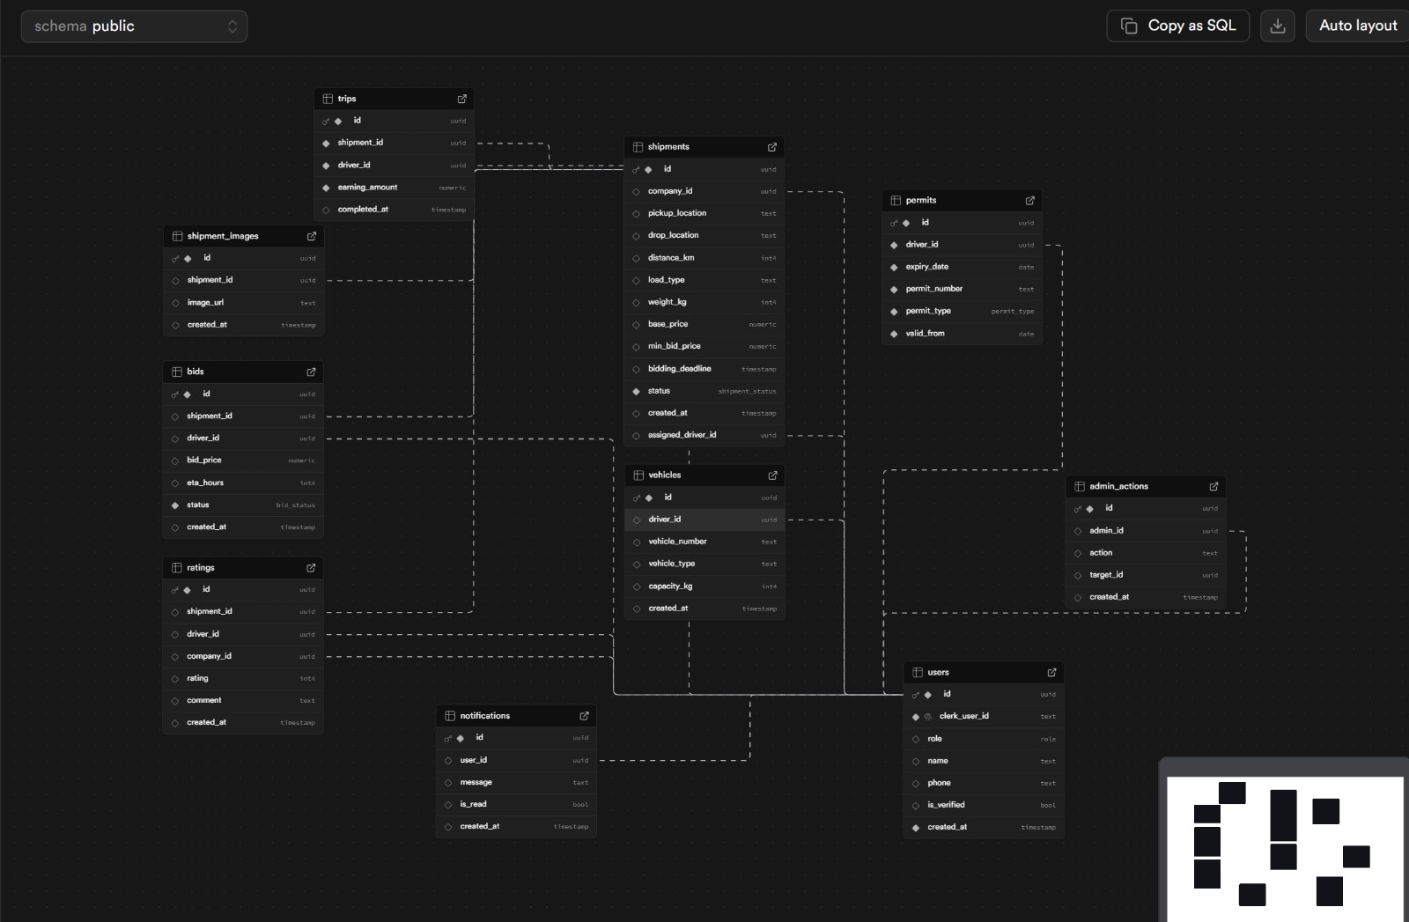
Supabase Overview

Slide 6
TECHNOLOGIES AND TOOLS
SarthiX employs a wide range of cutting-edge tools and technologies that ensure scalability, security and real-time capabilities.
React.js (with Vite): To build a highly performant, responsive & dynamic front-end. This allows drivers and shippers to easily switch between dashboards.
Supabase: you get a backend which offers you everything from PostgreSQL database, Real time data and user secure storage of users bids, shipment records and permit records.
Clerk Authenticaionit will authenticate the user securely and take care of role based access for Driver / Shipper login.
REST APIs: To efficiently communicate between front-end and back-end services while maintaining secure transmission of data.

Slide 7
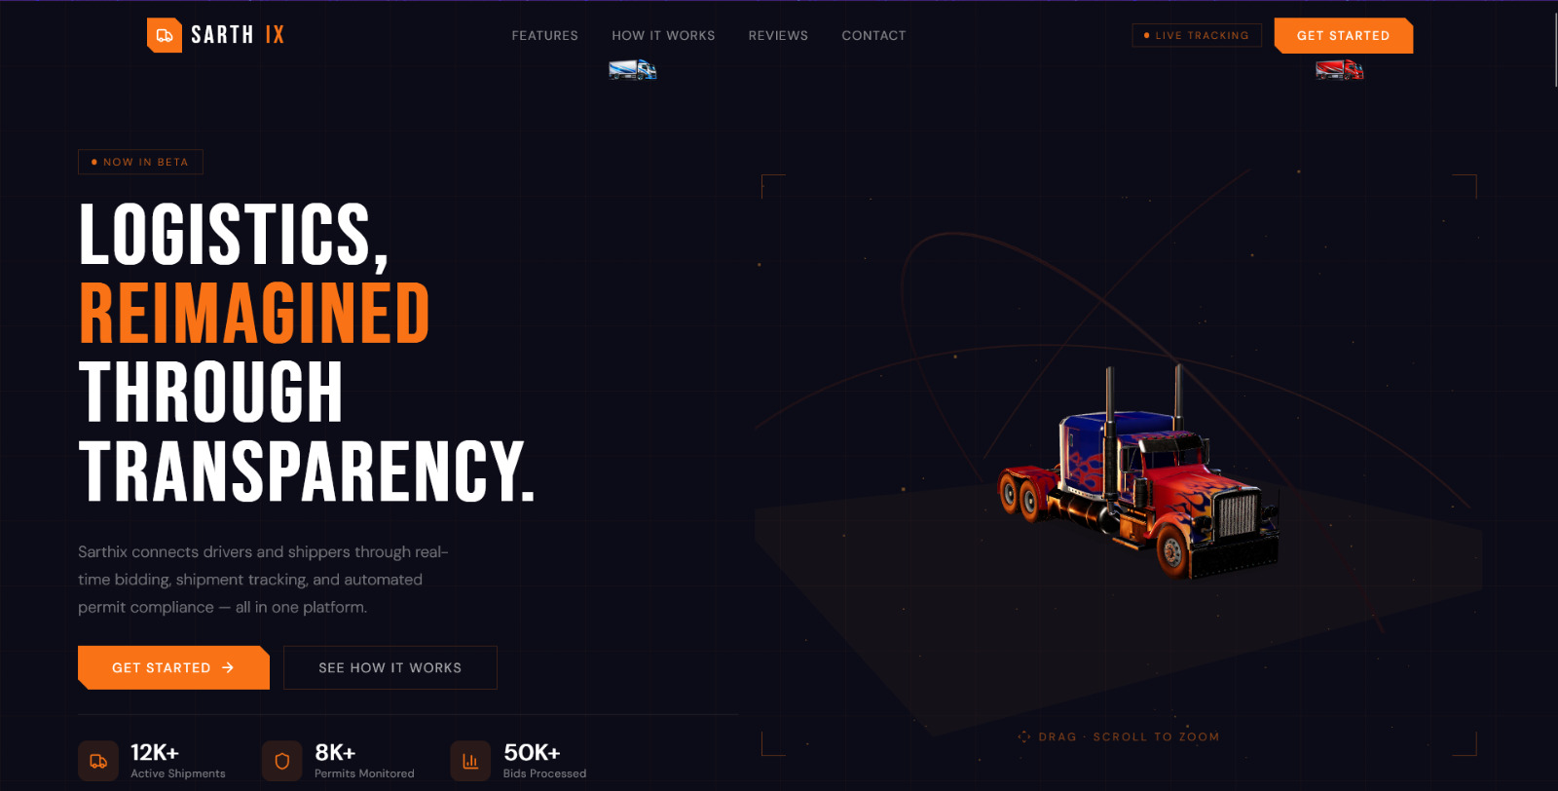
VISUAL REPRESENTATION

Slide 8
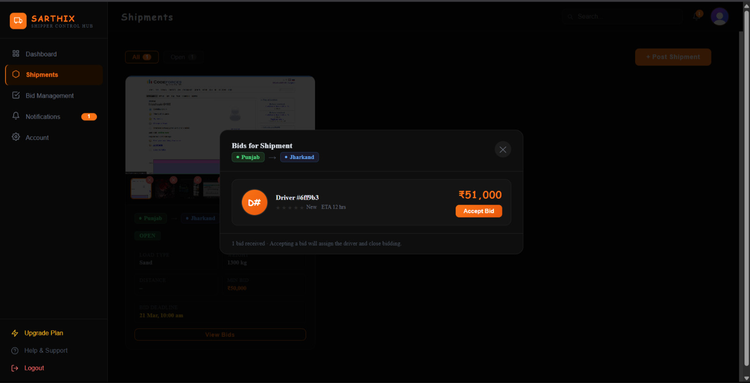
VISUAL REPRESENTATION

Slide 9
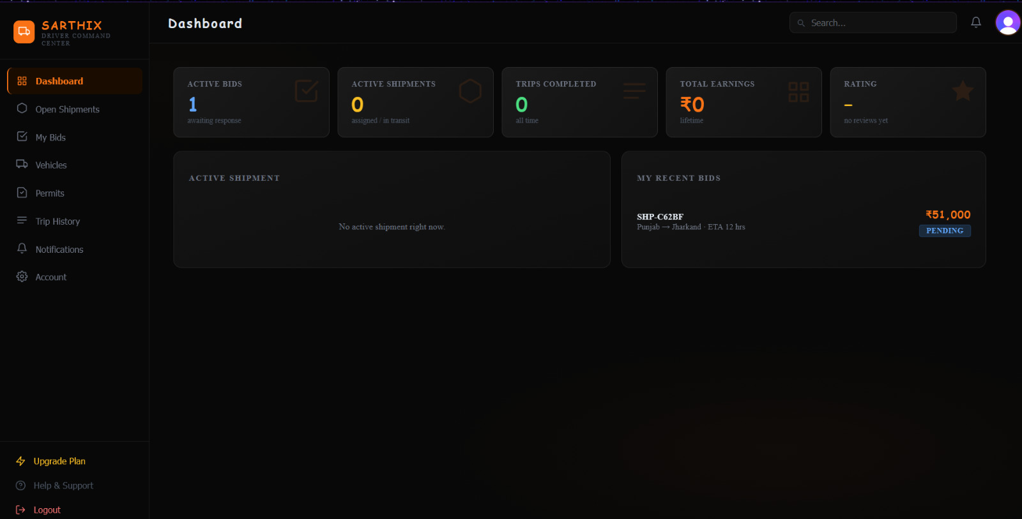
VISUAL REPRESENTATION

Slide 10
Future Scope
SarthiX has large scope to grow in future. The expanding of the platform from basic features to intelligent logistics technology and digital transportation system shall enable augmentation in operational efficiency, automation, transparency. Future improvements may include.
AI Enabled Price Recommendation: AI-driven insights to recommend ideal bidding prices based on earlier shipment records, distance, trend in fuel costs, and demand behavior.
Live GPS TrackingIntegration:Real-time immersive and accurate advanced live GPS tracking with route optimization, estimated delivery time prediction, and traffic signal-based re-routing.
In-App Communication System:Built-in chat and call functionality to enable seamless communication between drivers and shippers without relying on external platforms.
Digital Document Verification:Integration of automated document verification for permits, insurance, and licenses to reduce manual verification delays and enhance compliance.

Slide 11
Conclusion
The evolution of SarthiX is a major progress in the digital logistics and transportation management systems. The system should be able to bridge the gap between traditional freight allocation methods and modern digital marketplace solutions by integrating a real-time bidding mechanism, shipment lifecycle tracking, and automated permit compliance monitoring, all onto a web-based platform. It allows drivers and shippers to communicate with transparency, make better decisions, and execute their shipments with ease.
Using technologies like, Vite, React. Built with Node, React, TypeScript, Nextjs, Supabase & Clerk authentication; SarthiX provides a hassle-free experience for all wanting maximum scalability with optimal performance and security while achieving reliable role-based access control. Not only does the platform simplify load assignment and bidding processes and lowers your compliance risk with automated permait notifications and monitoring capabilities.
In summary, SarthiX is not a logistics marketplace at all; it is an integrated operational and compliance ecosystem that drives transparency, efficiency and trust across the transportation space. With ongoing improvements and-enabled by new technology, the platform could become a true one-stop shop for an intelligent and ubiquitous digital freights management.

Slide 12
Bibliography/References
React (Official Documentation) Meta. React – A JavaScript Library for Building User Interfaces. https://react.dev
Vite (Official Documentation) Evan You. Vite – Next Generation Frontend Tooling. https://vitejs.dev
Clerk (Authentication Platform) Clerk Inc. Clerk – Authentication and User Management. https://clerk.com/docs
Tailwind CSS (Official Documentation) Tailwind Labs. Tailwind CSS – Utility-First CSS Framework. https://tailwindcss.com/docs
Supabase (Official Documentation) Supabase Inc. Supabase – Open Source Firebase Alternative. https://supabase.com/docs
Supabase Storage (Bucket Service) Supabase Inc. Supabase Storage – File & Object Storage. https://supabase.com/docs/guides/storage
Express.js (Official Documentation) OpenJS Foundation. Express – Fast, Unopinionated Web Framework for Node.js. https://expressjs.com
PostgreSQL (Official Documentation) PostgreSQL Global Development Group. PostgreSQL – Advanced Open Source Relational Database. https://www.postgresql.org/docs

Slide 13
Thank You
13

