Slide 1
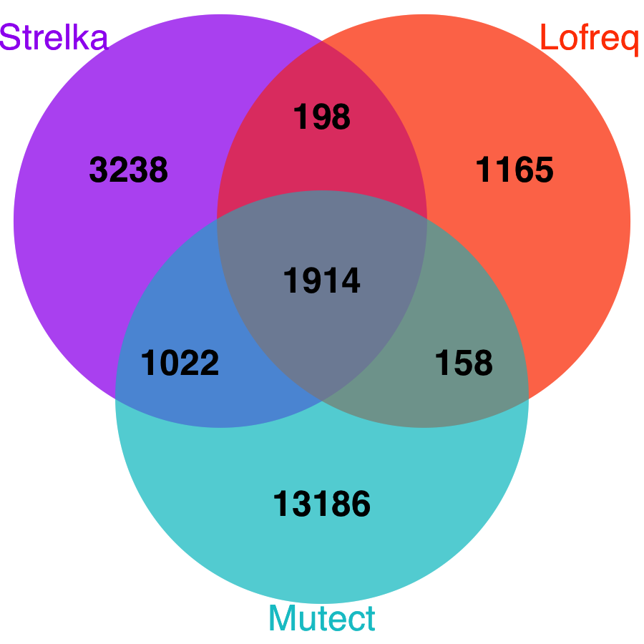

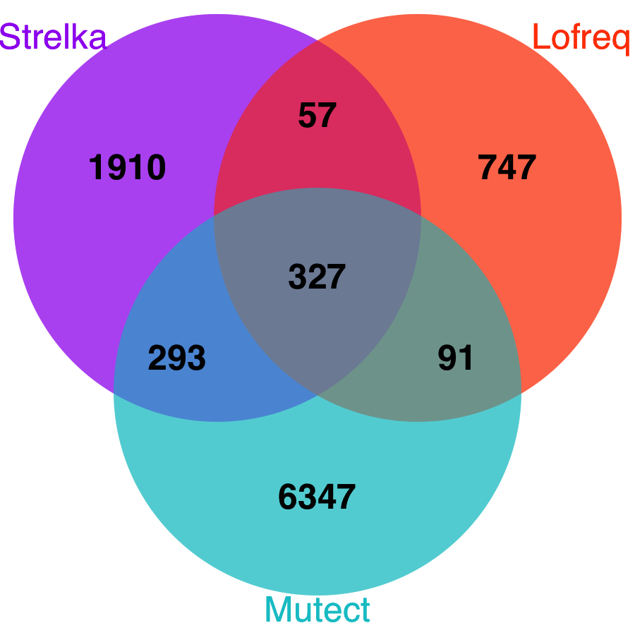

A
F03 – FVB Called Variants
F05 – FVB Called Variants
FVB – F03 Called Variants
FVB – F05 Called Variants

Slide 2
B

