Slide 1

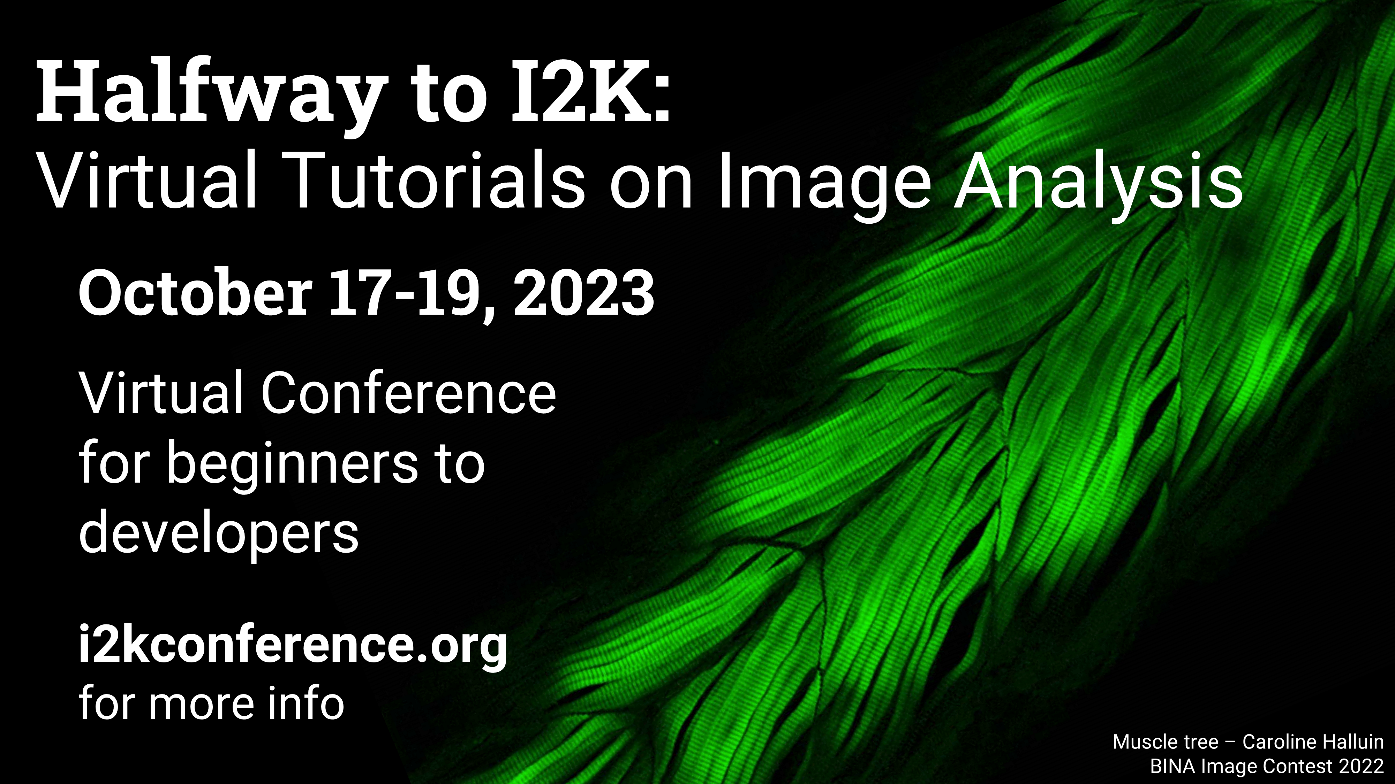

Machine Learning and Deeplearning for Dummies
Aryeh Weiss
Faculty of Engineering
Bar Ilan University
Presented at:
Anne Alerding
Department of Biology
Virginia Military Institute

Slide 2
Classical Image Processing
“Shallow” machine learning
Deep learning

Slide 3
Classical Image Processing
Noise reduction and background leveling
Filtering to enhance objects vs background
Thresholding to identify objects
Analysis based on measured properties

Slide 4
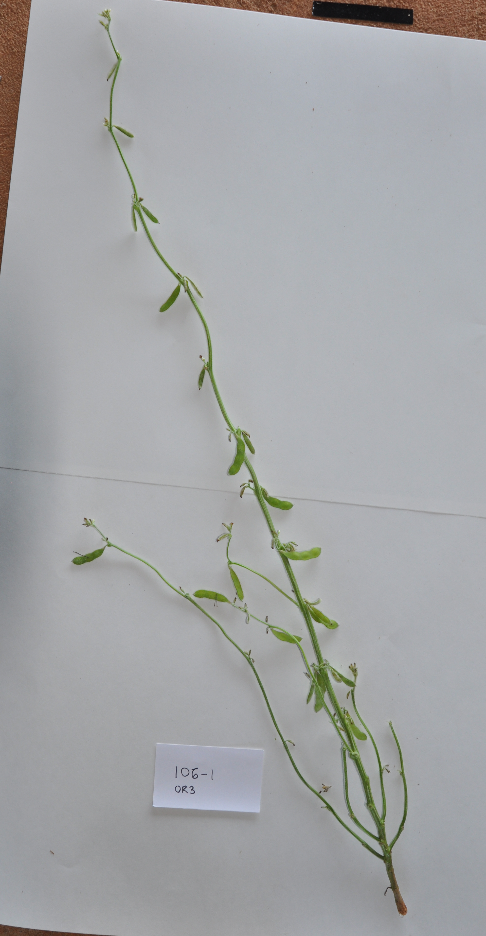
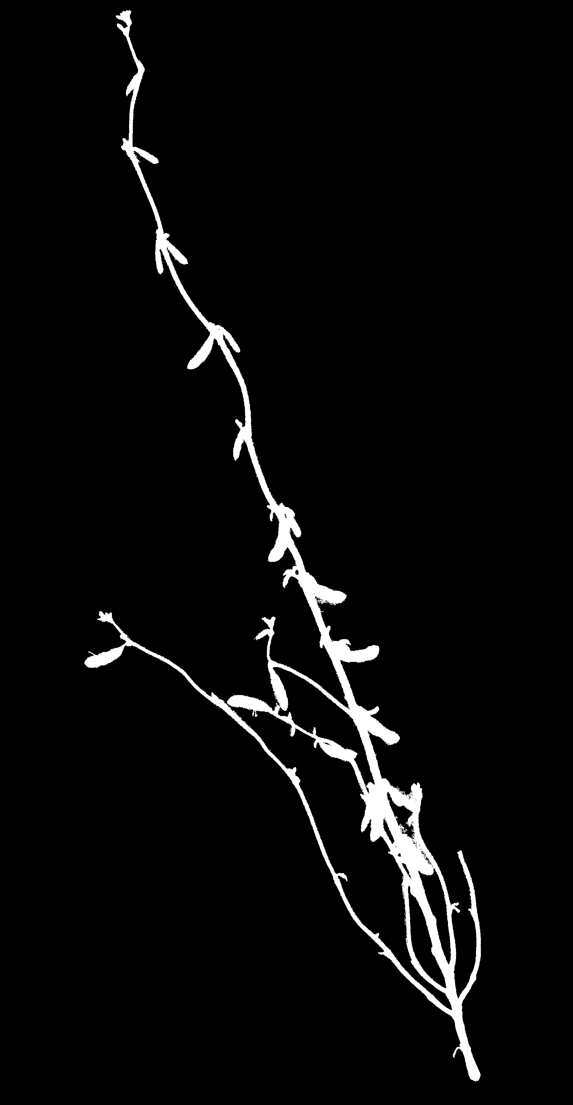
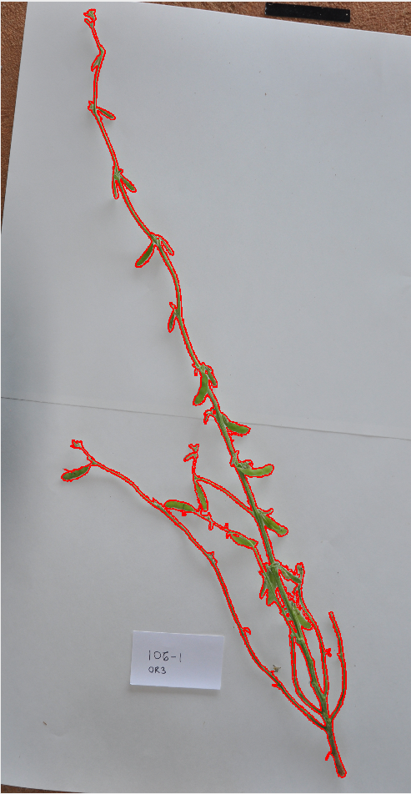
Example – segmentation of whole plant image
Original Image Segmentation Overlay of segmentation Edges

Slide 5
Elements of the workflow
Conversion to LAB colorspace
Thresholding on intensity and color dimensions
Size criteria to eliminate small artifacts
Morphological operations

Slide 6
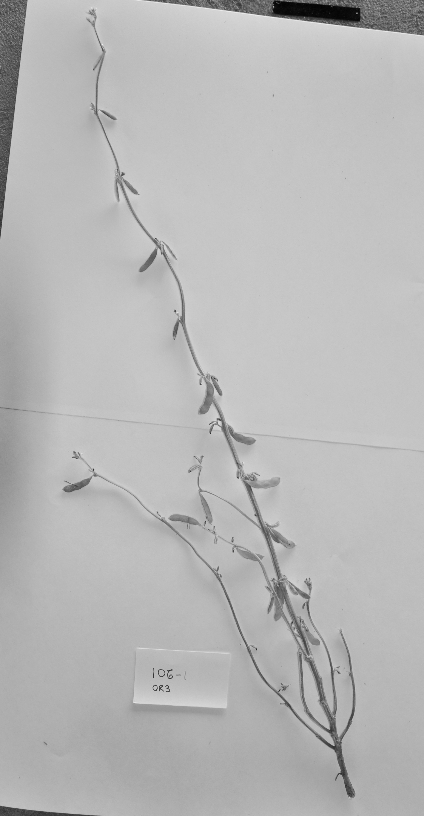
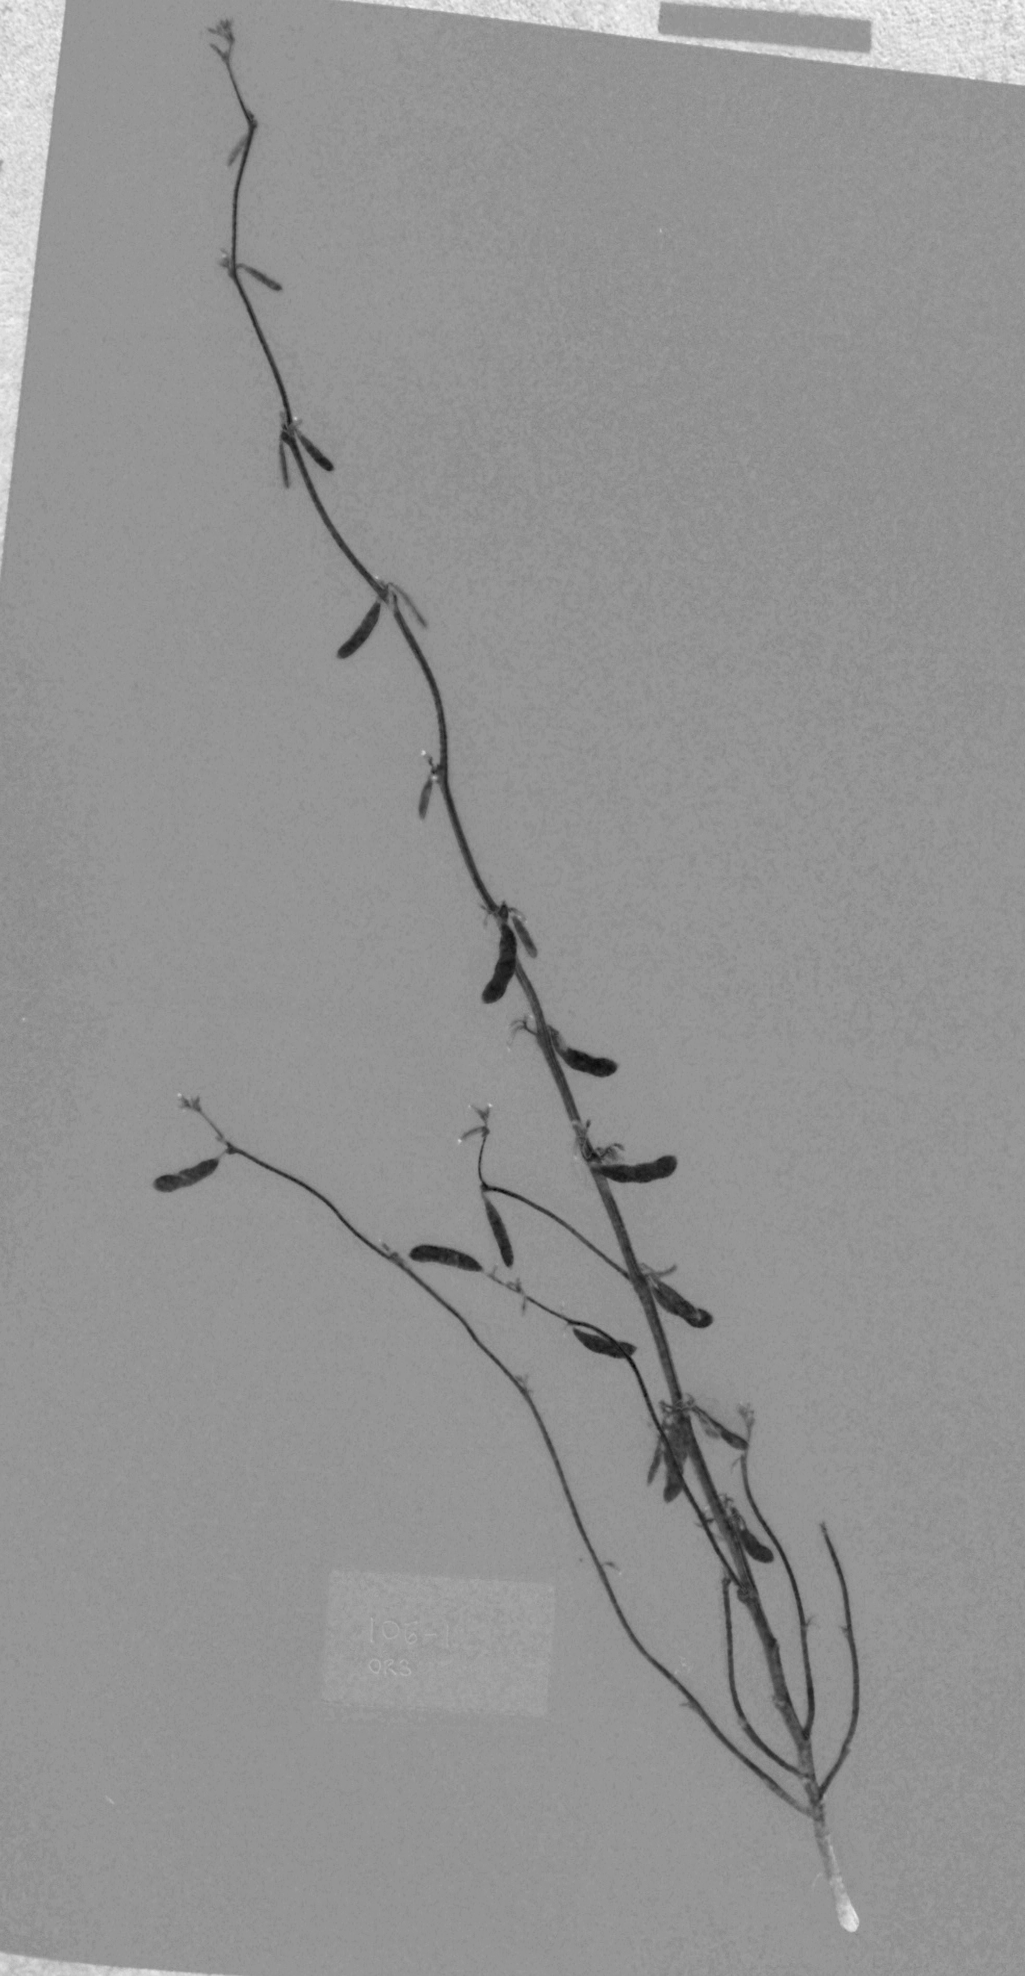
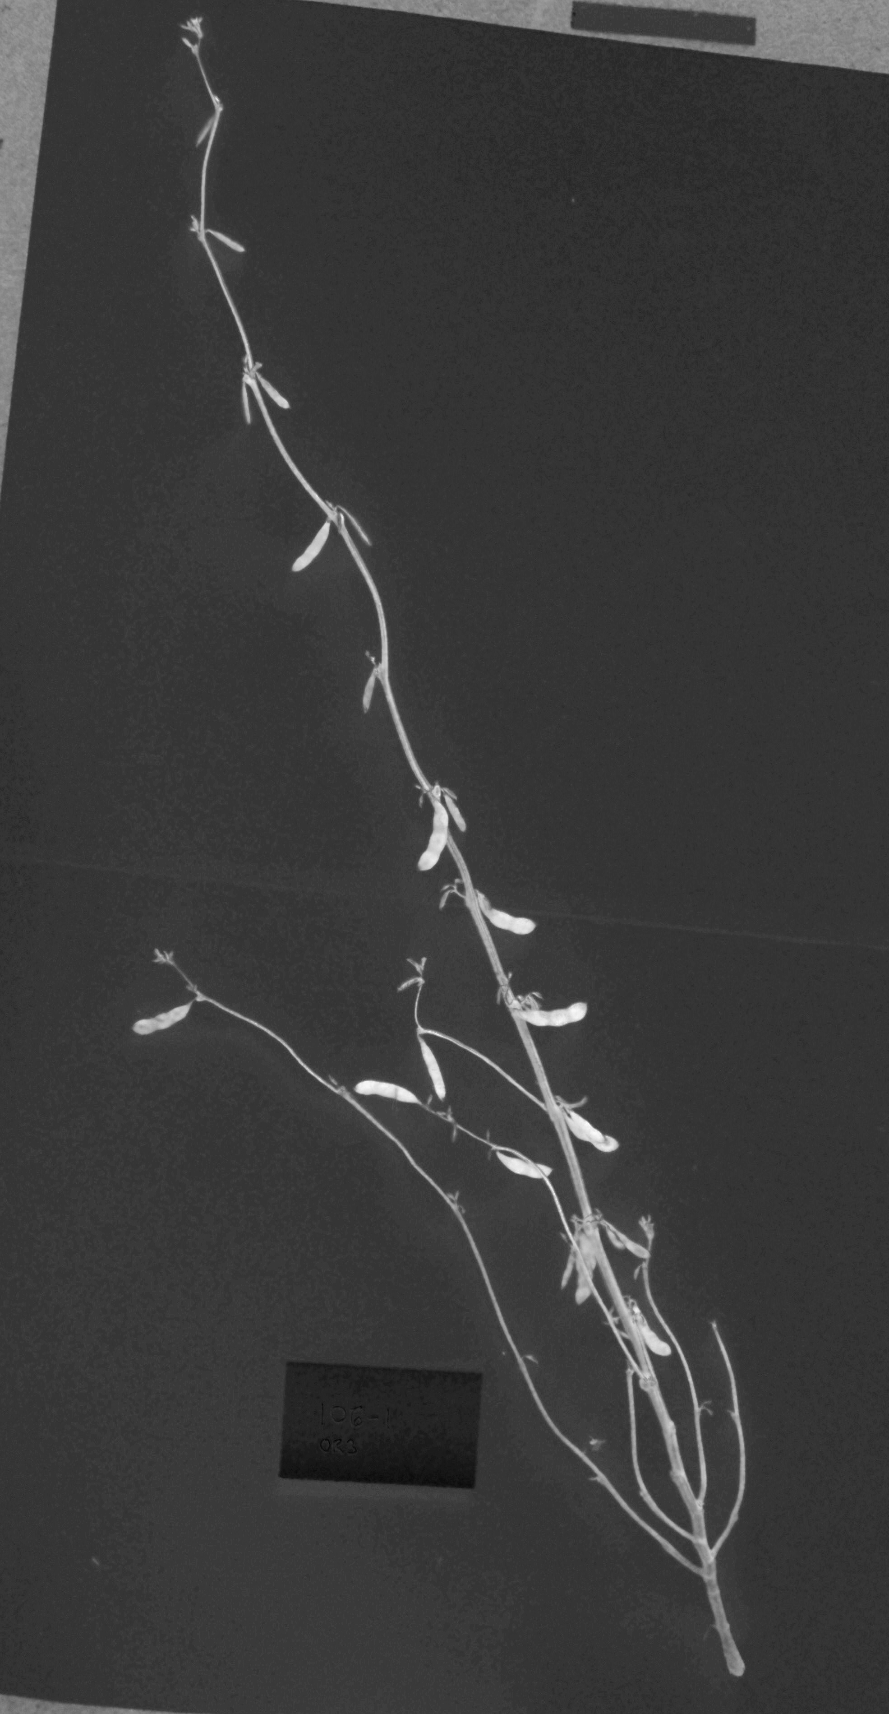
Example – conversion to LAB colorspace
Luminence a-channel b-channel

Slide 7
Limitation – how to segment pods from stems
The plant is very different from the background
– color, brightness, distinctive shape (morphology)
Pods look very much like stems.
– Thickness?
– Main stem is thick
– Some pods are thin
– Color? varies from brown to green

Slide 8
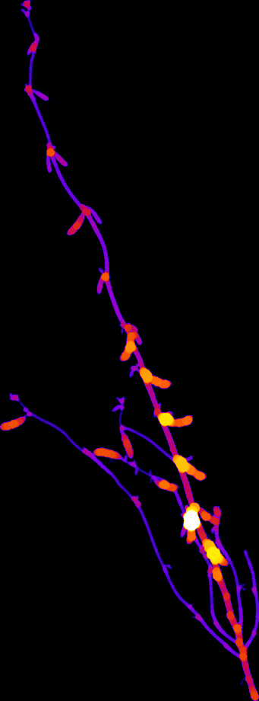
Example – heat map of minimum thickness
Heat map of minimum thickness at each point of a whole plant image.
Pods are generally thick than stems, but the main stem is thicker that some pods.

Slide 9
Machine Learning
Measure N features of each pixel.
Create a N dimensional feature space.
Cluster the points to minimize some loss function.
Examples:
– Ilastik
– Trainable Weka Segmentation (ImageJ/Fiji)

Slide 10
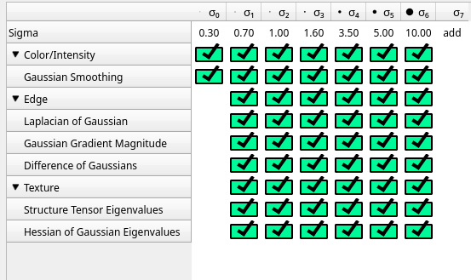
Ilastik – feature selection

Slide 11
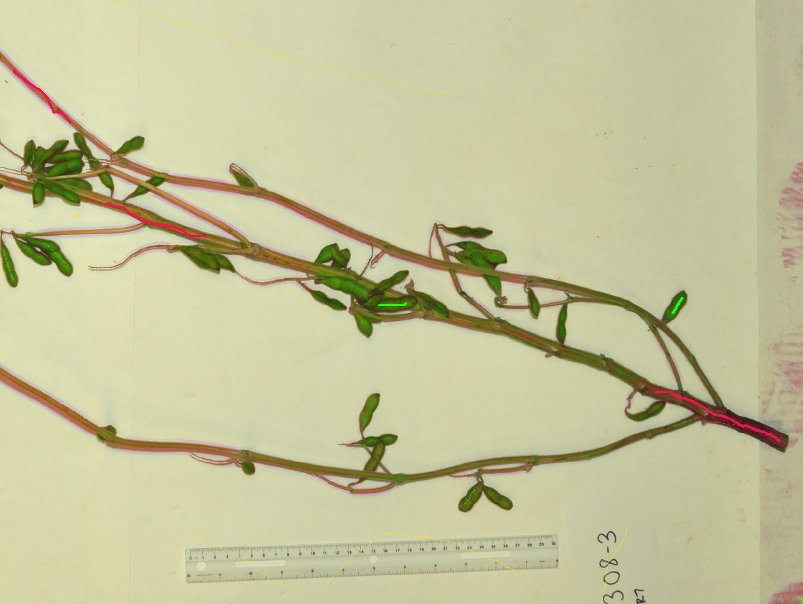
Ilastik – sparse labeling

Slide 12
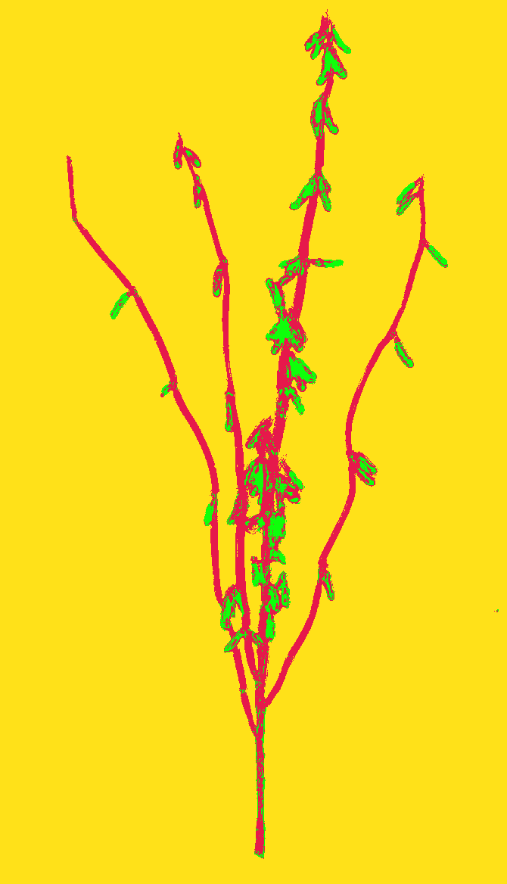
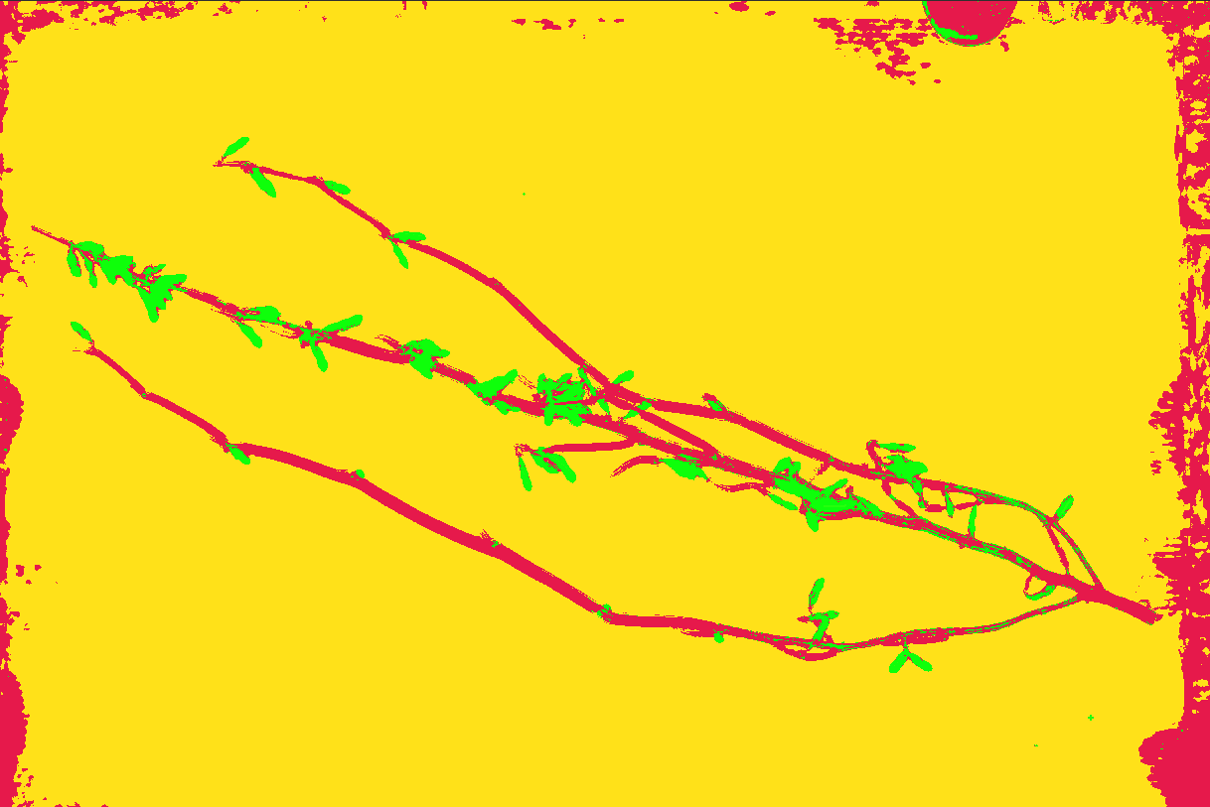
Ilastik - prediction

Slide 13
Machine Learning
Provides convenient tools for high dimensional feature spaces.
Provides decent results with relatively little annotation.
Requires prior selection of feature space.
When it works, it is reasonably simple to know what it did.

Slide 14
Deep Learning – based on neural networks
Finds the relevant features as part of the training.
Computationally intensive (especially for images)
Python libraries highly developed
– Tensorflow, Pytorch
Prepared programs – eg ZeroCOSTDL4Mic
GUI tools – eg mianalyzer, MATLAB Deeplearning toolbox
Can require a large training set.

Slide 15
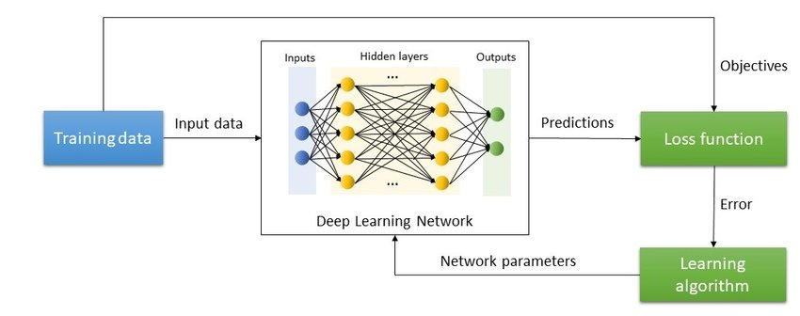
Neural networks
Many trainable parameters (can easily be millions)
Training requires serious computing power (GPU)
https://www.researchgate.net/figure/Training-process-in-Deep-Learning-algorithms_fig1_350361033

Slide 16
Convolutional NN (CNN) and Unet
Images often contain millions of pixels. A fully connected NN to process them by “brute force” would be huge, even for current computer systems.
The Unet architecture + CNNs allow semantic segmentation with a reasonably sized network.

Slide 17
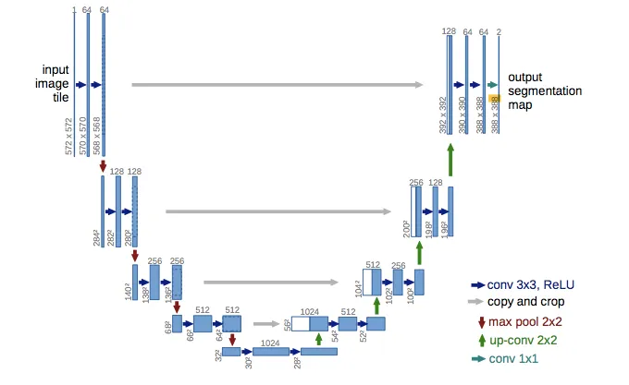
Unet Architecture
https://medium.com/coinmonks/learn-how-to-train-u-net-on-your-dataset-8e3f89fbd623

Slide 18
Why can dummies do it?
There are many free software tools (libraries, applications)
Tensorflow, Pytorch, Mianalyzer (GUI), DeepImageJ.
Microscopy Image Browser (MIB)
Serious computing power is readily available (GPU clusters, cloud computing). My laptop has an Nvidia Ti3080 with 16GB DDR6 RAM.
(Gets pretty hot!)
On-line tutorials and free courses are available.
Most important – an incredible community of developers and users who provide help in close to real time. ( image.sc and more )

Slide 19
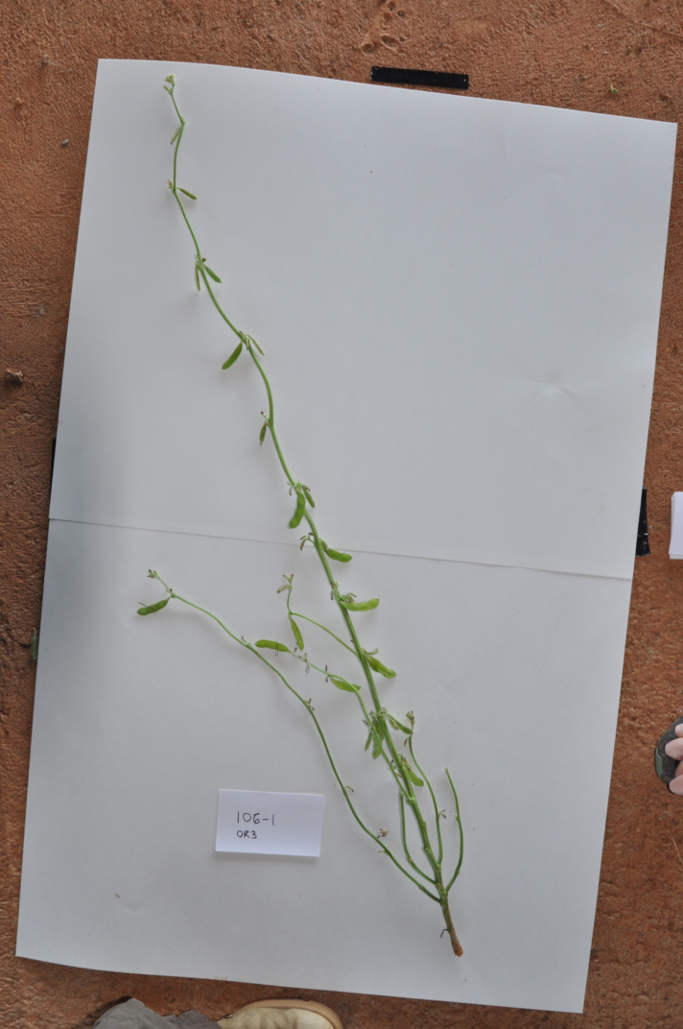
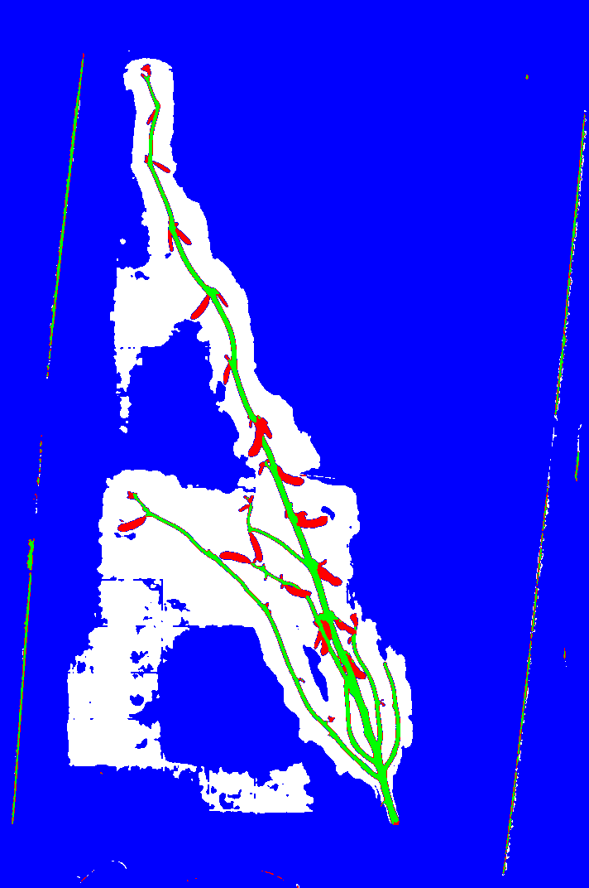
Semantic segmentation of pods and stems
NN architecture: UNET
Backbone: efficientnet b1
Training set: 30 annotated
images.
4 classes: pod
stem
background
unlabeled
Trained for 100 epochs
Used mianalyzer (headless)
Original image
LUT: white (0): unlabeled; blue (1): background; green (2): stem; red (3): pod

Slide 20
Deep learning workflow
Prepare a training set of representative images.
Annotate the images (this is the bottleneck!)
Convert the annotated images to the correct format.
train (training set, validation set)
test (test set – not to be used during training)
prediction (naive images)

Slide 21
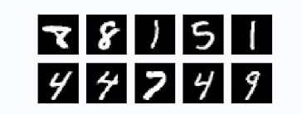
Annotation
Many tools for labeling (Labelme, ImageJ/Fiji, QuPath)
Manual labeling , Semi-automatic labeling, “Magic wand”
Semantic segmentation (pixel classification).
Requires fewer images, but annotation is harder.
Instance segmentation (classify objects or images)
Requires many images. (Example – MNIST digits)

Slide 22
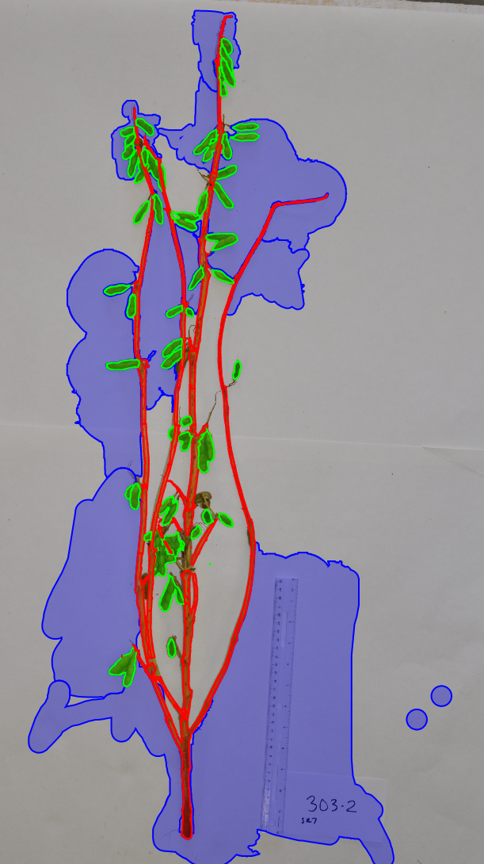
Annotation with QuPath
Why QuPath?
Because it has a convenient “magic wand” annotation mode that works nicely, and also a nice mode for erasing over filling.
Because it has a scripting capability for converting annotated images into labeled image files.
Example of an annotated image.

Slide 23
Annotated Images
Label images: set pixel values according to class
QuPath Groovy script
def imageData = getCurrentImageData()
// Define output path (relative to project)
def outputDir = buildFilePath(PROJECT_BASE_DIR, 'export')
mkdirs(outputDir)
def name = GeneralTools.getNameWithoutExtension(imageData.getServer().getMetadata().getName())
def path = buildFilePath(outputDir, name + "-labels.tif")
// Define how much to downsample during export (may be required for large images)
double downsample = 1
// Create an ImageServer where the pixels are derived from annotations
def labelServer = new LabeledImageServer.Builder(imageData)
.backgroundLabel(0, ColorTools.WHITE) // Specify background label (usually 0 or 255)
.downsample(downsample) // Choose server resolution; this should match the resolution at which tiles are exported
.addLabel('bg', 1) // Choose output labels (the order matters!)
.addLabel('pod', 2)
.addLabel('stem', 3)
.multichannelOutput(false) // If true, each label refers to the channel of a multichannel binary image (required for multiclass probability)
.build()
// Write the image
writeImage(labelServer, path)

Slide 24
mianalyzer for semantic segmentation
mianalyzer is a GUI application that allows the user to choose a NN architecture and backbone, set training parameters, train and predict.
Written by Nils Koerber (who is very helpful) https://www.biorxiv.org/content/10.1101/2022.01.14.476308v1
Help is available on image.sc , tag mia
We will describe an mianalyzer based workflow.

Slide 25
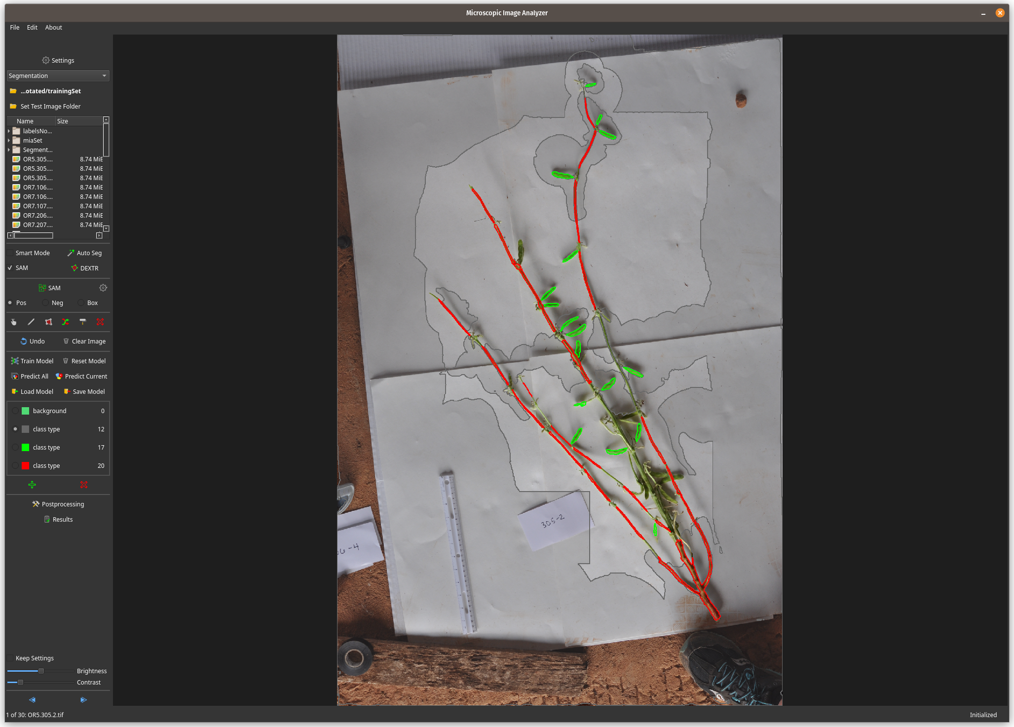

Slide 26
Labeled images and NPZ files
mianalyzer requires NPZ files that encode contours.
Nils Koerber wrote a script that converts label-images to the NPZ files that mianalyzer requires for training.
The result is a set of NPZ files that provide the ground truth.
These will reside in a subdirectory called Segmentation_labels.
A multiclass conversion script to convert label images to NPZ images can be found here:
https://github.com/aryehw/miaHeadless/tree/master/mia/multiclass_conversion
The labeling workflow:
– Annotate images in QuPath
– Save annotated images as pixel-labeled images
– Convert labeled images to NPZ

Slide 27
Training and Prediction
Select the training directory.
Select NN architecture, backbone, epochs, learning rate, etc.
Train
Predict
Save predictions and model.

Slide 28
Remote operation
NN training is very compute intensive. It requires a GPU with at least 12GB of RAM (for my problem)
mianalyzer is a GUI application, which uses the X-windows system. This is too slow to run over a remote network (screen update is too slow).
However, mianalyzer was not meant to run headless.
Nils Koerber (author of mianalyzer) provided a basic script that allows headless operation of the training phase.
We adapted this script to carry out training and prediction from a Python script.
This script is available on a Github site:
https://github.com/aryehw/miaHeadless/tree/master/mia
We can also run the training on a Lenovo P1 Gen 5 Extreme laptop computer with a
Nvidia Ti3080 GPU with 16 GB DDR6 RAM. A cooling stand is recommended for long training runs.

Slide 29
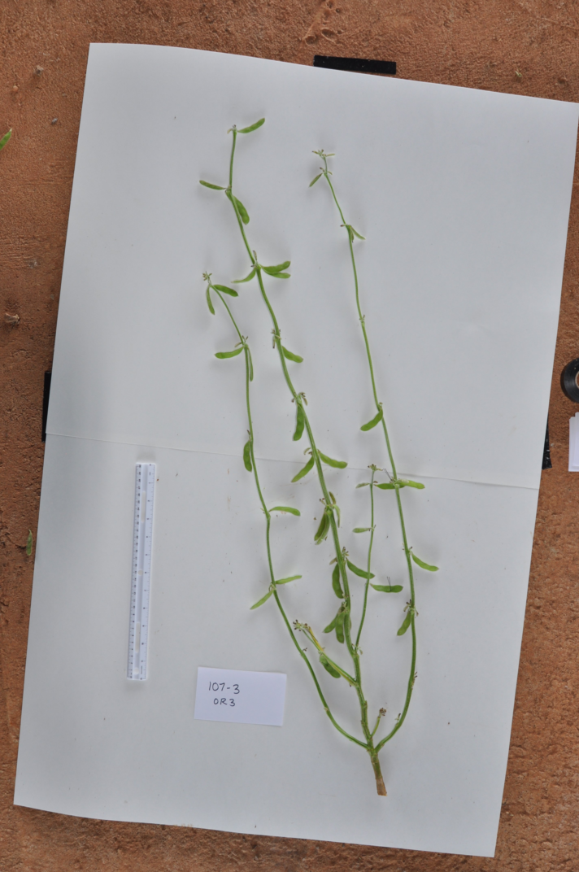
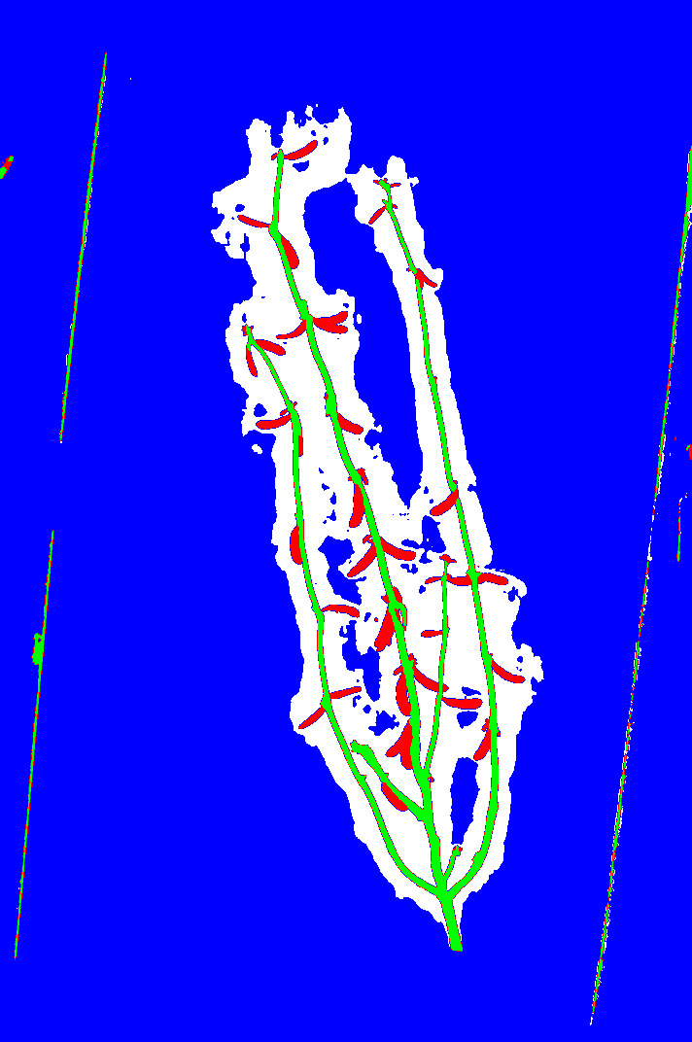
Results – Unet with efficientnetb1
Harvest 1 OR5 9 Aug 17

Slide 30
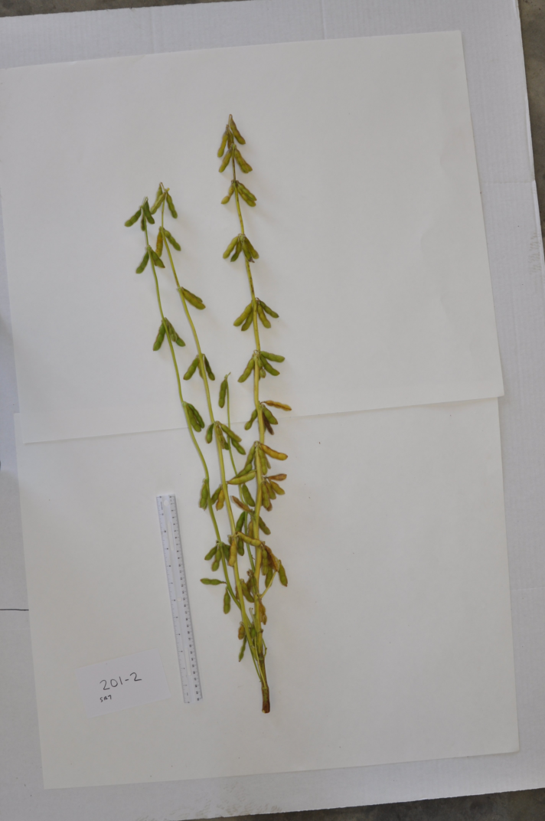
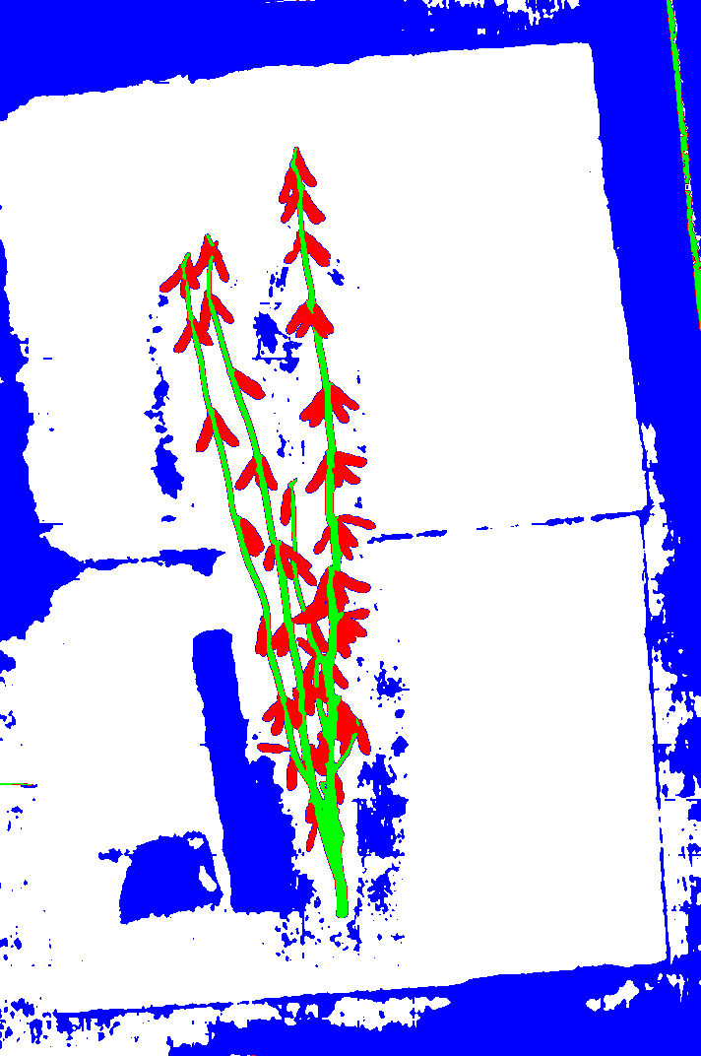
Results – Unet with efficientnetb1
Harvest 4 SR7 6 Oct 17

Slide 31
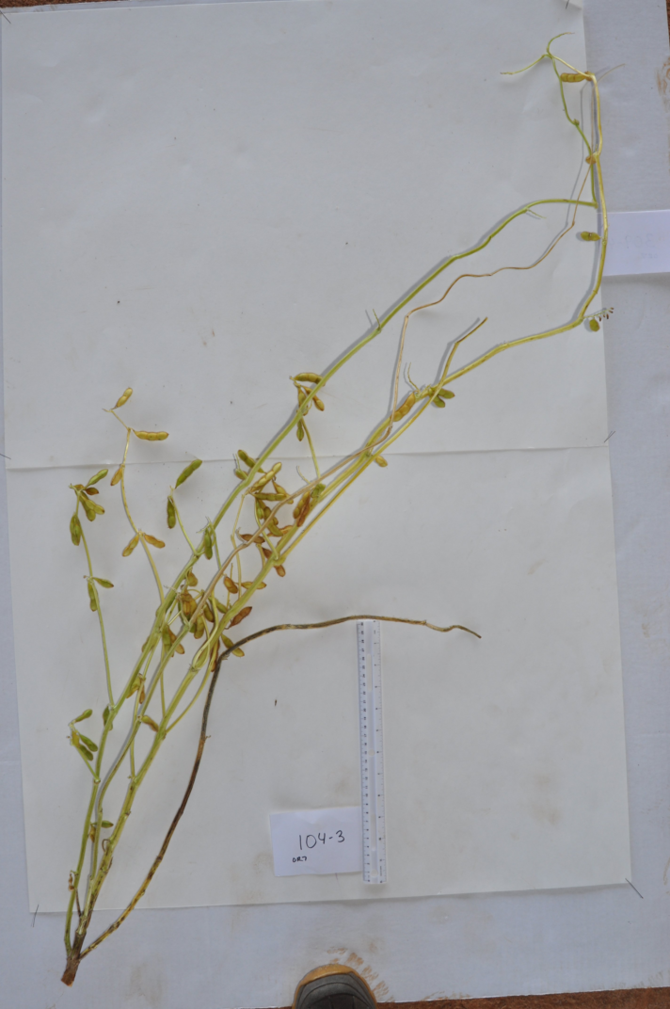
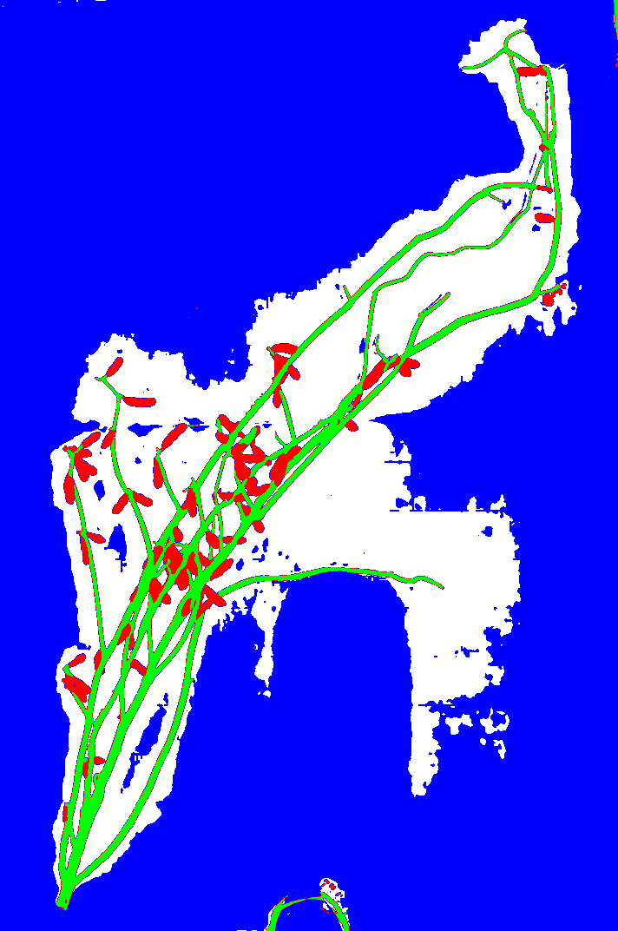
Results – Unet with efficientnetb1
Harvest 8 OR7 5,7 Oct 17

Slide 32
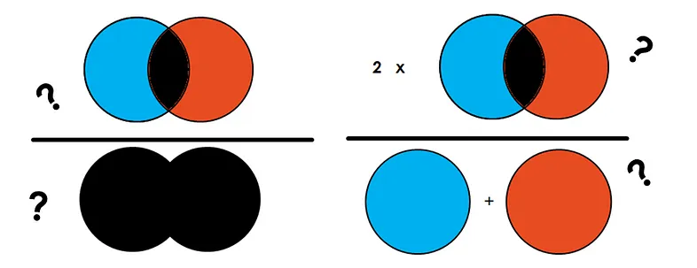
Evaluation of Results
Intersection over Union (IoU) Dice coefficient
Both of these metrics range from 0 (completely wrong) to 1 (completely correct)
An annotated test set is required to calculate the metrics.
There are other metrics (precision, accuracy, etc). These are probably better for classification problems.
https://towardsdatascience.com/metrics-to-evaluate-your-semantic-segmentation-model-6bcb99639aa2

Slide 33
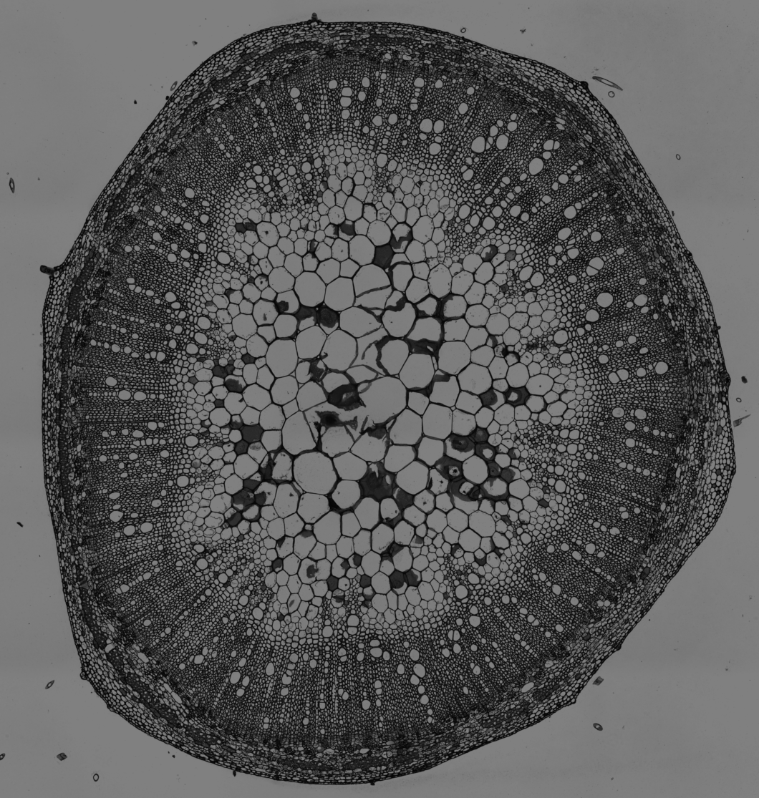
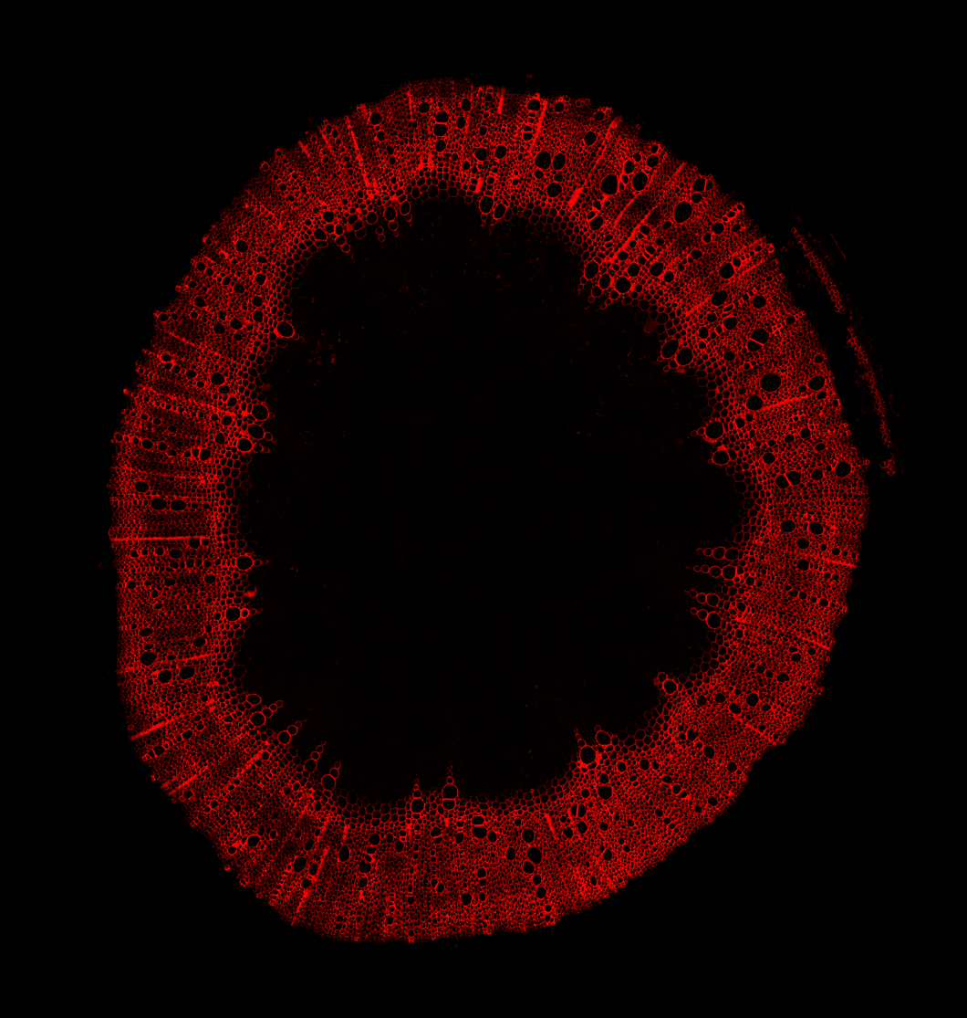
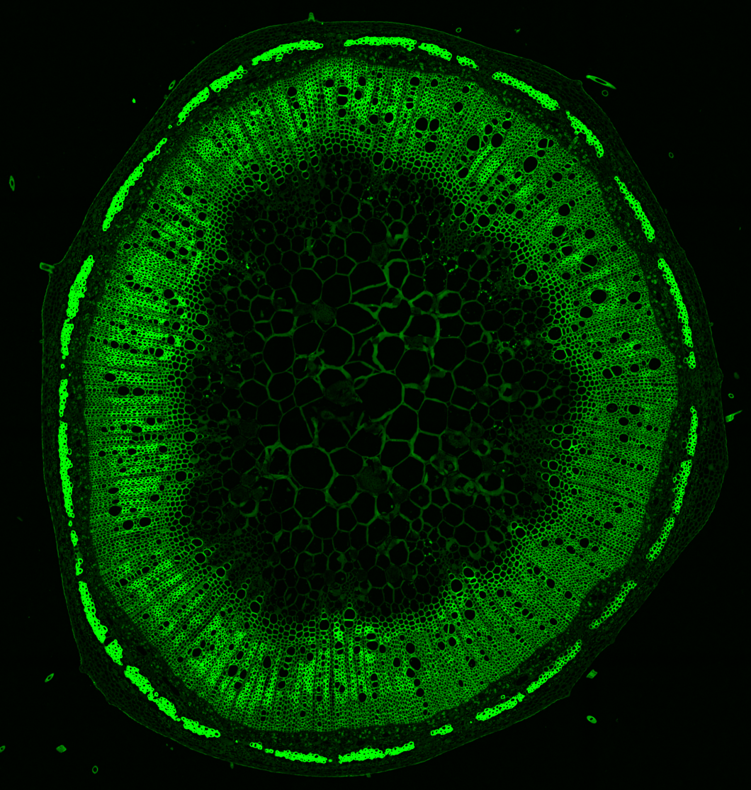
More segmentation problems
Transmitted light Xylem Cellulose
(safranin) (fast green)

Slide 34
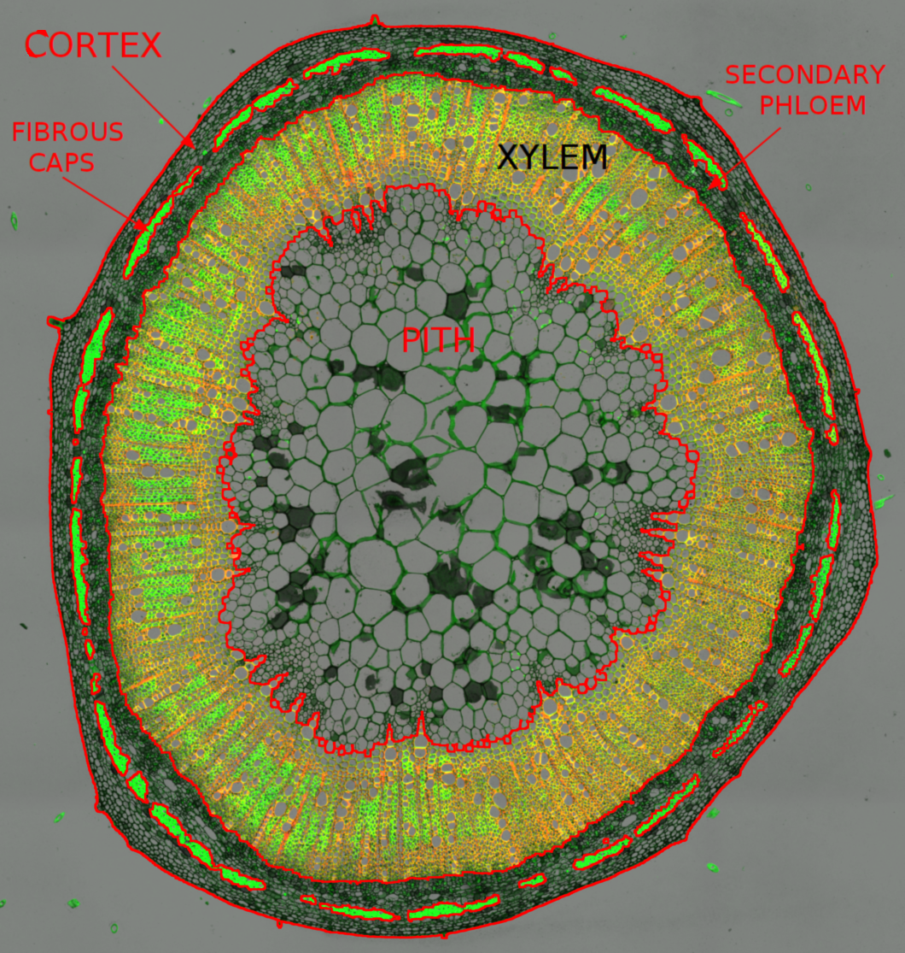
Segmentation of stem section (classical)
Segmented stem section.
Pith, Xylem, Phloem caps.
Problem: segment secondary phloem

Slide 35
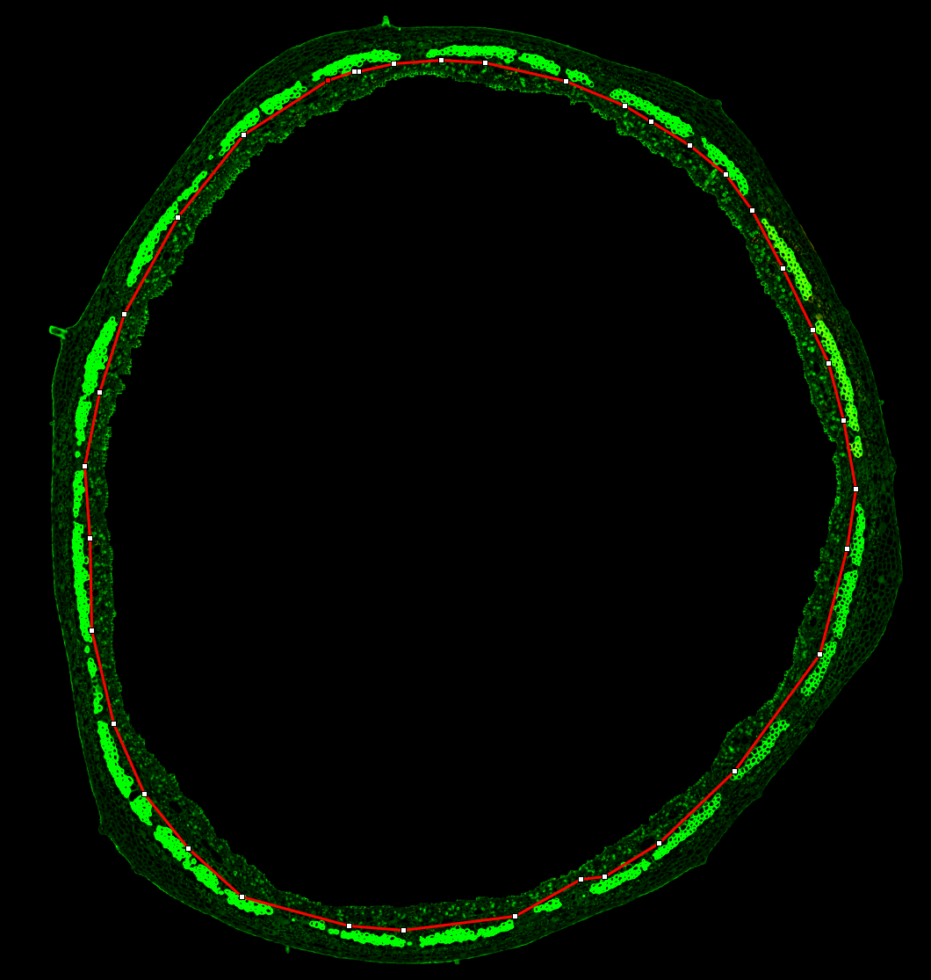
Problem – isolation of secondary phloem
We want to detect the gelatenous fibers in the secondary phloem
(the area inside of the red boundary)
This is a candidate for deep learning.
We need a set of annotated images.
Most of the tissues can be automatically annotated, but the secondary phloem must be manually labeled.

Slide 36
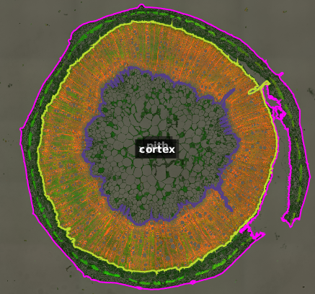
Problem – damaged sections
The classical image processing approach is not robust against damage sich as breaks in the cortex.
Fibrous phloem was not segmented.
Machine learning could probably recognize the fibrous caps, even if trained on undamaged sections.

Slide 37
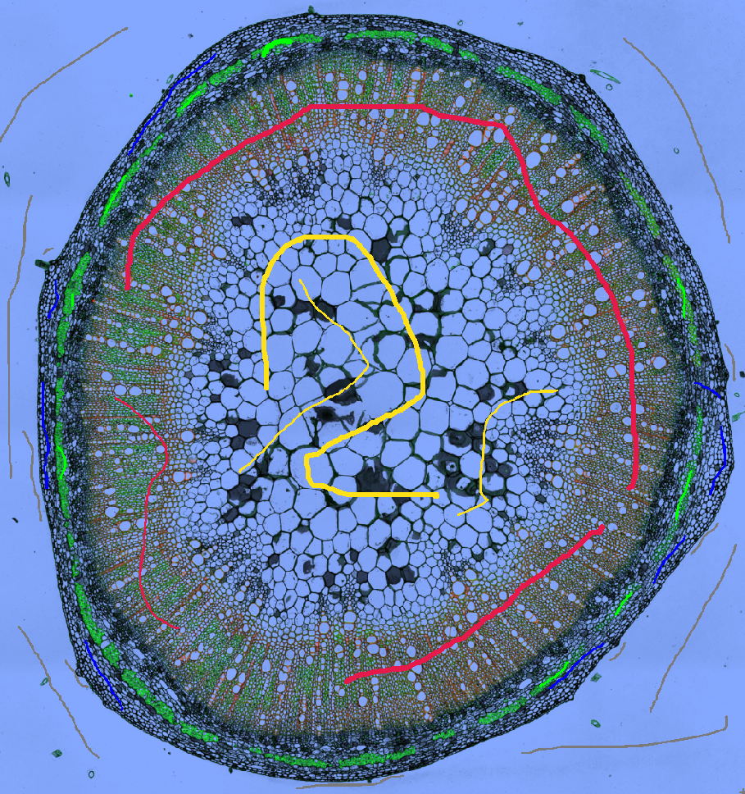
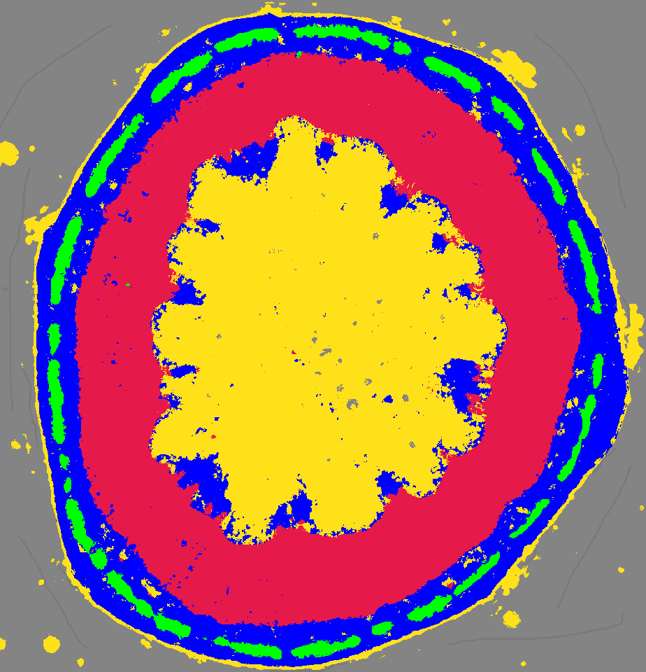
Segmentation with Ilasktik (“shallow” ML)
yellow: pith
red: xylem
blue: cortex+phloem
green: fibrous phloem
gray: background
Labeled image predictions

Slide 38
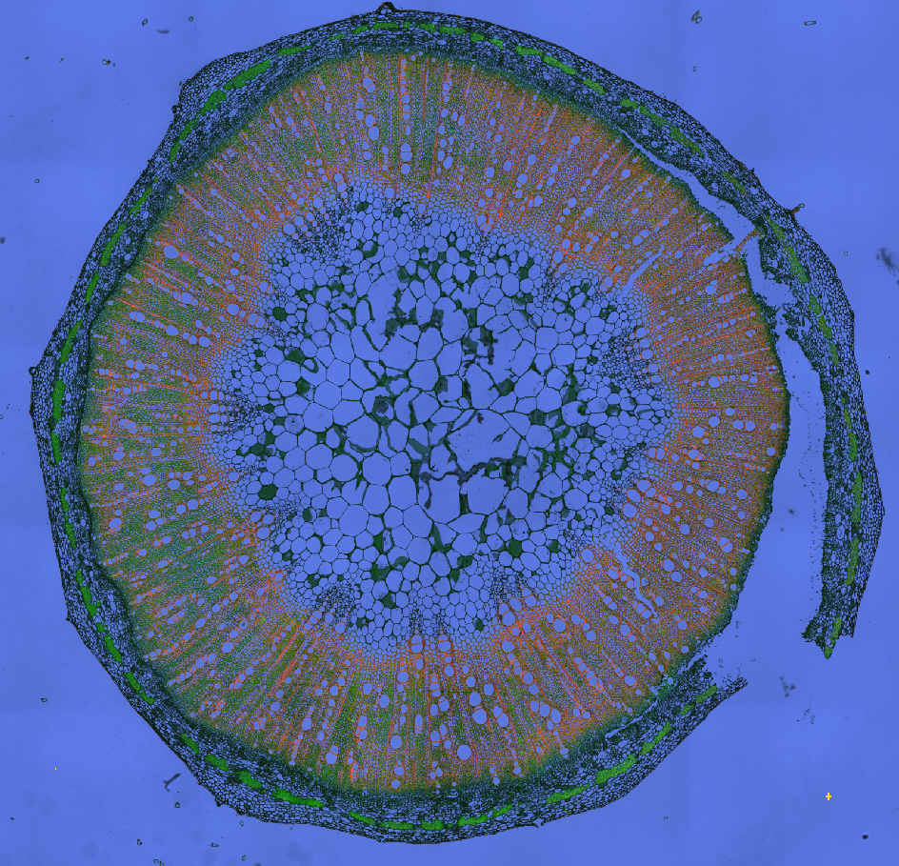
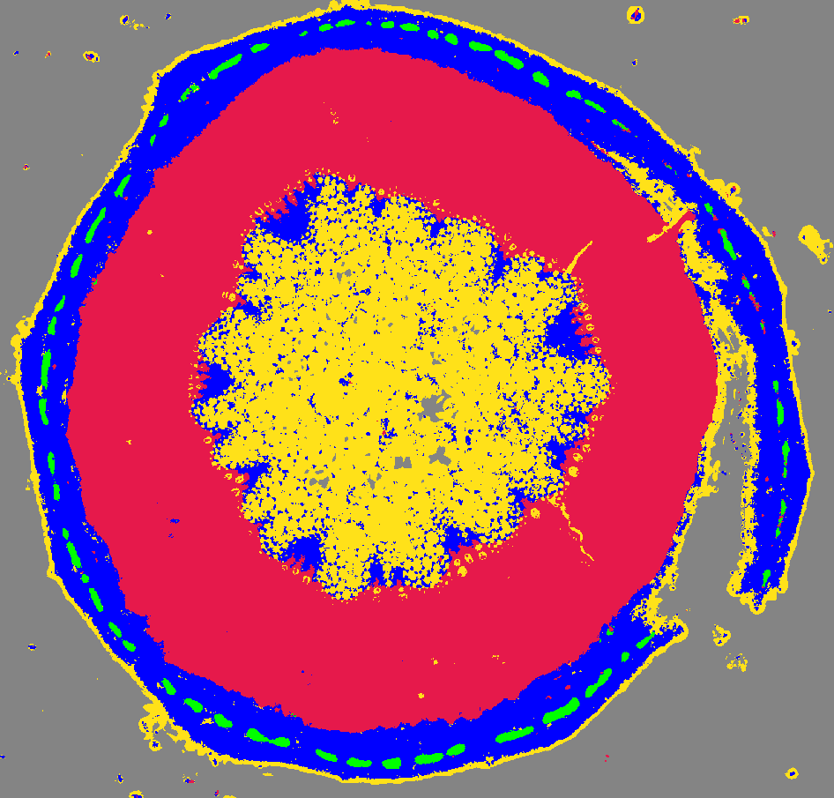
Ilasktik on unlabeled image
yellow: pith
red: xylem
blue: cortex+phloem
green: fibrous phloem
gray: background
Naive image predictions
Based on 4 sparsely labeled images. Not bad, especially for the fibrous phloem.
However, it cannot distinguish primary xylem from cortex, because spatial location is not part of the feature space. Post processing could resolve the false assignments.

Slide 39
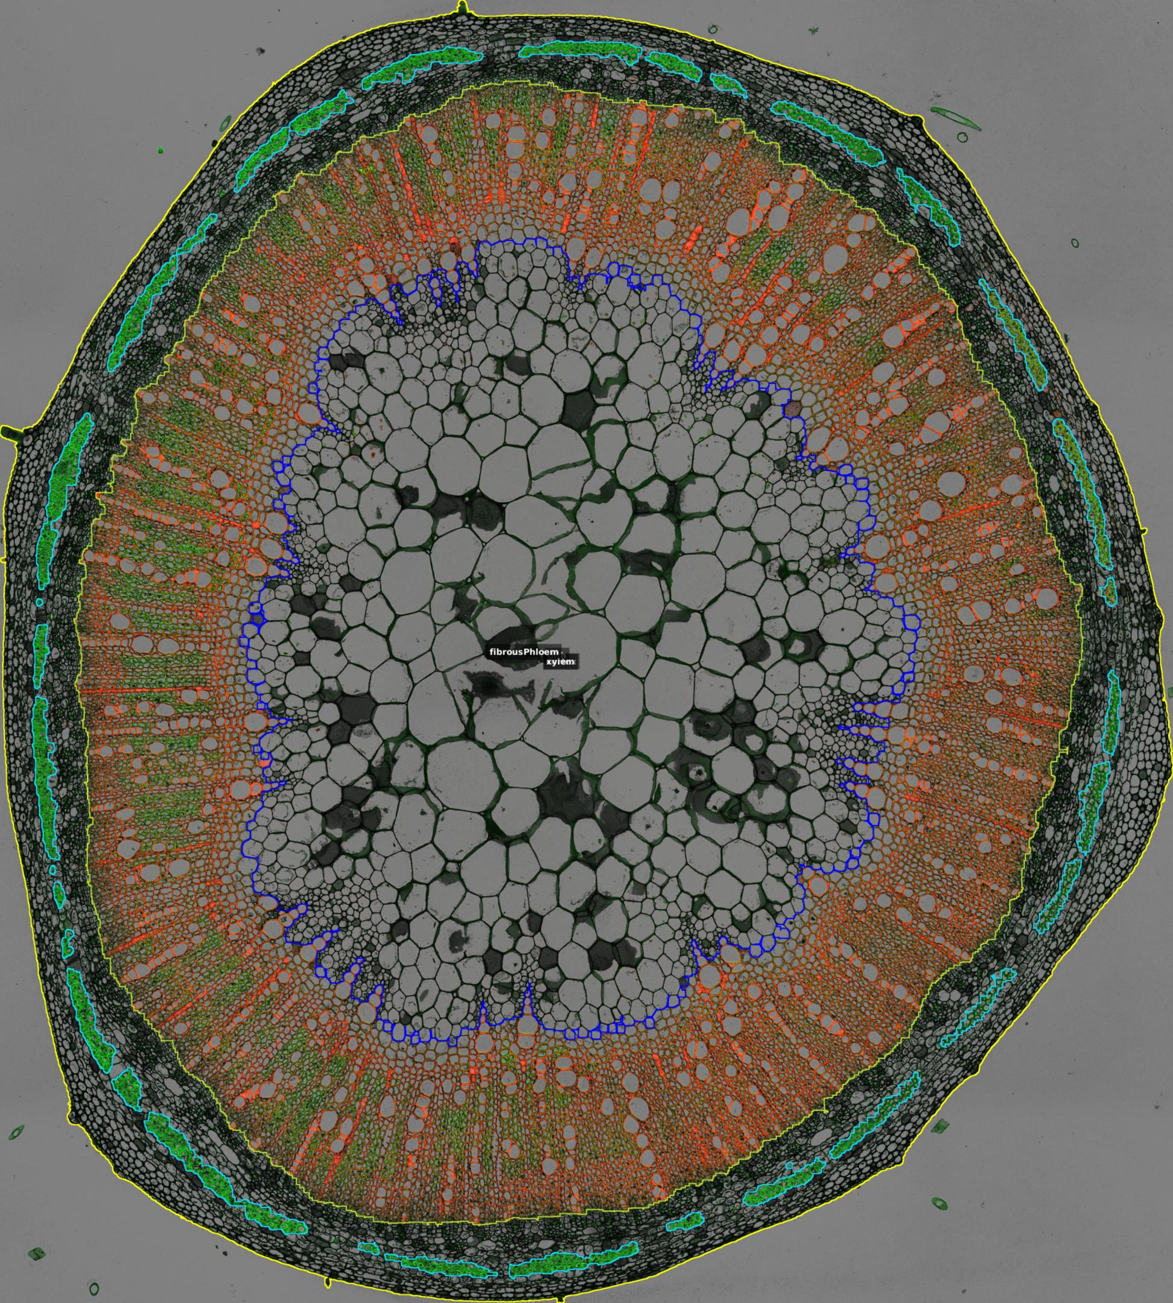
Using QuPath to fully annotate for DL
Segmented image with ROIs label-image
Workflow:
Segment xylem, pith, cortext and fibrous phloem (where possible) with ImageJ/Fiji python script.
Import ImageJ ROIset into QuPath – regions are then annotated.
Add annotations for objects that the Fiji script does not segment.
Use QuPath groovy script to export label images

Slide 40
Summary (1)
Classical image processing can segment some plant tissues very well.
Machine learning allows one to use a large feature space to segment difficult cases.
Deeplearning can be used for even more difficult cases where the feature space is not obvious.
Classical image processing can clean up the output of the semantic segmentation from ML and DL.

Slide 41
Summary (2)
A rich set of tools enable ML and DL to be done by dummies.
ML: Trainable Weka segmentation and Ilastik (and more)
DL: Tensorflow, pytorch, mianalyzer, DeepImageJ, Deep Learning Toolbox (MATLAB), Microscopy Image Browser (and more).
I have focused on ImageJ/Fiji, Ilastik, QuPath, and Mianalyzer as tools for image processing, shallow ML, annotation, and DL.
There are many other tools available – these are the tools that
this dummy found easiest to use.

Slide 42
Addendum
Since preparing the above slides, I learned of the Microscopy Image Browser (MIB). This is a rich processing environment that includes DL tools.
Runs in MATLAB or standalone.
Includes preprocessing, training, and prediction tools. Requires no programming.
Website: http://mib.helsinki.fi/
Author: Ilya Belevich. Provides amazing help, especially via image.sc forum (tag is mib)

