Slide 1
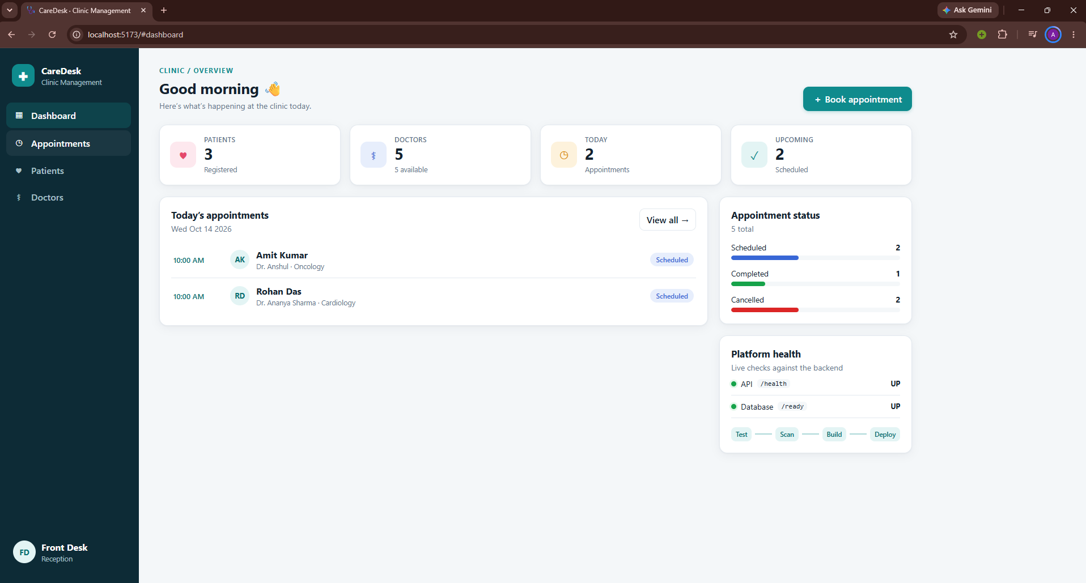
CareDesk
DEVSECOPS CAPSTONE · SESSION 21
A clinic management app, delivered end to end by a full DevSecOps pipeline
github.com/aryen1101/clinic_managment_devops
Notes:
Hi, this is my DevSecOps capstone project: CareDesk, a clinic management system. I'll first explain what I built and the architecture, then do a live walkthrough of the code, the CI/CD pipeline, Terraform, Argo CD, Kubernetes, Prometheus and Grafana.

Slide 2






The problem CareDesk solves
Small clinics today
With CareDesk
Paper registers
Patient details and visits are hard to find
Patient registry
Search, profiles and full visit history
Double-booked doctors
Two patients get the same slot
Safe booking
A doctor can never be double-booked (HTTP 409)
No overview
Nobody sees today's schedule at a glance
Live dashboard
Today's appointments, status and system health
Notes:
Small clinics often track patients and appointments on paper, which leads to double-bookings and lost history. CareDesk gives the front desk a patient registry, safe booking that blocks double-booking, and a live dashboard.

Slide 3
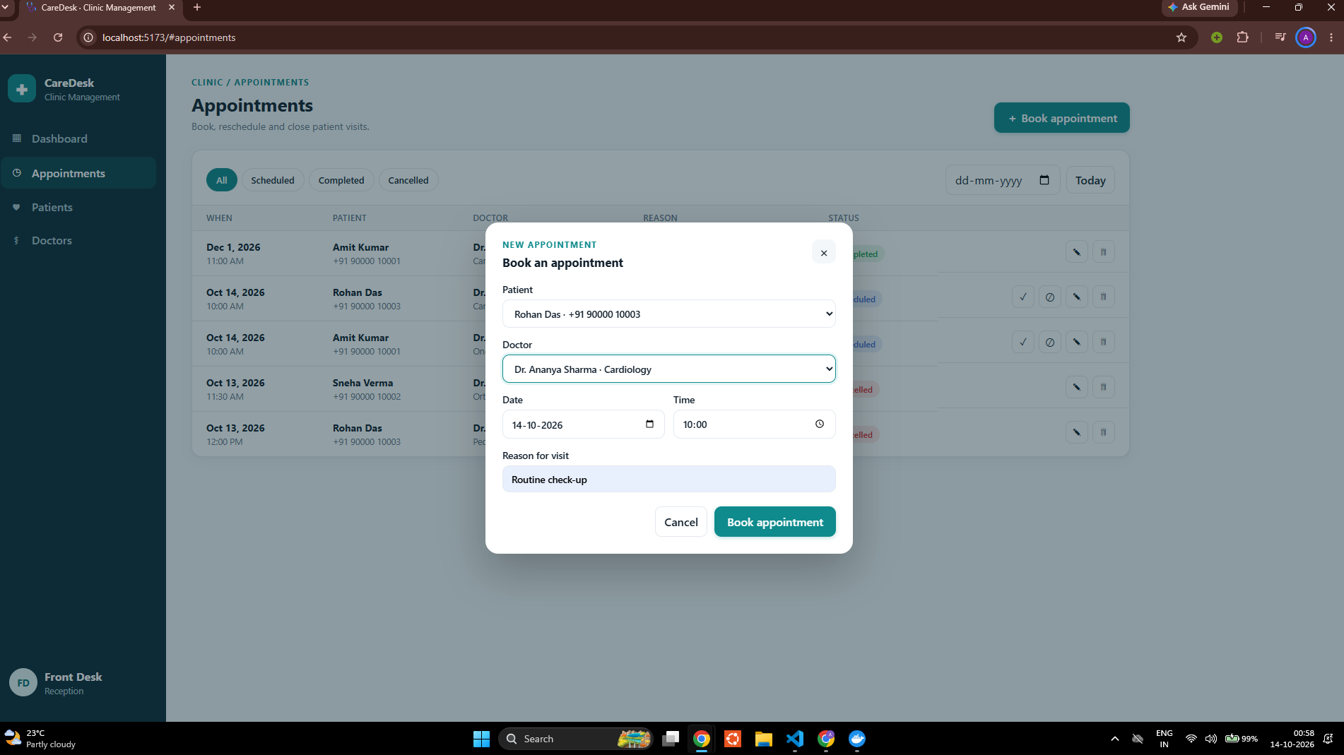
What I built
3
linked tables: patients, doctors, appointments
20+
REST endpoints with Swagger docs
24
automated API tests (pytest)
Notes:
The app is a three-tier application: a React frontend, a FastAPI Python backend and PostgreSQL with Alembic migrations. There are three linked tables, more than twenty REST endpoints, and 24 automated tests. Here you can see the booking form.

Slide 4












Technology stack
FRONTEND
React 19 + Vite
BACKEND
FastAPI · Python 3.13
DATABASE
PostgreSQL + Alembic
TESTING
Pytest · 24 tests
CONTAINERS
Docker + Compose
CI/CD
GitHub Actions + GHCR
SECURITY
Trivy · Bandit · Gitleaks
INFRASTRUCTURE
Terraform · AWS EKS
ORCHESTRATION
Kubernetes
PACKAGING
Helm 3
GITOPS
Argo CD
OBSERVABILITY
Prometheus + Grafana
Why Kubernetes: self-healing, rolling updates, autoscaling · alternatives considered: Docker Swarm, AWS ECS
Notes:
This is the stack. Python FastAPI backend as required, React frontend, PostgreSQL. Docker and GitHub Actions for CI/CD, Trivy, Bandit and Gitleaks for security, Terraform for AWS, Kubernetes with Helm, Argo CD for GitOps, and Prometheus with Grafana for monitoring. I chose Kubernetes over plain Docker Compose because it gives self-healing, rolling updates and autoscaling.

Slide 5
Architecture overview
Developer
GitHub repo
GitHub Actions
test · scan · build
GHCR images
tag = commit SHA
new tag commit
Kubernetes cluster (Minikube locally · EKS in AWS)
Terraform
Argo CD
Ingress
clinic.local
Frontend ×2
React + nginx
PostgreSQL
StatefulSet + PVC
Backend ×2–6
FastAPI + HPA
AWS VPC + EKS
60 resources planned
Prometheus
Grafana
scrapes /metrics every 15 s
Notes:
Here is the architecture. A developer pushes to GitHub. GitHub Actions tests, scans and builds the images and pushes them to GitHub Container Registry, tagged with the commit SHA. The pipeline then commits the new tag to Git, and Argo CD syncs it into the Kubernetes cluster. Inside the cluster, the Ingress routes traffic to the frontend and backend, the backend autoscales with an HPA, and PostgreSQL keeps its data on a persistent volume. Prometheus scrapes metrics and Grafana visualises them. Terraform describes the AWS VPC and EKS cluster this would run on in production.

Slide 6
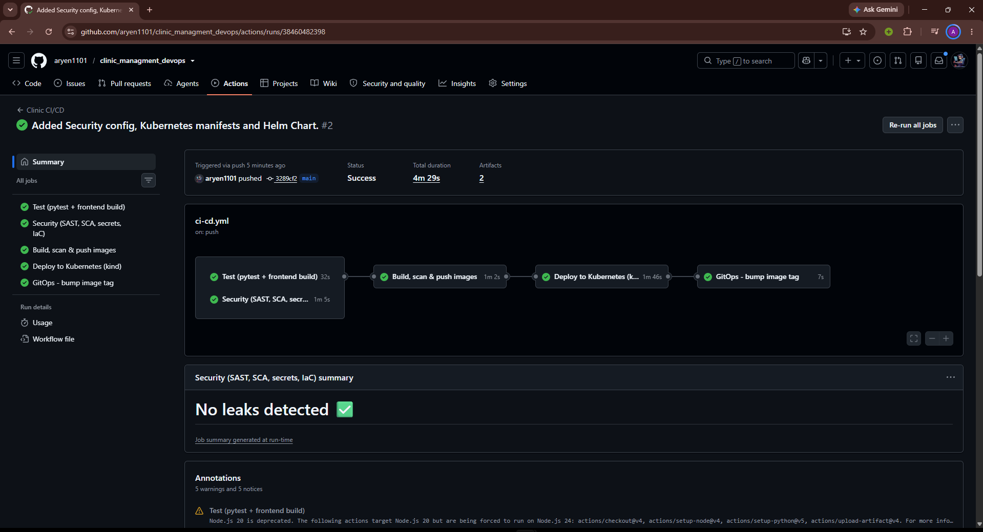



CI/CD pipeline on every push to main
1
Test
2
Security
3
Build & scan
4
Push
5
Deploy
ruff + 24 pytest
frontend build
Bandit · pip-audit
npm audit · Gitleaks
Docker build
Trivy gate
GHCR, tag =
commit SHA
kind smoke test
GitOps tag bump
Trigger
Every push and pull request to main
Traceable images
Tag = Git commit SHA, never latest
Quality gate
A failing test stops the pipeline: nothing is pushed
Notes:
This is the CI/CD pipeline in GitHub Actions. It runs on every push to main. First tests and security scans run in parallel. Then both Docker images are built and scanned by Trivy; if there is a HIGH or CRITICAL vulnerability the pipeline stops. Images are pushed to GHCR tagged with the commit SHA, deployed to a temporary kind cluster for a smoke test, and finally the new tag is committed for Argo CD. I also tested the quality gate by pushing a broken test: the pipeline went red and no image was pushed.

Slide 7



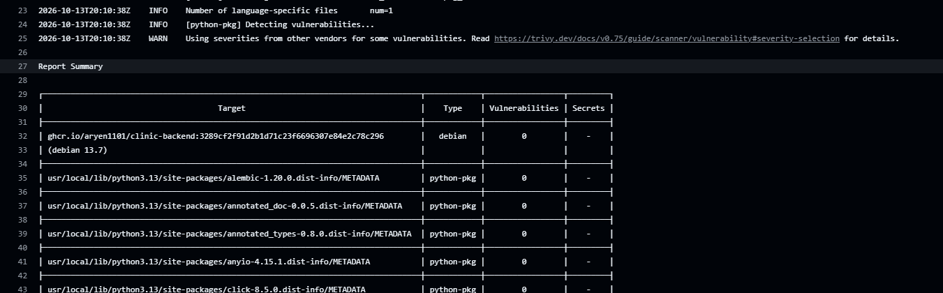

Security at every layer
SAST · Bandit
Insecure patterns in my Python code
47 → 0
SCA · pip-audit + npm audit
Known CVEs in dependencies
HIGH CVEs after hardening the images: apk upgrade in the nginx image, pip removed from the Python image
Secrets · Gitleaks
Passwords or keys in Git history
IaC · Trivy config
Misconfigured Dockerfiles, K8s, Terraform
Containers · Trivy image
Fails the build on HIGH or CRITICAL CVEs
Notes:
Security runs at five layers: Bandit for my own code, pip-audit and npm audit for dependencies, Gitleaks for secrets in the Git history, Trivy config for infrastructure files, and Trivy image scans as a gate. The first scan actually found 47 HIGH vulnerabilities, mostly in base images. I fixed them by running apk upgrade in the frontend image and removing pip from the backend image. Now both images scan clean.

Slide 8

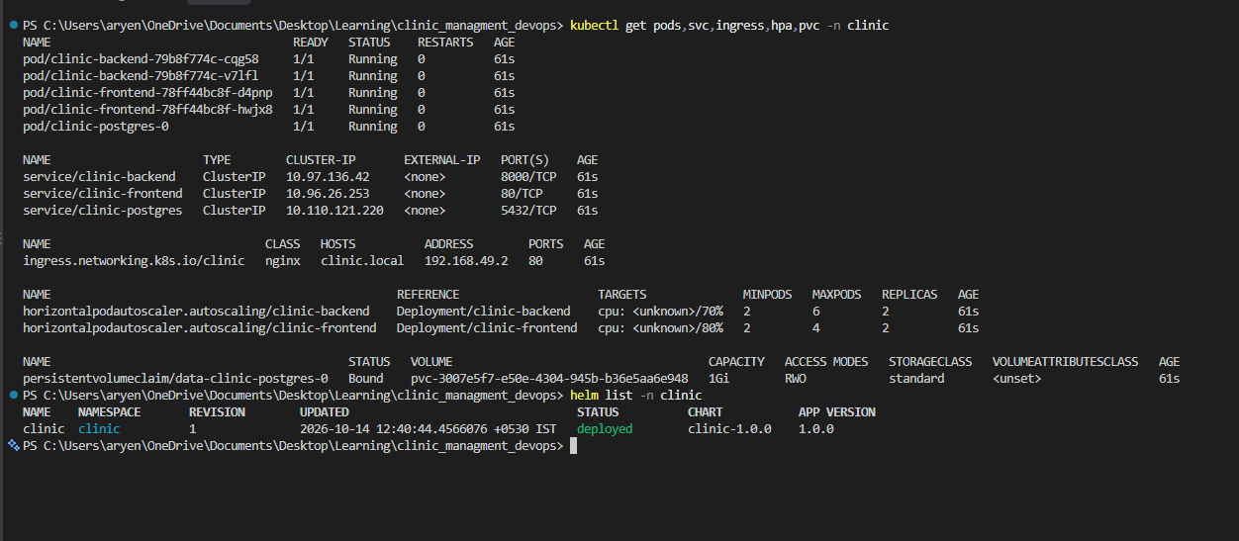



Containers and Kubernetes
Non-root images
Backend uid 10001 · frontend nginx uid 101
Multi-stage build
Node builds it, nginx serves it
Health checks + probes
/health liveness · /ready checks the database
ConfigMap + Secret
Config and DB password outside the image
Helm release: 2 backend + 2 frontend + PostgreSQL pods, ClusterIP services, Ingress, HPA and a bound PVC
Notes:
Both Docker images run as non-root users, and the frontend uses a multi-stage build, so build tools never reach the runtime image. In Kubernetes, the app runs from a Helm chart: two backend and two frontend pods, PostgreSQL as a StatefulSet with a persistent volume, ClusterIP services, an Ingress, autoscalers, liveness and readiness probes, and a ConfigMap and Secret for configuration.

Slide 9
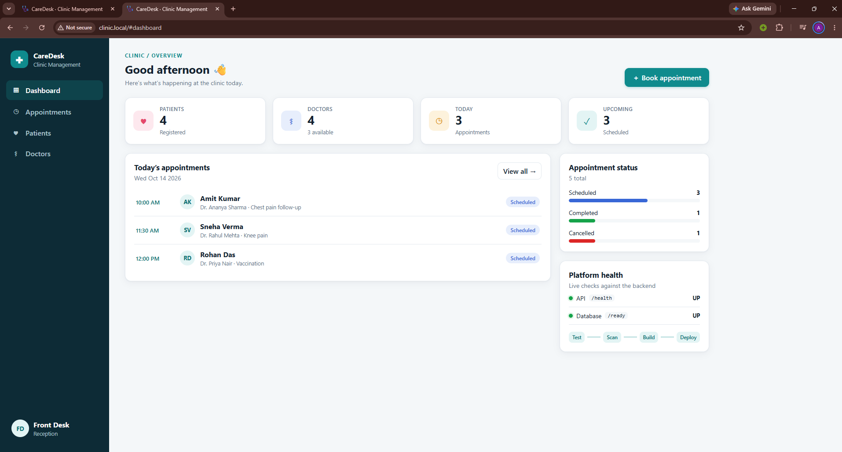
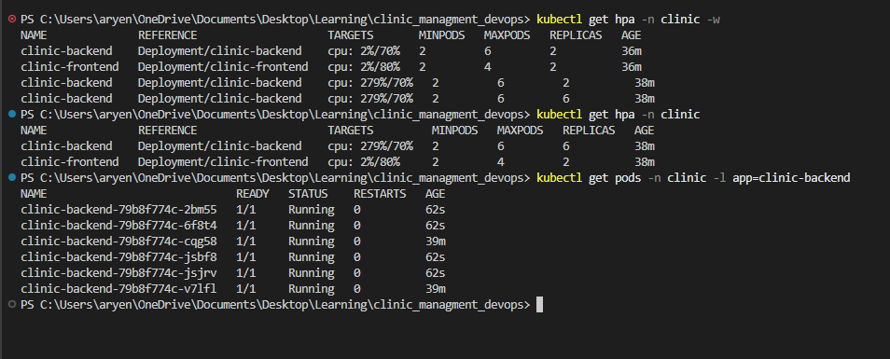
Ingress and autoscaling under load
2 → 6
http://clinic.local through the nginx Ingress
backend pods when CPU reached 279% of the 70% target
Notes:
The app is reachable through the nginx Ingress at clinic.local: slash goes to the frontend, slash api to the backend. To test autoscaling I generated load inside the cluster; CPU went to 279 percent of the target, and the Horizontal Pod Autoscaler scaled the backend from 2 to 6 pods automatically.

Slide 10


Infrastructure as Code with Terraform
60
AWS · ap-south-1 (Mumbai)
AWS resources in terraform plan
VPC 10.30.0.0/16
init · fmt · validate · plan
All run against a real AWS account
2 public subnets
Internet + NAT gateway, load balancers
2 private subnets
EKS worker nodes
apply skipped on purpose
EKS and NAT are not in the free tier
EKS cluster · Kubernetes 1.33
Managed node group 2 × t3.medium · add-ons incl. EBS CSI
No credentials in Git
tfvars and state are git-ignored
Notes:
Terraform describes the AWS infrastructure: a VPC with two public and two private subnets, a NAT gateway, and an EKS cluster with a managed node group. I ran init, validate and plan against a real AWS account, and the plan shows 60 resources. I did not run apply, because EKS and the NAT gateway are not covered by the free tier and the account must not be charged. No credentials are committed to Git.

Slide 11

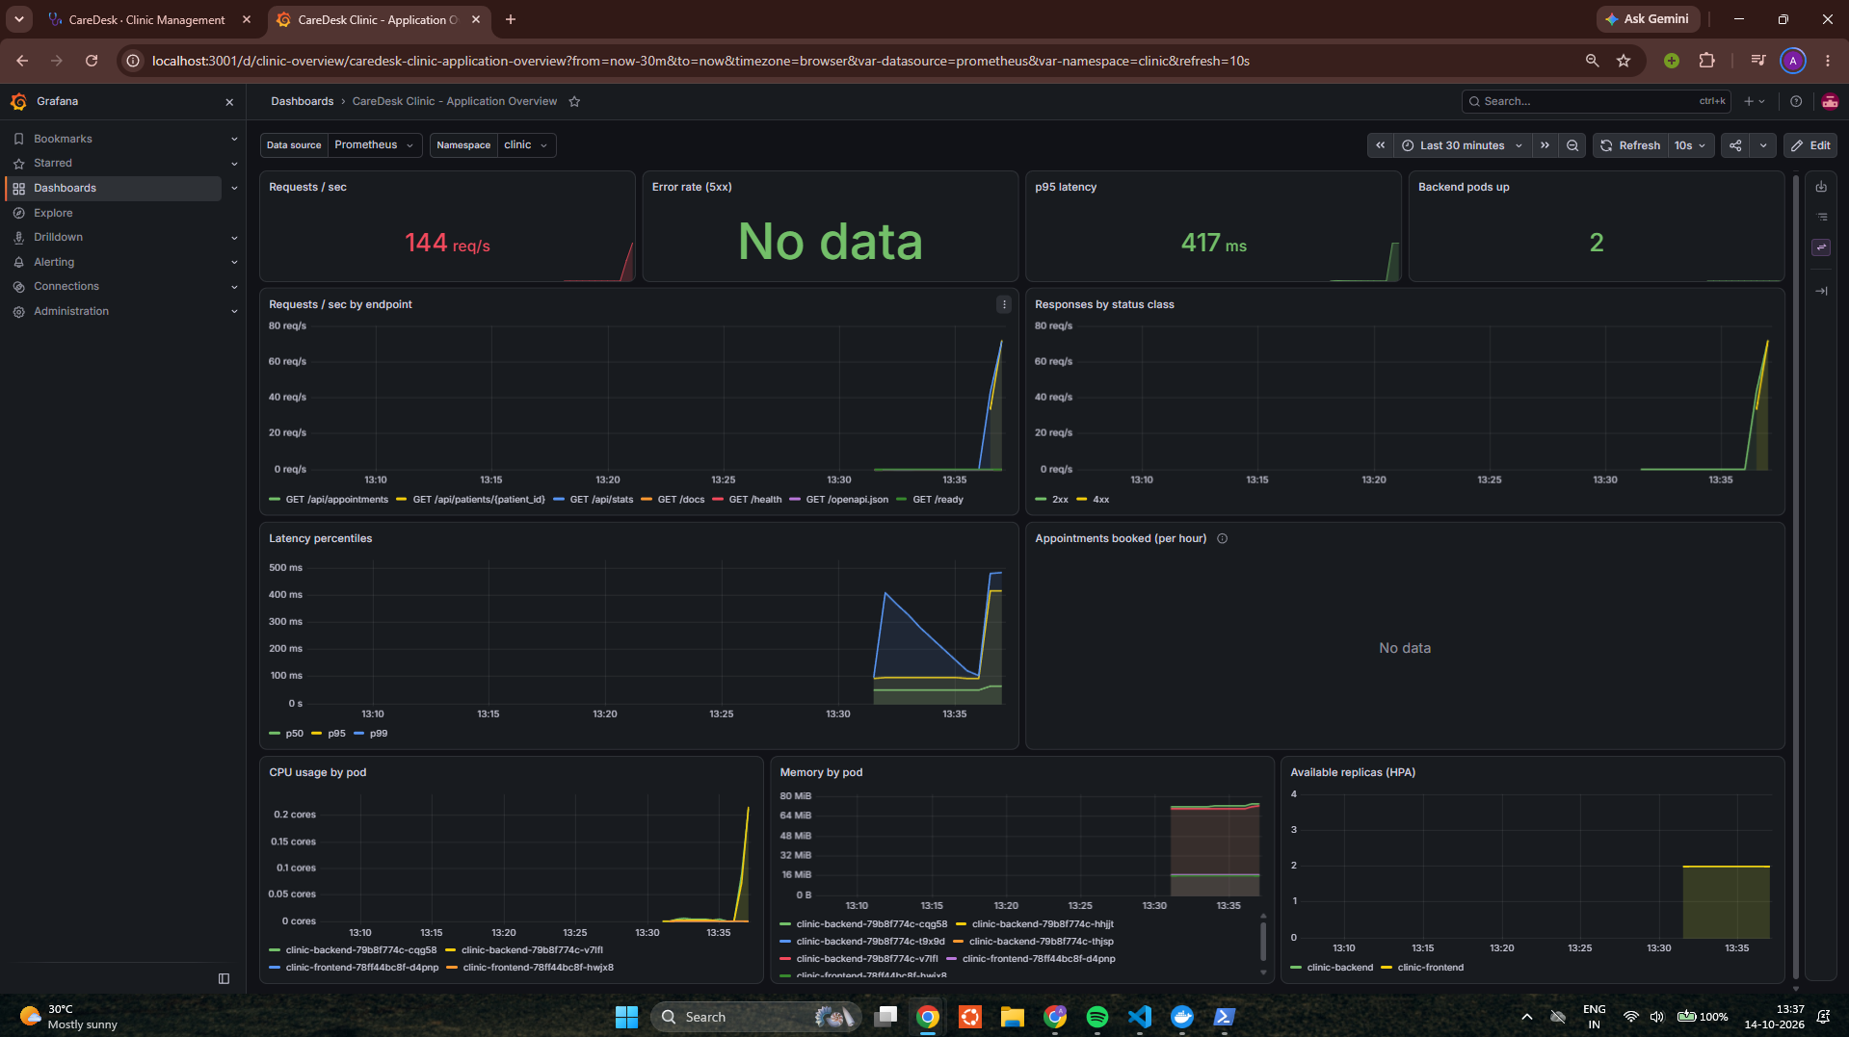

Monitoring and observability
Prometheus
Scrapes /metrics every 15 seconds
Grafana dashboard
11 panels: traffic, errors, latency, CPU
3 alert rules
Backend down · errors · slow p95
Business metric
Appointments booked over time
Notes:
For observability, the backend exposes Prometheus metrics. A ServiceMonitor tells Prometheus to scrape every backend pod every 15 seconds. The Grafana dashboard is created automatically from the Helm chart and shows requests per second, error rate, latency, CPU, memory and replicas. There are also three alert rules, and a business metric for appointments booked.

Slide 12
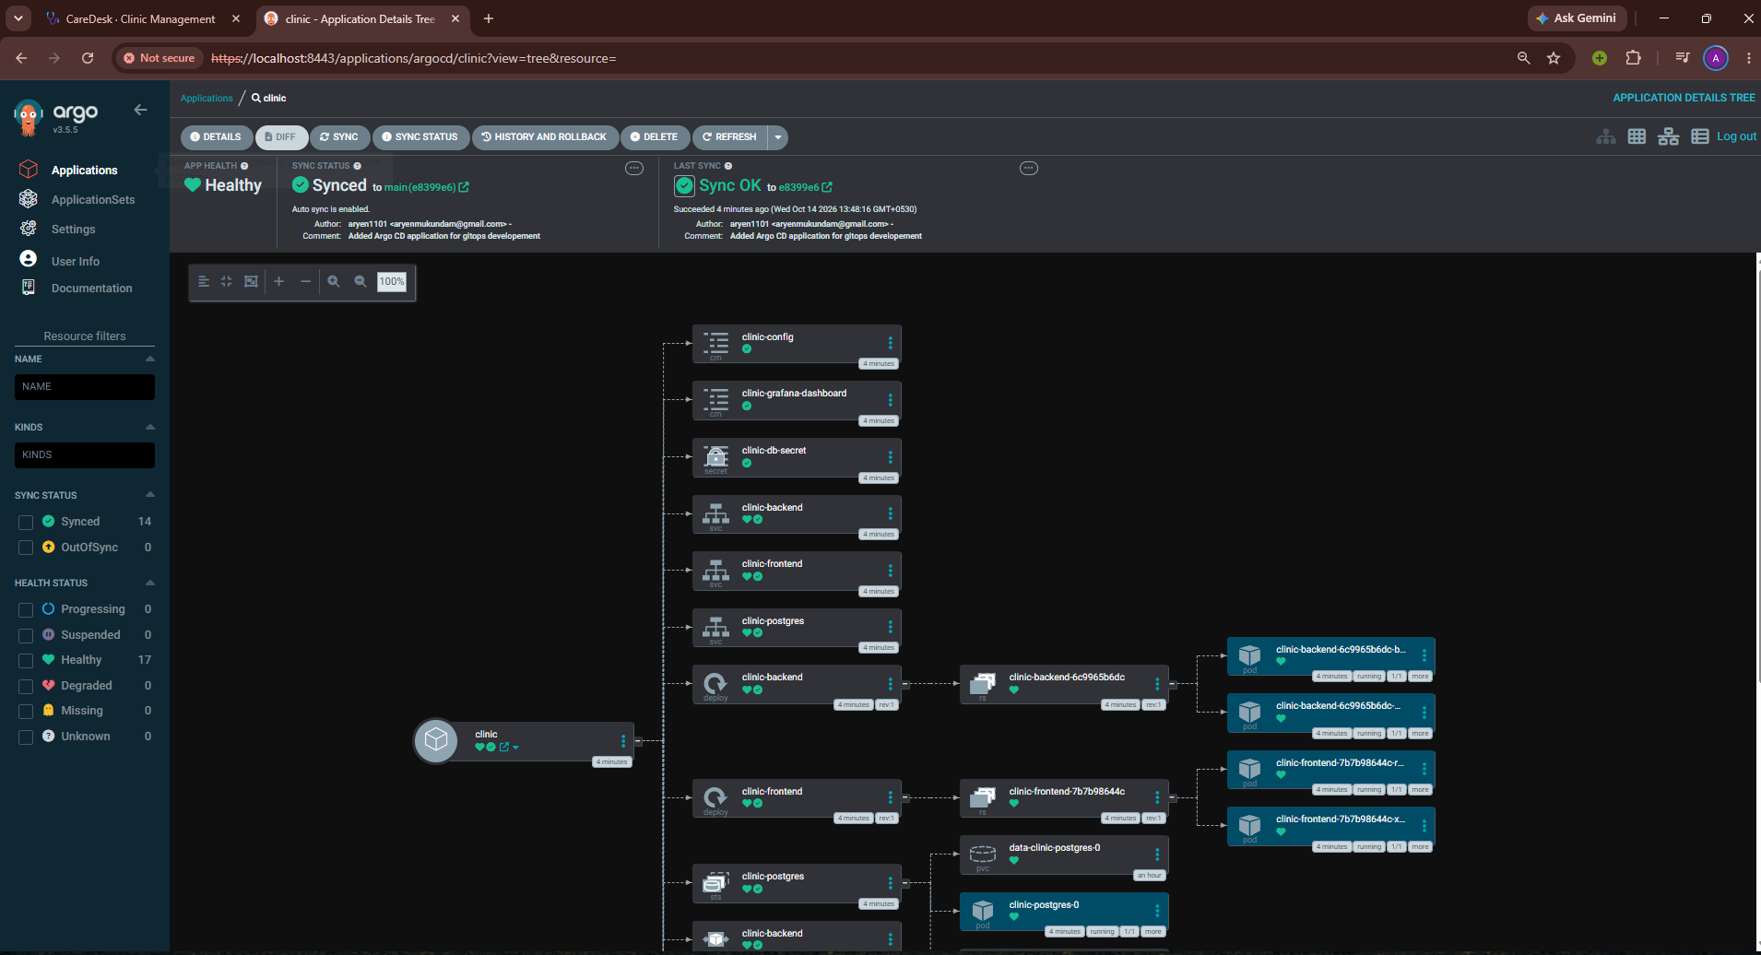



GitOps with Argo CD
git push
CI builds image (SHA)
CI commits new tag
Argo CD syncs
Rolling update
Auto-sync with prune and self-heal: Git is the single source of truth, and manual kubectl changes are reverted
Notes:
With GitOps, the pipeline never runs kubectl against the cluster. It only commits the new image tag to Git. Argo CD, running inside the cluster, notices the change and rolls it out. Self-heal is on, so if someone changes the cluster by hand, Argo CD puts it back to what Git says.

Slide 13
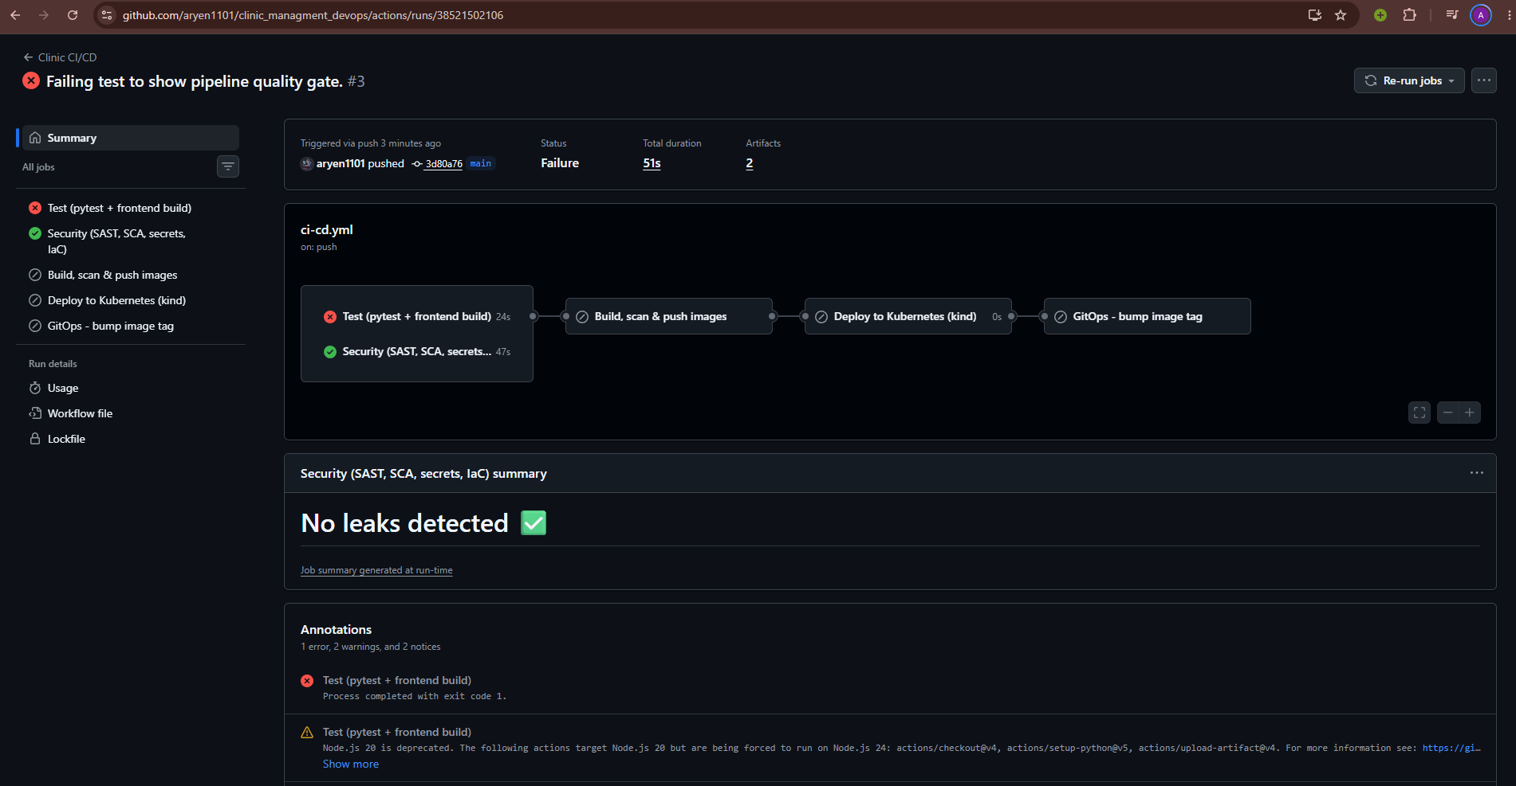
Quality gates that stop bad code
24
API tests on an isolated test database
5
security scanners in the pipeline
0
HIGH or CRITICAL CVEs in the images
A deliberately broken test turned the pipeline red: no image was built, pushed or deployed
Notes:
Quality is enforced automatically: 24 tests, five security scanners and a zero-HIGH-CVE rule. To prove the gate works, I pushed a broken test on purpose. The pipeline stopped at the test job and nothing was built or deployed. After reverting, it went green again.

Slide 14

Lessons learned
Readiness ≠ liveness
/health ignores the DB; /ready checks it
Startup order matters
Wait-for-DB + migration lock: zero restarts
Scanners find real issues
47 HIGH CVEs, fixed in the base images
Tag with the commit SHA
Every pod traces back to one commit
NEXT STEPS
Amazon RDS · TLS with cert-manager · staff login and roles · central logs with Loki
Thank you · github.com/aryen1101/clinic_managment_devops
Notes:
To wrap up, the main lessons: readiness and liveness are different checks, startup order matters in Kubernetes, security scanners find real problems, and tagging images with the commit SHA makes every deployment traceable. Next steps would be a managed RDS database, TLS, staff login and central logging. Now let me show everything live.

