Slide 1
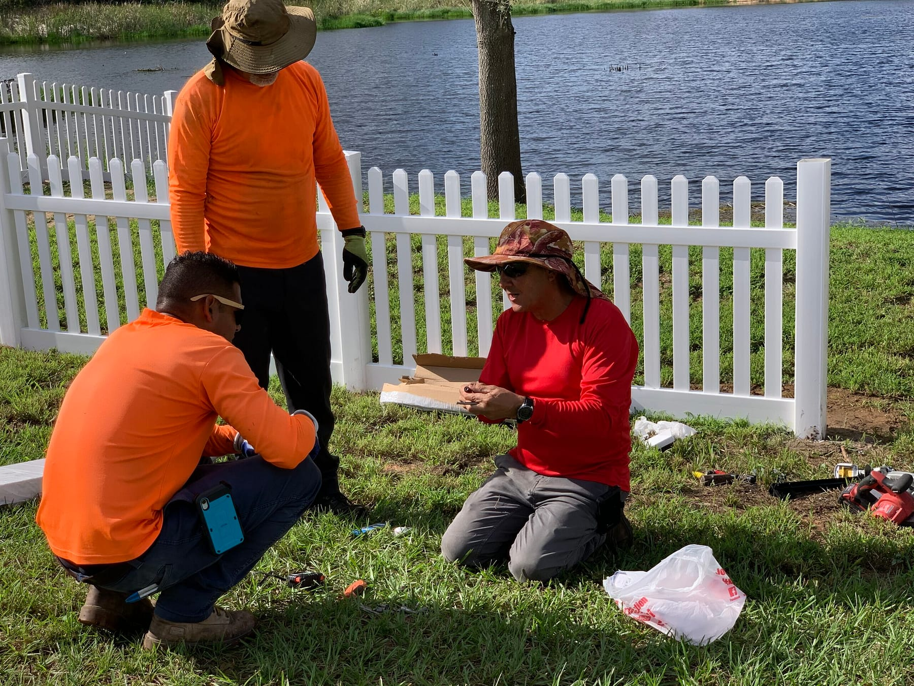

COMPLETE CUSTOM FENCE · GROVELAND, FL
Welcome to
the team.
20+ Years
American-Made
Lifetime Warranty
Real Leads · Real Commissions

Slide 2
A NOTE FROM OWNERSHIP
We're glad you're here.
20+
Complete Custom Fence was built on a simple idea: do the job right, treat people like they matter, and the reputation takes care of itself. Twenty years later, that's still the whole strategy.
When you show up to a job site wearing this company's name, you're carrying something we worked hard to build. We're going to do everything on our end to make sure you're proud to carry it.
If you're in sales, here's what I want you to know: the hardest part of selling is already done. We spent 20 years building a reputation that homeowners trust before you ever knock on their door. Lifetime warranty, American-made materials, five-star reviews you can pull up on your phone at the kitchen table.
We don't hire people to fill seats. We hire people we want to build something with. You're one of those people — now let's get to work.
Years serving Central Florida
50+
Years combined team experience
100%
American-made materials
★★★★★
Luke Payne
Owner · Complete Custom Fence
Verified Google & Facebook

Slide 3
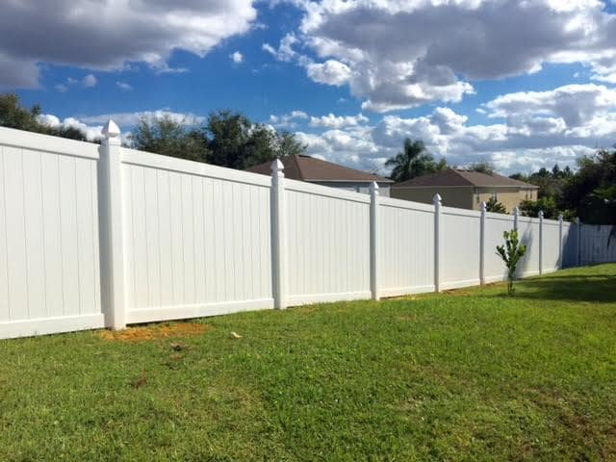
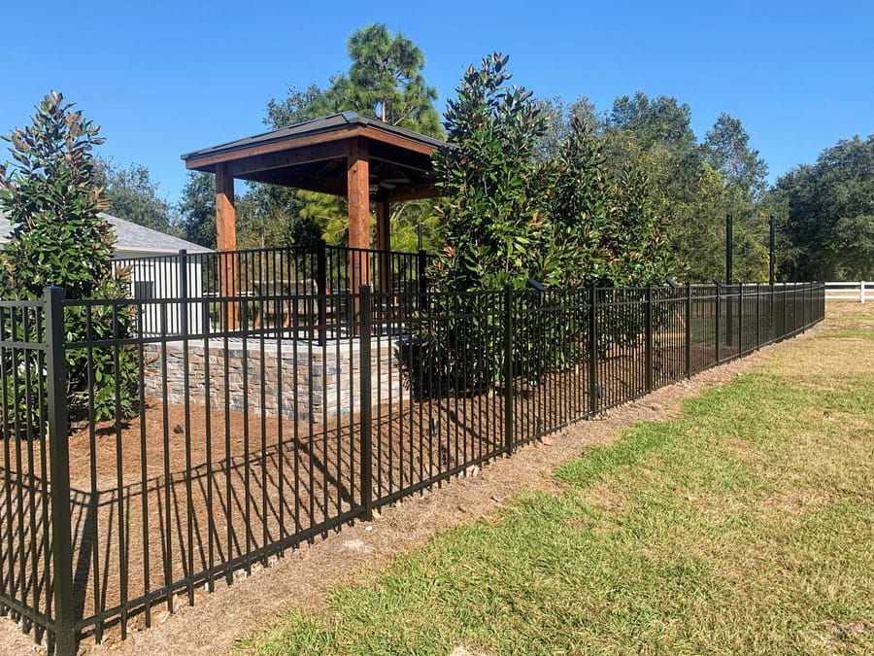
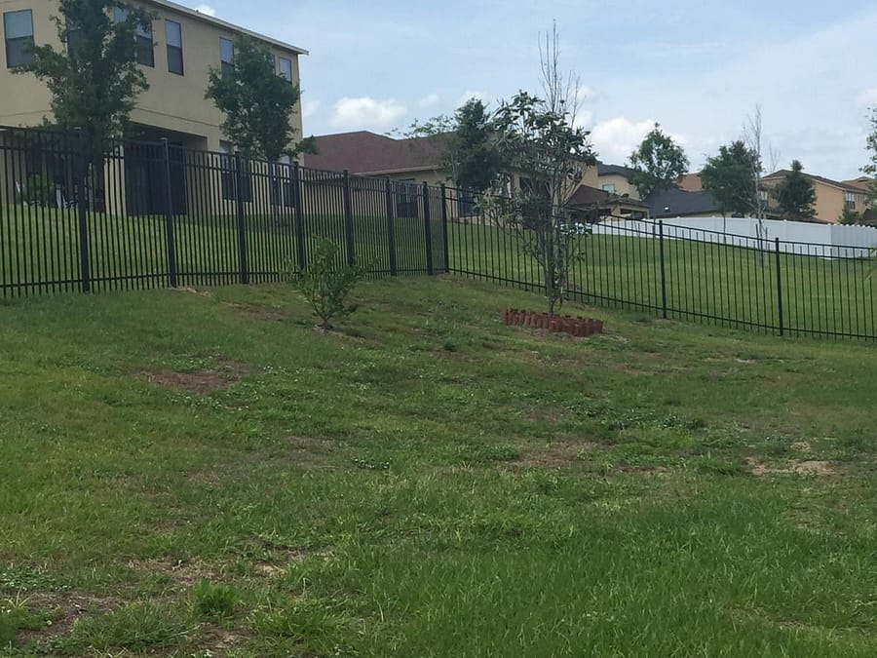
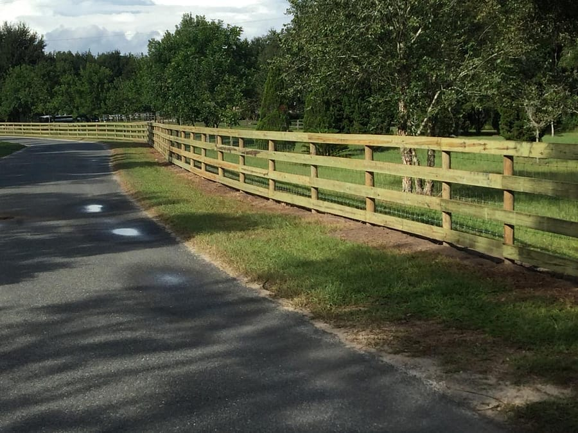
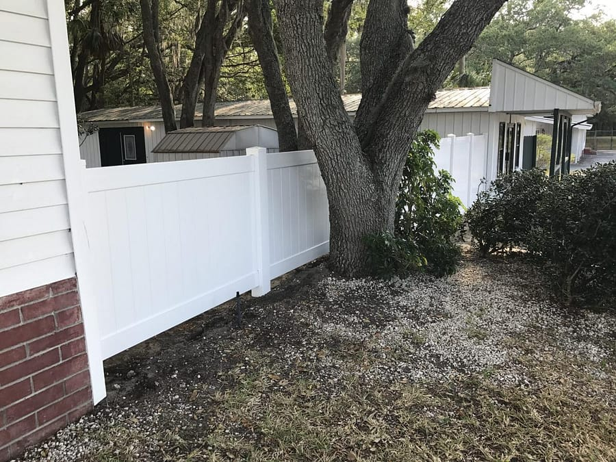
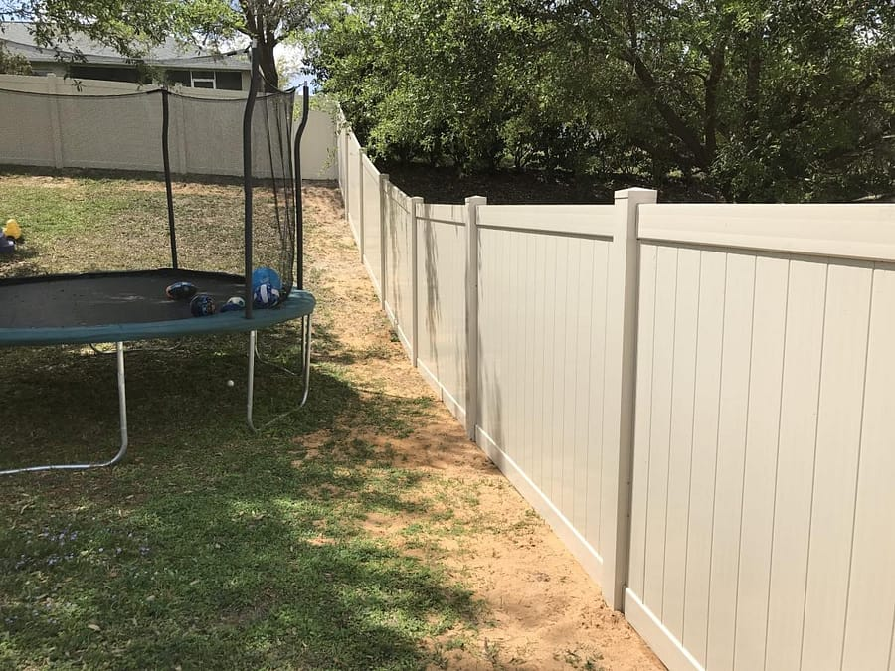
THIS IS WHAT WE BUILD
Real Work. Real Florida Homes.
VINYL PRIVACY
ALUMINUM ORNAMENTAL
COMMERCIAL ALUMINUM
Shadow Box Privacy Panel
Estate Gate & Perimeter
Business Perimeter Security
CEDAR WOOD
VINYL PRIVACY
VINYL SCALLOP PICKET
Full Privacy Panel
Closed Top Panel System
Front Yard Curb Appeal

Slide 4
WHAT HOMEOWNERS SAY
Real Customers. Real Results.
★★★★★
★★★★★
★★★★★
★★★★★
★★★★★
"They are prompt on getting the permit, the Groveland office was great in keeping me informed of everything and the guys that did the job couldn't have been nicer. They did a fantastic job."
"Complete Custom Fence was professional until the end. They were extremely flexible with what I wanted. Fantastic customer service and extremely quick fence install!"
"Submitted a request and within 5 minutes I received a call from a very polite lady. This is a company I'd want to do business with — from the very first phone call there was a connection."
"George was very responsive, never felt pressured. The customer service was great. Thanks for the reasonable quote and great quality product!"
Jose Vega
Max Hitzemann
Robert Williams
Jonatan Portillo
Verified Google Review
Verified Google Review
Verified Google Review
Verified Google Review

Slide 5
You'll Know Where You Stand
Growth Is Real Here
Clear expectations, direct feedback, 30/60/90-day reviews on schedule.
Crew leads come from within. High performers get compensated.
✦ PROMISE
We Back Our Team
You're Not a Number
Difficult customers? Office handles it. Safety stops the job.
Family-owned. Leadership knows your name and your work.
CCF's Promise
to You
You'll Have What You Need
Proud of the Work
Before we ask anything of you, here is what we commit to as your employer.
Proper equipment. Clear processes. Tools and systems.
Lifetime warranty. 100% American materials. The standard.

Slide 6
04 ROLE & EXPECTATIONS
Your Role & Expectations
CATEGORY
DETAILS
Daily Responsibilities
Fence installation, measuring, material handling, photo documentation in Company Cam every job.
Physical Requirements
Lifting 60+ lbs. Extended outdoor work in all Florida weather. Uneven terrain is standard.
Tools Used
Post hole diggers, augers, saws, nail guns, levels. ARC Site + Measure App.
Quality Standard
Posts plumb. Alignment clean. Zero debris. Company Cam close-out photos confirm every job.
Customer Interaction
Professional, brief, respectful. Questions go to crew lead. No field commitments.
Work Schedule
Monday–Friday. Hours per job schedule. Weather delays through office.
Reporting Structure
You → Crew Lead → Director of Sales → Luke (Owner).

Slide 7
02 DAY-ONE DOCUMENTS
Day-One Documents
Legally required. Complete before or on your first day.
Form I-9 — Employment Eligibility Verification
W-4 — Federal Tax Withholding
Florida State Tax Forms (if applicable)
Direct Deposit Authorization
Emergency Contact Form
Driver's License / Government ID — copy on file
Employee Handbook Acknowledgment
📋 OFFICE CONTACT
720 W Broad Street, Groveland, FL · (352) 429-9999 · info@completecustomfence.com

Slide 8
07 SAFETY GUIDELINES
Safety Guidelines
⚠️ FLORIDA LAW — CALL 811 BEFORE EVERY DIG
Florida Statute 556 requires calling 811 before any ground penetration — no exceptions. The office coordinates during permitting, but every crew member must verbally confirm before any post hole digger touches the ground.
Required PPE
Heat & Weather
Equipment Safety
Incident Reporting
Steel-toed boots, safety glasses, gloves, high-vis vest near roadways. Not optional.
Hydrate constantly. Lightning within 10 miles stops the job. Look out for your crew.
Inspect tools before use. Report defects immediately. Augers require two-person handling.
Any injury, near-miss, or property damage — even minor — reported immediately and logged same day.

Slide 9
08 30 / 60 / 90 DAY PLAN
30 / 60 / 90 Day Plan
DAYS 1–30
DAYS 31–60
DAYS 61–90
Learn
Execute
Elevate
— Complete all orientation paperwork
— Lead install sections supervised
— Fully independent on standard installs
— Shadow experienced crew on 3–5 jobs
— JotForm entries without prompting
— Identifying quality issues proactively
— Learn installation standards
— Active Knocker D2D workflow
— Mentoring newer teammates
— Onboard to all 9 apps
— Hit productivity benchmarks
— Crew lead track conversation
— Log Company Cam photos every job
— Customer-facing professionalism
— 90-day review & compensation
— PPE compliance daily
— 60-day formal evaluation
— Eligible for performance incentives
— 30-day supervisor check-in

Slide 10
11 TECH STACK & TOOLS
Tech Stack & Tools
Functional in all 9 platforms by Day 30.
Gmail
Company Cam
JobNimbus
Primary communication
Photo documentation
CRM & job management
REQUIRED
FIELD
REQUIRED
Active Knocker
Discord
Natural Forms
D2D tracking & leads
Team communication
Digital forms & data
FIELD
REQUIRED
FIELD
ARC Site
Turbo Scan
Measure App
Mobile estimating
Mobile scanning
Quick confirmations
FIELD
OFFICE
FIELD

Slide 11
14 ACKNOWLEDGMENT
Acknowledgment
Review each item. Sign below to confirm receipt and understanding of this orientation kit.
Employee Signature Block
Complete Custom Fence · New Hire Orientation Kit · 2026
EMPLOYEE PRINTED NAME
EMPLOYEE SIGNATURE
DATE
SUPERVISOR SIGNATURE & TITLE
Complete Custom Fence · 720 W Broad St, Groveland FL 34736 · (352) 429-9999

