Slide 1
Solving the Management Problems in Heterogeneous Environments
Alex Rykov
Senior Consultant
Montage.DMC

Slide 2
Overall Presentation Goal
Share experience about component approach to Jiro™ management application development
Beginning

Slide 3
Speaker’s Qualifications
Technology consultant at MONTAGE.DMC
Currently works on Jiro™ applications and component approach to solving common management client problems
Speaker on the use of Java™
for building network centric solutions for heterogeneous environments
Beginning

Slide 4
The Network is The Computer™
AT&T Research: Network traffic grows 100% a year
Network infrastructure complexity grows accordingly. We need a normalized way to manage our “computer”
Beginning

Slide 5
Why use Jiro™?
Why use Jiro™?
Enables management infrastructure based on Java™ platform
Designed to solve interoperability and MANAGEMENT AUTOMATION issues
Focused on highly distributed environments
Enables intelligent management solutions based on industry-defined technologies
Enables management infrastructure based on Java™ platform
Designed to solve interoperability and MANAGEMENT AUTOMATION issues
Focused on highly distributed environments
Enables intelligent management solutions based on industry-defined technologies
Beginning
Beginning

Slide 6
Learning Objectives
Overview of Jiro™
  Approach to management problems
Management Client
  Responsibilities and common problems
Management Client Framework
  REUSABLE COMPONENTS to simplify development
Beginning

Slide 7
Presentation Agenda
What problems does Jiro™ solve?
Jiro™ technology architecture
The Jiro™ CLIENT FRAMEWORK
How to write Jiro™ management applications?
Beginning

Slide 8
Problem
EVERYTHING NEEDS MANAGEMENT
  Servers, routers, storage systems, network devices
How does it happen now?
  Proprietary management tools
  A lot of information in administrators head
  Constant “firefighting”, lack of CONTROL
Desire predictive solution(proactive)

Slide 9
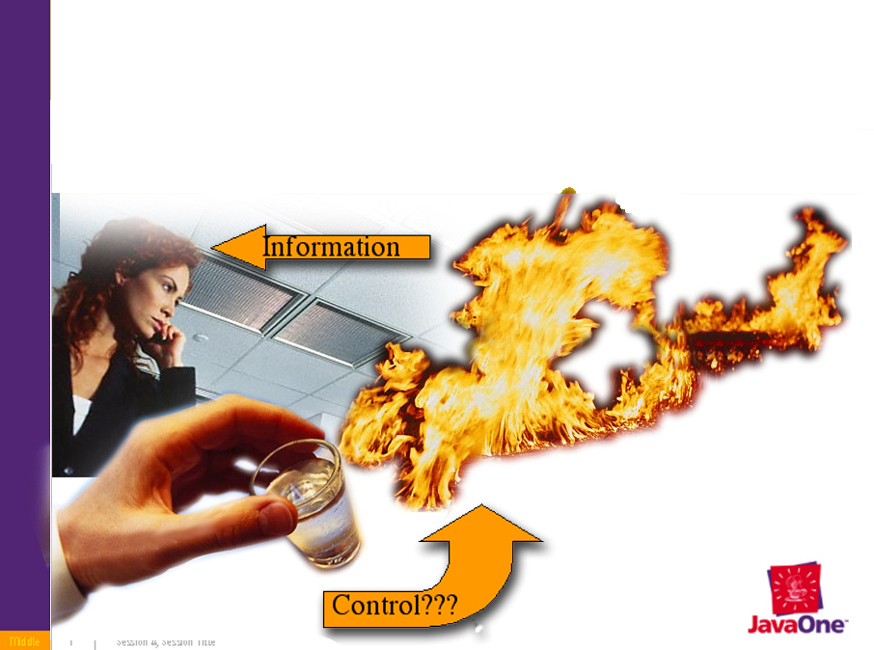
Problem

Slide 10
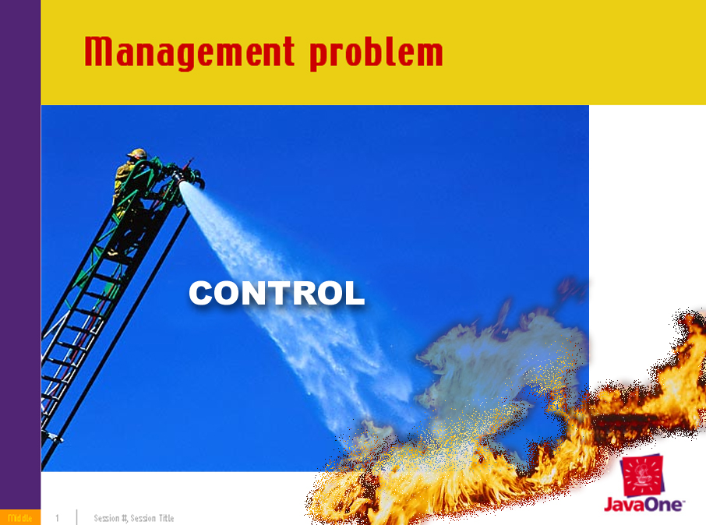
Problem

Slide 11
Problem
What do we want to achieve?
Control not just information
Policy based management
  Proactive reaction
  Behavior can be redefined
Interoperate with existing standards
  SNMP
  WBEM
  Proprietary

Slide 12
Problem
How do we want to achieve it?
Three tiered management
Control based management
Network centricity
Protocol neutrality

Slide 13
Logical structure
Three tiered management
Management
Client
Presentation
Jiro™
Services
Agent
WBEM
SNMP
Other

Slide 14
Physical Structure
Jini™ Lookup service
Base Services
Logging,
Events,
Security,
Controller,
Transaction,
Scheduling
Station
Station
Station
Dynamic Services
Management facades,
Bays,
POLICY based logic

Slide 15
Resource locking
Controllers
  Client, services
Controller locks
  Exclusive control
  Long lived
Resource reservation
FB
FB
MF
Resource

Slide 16
Network centricity
Hosts and OSs are not visible
Each management domain has a Jini™ lookup service
Services and stations publish interfaces
Management domain is a collection of managed resources and services

Slide 17
Protocol neutrality
Lookup service
P
Client
Station
P
Any protocol
P
Service
SNMP
WBEM
…
R
R
R

Slide 18
Functions of Jiro™ client
Jiro™ client – MANAGEMENT console, MONITORING tool
Monitoring
  Errors
  Events
Management
  Service Deployment
  Service Recall
  Service Installation
  Specific tasks

Slide 19
How to simplify development process?
Define COMMON PROBLEMS
Design solutions for these common problems
Package solution in a set of reusable Jiro™ aware Java™ Beans. This allows to SOLVE ALL PROBLEMS ONCE
Let developer employ “local programming model” when possible

Slide 20
Jiro™ client structure
Management Application
JIRO™ CLIENT
FRAMEWORK
Application specific
components
Jiro™

Slide 21
Jiro™ client
Can deploy/recall services
Can install/uninstall
Performs specific tasks
  Sets policies
  Gets information about managed resources
  Notifies about potential problems
  Configures resources

Slide 22
Common problems
What client needs
Dynamic services management and state tracking
Domain discovery
Deployment/recall
Lease management
Event listening
Answer: Client Framework

Slide 23
Jiro™ client framework
Dynamic Service
Adapter
Deployment
manager
Event Adapter
Discovery Manager
Lease Manager

Slide 24
Client Framework:
Lease Manager
Keeps the list of leases
Makes sure they are renewed on time
Can be used by the client and by services
Is not Jiro™ specific. Can be used in Jini™ environment
SOLVES LEASE MANAGEMENT

Slide 25
Client Framework:
Discovery Manager
Discovers lookup services in visible domains
Keeps track of available services
Sends local notifications when service is discovered / lost
Gives access to the service proxy, once it is found
Prevents redundancy of the lookup / discovery process
SOLVES DOMAIN DISCOVERY

Slide 26
Client Framework:
Discovery Manager
DiscoveryManager dm = DiscoveryManager.getSingleton();
dm.addListener("jiro:montage", servicetemplate, new RegistrationEventListener());
....
public class RegistrationEventListener implements RemoteEventListener{
public void notify(RemoteEvent theEvent){
if (ev instanceof ServiceEvent) {
ServiceEvent sev = (ServiceEvent) ev;
if(sev.getTransition() == TRANSITION_NOMATCH_MATCH){
ServiceItem item = sev.getServiceItem();
DeploymentStation ds = (DeploymentStation) item.service;
....
}
}
}

Slide 27
Client Framework:
Event Adapter
Transforms remote Jiro™ events into local events
The client subscribes to Event adapter instead of Jiro™ EventService
Support of Observers and Responsible Listeners
Amount of actual subscriptions minimization
SOLVES EVENT LISTENING

Slide 28
Client Framework:
Dynamic Service Adapter
Jiro™ aware Java™ bean represents the service state as a set of properties.
State change are communicated by means of PropertyChangeEvent
State installed/uninstalled: Lookup service
State deployed/recalled: DeploymentStation
SOLVES SERVICE MANAGEMENT and STATE TRACKING

Slide 29
Client Framework:
Dynamic Service Adapter
Client JVM
Jiro™ Domain
Listener
Discovery
manager
Lookup
service
ServiceEvent
Property Change
Installed
Dynamic
Service Adapter
Jiro™
Station
Deployed

Slide 30
Client Framework:
Dynamic Service Adapter
DynamicServiceAdapter dsa = new DynamicServiceAdapter(
“jiro:montage”, “com.faultmgmt”,
“1.0”, servicetemplate);
dsa.addPropertyChangeListener(new FaulMgmtServiceListener());
…
public void propertyChange(PropertyChangeEvent evt){
if(evt.getPropertyName().equals("proxy"))
if(evt.getOldValue() == null)
try{
Lease lease =
((FaultMgmtService)evt.getNewValue()).
enforce(defaultpolicy);
LeaseManager.instance().addLease(lease);
}catch(PolicyEnforcementException ex){...}
}

Slide 31
Conclusion
Most of shown components are not just client specific
Similar approach can be used for service development

Slide 32
Summary
Jiro™ technology helps solve the problem of DISTRIBUTED RESOURCE MANAGEMENT
It is:
Three tiered
Control based
Network centric
Protocol neutral
End

Slide 33
Summary
Jiro™ client – administration and monitoring tool
SOLVE PROBLEMS ONCE
Develop reusable components
Let developer employ “local programming model” when possible
End

Slide 34

Join the trend
Just a year since the first release, but already seriously taken by companies in Storage, Telecommunications, Electronics, Automotive industries
If you want universal management solution Jiro™ is the right choice
End

Slide 35
Resources
Jiro 1.5 available at http://jiro.com/downloads/
jiro.com
  Jiro technology community
sun.com/jiro
  Jiro technology product information
alex.rykov@montage.ca
  Questions
End
End

Slide 36


Slide 37




