Slide 1

JIRO
August 2000

Slide 2


Who are we?
16 years in the consulting business
Nearly 400 employees
5 branches in Canada, 2 in the US, 1 in Europe
Broad range of practices
    - Internet Solutions
    - Oracle Financials
    Business Intelligence
    eMarketing

Slide 3
















Clients

Slide 4
Experts in Java technologies
Java Beans
JDBC
JSP, Servlets – Choice, AdLink
EJB – Metro Police, TD Bank
RMI – Teds, JIRO
JNI – Net Venue
JINI
JIRO

Slide 5
Partnership with Sun
Montage – Authorized Java Center
Certain level of qualification, certified people
Consulting
Training
Case Studies

Slide 6
Projects with Sun
Java Day City of Toronto
ATB
Teds
JIRO

Slide 7
Teds
Rewritten existing advertising layout program
Pure Java application
Rich GUI with DND functionality
Running on Solaris, Mac, NT

Slide 8
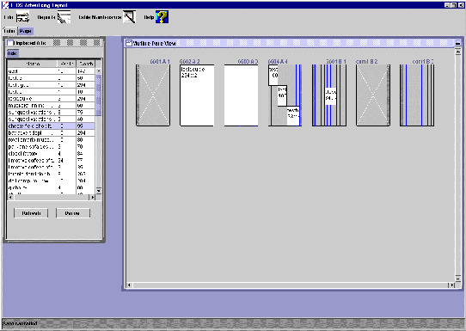
Teds

Slide 9
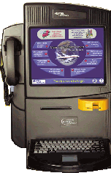
Nortel NetVenue
User interface
Media support
Web Service API
Native Service API
Browser Component
Device Support
Configuration Access
eCommerce(credit and debit)

Slide 10
Responsibilities
Analysis of the typical JIRO application
Abstraction of common elements as separate components
Development of sample application
Market research

Slide 11
Components
JIRO Application Framework
Dynamic Service Adapter
“JIRO Beans”
Lease Manager
Discovery manager

Slide 12
Application Framework
Flexibility and Extendibility
  Support for dynamic domain selection and management
  Support for dynamic JIRO domain properties (optional persistence)
  Implements commonly used functionality for a multiple domain management application

Slide 13
Application Framework Offerings
Service or Management Façade
  Deployment, Installation & Recall
    Deployer: Makes the service/façade JAR files available to the JIRO domain
    Installer: Instantiates (if applicable) the object. An event returns the proxy to the registered event listener(s)
    Recaller: Removes the specified deployment of the service/façade from the deployment list

Slide 14
Application Utilities
Dynamic Service Adapter
  Uses DSA to dynamically detect the state of any given service in the current JIRO Domain
“JIRO Beans”
  Receives notification that the state of the service it is maintaining has changed

Slide 15

JIRO beans
Jiro Beans are “Jiro aware” Java Beans, and reflect the state of the service.

Slide 16
Dynamic Service Adapter
DSA – a Java Bean, which transforms changes of the Service state into local events.
The application, using the DSA does not have to know about Jiro nature of the service. It is notified about changes via local events mechanism.

Slide 17
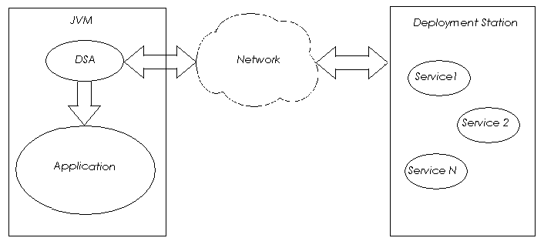
Dynamic Service Adapter

Slide 18
Lease Manager
Keeps track of all leases
Renews leases automatically
Is used by application and the service
Can be used by any JIRO/JINI application for lease renewals

Slide 19
Discovery manager
Keeps track of all lookup services available
Keeps track of services in particular groups the clients are interested in
Sends events to the clients when the service is registered/unregistered
Can be used by any JIRO/JINI application

Slide 20
Questions?

