Slide 1

MinCaml:
A Simple and Efficient Compiler for a Minimal Functional Language
Eijiro Sumii
Tohoku University
Notes:
I’m Eijiro Sumii from Tohoku University.
I’m going to talk about
a _very_ simple _and_ efficient compiler
for a small but non-trivial functional language

Slide 2
Highlights
"Simple and efficient compiler
for a minimal functional language"
Only 2000 lines of OCaml
Efficiency comparable to OCamlOpt and GCC for several applications
  Ray tracing, Huffman encoding, etc.
Used for undergraduates in Tokyo since 2001
Notes:
The compiler is as simple as only 2000 lines of OCaml.
But yet, it is almost as efficient as OCamlOpt and even GCC
for several applications such as ray tracing and Huffman encoding.
Of course, OCamlOpt compiles OCaml,
GCC compiles C, and
MinCaml compiles a small functional language,
so we are comparing _different_ implementations of the same applications,
written in the optimal style of each language.
MinCaml has been used in an undergraduate course
in the CS major in the University of Tokyo since 2001.
By the way, I myself am no longer in Tokyo
because I moved to Pennsylvania and then to Tohoku,
but MinCaml is still used in Tokyo by my successors.

Slide 3
Outline of This Talk
Pedagogical background
Design and implementation of MinCaml
Efficiency
Notes:
The outline of this talk is like this.
First, I talk about the pedagogical backgroud of MinCaml,
such as the computer science major curriculum in Tokyo.
Then, we look at a little details of MinCaml itself,
and experiments to see the efficiency of MinCaml.

Slide 4
Computer Science for
Undergraduates in Tokyo
Liberal arts (1.5 yr)
  English, German/Chinese/French/Spanish, mathematics, logic, physics, chemistry, ...
  Computer literacy, CS introduction,
  Java programming, data structures
CS major (2.5 yr) [~30 students/yr]
  Algorithms, OS, architecture, ...
  SPARC assembly, C, C++, Scheme, OCaml, Prolog
Notes:
In Tokyo, _all_ undergraduate students first study liberal arts for 1.5 years,
such as English, a second foreign language, mathematics,
logic (including topics like Goedel’s incompleteness theorem),
physics, chemistry and so on.
In particular, all of them take a computer literacy course
(this is almost equivalent to how to use UNIX,
because everybody knows how to use Windows already),
and some study introductory computer science, Java programming,
and data structures such as lists and trees.
Then, about 30 of them choose the computer science major
and take standard CS courses such as algorithms, operating systems, and architecture.
In particular, they learn programming languages including
SPARC assembly, ..., and Prolog.
These imperative languages are mainly used in operating system and architecture classes,
while these more declarative languages are mainly used in programming language classes.

Slide 5
Programming Languages for
CS Major in Tokyo
PL labs (63 hr)
  Mini-Scheme interpreter in Scheme,
  Mini-ML interpreter in OCaml,
  Othello/Reversi competition in OCaml, etc.
Compiler lecture (21 hr)
  Parsing, intermediate representations, register allocation, garbage collection, ...
PL theory lectures (42 hr)
  λ-calculus, semantics, type theory, ...
Notes:
In the programming language classes,
students first learn basic programming in Scheme, OCaml, and Prolog.
Then, they study how these languages work
by implementing min-interpreters.
They also write realistic applications
such as Othello or Reversi programs,
competing with each other.
In parallel, they take classes on compilers and programming language theories,
such as parsing, register allocation, garbage collection,
lambda-calculus and type theory.

Slide 6
CPU/Compiler Labs (126 hr)
CPU lab
  Design and implement original CPUs by using VHDL and FPGA
Compiler lab
  Develop compilers for the original CPUs
  MinCaml is used here!
⇒ Compete by the speed of ray tracing
(5-6 students per group)
Notes:
In addition, we have very interesting laboratory work
called CPU lab and compiler lab.
This is group work; each group consists of 5 to 6 student.
They design and implement an original CPU using a programmable LSI.
Typically, their CPUs are about 2 or 3 times slower
than real CPUs such as UltraSPARC.
Then, they develop a compiler for the original CPU;
this is where MinCaml is used.
In the end of the semester,
they compete by the speed of ray tracing
written in MinCaml and run on their CPUs.

Slide 7
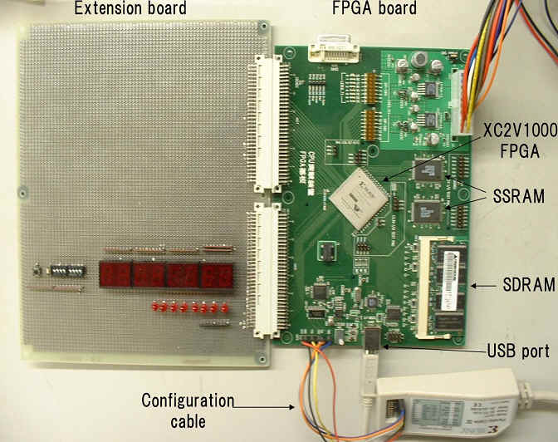
Special thanks to Hiraki laboratory
Notes:
Just for fun, this is how the hardware looks like.
We have the programmable LSI here,
some RAMs here,
a USB port here,
and some LEDs here for debugging.
Students may also add some hardware onto this extension board.

Slide 8
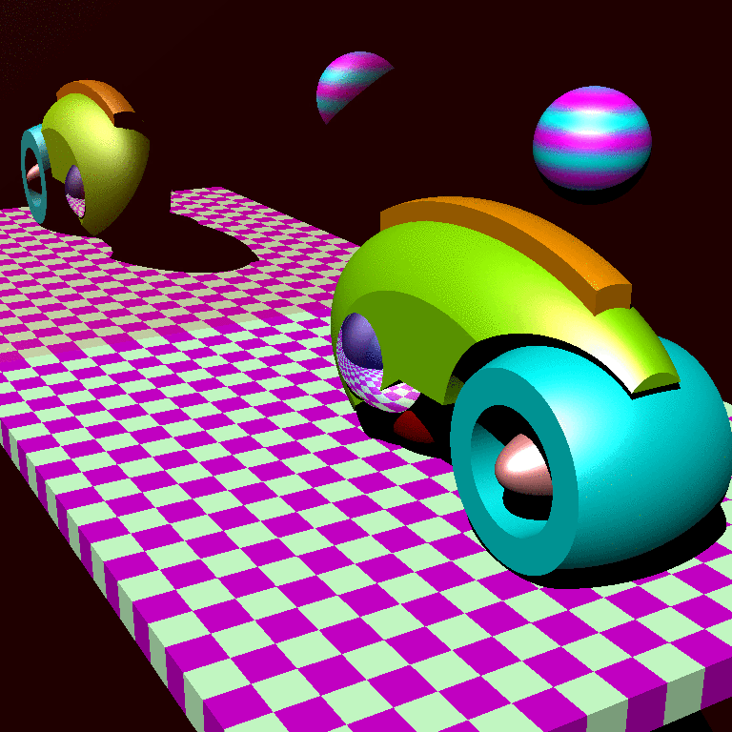
Notes:
This is an example of a scene rendered by the ray tracing.
This “tron” car is made of intersections and differences of ellipsoids.
The surface of this ball is a mirror.
And this wall is a mirror, too.

Slide 9
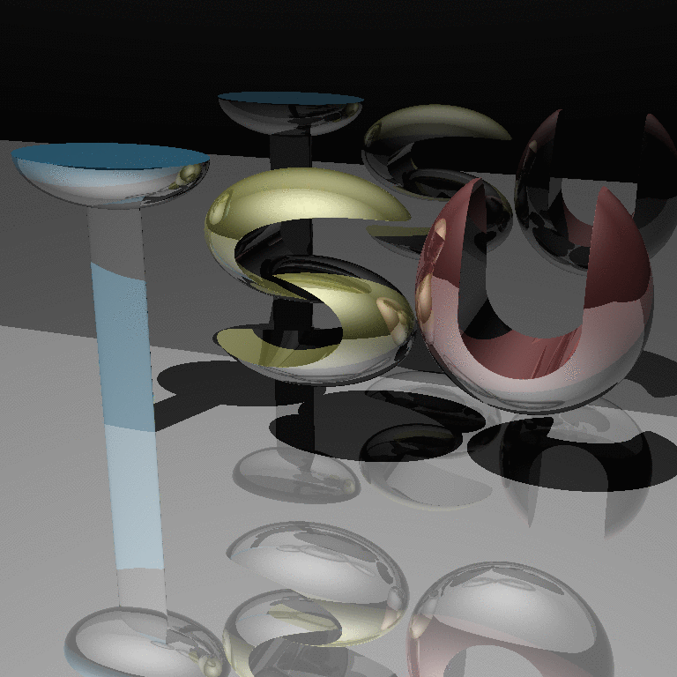
Notes:
Here is another example, made by a friend of mine
when we took a previous version of this class 9 years ago.
As you can see, this scene is full of reflections
and takes a lot of time to render.
Of course, MinCaml didn’t exist at that time,
so we ported GCC to our CPU, which was a pain.

Slide 10
How is MinCaml Used?
Students are given high-level descriptions of MinCaml
  in Japanese and pseudo-code
Each group is required to implement them
Every student is required to solve small exercises
  such as hand compilation
Notes:
MinCaml was developed in year 2001
when I took over the compiler lab class.
In the class, MinCaml is used like this.
Students are given high-level descriptions of MinCaml
in Japanese prose and mathematical pseudo-code;
I’ll give examples of the pseudo-code later.
Given these descriptions, each _group_ is required to
implement the compiler for their own CPU.
In addition, every _student_ is required to solve small exercises
such as hand compilation of tiny programs.

Slide 11
Outcome (1/2)
Students liked ML!
Implemented polymorphism
(like MLton), garbage collection,
inter-procedural register allocation, etc. without being told
Started a portal site (www.ocaml.jp) with Japanese translations of the OCaml manual without being told
Notes:
The use of MinCaml in Tokyo has been successful
in the sense that students liked ML.
Some of them implemented polymorphism
by means of code duplication like MLton,
garbage collection, inter-procedural register allocation,
and so on _even though_ I didn’t tell them to do so.
Others started a portal site in Japanese for OCaml
and translated its manuals, again without being told.

Slide 12
Outcome (2/2)
"Outsiders" are also using MinCaml
Somebody anonymous wrote a comprehensive commentary on MinCaml
Ruby hackers organized an independent seminar to study MinCaml
Prof. Asai is using MinCaml in Ochanomizu University
Notes:
MinCaml has also been used by outsiders.
Somebody anonymous published a nice commentary about MinCaml on the Web,
complementing my own tutorial, but I _really_ don’t know the author.
Also, according to their blogs, some Ruby hackers
held a seminar to read the source code of MinCaml.
And Prof. Asai, sitting there, is using MinCaml for some research and education
in Ochanomizu University.

Slide 13
Outline of This Talk
Pedagogical background
Design and implementation of MinCaml
Efficiency
Notes:
OK, that’s enough pedagogy;
let’s move on to technical details.

Slide 14
Goals
As simple as possible
but
Able to efficiently execute
non-trivial applications
(such as ray tracing)
Notes:
The compiler for the class had to be as simple as possible
because the students are undergraduate.
At the same time, it had to be efficient
at least for one application: ray tracing.

Slide 15
MinCaml: The Language
Functional: no destructive update of variables (cf. SSA)
Higher-order
Call-by-value
Impure
  Input/output
  Destructive update of arrays
Implicitly typed
Monomorphic
Notes:
Given these requirements, I designed the source language of our compiler class like this.
First of all, it is a functional language,
meaning no destructive update of variables,
so it is _definitely_ not C.
In other words, it is a kind of static single assignment form in the first place.
It is higher-order, call-by-value, impure for I/O and destructive update of _arrays_.
For the efficiency of floating-point number computations in ray tracing,
it is implicitly typed but monomorphic.
This language is named MinCaml, because its syntax is a minimal subset of Objective Caml.

Slide 16
Syntax (1/2)
M, N (expressions) ::=
c
op(M₁, ..., M_{n})
if M then N₁ else N₂
let x = M in N
x
let rec x y₁ ... y_{n} = M₁ in M₂
M N₁ ... N_{n} (no partial application)
... (cont.)
Notes:
This is the syntax of MinCaml.
We have constants, primitives for arithmetic, conditional branches,
variable definitions, reading from variables, recursive function definitions,
and function applications.
We don’t support partial function application,
though it is easy to implement by a type-based transformation.

Slide 17
Syntax (2/2)
M, N (expressions) ::=
...
(M₁, ..., M_{n})
let (x₁, ..., x_{n}) = M in N (cf. #_{i} M)
Array.create M N
M.(N)
M₁.(M₂) ← M₃
()
Literally implemented as
ML data type Syntax.t
Notes:
We also have tuple creations, reading from tuples,
array creations, reading from arrays, writing to arrays,
and unit.
The reading from tuples is a pattern matching form instead of a projection
to avoid the flex record problem in type inference like Standard ML.
This syntax is literally implemented as an ML data type Syntax.t.

Slide 18
Everything else is omitted!
Array boundary checking (easy)
Garbage collection
Data types and pattern matching
Polymorphism
Exceptions
Objects etc.
Optional homework
(≥ 2 compulsory from this year)
Notes:
MinCaml is _intended_ to be a minimal functional language,
so _everything_ else is omitted.
For example, we _don’t_ have array boundary checking,
though this one is easy to implement; we don’t have
garbage collection; we don’t have data types or pattern matching,
polymorphism, exceptions, or objects.
Implementation of these features is optional homework:
in the past, some students did implement a few of them;
they complained that the lab is too easy!
From this year, it becomes compulsory to implement at least two.

Slide 19
MinCaml: The Compiler
Lexer
Parser
Typing
KNormal
Alpha
100
168
165
181
46
Const
Fold
Elim
Inline
Assoc
Beta
34
33
18
38
46
Reg
Alloc
Closure
Virtual
Simm13
Emit
104
163
42
256
262
Notes:
The overall structure of the MinCaml compiler looks like this.
It is a sequence of transformations from the source language to SPARC assembly.
These numbers are the code lines of each module.
We have lexing, parsing, type inference, and so on.
I am not going to lecture a full compiler course,
but let’s have a short look at each module.

Slide 20
Lexing and Parsing
Written in OCamlLex and OCamlYacc
Given by the instructer
  Algorithms are out of scope
  Cf. packrat parsing [Ford 2002]
Notes:
Lexing and parsing are totally standard.
They are just given by the instructor in OCamlLex and OCamlYacc,
because algorithms for lexing and parsing are already covered in the previous compiler lecture.
Alternatively, we could use simpler algorithms like packrat parsing,
but we haven’t yet implemented it.

Slide 21
Type Inference
Based on standard unification
using ML references
  Let-polymorphic version is
  already taught in PL lab
Free variables are treated as
external functions (or arrays)
  "Principal typing" [Jim 96] is
  automatically inferred
Notes:
The monomorpihc type inference is also very standard,
using ML references for unification.
This is also easy because students have already implemented
even polymorphic type inference in a previous lab on programming languages.
The only non-standard point is that
the types of free variables are automatically inferred
as external functions or arrays,
so we don’t have to declare their types by hand.
This principal typing is possible because our types are monomorphic.
With ML-polymorphism, this is known to be impossible.

Slide 22
MinCaml: The Compiler
Lexer
Parser
Typing
KNormal
Alpha
100
168
165
181
46
Const
Fold
Elim
Inline
Assoc
Beta
34
33
18
38
46
Reg
Alloc
Closure
Virtual
Simm13
Emit
104
163
42
256
262

Slide 23
K-Normalization
a + b + c * d
⇓
let tmp1 = a + b in
let tmp2 = c * d in
tmp1 + tmp2
Nesting is allowed
let x = (let y = M₁ in M₂) in M₃
  Simplifies the normalization and inlining
  Cf. A-normalization by CPS

Slide 24
Syntax of K-Normal Form
M, N ::=
c
op(x₁, ..., x_{n})
if x then M₁ else M₂
let x = M in N
x
let rec x y₁ ... y_{n} = M₁ in M₂
x y₁ ... y_{n}
...
Implemented as KNormal.t

Slide 25
Algorithm of K-Normalization: Pseudo-Code Given to Students
K : Syntax.t → KNormal.t
K(c) = c
K(op(M₁, ..., M_{n})) =
let x₁ = K(M₁) in ... let x_{n} = K(M_{n}) in
op(x₁, ..., x_{n})
K(if op(M₁, ..., M_{n}) then N₁ else N₂) =
let x₁ = K(M₁) in ... let x_{n} = K(M_{n}) in
if op(x₁, ..., x_{n}) then K(N₁) else K(N₂)
K(let x = M in N) = let x = K(M) in K(N)
K(x) = x etc.

Slide 26
α-Conversion (Another
Example of Pseudo-Code)
α : KNormal.t → Id.t Map.t → KNormal.t
α(c)ρ = c
α(op(x₁, ..., x_{n}))ρ = op(ρ(x₁), ..., ρ(x_{n}))
α(if x then N₁ else N₂)ρ =
if ρ(x) then α(N₁)ρ else α(N₂)ρ
α(let x = M in N)ρ = (x' fresh)
let x' = α(M)ρ in α(N)ρ[x→x']
α(x)ρ = ρ(x)
etc.

Slide 27
MinCaml: The Compiler
Lexer
Parser
Typing
KNormal
Alpha
100
168
165
181
46
Const
Fold
Elim
Inline
Assoc
Beta
34
33
18
38
46
Reg
Alloc
Closure
Virtual
Simm13
Emit
104
163
42
256
262

Slide 28
β-Reduction
let x = y in M ⇒ [y/x]M
Pseudo-code (similar to previous examples) is left as an exercise

Slide 29
Nested "Let" Reduction
let y = (let x = M₁ in M₂) in M₃
⇓
let x = M₁ in let y = M₂ in M₃
Resembles A-normalization,
but does not expand "if"
C[if M then N₁ else N₂]
⇒ if x then C[N₁] else C[N₂]

Slide 30
Inlining
Inlines all "small" functions
Includes recursive ones
"Small" = less than a constant size
  User-specified by "-inline" option
Repeat for a constant number of times
  User-specified by "-iter" option

Slide 31
Constant Folding and
Unused Variable Elimination
let x = 3 in let y = 7 in x + y
⇓
let x = 3 in let y = 7 in 10
⇓
10
Effective after inlining

Slide 32
MinCaml: The Compiler
Lexer
Parser
Typing
KNormal
Alpha
100
168
165
181
46
Const
Fold
Elim
Inline
Assoc
Beta
34
33
18
38
46
Reg
Alloc
Closure
Virtual
Simm13
Emit
104
163
42
256
262

Slide 33
Closure Conversion
Local function definitions (let rec)
+ function applications
⇓
Top-level function definitions
+
● Closure creations (make_closure)
● Closure applications (apply_closure)
● Known function calls (apply_direct)

Slide 34
Example 1:
Closure Creation/Application
let x = 3 in
let rec f y = x + y in
f 7
⇓
let rec f_{top} [x] y = x + y ;;
let x = 3 in
make_closure f = (f_{top}, [x]) in
apply_closure f 7

Slide 35
Example 2: Known Function Call
let rec f x = x + 3 in
(f, f 7)
⇓
let rec f_{top} [] x = x + 3 ;;
make_closure f = (f_{top}, []) in
(f, apply_direct f 7)

Slide 36
Example 3:
Unused Closure Elimination
let rec f x = x + 3 in
f 7
⇓
let rec f_{top} [] x = x + 3 ;;
apply_direct f 7

Slide 37
MinCaml: The Compiler
Lexer
Parser
Typing
KNormal
Alpha
100
168
165
181
46
Const
Fold
Elim
Inline
Assoc
Beta
34
33
18
38
46
Reg
Alloc
Closure
Virtual
Simm13
Emit
104
163
42
256
262

Slide 38
Virtual Machine Code Generation
SPARC assembly with:
Infinite number of registers/variables
Top-level function definitions and calls (call_closure, call_direct)
Conditional expressions (if)
Tuple creations/accesses
and closure creations are
expanded to stores and loads

Slide 39
Register Allocation
Greedy algorithm with:
Look-ahead for targeting
  let x = 3 in let y = 7 in f y x
  ⇒ let r₂ = 3 in let r₁ = 7 in f r₁ r₂
Backtracking for "early save"
  let x = 3 in
  ...; f (); ...; x + 7
  ⇒ let r₁ = 3 in
  save(r₁, x); ...; f (); ...; restore(x, r₂); r₂ + 7

Slide 40
13-Bit Immediate Optimization
Specific to SPARC
“Inlining” or "constant folding"
for integers from -4096 to 4095
set 123, %r1
add %r1, %r2, %r3
⇓
add %r2, 123, %r3

Slide 41
Assembly Generation
Lengthy (256 lines)
but easy
Tail call optimization
Stack map computation
Register shuffling
  Somewhat tricky but short (11 lines)

Slide 42
Outline of This Talk
Pedagogical background
Design and implementation of MinCaml
Efficiency

Slide 43
Environment
Machine: Sun Fire V880
  4 Ultra SPARC III 1.2GHz
  8 GB main memory
  Solaris 9
Compilers:
  MinCaml (32 bit, -iter 1000 -inline 100)
  OCamlOpt 3.08.3 (32 bit, -unsafe -inline 100)
  GCC 4.0.0 20050319 (32 bit and 64 bit, -O3)
  GCC 3.4.3 (32 bit "flat model", -O3)

Slide 44
Applications
Functional
  Ackermann
  Fibonacci
  Takeuchi
Imperative
  Ray tracing
  Harmonic function
  Mandelbrot set
  Huffman encoding

Slide 45
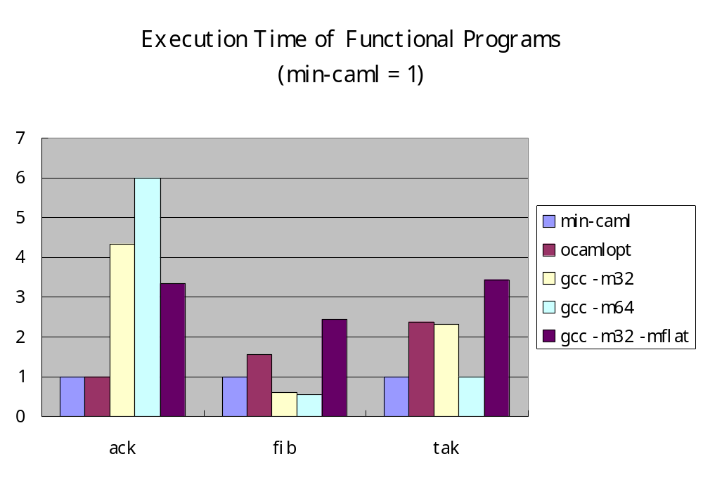

Slide 46
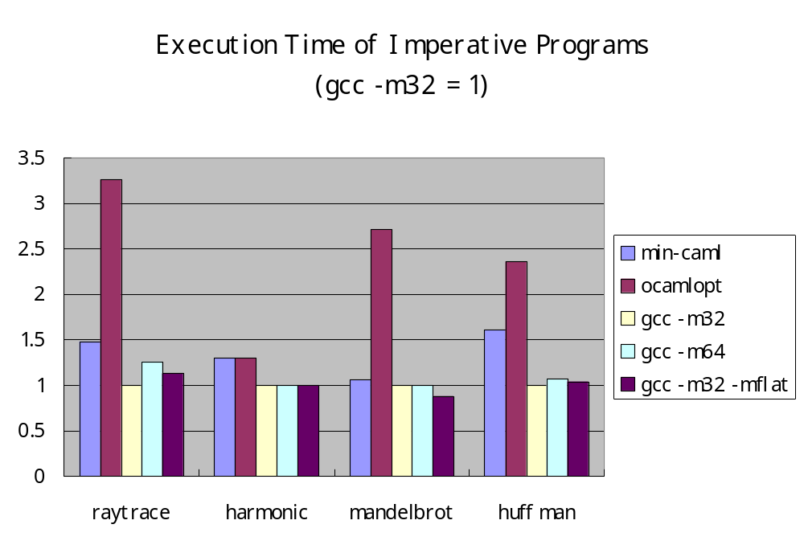

Slide 47
Summary
"Simple and efficient compiler
for a minimal functional language"
Future work:
Improve the register allocation
  By far more complex than other modules
  Too slow at compile time
Retarget to IA-32
  2-operand instructions (which are "destructive" by definition) and FPU stack

Slide 48
http://min-caml.sf.net/

