Slide 1

Seasonal Agriculture Performance Analysis
Aryan Kumar
Noida International University
AICTE STU ID : STU6a30bcb2b1d3b1781578930

Slide 2

PROBLEM STATEMENT
Agricultural activities are influenced by seasonal variations in environmental conditions, farming practices, resource availability and market conditions. As a result, agricultural performance may differ from one season to another.
However, raw agricultural data does not clearly explain how agricultural performance changes across seasons or what patterns can be observed in different seasonal conditions. The problem is to analyze the given agricultural dataset and investigate seasonal differences in agricultural performance by identifying meaningful patterns, trends, relationships and variations within the available data.

Slide 3
Project Description
Seasonal Agriculture Performance Analysis focuses on analyzing agricultural performance across different seasons, crops, geographical areas and farming conditions.
The project uses 4,000 farm records to examine important factors such as crop yield, production, revenue, profit, irrigation, water usage and disease/pest risk.
The dataset was cleaned by handling missing values and checking for duplicate records. Different groups were compared to identify seasonal variations, performance patterns and meaningful insights.
The analysis was performed using Python, Pandas and data visualization techniques in Jupyter Notebook/Google Colab to support data-driven conclusions and recommendations.

Slide 4

WHO ARE THE END USERS?
Farmers & Farm Managers
To understand seasonal crop performance, yield, water usage and profitability, helping them make better farming decisions.
Agricultural Analysts & Researchers
To analyze seasonal trends, compare crops and regions, and identify meaningful patterns and relationships in agricultural data.
Agricultural Planners & Decision Makers
To support better resource planning, farming strategies and seasonal decision-making based on data-driven insights.

Slide 5

Technology Used
  Python
  Used for data analysis and processing.
  Pandas
  Used for data cleaning, manipulation and analysis.
  Matplotlib & Seaborn
  Used for creating charts and visualizations.
  Google Colab
  Used as the environment for performing and documenting the analysis.

Slide 6
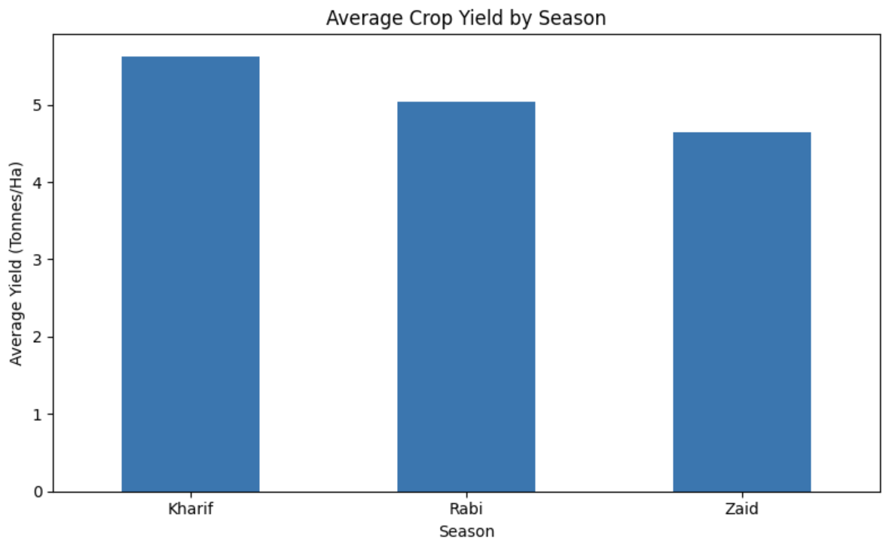
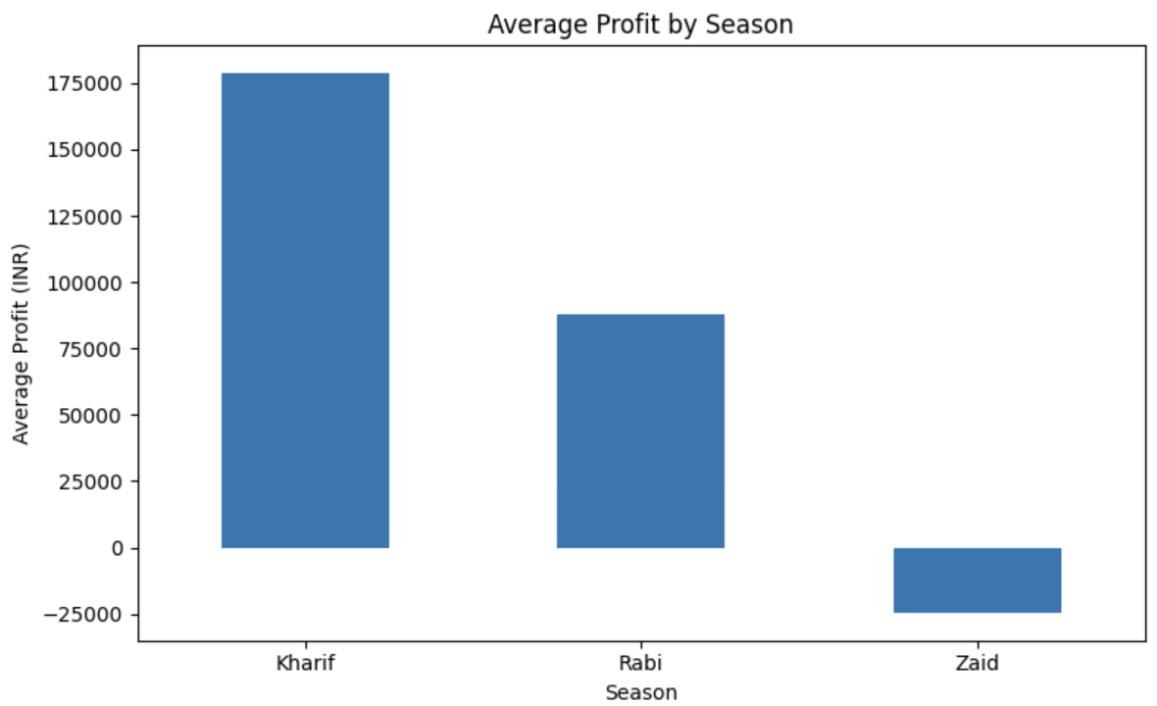
Results — Seasonal Performance
Yield and profit comparisons across seasons
Kharif has the highest average yield: 5.63 tonnes/ha.
Kharif has the highest average profit: about ₹1.79 lakh.

Slide 7
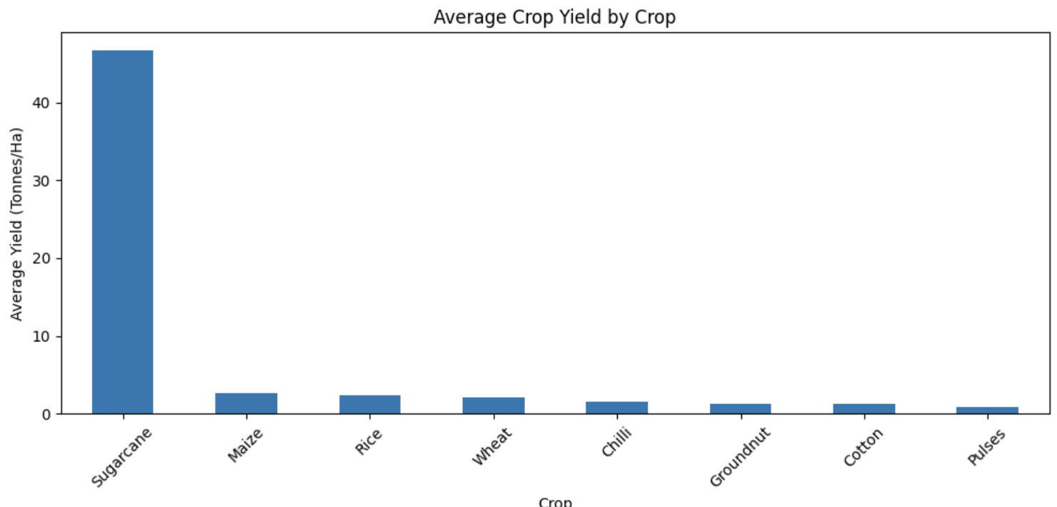
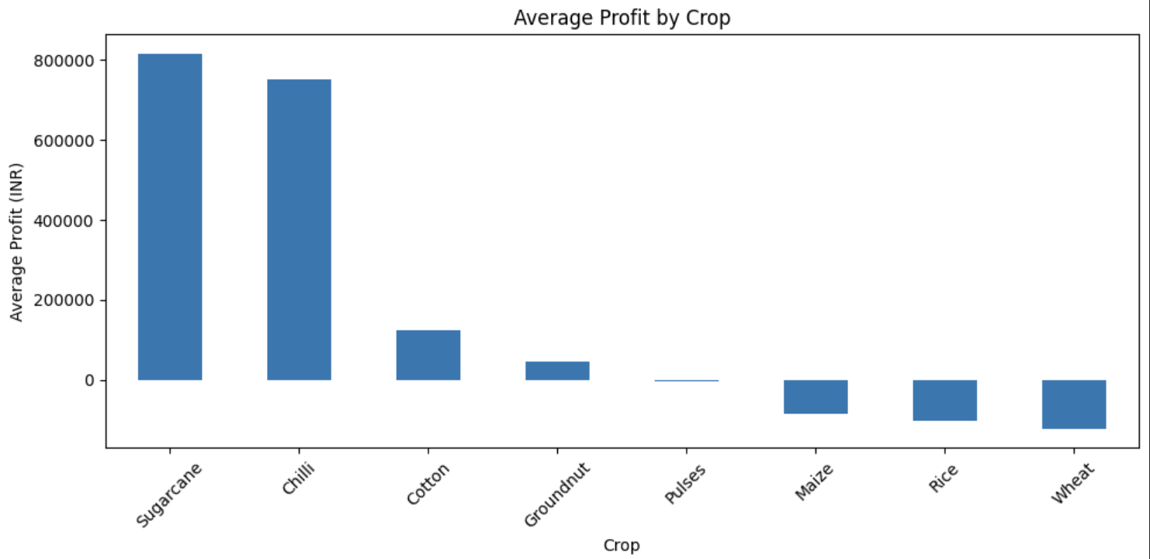
Results — Crop Performance
Yield and profit vary substantially across crops
Yield and profit comparisons across seasons
Sugarcane has the highest average yield: 46.64 tonnes/ha.
Sugarcane also has the highest average profit: about ₹8.17 lakh.

Slide 8
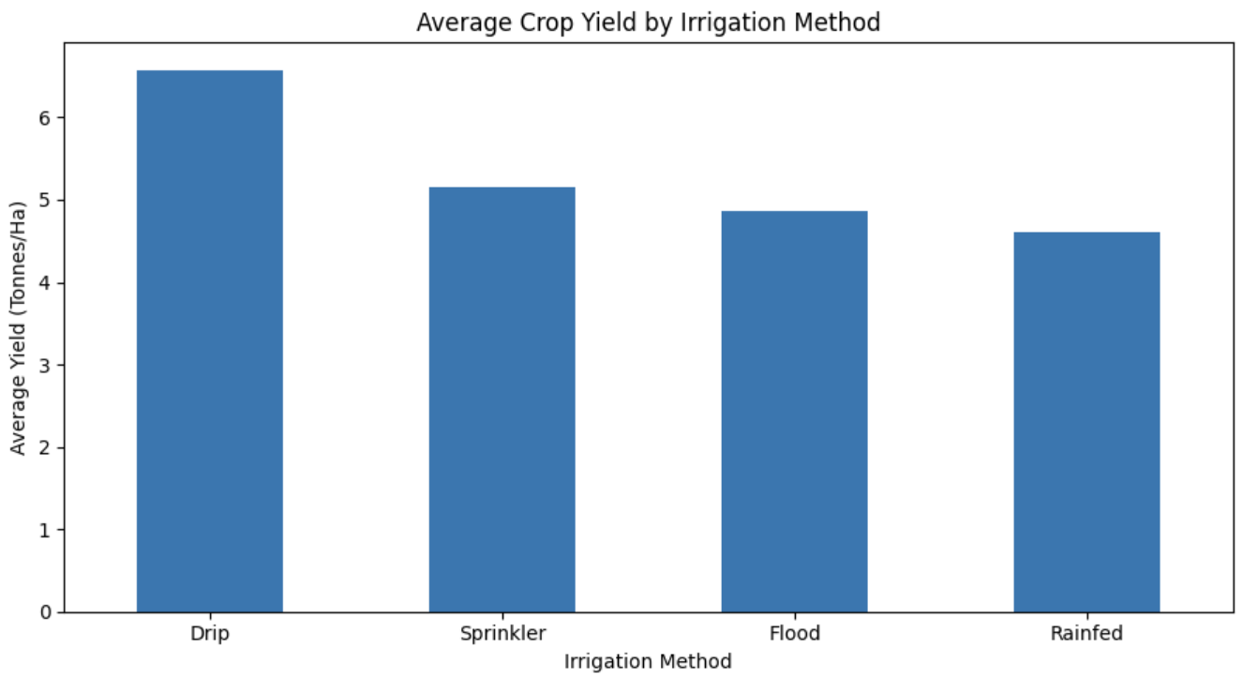
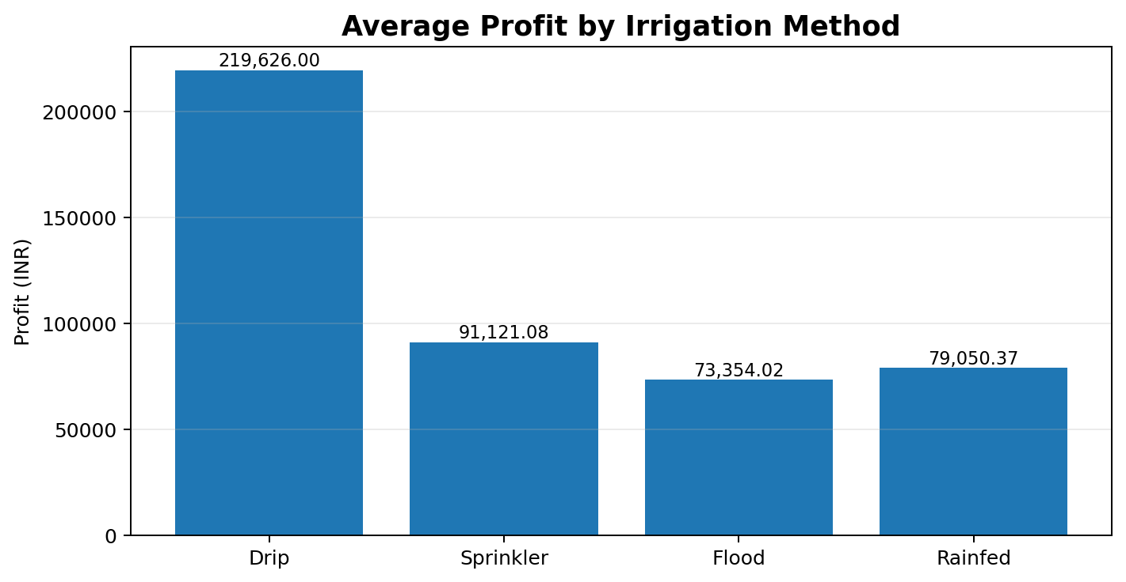
Results — Irrigation Performance
Comparison of yield and profit by irrigation method
Drip irrigation has the highest average yield: 6.58 tonnes/ha.
Drip irrigation has the highest average profit: about ₹2.20 lakh.

Slide 9
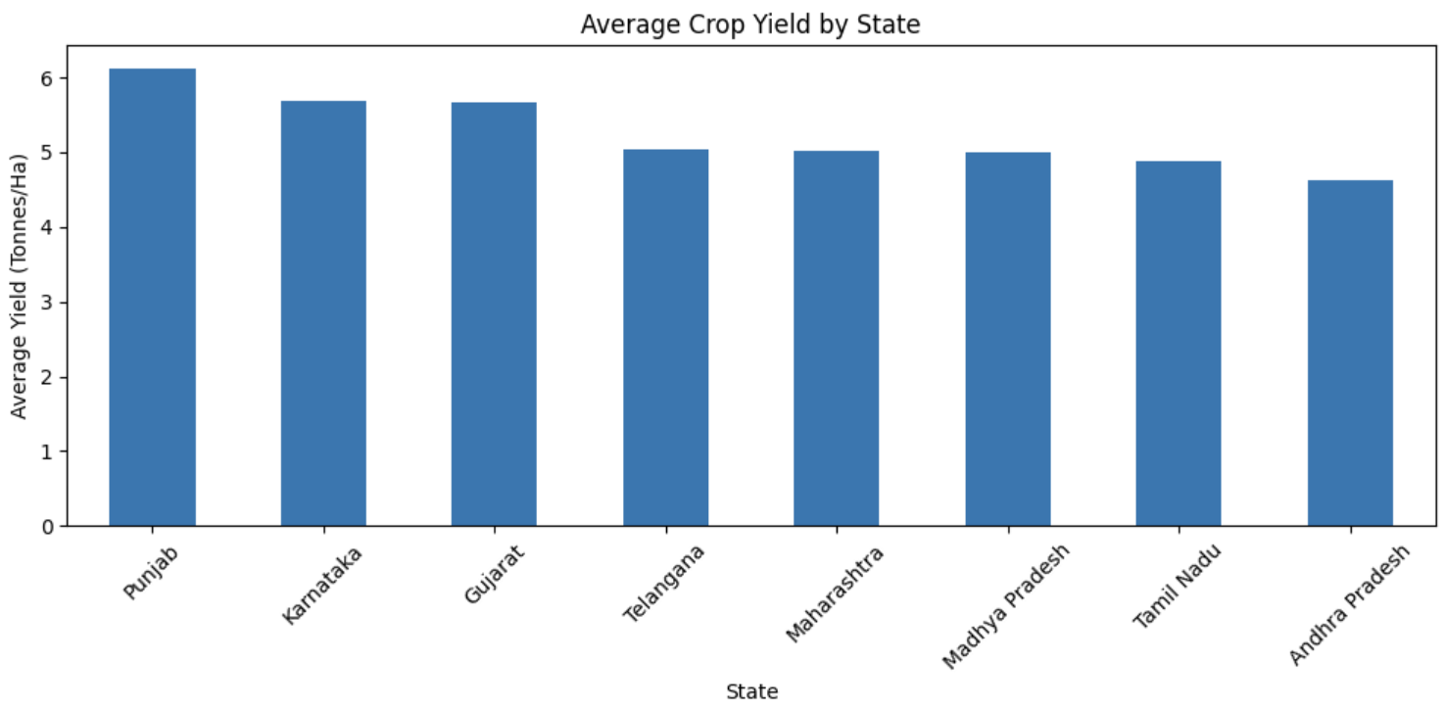
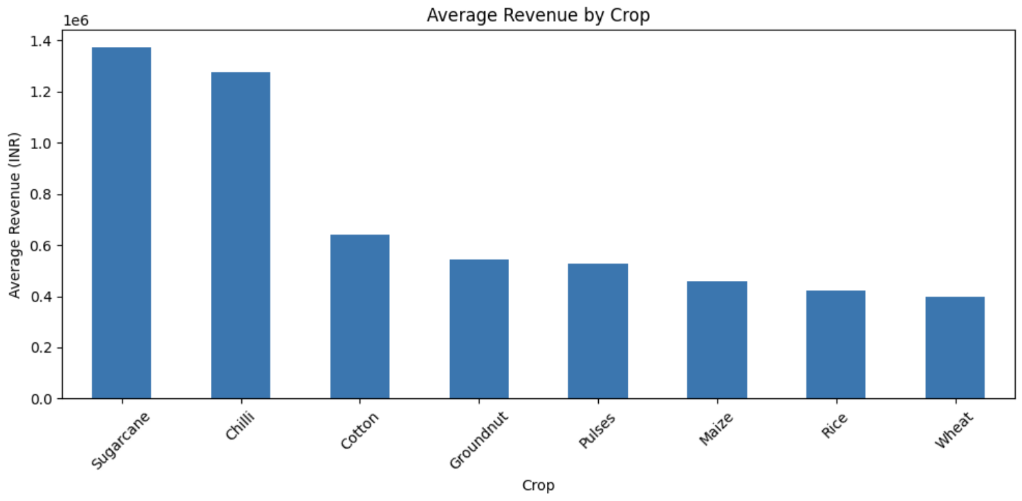
Results — Regional & Revenue Analysis
State-wise yield and crop-wise revenue
Punjab records the highest average yield: 6.12 tonnes/ha.
Sugarcane generates the highest average revenue: about ₹13.72 lakh.

Slide 10
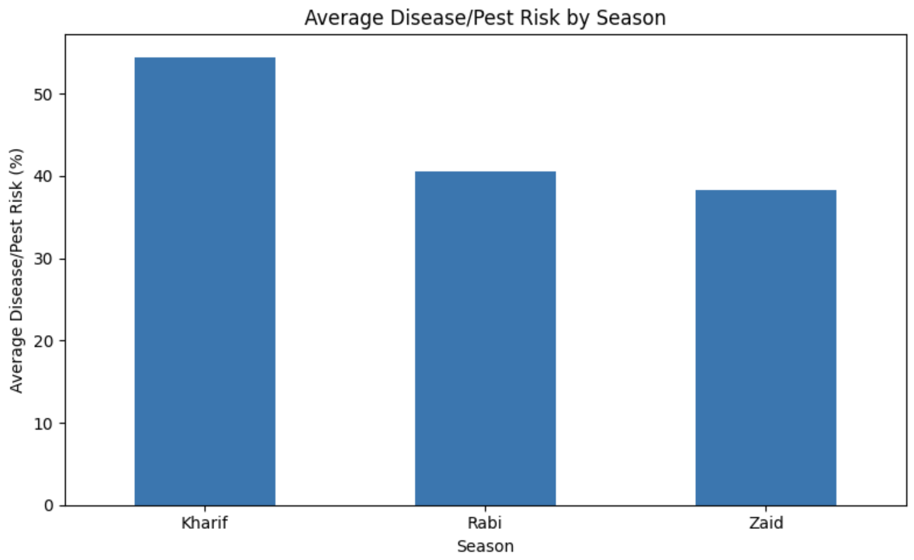
Results — Risk & Relationship Analysis
Disease/pest risk and environmental relationship
RAINFALL vs YIELD
Correlation ≈ 0.03
Very weak positive linear relationship in this dataset.
TEMPERATURE vs YIELD
Correlation ≈ 0.01
Extremely weak positive linear relationship.
Kharif has the highest average disease/pest risk: 54.47%.

Slide 11
Future scope
• Build predictive models for crop yield and profit.
• Study interactions among rainfall, temperature, soil and irrigation.
• Develop dashboards for real-time agricultural monitoring.
• Add more years and regional data for stronger trend analysis.
• Explore crop-specific recommendations and resource optimization.
• Use advanced statistical and machine-learning techniques for forecasting.

Slide 12
GitHub Link
https://github.com/aryyancode/seasonal-agriculture-performance-analysis

Slide 13
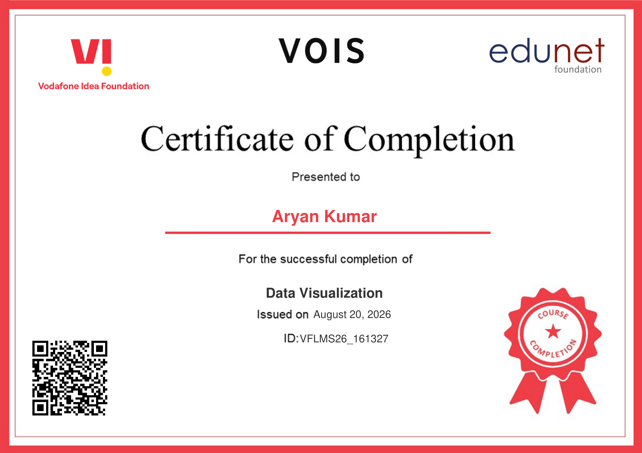
VOIS Course completion certificate -
Course name- Data Visualization

Slide 14
Thank you
Seasonal Agriculture Performance Analysis
Aryan Kumar • Noida International University
AICTE STU ID : STU6a30bcb2b1d3b1781578930
.
.

