Slide 1
SEASONAL AGRICULTURE
PERFORMANCE ANALYSIS
Major Project
Aryan Kumar
Noida International University
AICTE STU ID: STU6a30bcb2b1d3b1781578930

Slide 2
Problem Statement
Agricultural activities are influenced by seasonal variations in environmental conditions, farming practices, resource availability and market conditions. As a result, agricultural performance may differ from one season to another.
The project analyzes the given agricultural dataset to investigate seasonal differences and identify meaningful patterns, trends, relationships and variations within the available data.
FOCUS
METHOD
OUTPUT
Seasonal variation
Data analytics
Evidence-based insights
Compare agricultural performance across seasons.
Use statistical and visualization techniques.
Support better seasonal agricultural planning.

Slide 3
Project Description
This project analyzes 4,000 agricultural records covering different crops, seasons, states, farming practices, environmental conditions, resource usage and economic outcomes.
• Cleaned the dataset by handling missing values and checking duplicates.
• Explored crop, season and state distributions.
• Compared yield, profit, revenue, water usage and disease/pest risk.
• Analyzed relationships between selected environmental/resource variables and crop yield.
• Used visualizations to communicate important findings and patterns.

Slide 4
Who Are the End Users?
• Farmers — to understand seasonal performance and farming outcomes.
• Agricultural planners — to support evidence-based seasonal planning.
• Agribusiness stakeholders — to compare crop and economic performance.
• Researchers and analysts — to explore agricultural patterns and relationships.
• Students and educators — to demonstrate practical data analytics.

Slide 5
Technology Used
LANGUAGE
DATA ANALYSIS
VISUALIZATION
Python
Pandas
Matplotlib
Used for data analysis and visualization.
Data cleaning, grouping and statistical analysis.
Charts and visual presentation of results.
VISUALIZATION
PLATFORM
Seaborn
Google Colab / Jupyter
Additional statistical visualization support.
Notebook-based analysis environment.

Slide 6
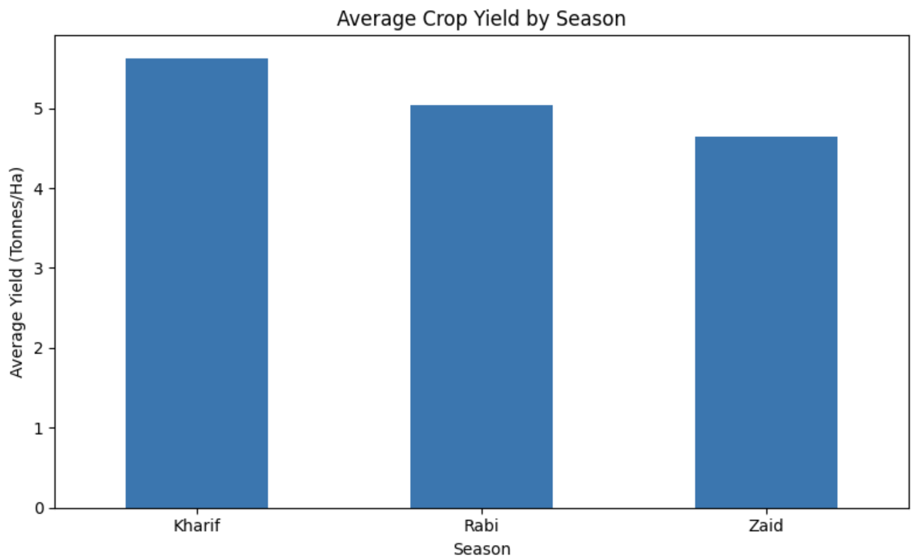
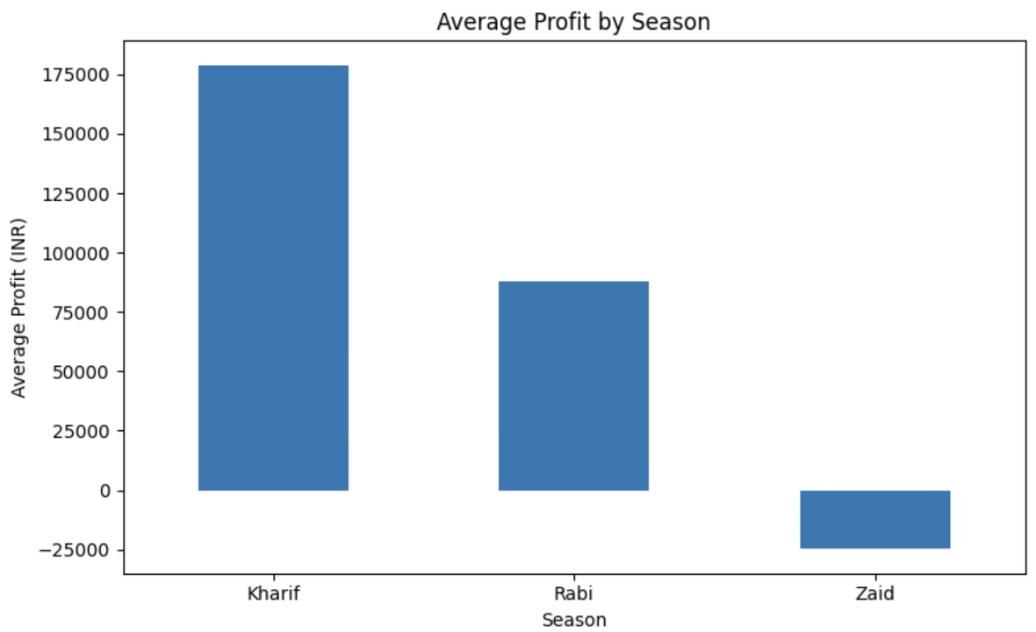
Results — Seasonal Performance
Yield and profit comparisons across seasons
Kharif has the highest average yield: 5.63 tonnes/ha.
Kharif has the highest average profit: about ₹1.79 lakh.

Slide 7
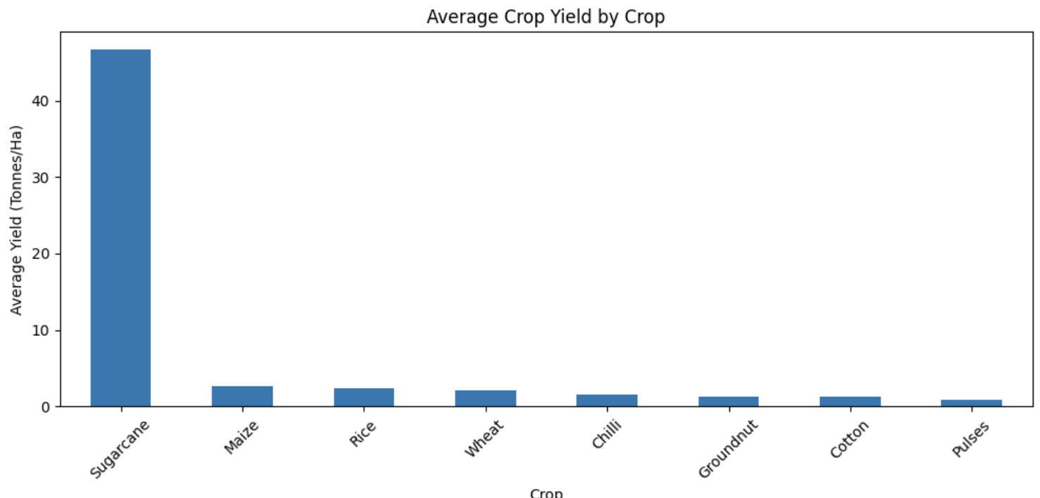
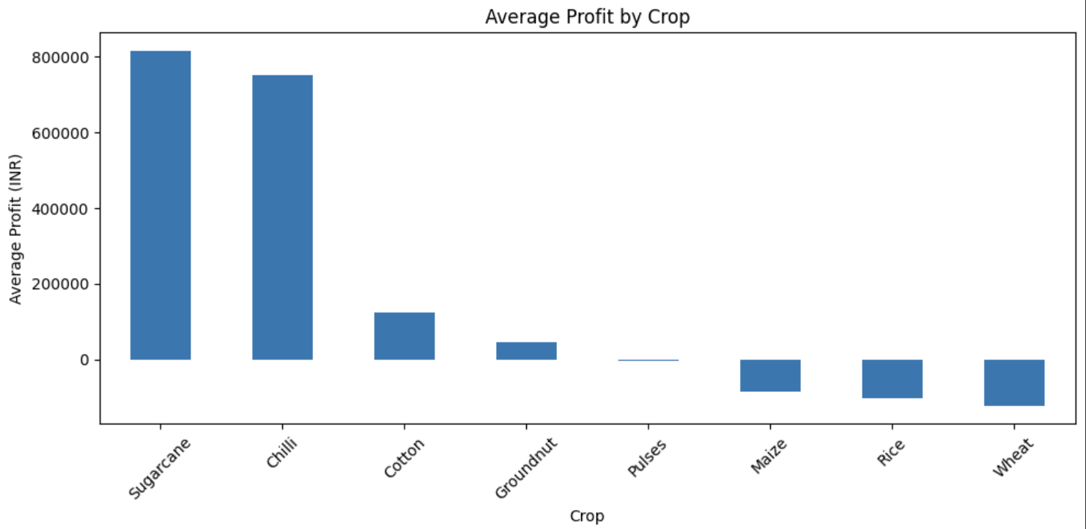
Results — Crop Performance
Yield and profit vary substantially across crops
Sugarcane has the highest average yield: 46.64 tonnes/ha.
Sugarcane also has the highest average profit: about ₹8.17 lakh.

Slide 8
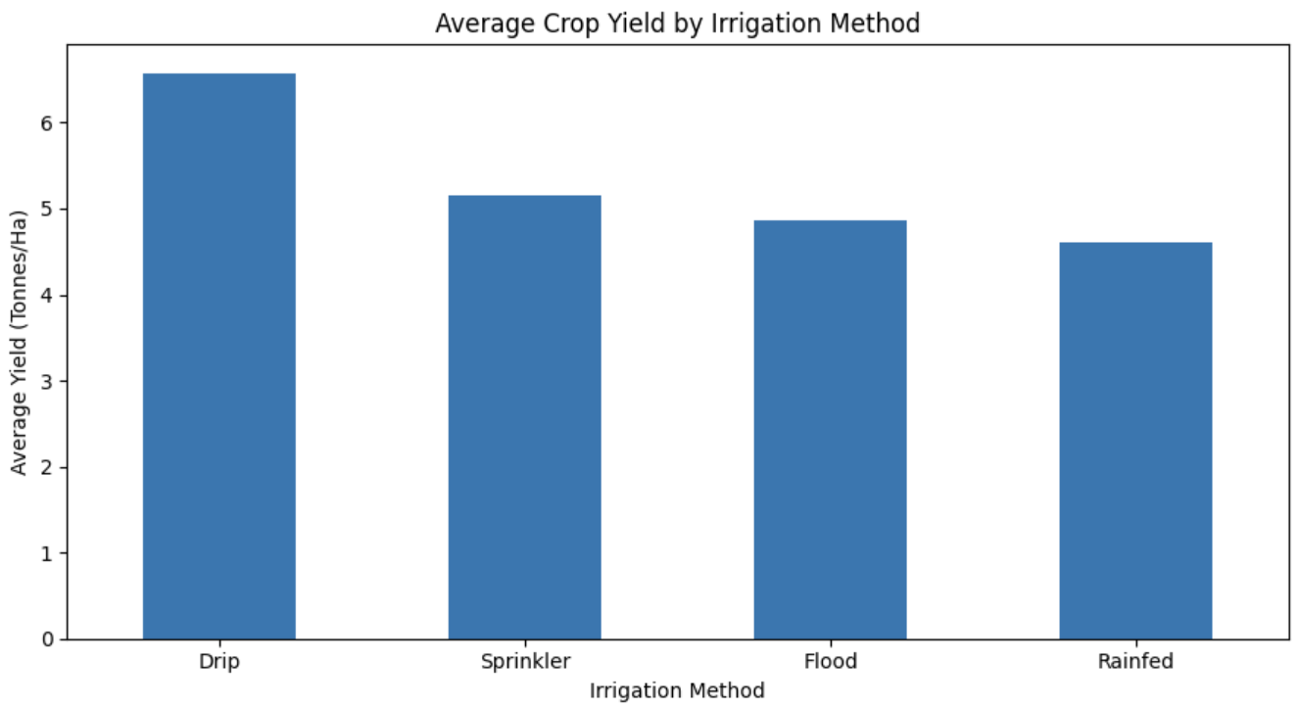
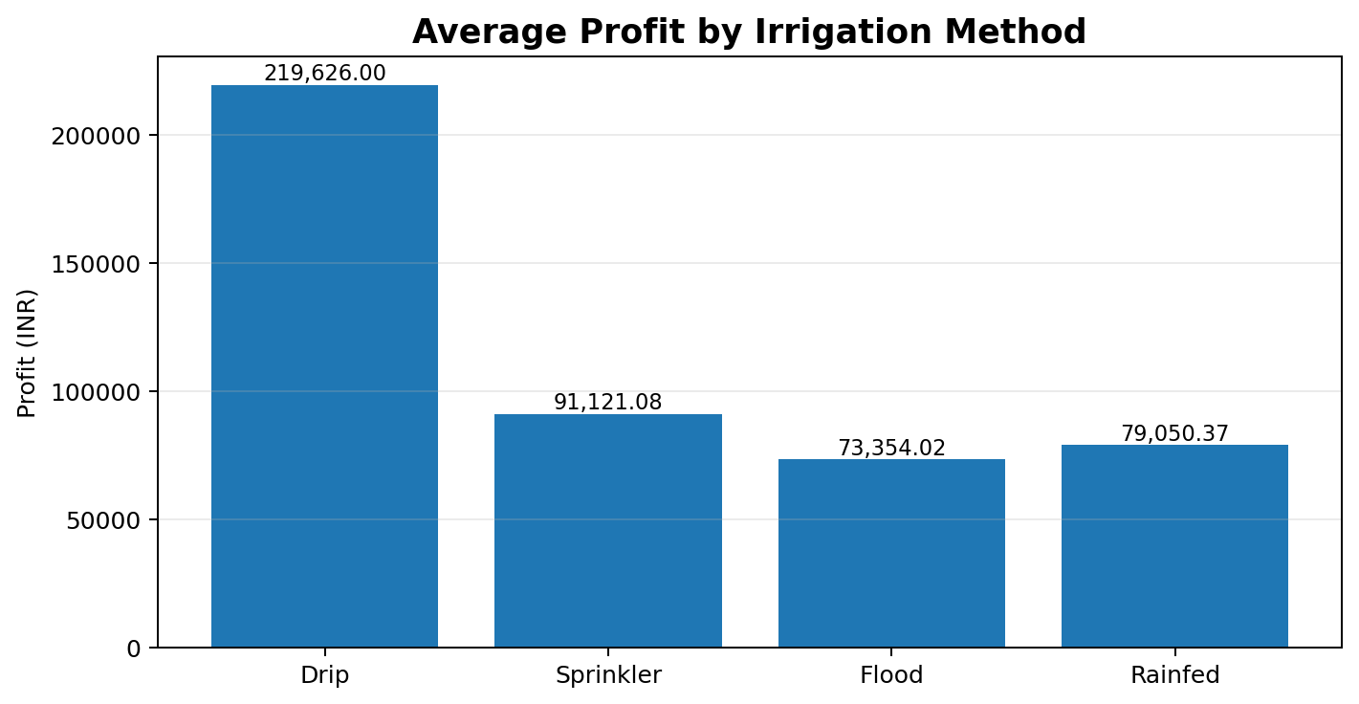
Results — Irrigation Performance
Comparison of yield and profit by irrigation method
Drip irrigation has the highest average yield: 6.58 tonnes/ha.
Drip irrigation has the highest average profit: about ₹2.20 lakh.

Slide 9
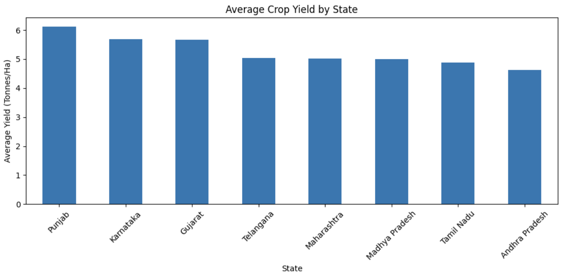
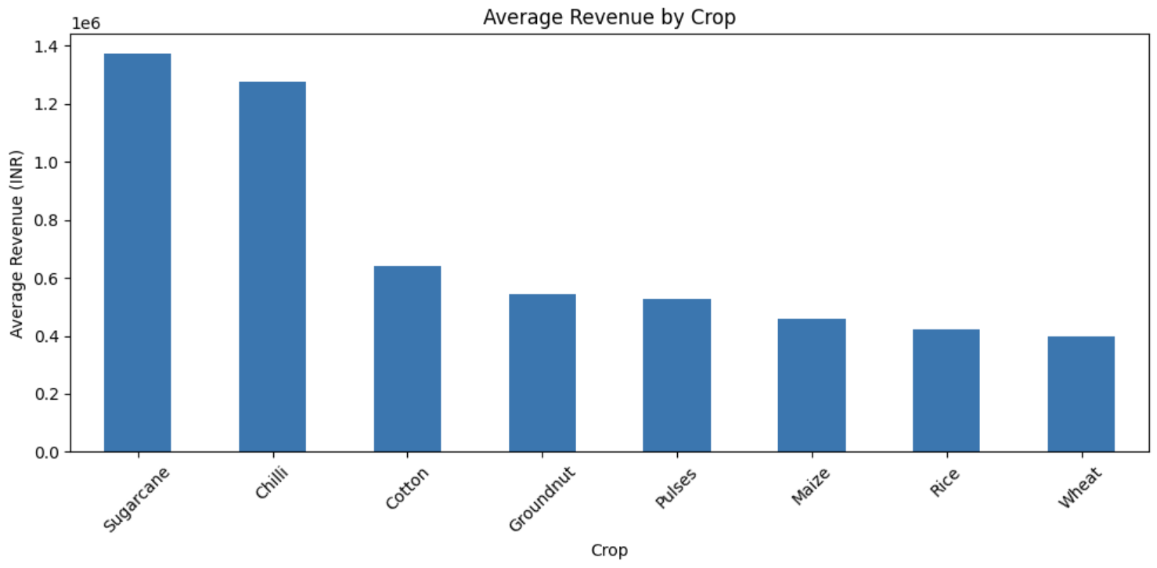
Results — Regional & Revenue Analysis
State-wise yield and crop-wise revenue
Punjab records the highest average yield: 6.12 tonnes/ha.
Sugarcane generates the highest average revenue: about ₹13.72 lakh.

Slide 10
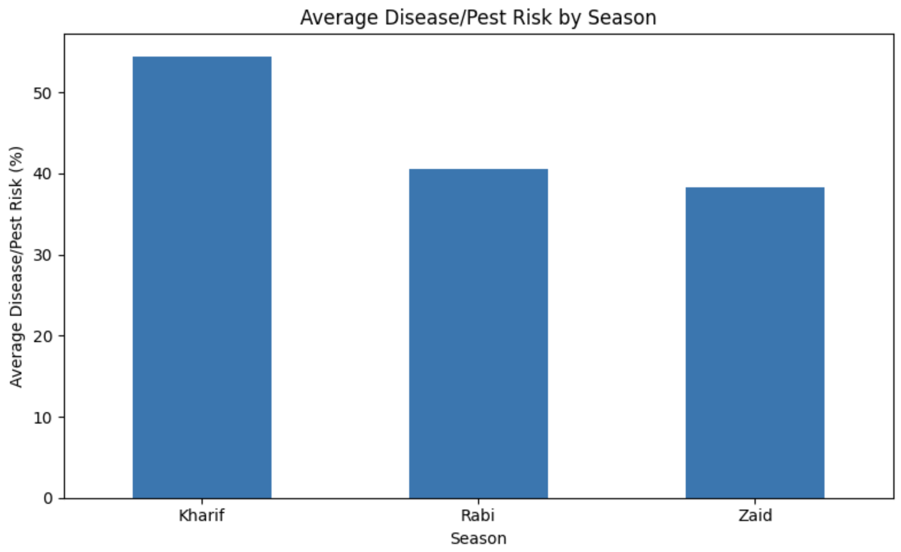
Results — Risk & Relationship Analysis
Disease/pest risk and environmental relationship
RAINFALL vs YIELD
Correlation ≈ 0.03
Very weak positive linear relationship in this dataset.
TEMPERATURE vs YIELD
Correlation ≈ 0.01
Extremely weak positive linear relationship.
Kharif has the highest average disease/pest risk: 54.47%.

Slide 11
Future Scope
• Build predictive models for crop yield and profit.
• Study interactions among rainfall, temperature, soil and irrigation.
• Develop dashboards for real-time agricultural monitoring.
• Add more years and regional data for stronger trend analysis.
• Explore crop-specific recommendations and resource optimization.
• Use advanced statistical and machine-learning techniques for forecasting.

Slide 12
GitHub Link
Project Repository
https://github.com/aryyancode/seasonal-agriculture-performance-analysis
Repository contents
• Analysis notebook
• Dataset
• Problem statement document
• PPT template and final presentation
• Course completion certificate

Slide 13
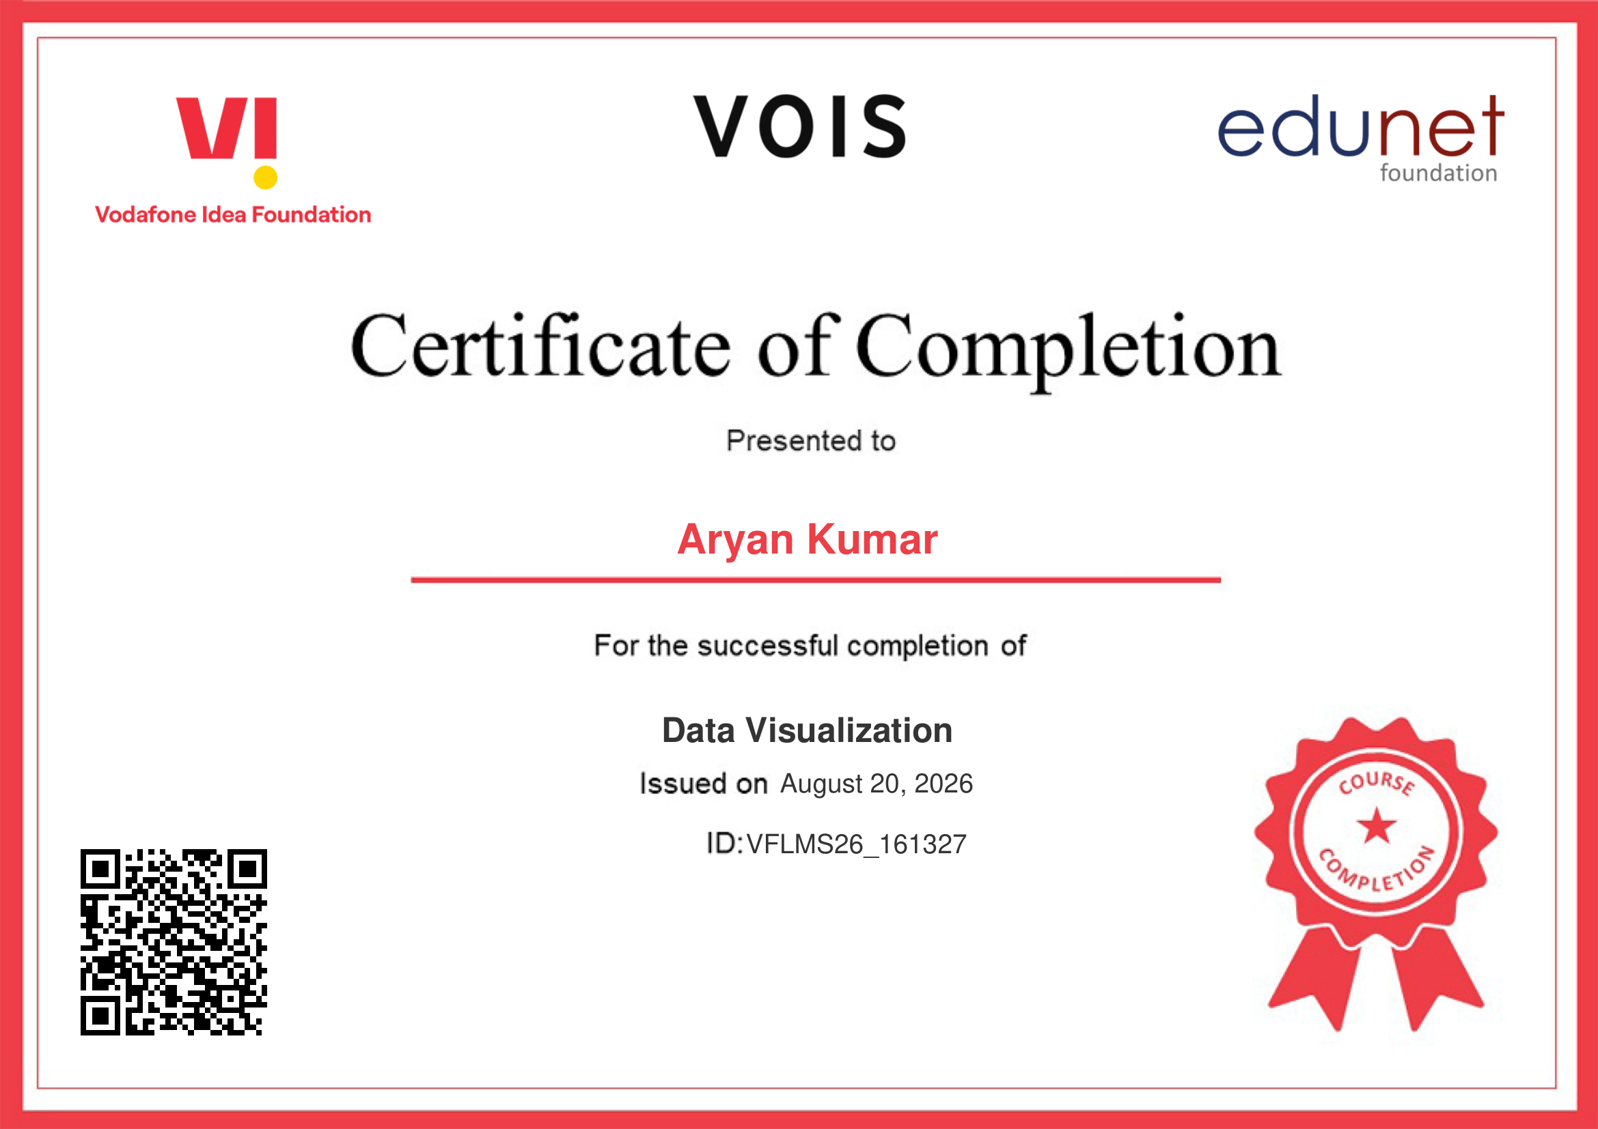
VOIS Course Completion Certificate
Course name - Data Visualization

Slide 14
Thank You
Seasonal Agriculture Performance Analysis
Aryan Kumar • Noida International University

