Slide 1

DIET & TRAINING
App
Application for Mobile Devices
BY: Javier Alexis Arzaga Salinas

Slide 2
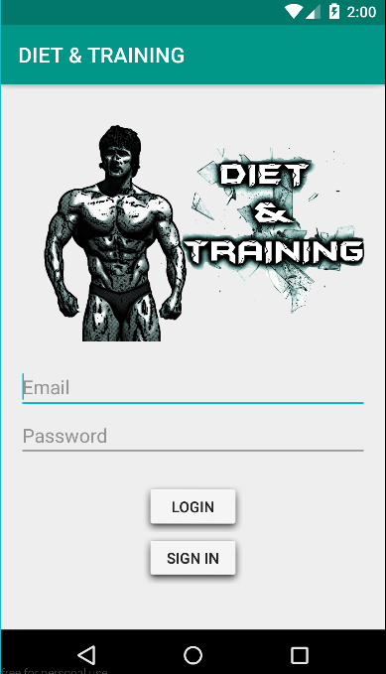
Login with your Account
You will have…
Your own configurations
Your own Body statistics

Slide 3
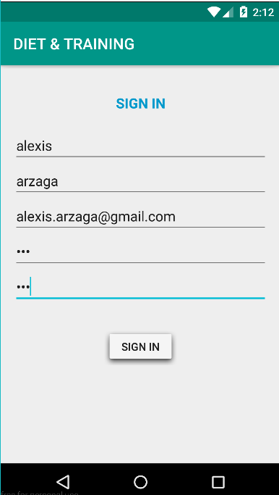
SIGN IN

Slide 4
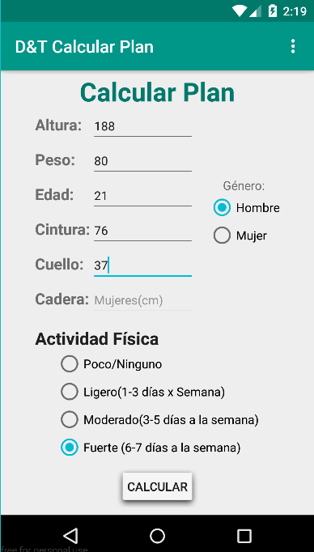
Introducing

Slide 5
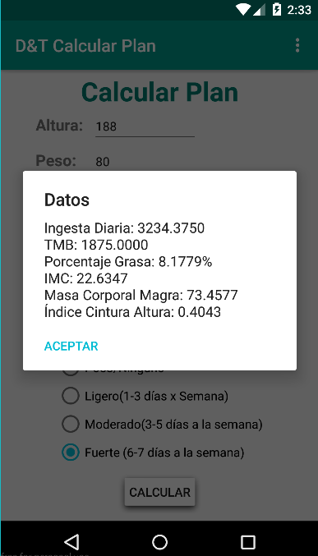
Your own Body Statistics

Slide 6
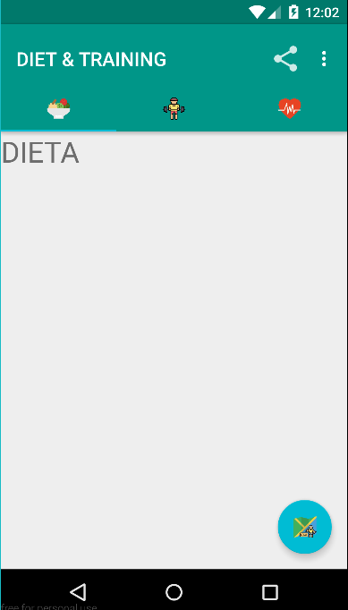
Share Button
Your diet plan
Your workout plan

Slide 7
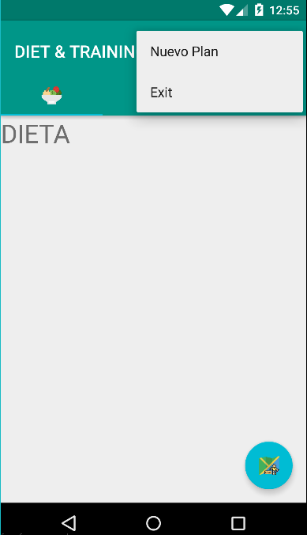
Log out
Create a new Routin

Slide 8

Thank You

