Slide 1

✳
COMPLIANCE AI ANALYSIS
Multi-Regulation Gap Analysis with Snowflake Cortex
POC Deliverable | 2026

Slide 2
AGENDA
•
Background & Problem Statement
•
POC Objectives
•
How Snowflake Solves It
•
Solution Architecture
•
Step-by-Step Implementation
▣
Application Walkthrough
•
Conclusion & Next Steps
Compliance AI Analysis POC | Confidential · 2 / 25

Slide 3

✦
THE CHALLENGE

Slide 4
Background: Compliance Is a Manual, Costly Burden
▣
Banks must comply with multiple, overlapping regulations: privacy laws (UU PDP / GDPR), regulator circulars (PBI / PADG / POJK), and internal policies
•
Each regulation is hundreds of pages of unstructured PDF / DOCX text
•
•
Compliance teams manually map every rule to dozens of source tables and hundreds of columns
•
Cycle time to answer 'are we compliant?' = weeks to months per audit
Compliance AI Analysis POC | Confidential · 4 / 25

Slide 5
The Hidden Cost
•
3+ regulation sources to cross-check (privacy law · regulator · internal policy)
•
100+ tables and columns to classify per audit
•
10x
•
Manual gap analysis cannot keep up with new regulator circulars
Business impact
Compliance AI Analysis POC | Confidential · 5 / 25

Slide 6
✦
POC OBJECTIVES

Slide 7
What This POC Aims to Prove
● Automate parsing of regulatory PDFs and internal policy DOCX files
● Use AI to classify every column for PII / financial / risk attributes
● Run gap analysis across 4 use cases on demand, not once a quarter
● Detect cross-coverage gaps between internal policy and regulator rules
● Deliver insights to compliance officers via a self-service dashboard
● Build everything natively in Snowflake — no data movement, no extra ML stack
Compliance AI Analysis POC | Confidential · 7 / 25

Slide 8
Four Use Cases Covered
•
UC1 — Privacy
•
UC2 — Internal Policy
•
UC3 — Regulator
•
UC4 — Cross-check
● PII columns vs privacy regulation
● Encryption · masking · retention · consent
● Transactions vs internal bank policy
● Operational controls validation
● Transactions vs regulator circulars
● PBI / PADG / POJK compliance
● Internal policy vs regulator
● Find coverage gaps & duplications
Compliance AI Analysis POC | Confidential · 8 / 25

Slide 9
✦
THE SOLUTION

Slide 10
Why Snowflake — Built-In AI for Compliance
✳
Cortex AISQL with claude-opus-4-7 — large-context reasoning over rule text
•
PARSE_DOCUMENT — native PDF & DOCX text extraction, no third-party OCR
•
Cortex Search — RAG over regulation text for citation-grade answers
•
Stored Procedures — make every step idempotent and re-runnable
✳
Streamlit-in-Snowflake — embedded UI, no separate web app to host
◈
Horizon governance — RBAC, masking and tagging on the same platform
Compliance AI Analysis POC | Confidential · 10 / 25

Slide 11
Snowflake Features Used
✳
Document AI
✳
Cortex AISQL
•
Cortex Search
● PARSE_DOCUMENT (PDF + DOCX)
● LAYOUT mode preserves structure
● Native to the warehouse
● claude-opus-4-7 model
● Column classification at scale
● JSON-structured rule reasoning
● RAG over regulation chunks
● Citation tracking for auditors
● Hybrid keyword + semantic
Compliance AI Analysis POC | Confidential · 11 / 25

Slide 12
What Cortex Delivers
✳
•
•
•
146
71
4
1
Columns classified by AI
Regulation rules indexed
Gap-analysis use cases
Click to refresh end-to-end
Compliance AI Analysis POC | Confidential · 12 / 25

Slide 13
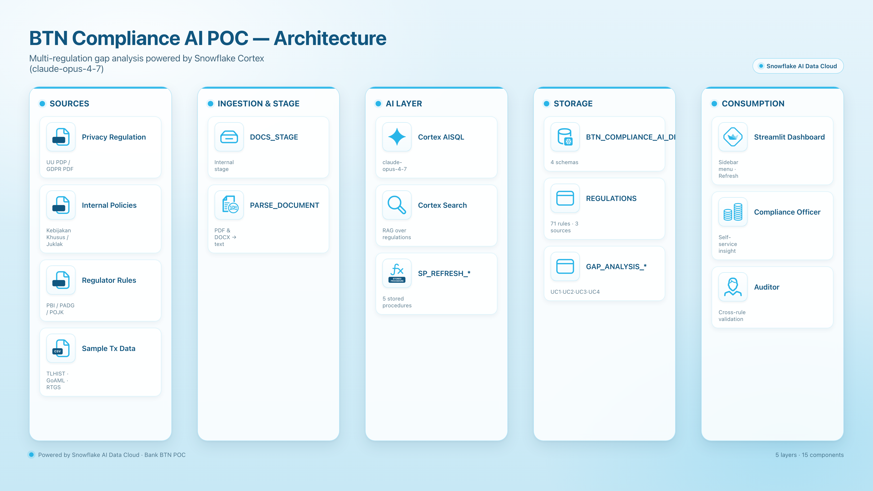

Slide 14
Solution Architecture — Components
1
Sources
2
Stage & Parse
3
AI Layer
Privacy regulation PDFs, internal policy DOCX, regulator circulars, sample transaction CSVs.
Internal stage stores raw documents; PARSE_DOCUMENT extracts text from PDF + DOCX in one call.
Cortex AISQL (claude-opus-4-7) classifies columns and runs gap analysis. Cortex Search powers RAG.
4
Storage
5
Stored Procedures
6
Streamlit Dashboard
One database, four schemas (Customer, Transaction, Docs, Results) holding inputs and AI outputs.
Five idempotent SPs (classification + UC1 / UC2 / UC3 / UC4) called by the dashboard's refresh button.
Sidebar menu, five tabs per use case, executive summary, refresh-on-demand.
14 / 25

Slide 15
✦
IMPLEMENTATION

Slide 16
Step-by-Step Build
Create database, warehouse, schemas, and source tables (synthetic data)
Upload regulation PDFs / DOCX to an internal Snowflake stage
Parse documents to text with SNOWFLAKE.CORTEX.PARSE_DOCUMENT
Seed REGULATIONS table with rule rows tagged by source
Run AI column classification (PII / risk / masking flags)
Compliance AI Analysis POC | Confidential · 16 / 25

Slide 17
Refresh Pattern — Always Current Compliance
•
Without SPs
•
With SP_REFRESH_*
● Analyst reruns scripts manually
● No traceable lineage
● Risk of partial / inconsistent results
● One click recomputes results
● Idempotent — safe to rerun
● Triggered from dashboard or scheduled task
Compliance AI Analysis POC | Confidential · 17 / 25

Slide 18
✦
WHAT IT LOOKS LIKE

Slide 19
Streamlit Dashboard — Sidebar Menu
•
Sidebar navigation with 5 menu options: Summary · UC1 · UC2 · UC3 · UC4
•
Brand-themed colors and logo
✳
•
Refresh button per use case calls the matching stored procedure live
✳
Built entirely with Streamlit-in-Snowflake — no external hosting
Compliance AI Analysis POC | Confidential · 19 / 25

Slide 20
Per Use Case — Five Tabs of Insight
◈
Overview — KPIs and risk counts (Compliant / Gap / Partial)
▣
Rule Coverage — every rule mapped to its compliance status
◈
Column Heatmap — AI-classified columns with risk severity
✳
Action Plan — AI-generated remediation steps, prioritized
✳
Raw Findings — full audit trail with reasoning text from claude-opus-4-7
Compliance AI Analysis POC | Confidential · 20 / 25

Slide 21
From Months to Minutes
◫
No data movement, no batch ETL
✳
Auditor-ready evidence with AI reasoning preserved
•
10x
•
Re-runnable as regulations evolve
Business impact
Compliance AI Analysis POC | Confidential · 21 / 25

Slide 22
✦
CONCLUSION

Slide 23
Conclusion — Compliance as a Continuous Capability
KEY TAKEAWAYS
•
Snowflake Cortex turned a multi-week manual review into a one-click refresh
☁
Four use cases (privacy · internal · regulator · cross-coverage) covered end-to-end on a single platform
● Snowflake Cortex turned a multi-week manual review into a one-click refresh
● Four use cases (privacy · internal · regulator · cross-coverage) covered end-to-end on a single platform
● PARSE_DOCUMENT + claude-opus-4-7 removed the need for external OCR or LLM stacks
● Stored procedures + Streamlit-in-Snowflake make compliance self-service for officers
● Pattern is reusable across other regulations (PCI-DSS, ISO 27001, SOX) and other industries
•
PARSE_DOCUMENT + claude-opus-4-7 removed the need for external OCR or LLM stacks
✳
Stored procedures + Streamlit-in-Snowflake make compliance self-service for officers
Compliance AI Analysis POC | Confidential · 23 / 25

Slide 24
Recommended Next Steps
•
Productionize
•
Expand Coverage
⚙
Operationalize
● Schedule SP refresh via Tasks
● Add row access policies
● Plug into Horizon catalog
● Onboard more regulations
● Cover credit, AML, KYC domains
● Add a Cortex Agent for chat
● Wire alerts to compliance team
● Track gap closure over time
● Audit-ready evidence export
Compliance AI Analysis POC | Confidential · 24 / 25

Slide 25
THANK YOU
Questions & Discussion

