Slide 1
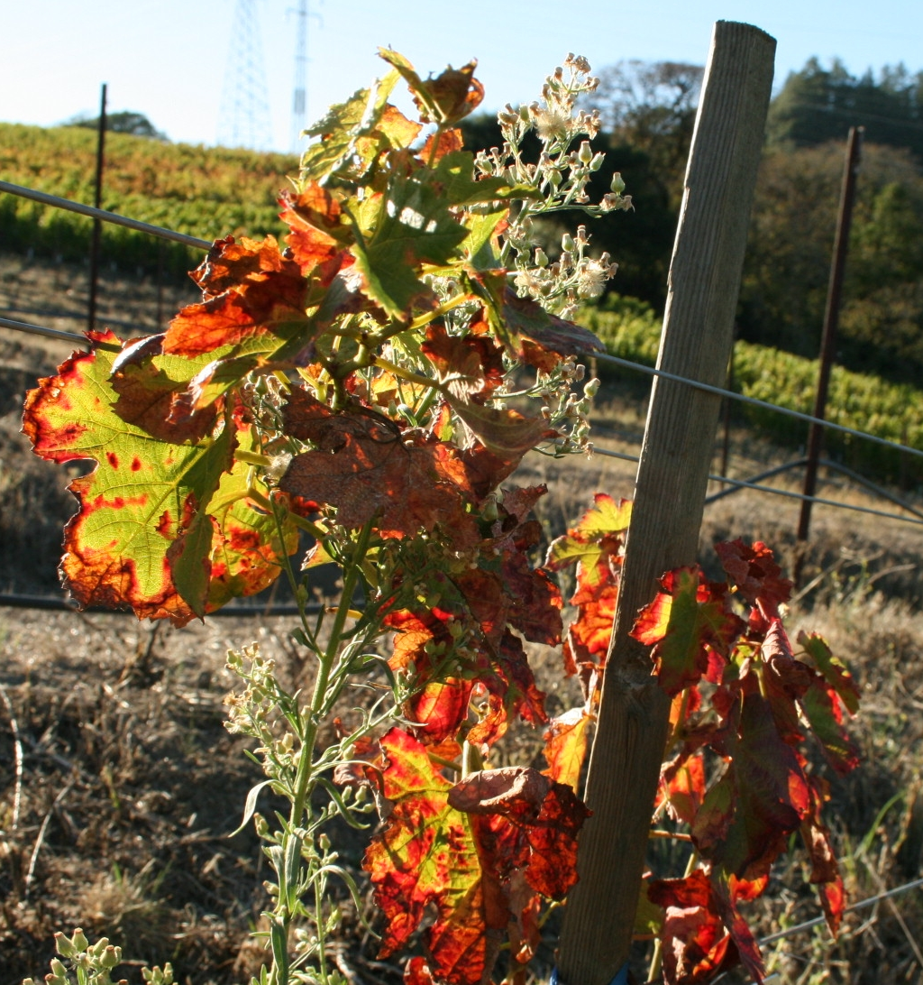
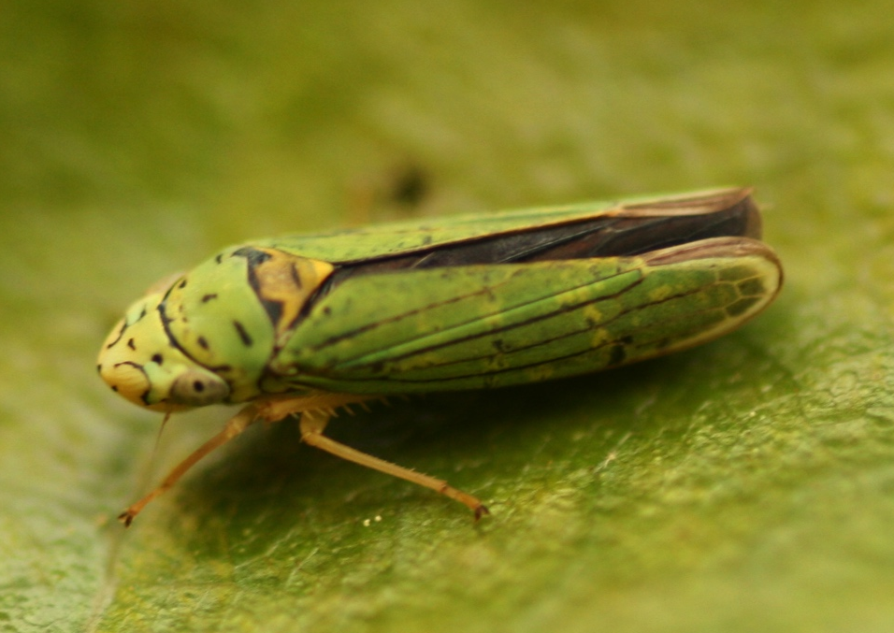
Pierce’s Disease of grapevines
Caused by bacterial pathogen Xylella fastidiosa
Spread by insect vectors, including blue-green sharpshooter (BGSS)
Transgenic plants have been developed by another lab to be resistant Xylella. Plants produce a protein called Diffusible Signaling Factor (DSF).
Diseased grapevine
Blue-green sharpshooter
Notes:
Vectors of diseases, whether plant or animal diseases, often show preference or discrimination between hosts of the same species depending on infection status. In many cases, vectors preferentially select symptomatic or diseased hosts. Examples include mosquitoes, tse tse flies, and many aphid and psyllid species. This is often thought to be a result of adaptation by the pathogen to enhance its own spread. On the other hand, other vectors have shown preferences for asymptomatic or healthy hosts. The glassy-winged sharpshooter, shown here, is one such example.

Slide 2
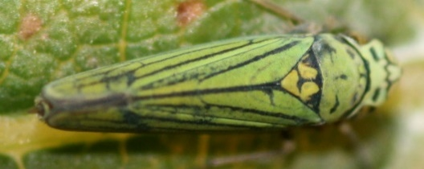
How does DSF production affect vector transmission of Xylella?
Test plant
BGSS
Needle
inoculation
of Xylella
DSF or WT
Source plant
Test plant

Slide 3
Analysis
What factors explain variation in….
Xylella populations in the source plant?
Xylella acquisition by insect vectors?
Transmission of Xylella to test plant?
Response variables:
Xylella populations in source plant
Xylella populations in vectors
Infection status (presence/absence of Xylella in test plants
Explanatory variables:
Genotype of source plant (factor with 2 levels: DSF or WT)
Distance from point of inoculation on source plant
Interaction between genotype and distance
Random effect: source plant ID – 2 insects caged on each plant

Slide 4
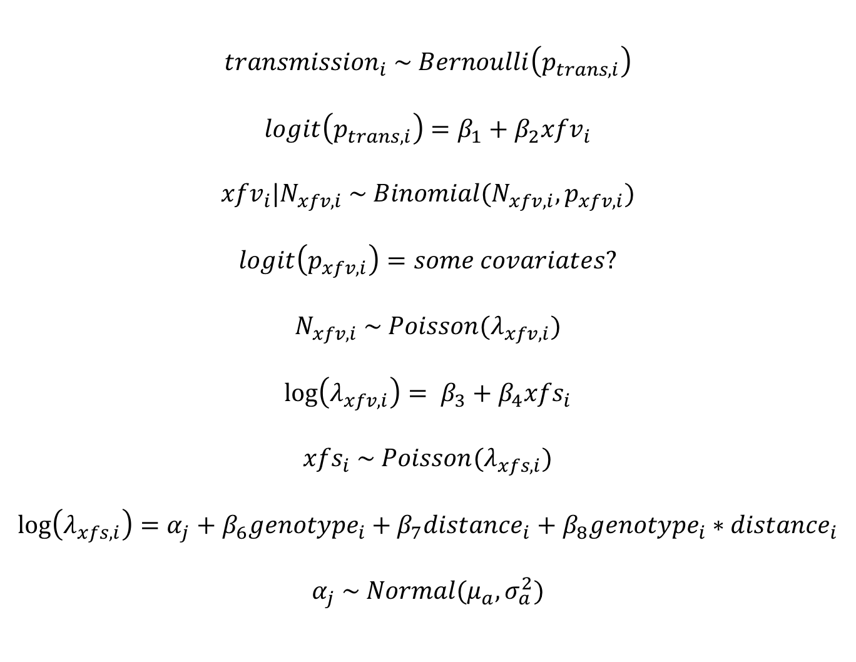
Hierarchical model
$${transmission}_{i} \sim Bernoulli\left(p_{trans,i}\right)$$
$$logit\left(p_{trans,i}\right)=β_{1}+β_{2}{xfv}_{i}$$
$${xfv}_{i}|N_{xfv,i} \sim Binomial(N_{xfv,i},p_{xfv,i})$$
$$logit\left(p_{xfv,i}\right)=some covariates?$$
$$N_{xfv,i} \sim Poisson(λ_{xfv,i})$$
$$\log\left(λ_{xfv,i}\right)= β_{3}+β_{4}{xfs}_{i}$$
$${xfs}_{i} \sim Poisson(λ_{xfs,i})$$
$$\log\left(λ_{xfs,i}\right)=α_{j}+β_{6}{genotype}_{i}+β_{7}{distance}_{i}+β_{8}{genotype}_{i}∗{distance}_{i}$$
$$α_{j} \sim Normal(μ_{a},σ_{a}^{2})$$
Where…
transmission is estimated infection status of test plant
xfv is estimated Xylella populations in vectors
xfs is estimated Xylella populations in source plants
p_{xfv} detection probability for Xylella in vectors
N_{xfv} is true population of Xylella in vectors

Slide 5
Error in detection
Infection status of test plant
vs.
Xylella populations in vector
False negatives
WT
DSF
(Results from logistic regression)

Slide 6
Other issues
Imperfect detection in estimating Xylella populations in source plants
N = 97 (treating each insect as a replicate)
Missing values for some replicates
I can identify false negatives in infection of vectors and source plants, but how do I model detection probabilty?

