Slide 1
Liam Concierge
Package assistance for residents
An AI application with verified actions
Arzhan Moldabayev · nFactorial Final Project
Notes:
0:00–0:30. Introduce yourself and the product. This is a student demonstration, not an approved property launch. All examples are fictional.

Slide 2
The package-room problem
Residents need to know what has arrived and when they can receive it.
An operator needs a reliable recipient, location and custody record.
Liam Concierge connects those tasks with scheduled delivery. The prototype supports one daily window and direct handoff.
2 / 12
Notes:
0:30–1:05. Source: knowledge/liam-demo-policy.pdf, pages 1–5; src/lib/service.ts. Three daily rounds remain a proposed operational extension. Do not claim actual customer adoption, savings or property approval.

Slide 3
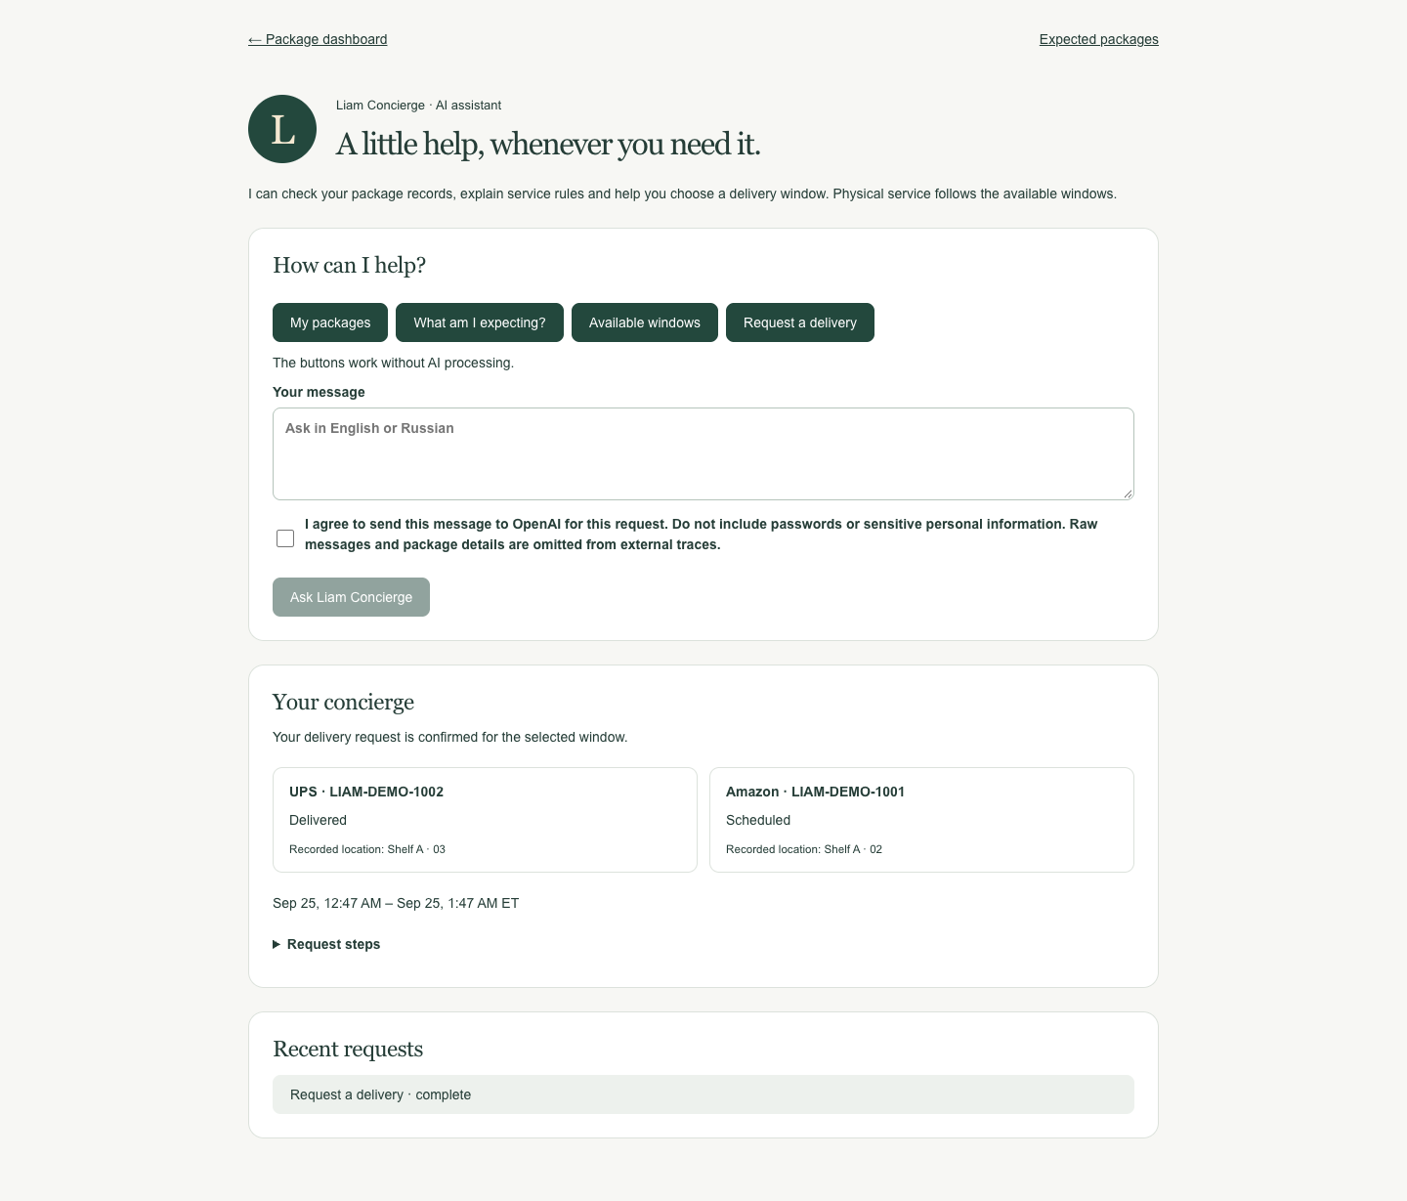
A resident’s delivery request
The resident sees their own packages and available windows.
A delivery request waits for explicit confirmation. Reloading the page preserves that step.
The server checks availability again before booking.
3 / 12
Notes:
1:05–1:50. Demonstrate /concierge with a fictional resident account. Request delivery, reload, then confirm. Sources: tests/assistant.test.ts and scripts/browser-check.mjs. Screenshot uses only fictional test data.

Slide 4
LangGraph orchestration
Classify the request, then branch to package tools, service rules or an access refusal.
Booking reads packages and windows, persists an interrupt in PostgreSQL, and resumes after confirmation.
The final MCP tool consumes a short-lived approval once. SQL locks enforce capacity.
4 / 12
Notes:
1:50–2:30. Sources: src/lib/assistant/graph.ts, service.ts, tools.ts and tests/assistant.test.ts. Guided buttons use the same graph without a model call. AI selects a bounded intent; it does not generate arbitrary SQL or call any tool it wishes.

Slide 5
Eight tools through an actual MCP server
Tool | Access / purpose
get_parcels | Resident’s physical and expected records
get_available_windows | Available booking windows
request_delivery | Explicit approval; transactional booking
get_package_details | Own package; operator can inspect all
get_room_capacity | Operator; timestamped room inspection
get_aging_packages | Operator; age since physical intake
get_package_exceptions | Operator; unresolved intake issues
preview_delivery_round | Operator; workload and recorded weights
MCP exposes typed, discoverable tools to the graph. Web APIs still handle browser requests and Gmail OAuth.
5 / 12
Notes:
2:30–3:10. Sources: scripts/mcp-server.ts, src/lib/assistant/mcp.ts, operations-tools.ts and MCP_TOOLS.md. stdio transport is real and local. Four tools are discoverable by residents; eight by the operator. A remote ChatGPT/Claude connector is future work.

Slide 6
PDF retrieval with page citations
An eight-page demonstration policy provides the knowledge base.
PDF text becomes page-based chunks and 256-dimensional embeddings in pgvector. Retrieval selects up to four relevant chunks.
The answer cites allowed source IDs and PDF pages. Unsupported questions produce an explicit absence-of-information response.
6 / 12
Notes:
3:10–3:50. Demonstrate the question “Do I need Gmail to use delivery?” Source: src/lib/assistant/rag.ts and knowledge/liam-demo-policy.pdf. text-embedding-3-small, cosine similarity, threshold 0.25. Citations verify source membership; they do not mathematically prove every generated claim.

Slide 7
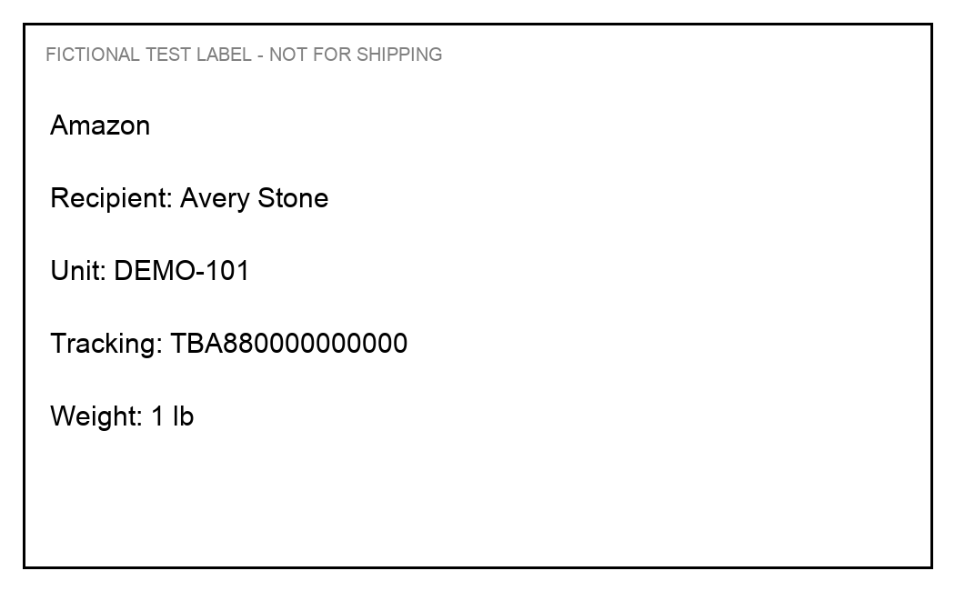
Label reading with a runtime Skill
A phone image provides the visible name, unit, tracking reference and printed weight.
The app loads skills/liam-parcel-exceptions/SKILL.md into the vision request. Missing values stay empty.
A verified local roster proposes a recipient. The operator reviews the draft before physical intake.
7 / 12
Notes:
3:50–4:35. Demonstrate /label-intake using this fictional fixture. Source: src/lib/assistant/vision.ts and skills.ts. No image or raw label fields are exported to Langfuse. The image goes to OpenAI only after explicit operator consent. Barcode decoding uses ZXing on the device.

Slide 8
Residents choose what to share
Tracking-only entry works without mailbox access.
A resident can paste one delivery notice, or separately connect their own Gmail account with read-only permission.
Expected shipment records remain separate from physical custody. Accounts cannot read one another’s notices.
8 / 12
Notes:
4:35–5:05. Sources: GMAIL_SETUP.md, src/lib/mail/, tests/mail.test.ts. Gmail OAuth and sync have mocked integration tests. A real Google OAuth client and a resident’s authorization are still required; no live mailbox connection is claimed. The requested Gmail read-only scope covers the mailbox; the sync query filters candidate messages, not the permission scope.

Slide 9
Evaluation on 40 frozen examples
Task | Result | Cases
Vision fields | 119 / 120 correct | 20 labels
Complete label match | 19 / 20 | 20 labels
Review branch | 20 / 20 | 20 labels
Policy citation checks | 10 / 10 | 10 questions
Intent classification | 10 / 10 | 10 requests
One vision result added a digit to a long tracking number. All fixtures are synthetic; these results do not measure accuracy in a real mailroom.
9 / 12
Notes:
5:05–5:50. Source: evals/results/golden-latest.json, run at 2026-09-25 UTC. Dataset hash recorded in the file. Six fields per label. Model gpt-4.1-mini-2025-04-14. Policy faithfulness and relevance were also 10/10 under an LLM judge; this is a small sample, not independent human validation. No failures were removed.

Slide 10
Model and retrieval experiments
Comparison | Quality | Median latency
GPT-4.1 mini · intent | 12 / 12 | 760 ms
GPT-6 Luna · intent | 11 / 12 | 909 ms
Page chunks · RAG | 10 / 10 | 2,566 ms
Fixed chunks · RAG | 10 / 10 | 2,375 ms
Selected GPT-4.1 mini: temperature 0, top_p 1, output limit 512. Page chunks preserve context with 8 chunks versus 24. RAG timing includes the evaluation judge.
10 / 12
Notes:
5:50–6:40. Sources: evals/results/development-latest.json and ab-latest.json, EVALS.md. Development uses 12 distinct intent examples; RAG A/B reuses the ten golden policy questions, so it is not an independent holdout. Temperature 0.3, top_p 0.8 and limits 256/1024 were also tested separately. Single small runs; no statistical significance claim. Baseline generation cost estimate: $0.001238 for twelve intent calls, excluding infrastructure; pricing source https://developers.openai.com/api/docs/pricing, 2026-09-25.

Slide 11
Observable calls and verified boundaries
Langfuse records graph steps, MCP calls, Skill loading, model settings, token usage and timing.
Explicit redaction keeps raw messages, images and package details out of external traces.
51 automated tests and the production browser flow passed, including real AI vision and PDF retrieval.
11 / 12
Notes:
6:40–7:20. Show the live Langfuse dashboard in the founder’s account, or the sanitized trace manifest. Sources: evals/results/trace-audit.json, src/lib/assistant/tracing.ts, tests/, scripts/browser-check.mjs. Trace access requires a separate account invitation. Credentials and private project links are excluded from the public submission.

Slide 12
Demonstration scope and next steps
The working core covers intake review, personal package queries, policy answers and confirmed delivery requests.
Next: real-device label tests, Gmail authorization and stronger operational evaluation.
Three daily rounds, outbound reminders, body-camera footage and courier GPS remain outside this prototype.
12 / 12
Notes:
7:20–8:00, leaving up to two minutes for questions. Property approval and insurance review remain separate launch requirements. No insurance coverage, physical shelf organization, unattended delivery or 24/7 staffing is promised. Sources: README.md and IMPLEMENTATION_STATUS.md.

