Slide 1
Exploring neighborhoods dataset in the city of New Delhi

Slide 2
Introduction
New Delhi is the capital city of India. The city itself has a population of 257,803. However, the much larger metro area has a population that exceeds 26 million. With its diverse culture, comes diverse food items. There are many restaurants in New Delhi, each belonging to different categories like Chinese, Italian, French, Mughlai, North Indian etc.
So in this project, we will list and visualize all major parts of the city and find out which part is the go-to place for Italian food so that a future restaurateur who wants to open a Italian cuisine restaurant can find the best part of the city in which the demand for Italian cuisine is very high.
I would need to use Foursquare location data to find out the ratings, reviews and other information to make a good analysis of the data that I have and create an efficient cluster model.

Slide 3
Questions a future restaurateur might ask if he/she were to open an Italian cuisine restaurant in New Delhi
Which neighbourhoods have greater number of restaurants?
Which neighbourhoods have fewer number of restaurants?
What neighbourhoods has greater demand for Italian Cuisine?

Slide 4
Data Description
For this project we need the following data:
Delhi Neighbourhood Dataset that contains a list of sort Borough, Neighbourhood, latitude and longitude.
Data source: Delhi Neighbourhood Dataset
Dataset: https://www.kaggle.com/shaswatd673/delhi-neighborhood-data
This data set contains the required information. And we will use this data set to explore various neighbourhoods of New Delhi city.
Nearby places in each locality of New Delhi city.
Data source: Foursquare API: https://developer.foursquare.com/
By using this API, we can get all the venues info including longitudes and latitudes, reviews and ratings of each venues in the neighbourhood.

Slide 5
Approach
Collect the necessary the New Delhi city data from Delhi Neighbourhood Dataset that we downloaded from Kaggle
Using Foursquare API, we will find all venues for each neighbourhood.
Filter out all venues that are nearby by locality.
Using aggregative rating for each restaurant to find the best places for Italian cuisine.
Visualize the best neighbourhoods for the new restaurant using folium library on a map

Slide 6
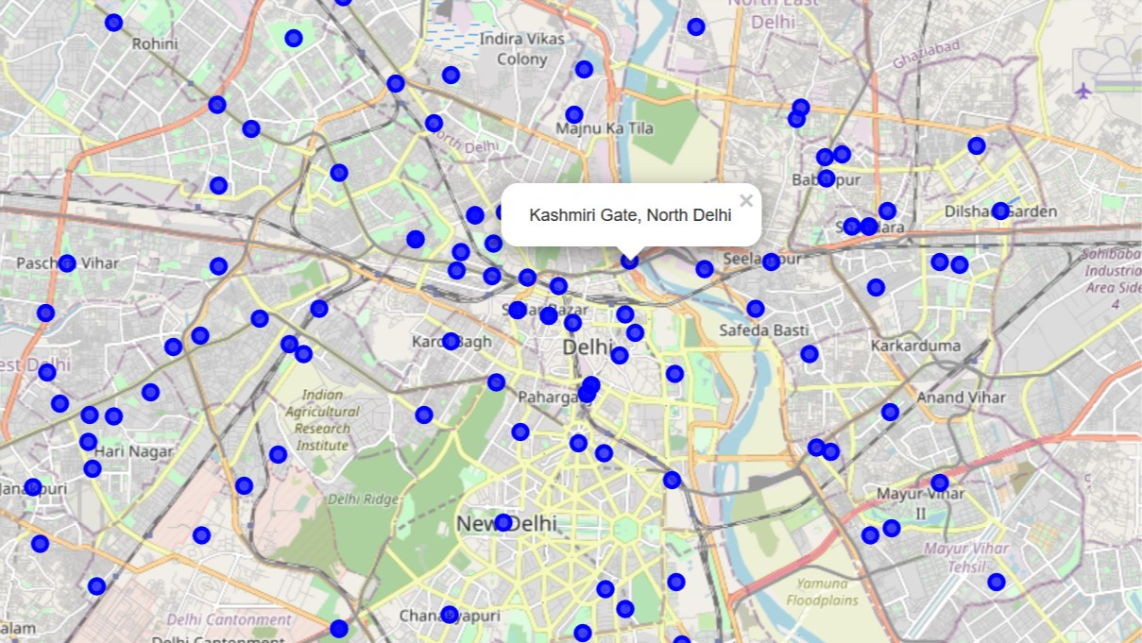
Map of new Delhi with to show neighborhoods

Slide 7
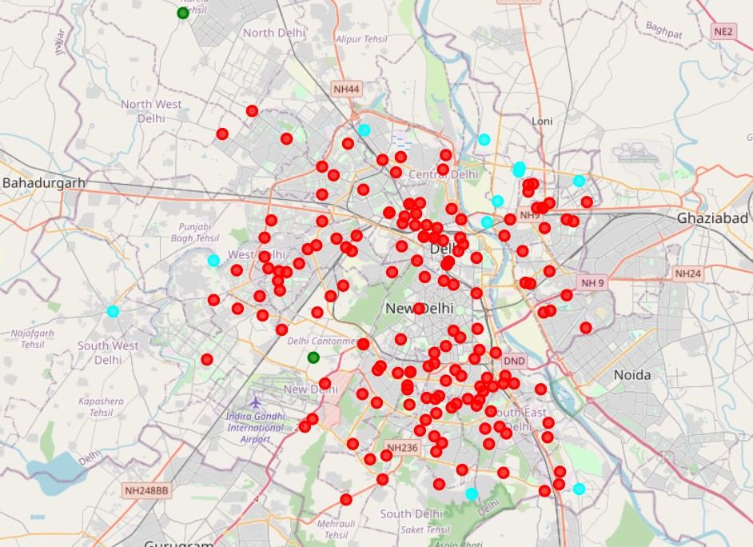
Visualized 3 clusters to divide the neighborhoods

Slide 8
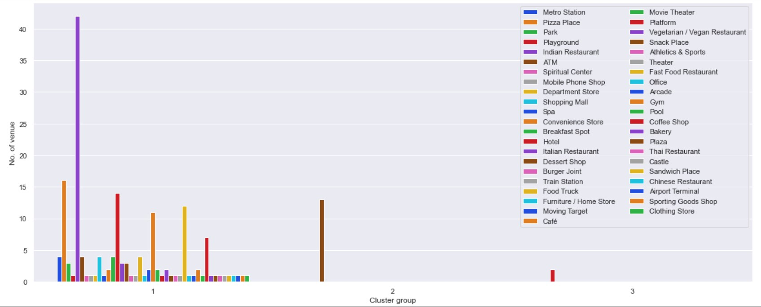
Made a countplot to observe the venue categories in the clusters

Slide 9
Neighborhoods in CLUSTER 1 which has Italian Restaurant in its top 3 Most Common Venue preferences

Slide 10
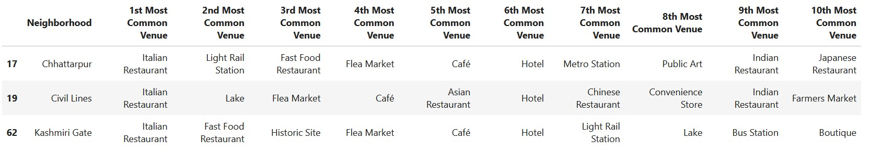
Neighborhood Which has Italian Restaurant as the 1st Most Common Venue preference

Slide 11
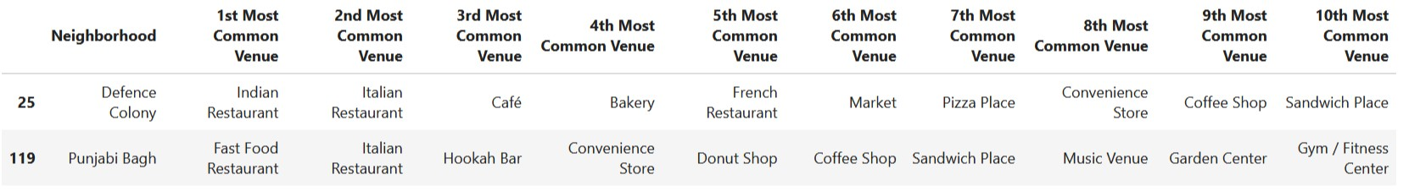
Neighborhood Which has Italian Restaurant as the 2nd Most Common Venue preference

Slide 12
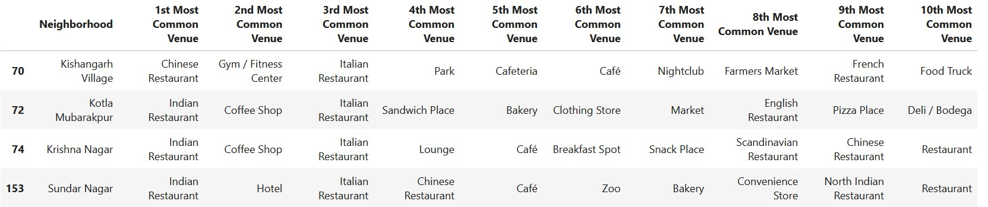
Neighborhood Which has Italian Restaurant as the 3rd Most Common Venue preference

Slide 13
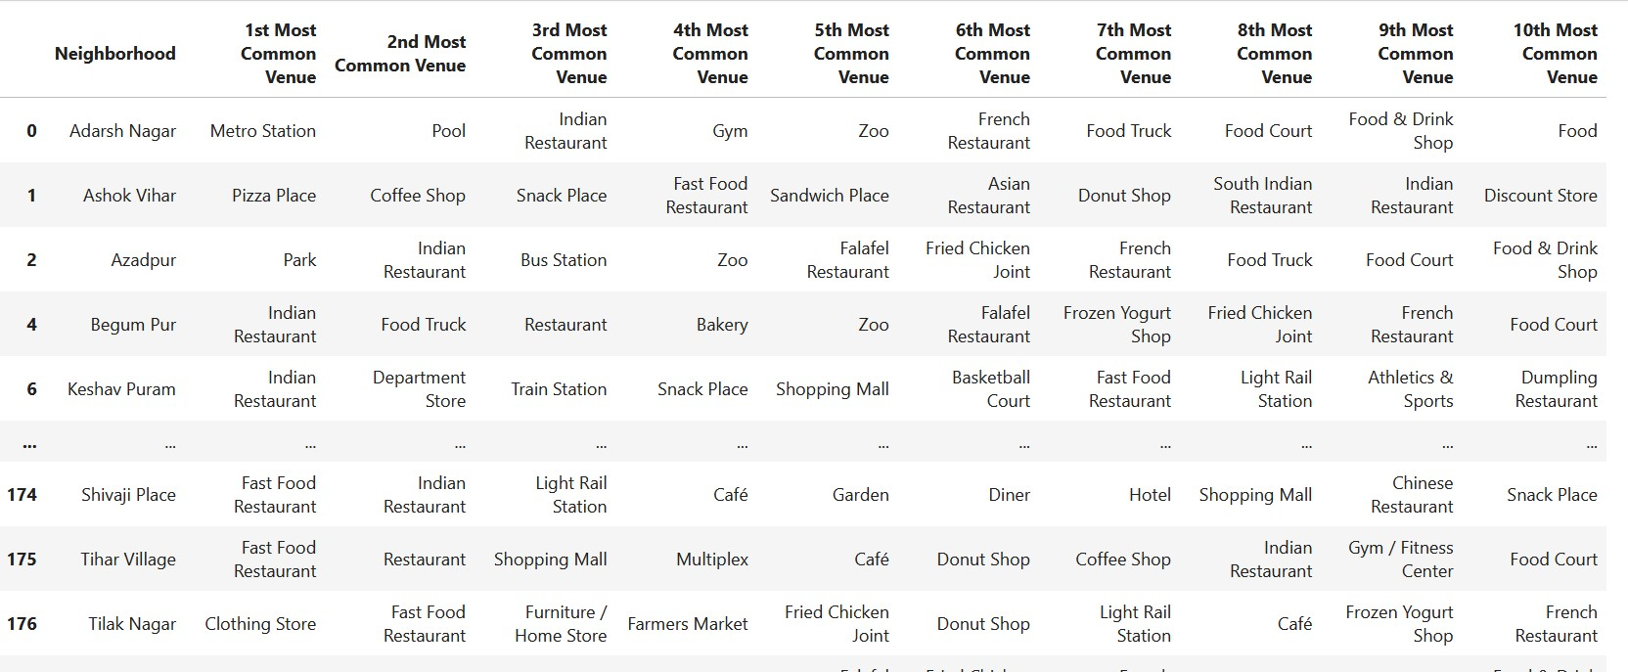
Cluster 1

Slide 14
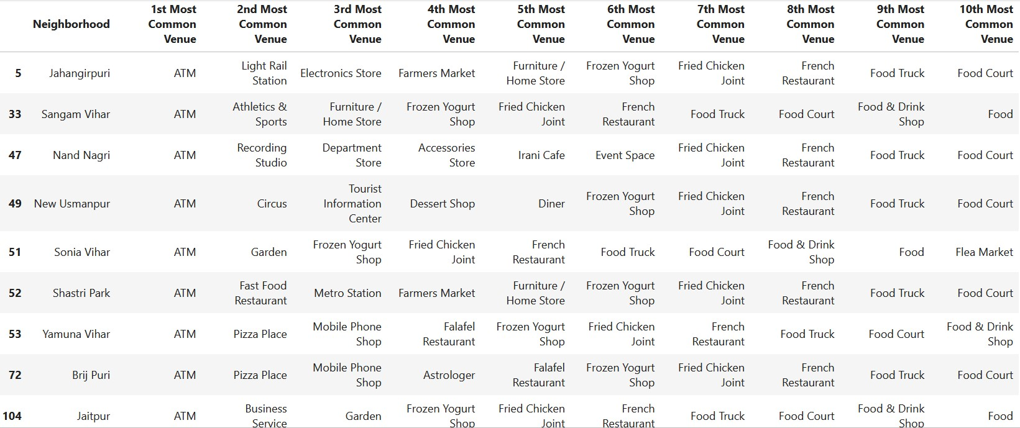
Cluster 2

Slide 15
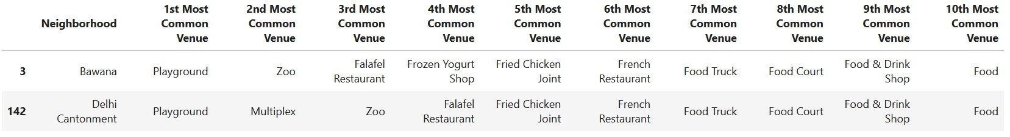
Cluster 3

Slide 16
Conclusion-
In Cluster 1:
Chhatarpur, Civil Lines and Kashmiri Gate are the best place to start a new Italian cuisine restaurant.
Defence Colony and Panjabi Bagh, Krishna Nagar, Kotla Mubarakpur and Sundar Nagar are good alternatives.
Cluster 2 and Cluster 3 mostly has Pizza places and Fast Food Restaurants. So if an in-depth survey is done on the neighborhoods of Cluster 2, we can find out if there are any interest in Italian Restaurants there.

