Slide 1

Final Project Building a Book Recommender System using Graph Neural Network
Isik Topbas, Arzu
CSCI E-104 Advanced Deep Learning, 2024
Harvard University Extension School
Prof. Zoran B. Djordjević

Slide 2
Introduction
Problem Definition
Description of Technology
Description of Data
Model Architecture
Results
Summary
YouTube URLs

Slide 3







Problem Definition
Develop a state-of-the-art book recommender system using advanced Graph Neural Network (GNN) techniques.
Leverage large-scale user interaction data to predict user preferences with high accuracy.
Compare LightGCN and NGCF models for enhancing user-book interactions.

Slide 4


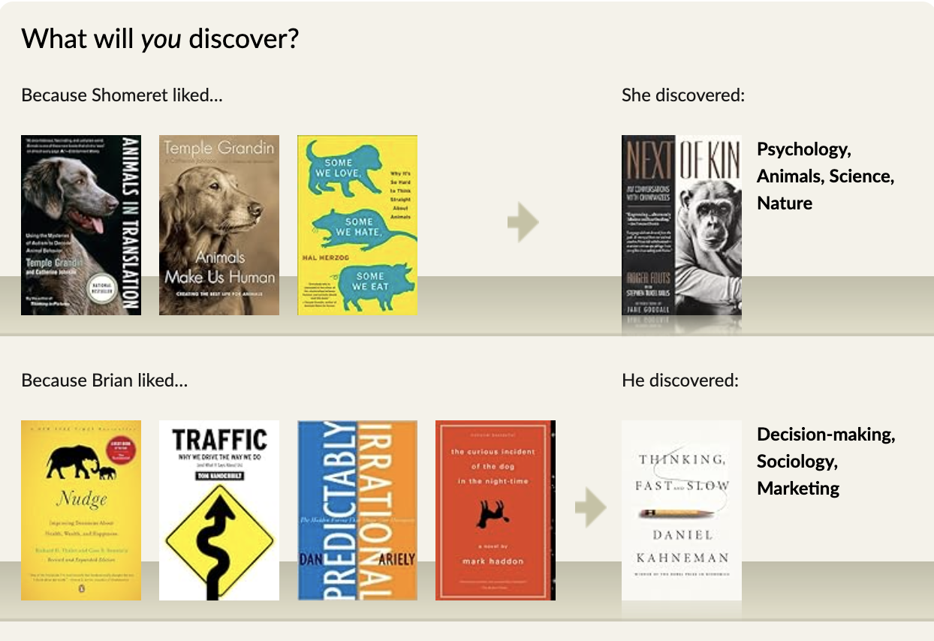
Description of Data
2.9 million ratings
52,000 users
91,000 books

Slide 5









Description of Technology
package | version
torch | 2.2.0
torch_geometric | 2.4.0
matplotlib | 3.8.3
networkx | 3.2.1
numpy | 1.26.4
pandas | 1.5.3
scikit-learn | 1.3.0
scipy | 1.11.2
tensorflow | 1.11.2

Slide 6

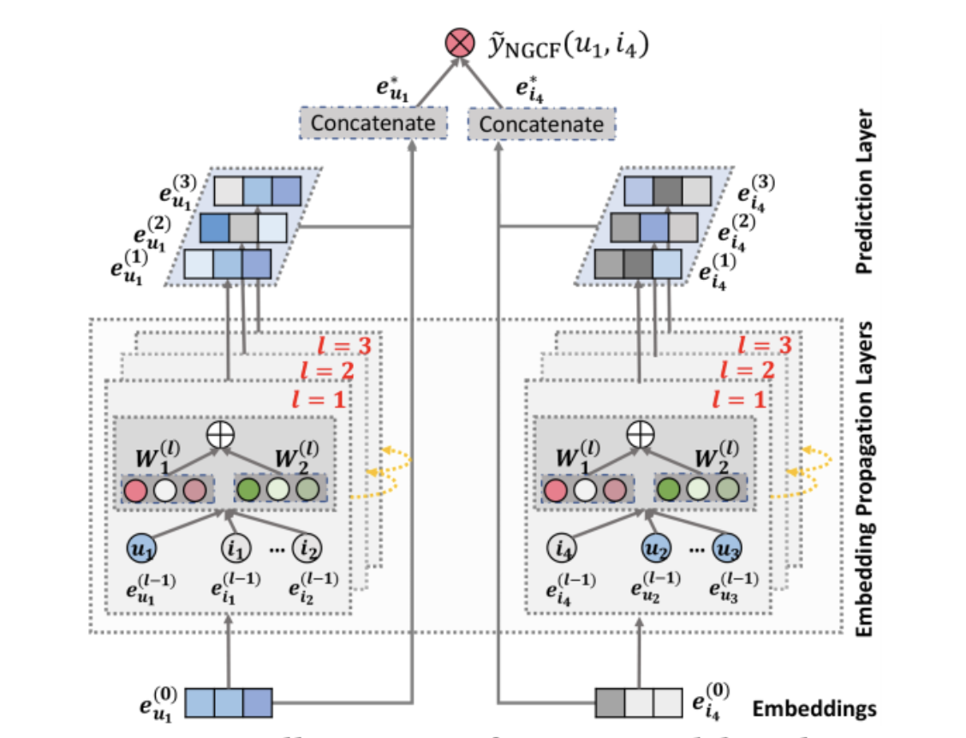
Model Architecture
NGCF is a graph-based recommendation model designed to improve recommendation performance by leveraging both user-item interactions and side information.
It incorporates additional features such as user and item embeddings to capture richer information beyond the graph structure.
NGCF employs a multi-layer aggregation mechanism to propagate information through the graph, enabling it to capture more nuanced relationships and interactions between users and items.
Advantages
Enhanced expressiveness
Flexibility
Disadvantages
Complexity
Overfitting risk
Neural Graph Collaborative Filtering (NGCF)

Slide 7
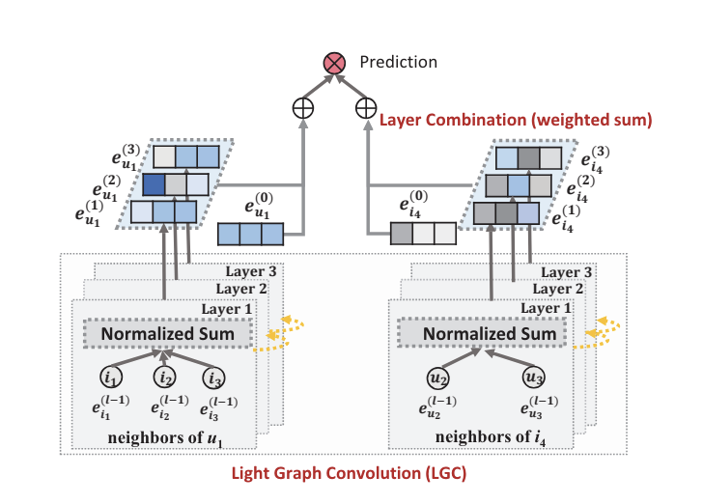
Model Architecture
LightGCN is a simplified version of Graph Convolutional Networks (GCNs) specifically designed for collaborative filtering tasks in recommendation systems.
It focuses solely on the user-item interaction graph without considering additional features or side information.
LightGCN aims to address the over-smoothing problem encountered in traditional GCNs by removing the complex aggregation functions and instead relying on simple linear transformations.
Advantages
Efficient
Effective for recommendation
Disadvantages
Lack of feature incorporation
Limited expressiveness
LIGHT Graph Convolutional Network (LIGHTGCN)

Slide 8

Loss Function and Metrics
Bayesian Personalized Ranking (BPR):
Method for learning to rank in recommendation systems.
Optimizes the order of recommended items, emphasizing personalization.
Considers implicit feedback (e.g., like/dislike) to tailor recommendations to individual user preferences.
Focuses on relevance and personalization in recommendation generation.
Regularization:
Prevents overfitting in machine learning models, crucial in recommendation systems.
Controls model complexity to avoid fitting noise in the data.
Balances capturing patterns in data with generalization performance on unseen data.
Utilizes techniques like L1 (Lasso) and L2 (Ridge) regularization to penalize large coefficients and promote simpler models.
Recall@k measures the proportion of relevant items that are recommended among the top k recommendations.
Precision@k calculates the proportion of relevant items among the top k recommendations.

Slide 9
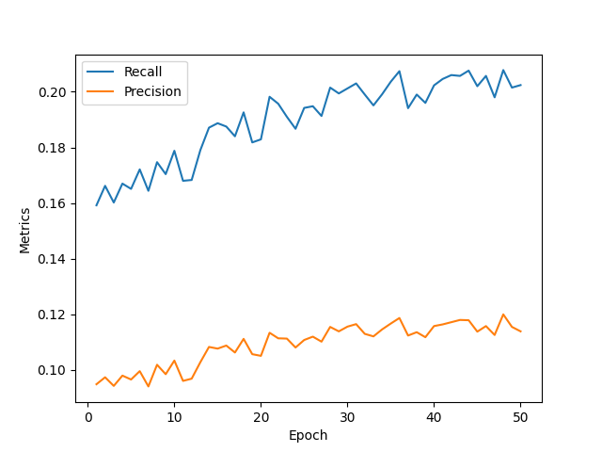
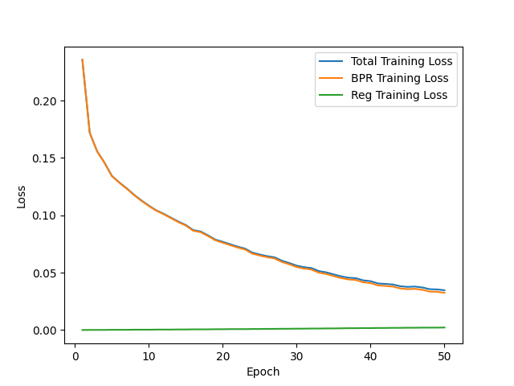
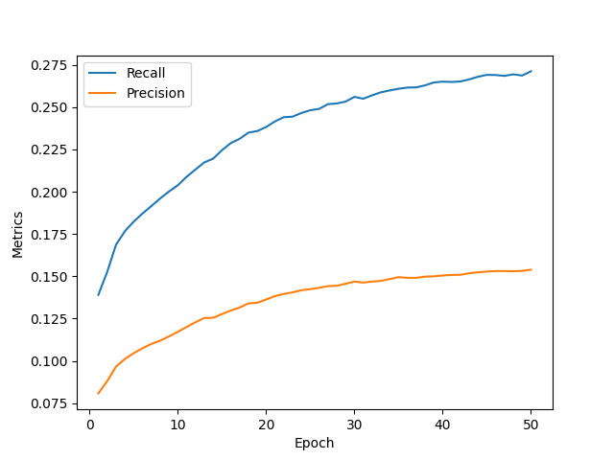
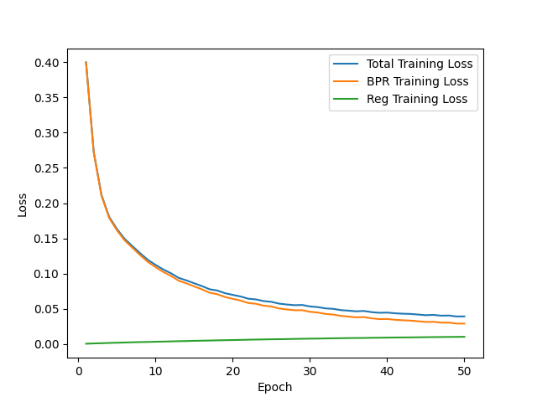
Results
Neural Graph Collaborative Filtering (NGCF)
LightGCN consistently provides higher precision and recall compared to NGCF.
Loss functions depict loss reductions and improvements in recommendation metrics over training epochs.
LIGHT Graph Convolutional Network (LIGHTGCN)

Slide 10

Conclusion and Future Work
Conclusion:
LightGCN outperforms NGCF in personalized book recommendations.
Future Enhancements:
Plans to integrate more sophisticated models such as Knowledge Graph Attention Networks (KGAT) for improved recommendation diversity and accuracy.
Exploration of adaptive models that can consider temporal dynamics like seasonality and session-based interactions, which could refine recommendations further.

Slide 11
Thank You!
@Arzu Isik Topbas

Slide 12

YouTube URLs
2 minutes video URL (short): https://www.youtube.com/watch?v=KoxsHPgpdzI
15 minutes video URL(long): https://www.youtube.com/watch?v=HmEZaVW4tdY

