Slide 1
Bias Analysis towards Fair AI in Education
By utilizing Student Score Prediction Dataset
Team: Multi-Agents
Artur Ganzha, Detijon Lushaj, Lasse Müller

Slide 2
Problem Definition
Identify potential inequalities in student performance based on race/ethnicity, parental education and gender.
Addressing unfair opportunities is crucial for creating a more equitable learning environment.
Target Group:
Educators, researchers, and students interested in educational equity.
Use of Insights:
Adjusting teaching strategies and student grouping to promote fairness.
Provides actionable insights to help create equitable educational environments.
Notes:
Introduction:
Our project identifies potential inequalities in student performance based on race/ethnicity, parental education, and gender.
Addressing these inequalities is vital to creating a more equitable learning environment.
Target Group:
The findings are valuable for educators, researchers, and students focused on educational equity.
Use of Insights:
Insights from the analysis can help adjust teaching strategies and student groupings to promote fairness.
This provides actionable data to help create a more just educational environment.

Slide 3
Goals and Objectives
Showcase inequalities in student performance.
Provide data-driven insights to support fairer educational practices.
Validate through ML models
Key Questions:
Are there disparities in performance among different groups?
Could these disparities suggest unfair opportunities?
How can educators use this data to reduce bias?
Goals:
Highlight inequalities in student performance.
Provide insights for educators to enhance fairness in educational practices.

Slide 4
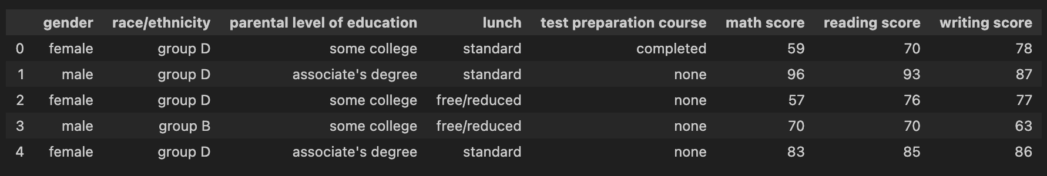
Student dataset
Data Source: Kaggle - Student Performance Prediction dataset.
Gender
race/ethnicity
parental level of education
test scores across subjects (math, reading, writing)
Notes:
The dataset comes from Kaggle’s "Student Performance Prediction" dataset.
It includes columns such as gender, race/ethnicity, parental level of education, lunch type, test preparation course, and scores across three subjects: math, reading, and writing.

Slide 5
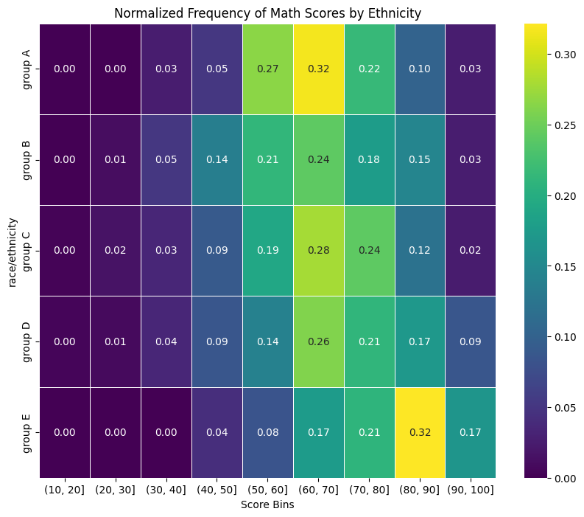
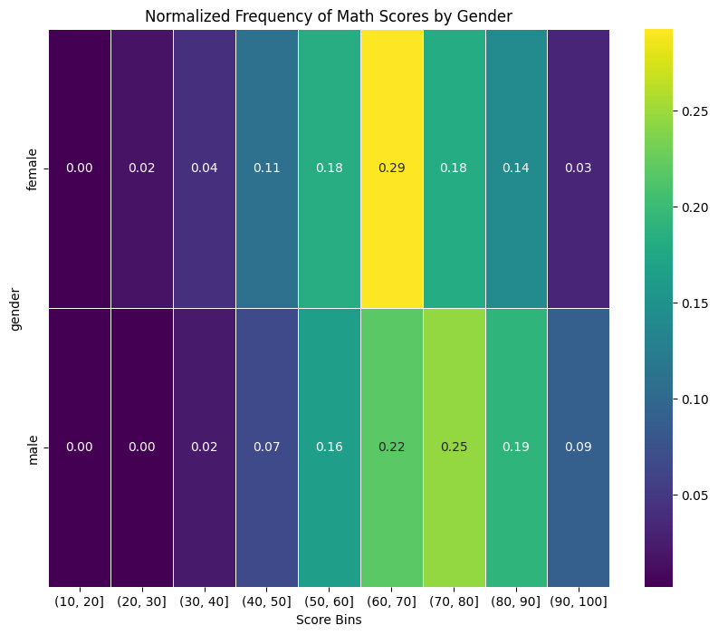
Student dataset
Notes:
The heatmaps show the normalized frequency of math scores based on ethnicity and gender.
Ethnicity Heatmap (Left):
The scores are mostly well-distributed around the middle range, with some outliers.
Indicates a diverse skill range among different ethnic groups.
Group A has a slightly higher concentration of scores in the 50-70 range.
Group E shows a notable concentration of higher scores (70-90 range), suggesting better performance overall
Gender Heatmap (Right):
Many female students perform in the middle range.
Male students are more spread out, with a noticeable presence in the higher score range.
Female students have more scores concentrated in the middle range (50-70), while male students are more spread out with a noticeable number in the higher score range (70-90).
More male students score in the higher ranges (60-100), suggesting a slight performance difference favoring males in math scores.

Slide 6
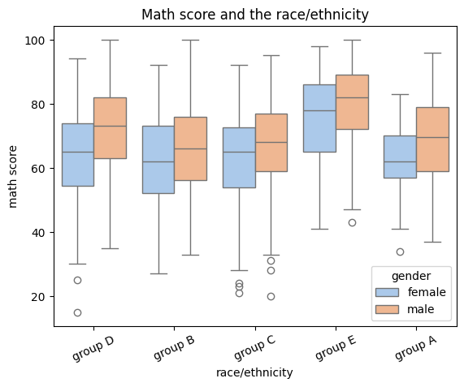
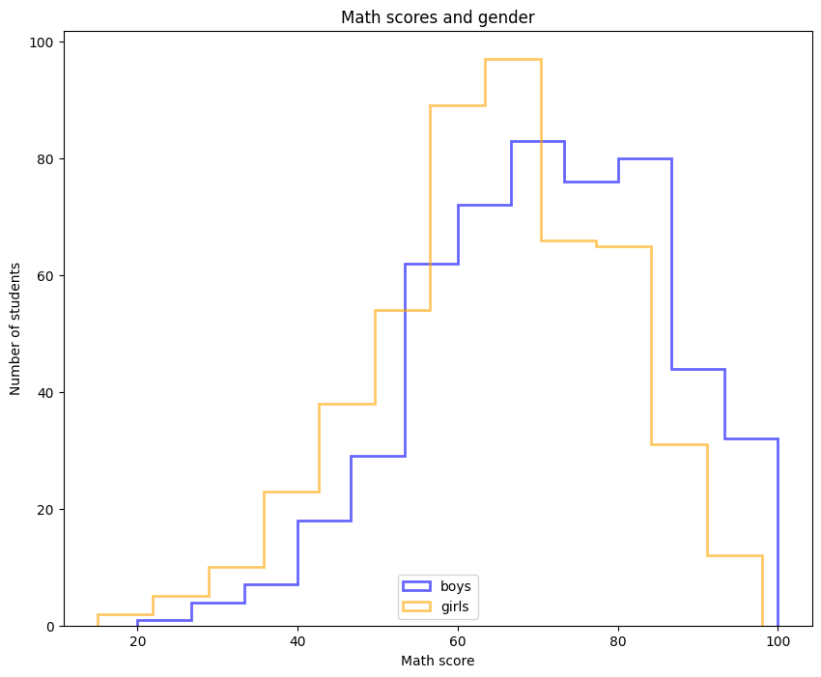
Student dataset
Notes:
Left Chart - Math Scores by Race/Ethnicity:
The math scores are generally well-distributed across different ethnic groups.Both male and female students show a similar pattern, with scores mostly around the middle range.
There are more male students who perform well overall, but the distribution is fairly balanced without a clear difference between groups.
Group E, however, stands out with a noticeably higher concentration of students achieving scores in the upper range, indicating better overall performance in math.
Right Chart - Math Scores by Gender:
The histogram illustrates the distribution of math scores between boys (blue) and girls (orange).
Female students' scores are mostly concentrated in the middle range.
Male students' scores are more spread out, with a noticeable number of high achievers at the top range.
This indicates some potential performance differences between genders.

Slide 7
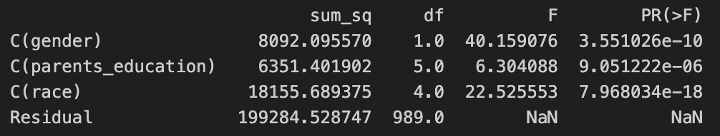
ANOVA Table
Gender (C(gender)):
F-statistic: 40.16, p-value: 3.55e-10
Strong evidence that gender impacts student performance.
Parental Education (C(parents_education)):
F-statistic: 6.30, p-value: 9.05e-06
Suggests a significant, but lesser impact compared to gender.
Race (C(race)):
F-statistic: 22.53, p-value: 7.97e-18
Indicates a strong influence of race on student performance.
Residual:
Sum of squares: 199,284.53
Represents unexplained variability within the data.
Notes:
The ANOVA table shows how different factors affect student performance:
Gender has a high F-statistic (40.16) and a very low p-value (3.55e-10), indicating a strong impact on performance.
Parental Education shows a moderate effect with an F-statistic of 6.30 and a p-value of 9.05e-06, suggesting it also significantly influences outcomes, but less than gender or race.
Race has a high F-statistic (22.53) and an extremely low p-value (7.97e-18), which strongly indicates its influence on performance.
The Residual value represents the variability not explained by these factors, highlighting that while these variables are significant, there is still variability due to other unmeasured factors.

Slide 8
Methodology
Data Preparation:
Trainings/Test split
Normalization of Data
Model Selection:
Linear Regression, Random Forests
Neural Networks
3 hidden layer, ReLU, Dropout-rate 0.2
Learning-rate 0.0005
Data Splitting:
K-Fold Cross-Validation
70-20-10 split
K = 5
Metrics for Evaluation:
R2 Score
MSE/MAE

Slide 9
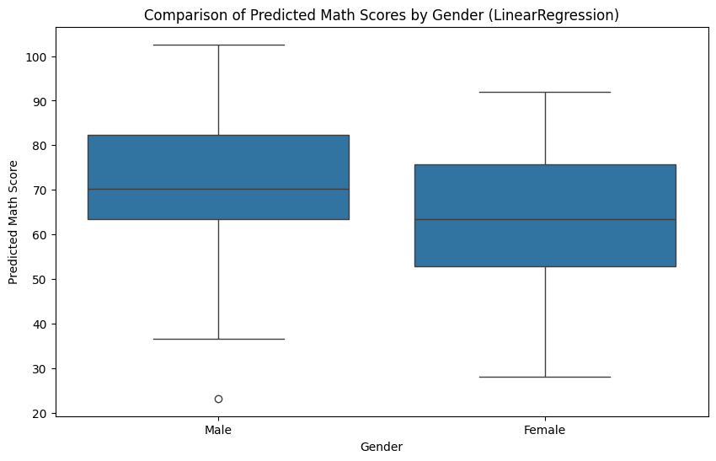
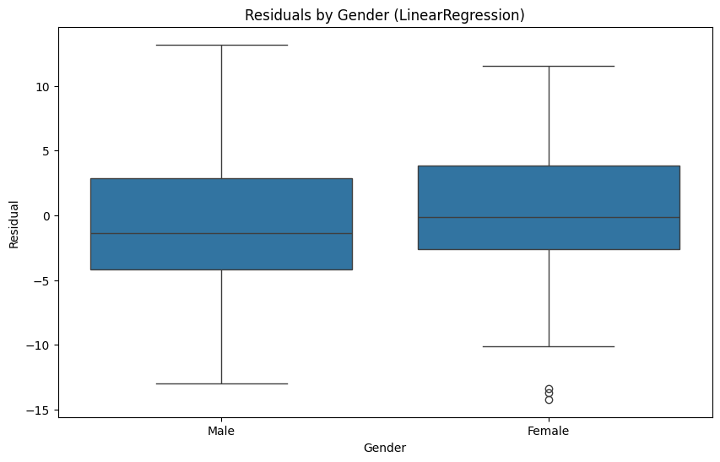
Linear Regression

Slide 10
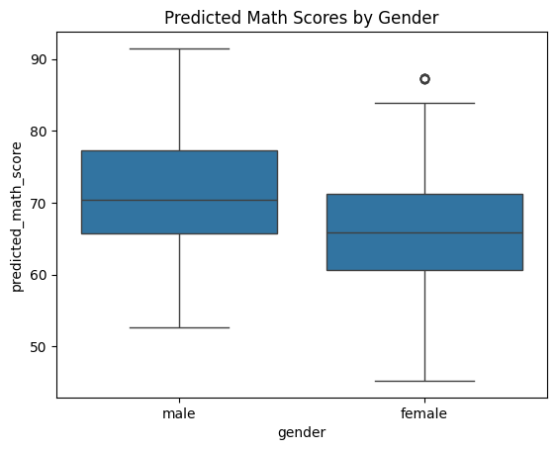
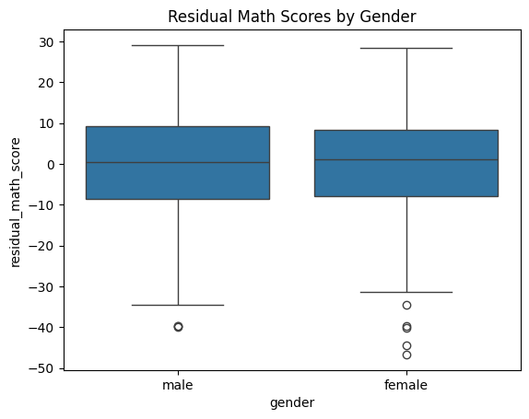
Neural Networks

Slide 11
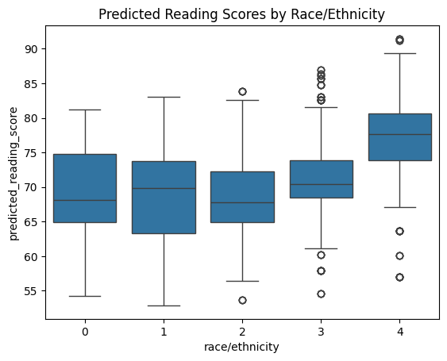
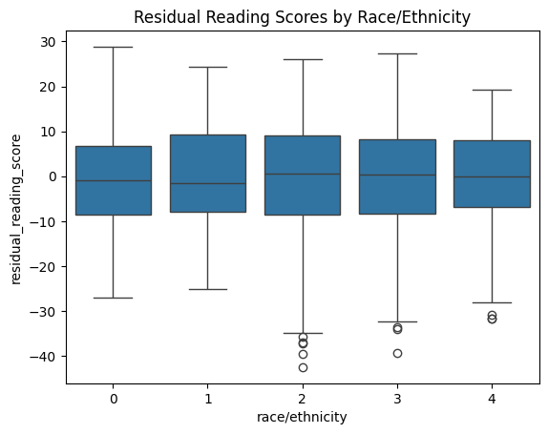
Neural Networks

Slide 12
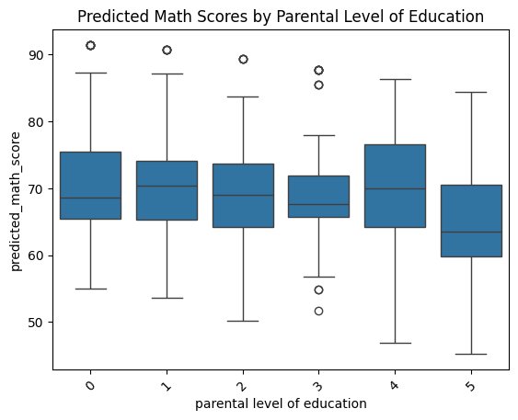
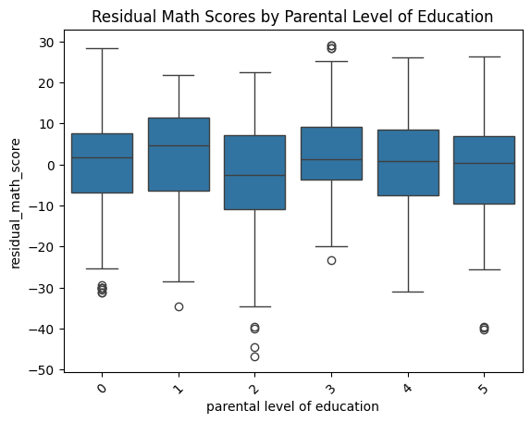
Neural Networks

Slide 13
Key Questions: Answers
Are there disparities in performance among different groups?
Yes there are disparities, but they are not necessarily caused by biases
Could these disparities suggest unfair opportunities?
These disparities do not favor / disfavor new students (backed by prediction results)
How can educators use this data to reduce bias?
Educators can shuffle student groups during task assignments to create more diversity

Slide 14
Results
The prediction models gave similar results
We decided going with neural networks, due to flexibility
There are disparities within gender and ethnicity
But the prediction models showed, that they have little to no residual
Hence we can conclude that the model reduces any bias as no class is favored / disfavored by the model
Key take aways: teachers can shuffle students who are performing well with students with worse performances to increase their respective influence

Slide 15
Thank you for your attention!

