Slide 1

Library System DATA maintenance and IMPROVEMENT project
QA Data Engineering Apprenticeship Module 5
Notes:
NOTE:
To change the image on this slide, select the picture and delete it. Then click the Pictures icon in the placeholder to insert your own image.

Slide 2
Presentation Brief
Build a presentation for the library client with a proposed solution. You must include:
An Architecture Diagram
Proposed Solution
A PowerBI dashboard to track the pipeline runs along with 3 Data Engineering metrics (this can be manual for today).
Demo (if novel)
Risks & Issues
SWAT Analysis
Stretch: Demo/Test Docker Swarm and explain how this would fit into the above.

Slide 3
Data Maintenance and Improvement PROJECT GOALS
Project to carry out Periodic Cleansing Tasks for the Library System Data
Validate and Correct Dirty Data – to improve data quality
Carry out Business Intelligence Derivations and Transforms on the data - to improve data business value

Slide 4
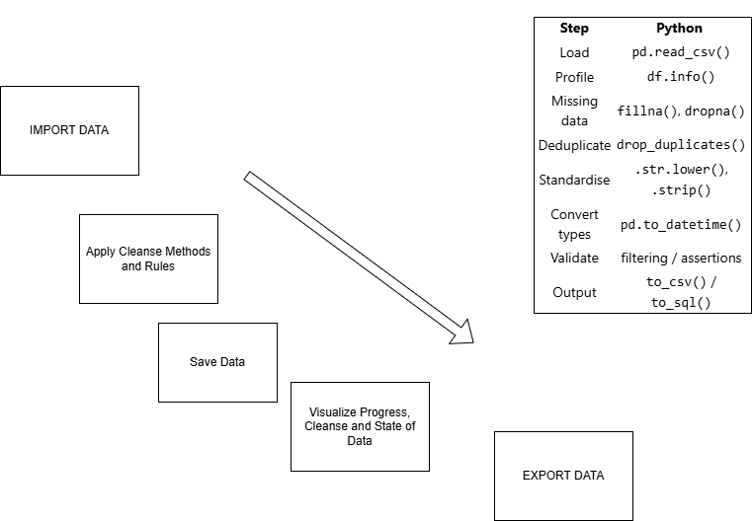

Workflow and Data Validation Rules

Slide 5


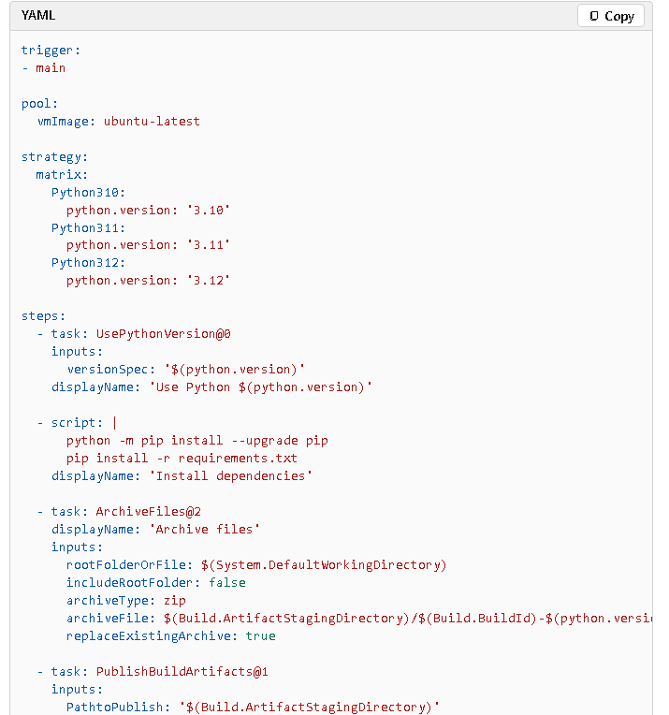

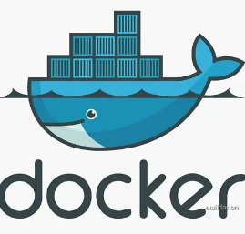
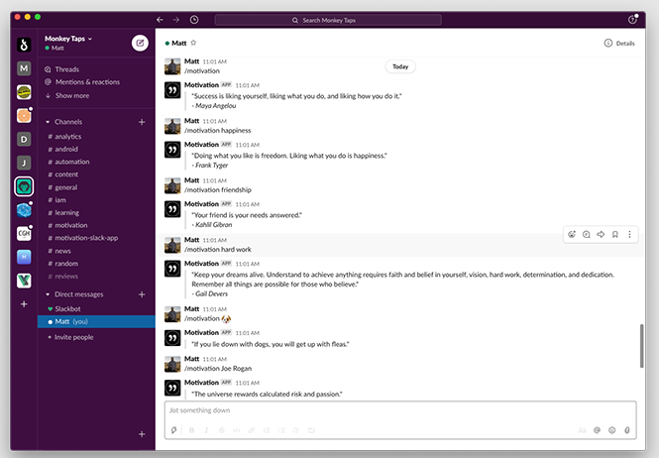
Proposed Solution - Tools
PYTHON SCRIPTS
CD– AUTO Trigger
VISUAL CODE
SQL LITE DATABASE - Logging
UNIT TESTING
AZ DevOPs
YAML File
Trigger
Pool
Strategy
Steps
Build and publish a Python app - Azure Pipelines | Microsoft Learn
CI – Manual Trigger
DOCKER CONTAINERS
POWER BI VIZ
TEAM COLAB - SLACK

Slide 6
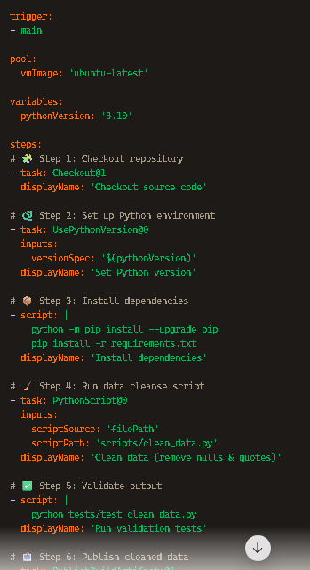
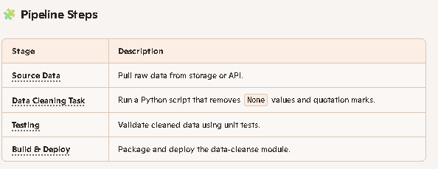
Proposed Solution - Pipeline
YAML File for AZ Dev Ops
Project Timeline
Phase 1 - MVP
Phase 2 – V1.1
Phase 3 – V2.0

Slide 7
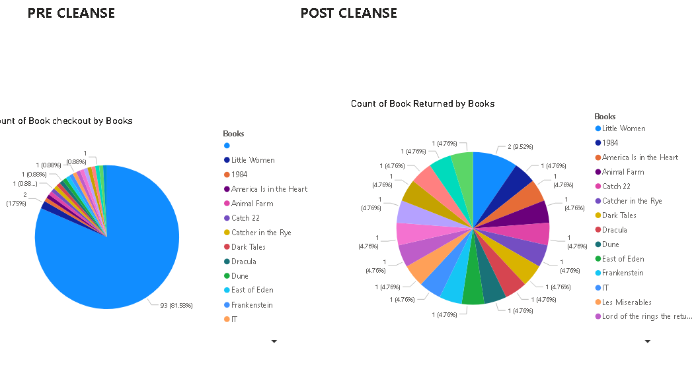
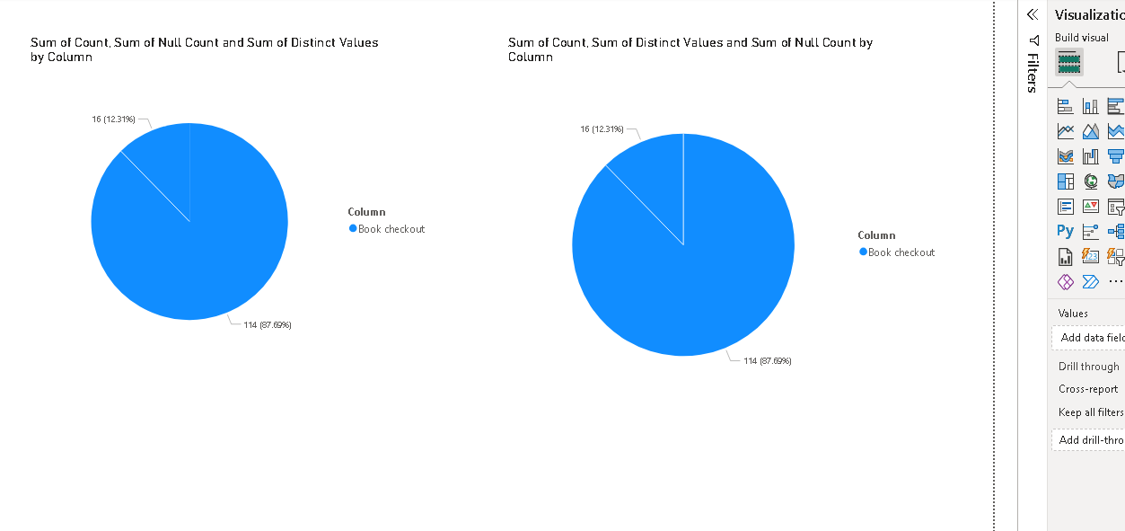
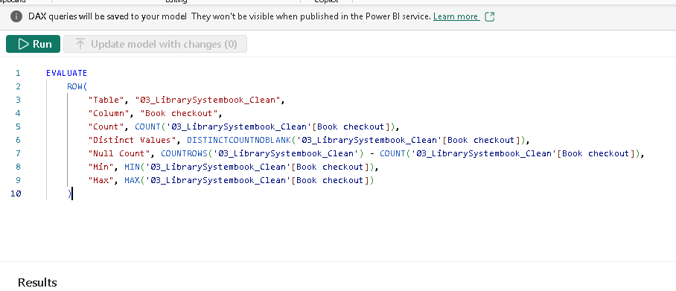
PowerBI dashboard
Data Quality
Business Intelligence – Business Value

Slide 8
SWAT
STRENGTHS
Task
Improve Data Quality
Improve Business Intelligence
Operational Efficiency
Weakness
Opportunity
Threats
Task
Project Cost vs Service income
Business Disruption
Decision Making – Agreement Reaching – Time taken
Task
Improve Analytics – Business opportunities
Process Standardization = Reuse
Long Term Data Gov Improvement
Security Risks
Scope Creep
Stakeholder Resistance
Upkeep Cost

Slide 9
Risks and Issues
RI ID | RISKS | RISK TYPE | ISSUES | ISSUE TYPE
RI 1 | Data Loss |  | High Volume of Data
RI 2 | Compliance |  | Poor Quality Data
RI 3 | Project Overrun |  | Data Anomalies
RI4 |  |  | Over Cleaning
TYPES:
Budget
Technical
Quality
Scope
Resource
Operational
Finance
Strategic
Compliance

Slide 10
Summary
To Do:
Capture Pre and Post Cleanse Data Sets
Tidy Up Repos
Repeat
Study Extension
Swarm, Orchestration

