Slide 1
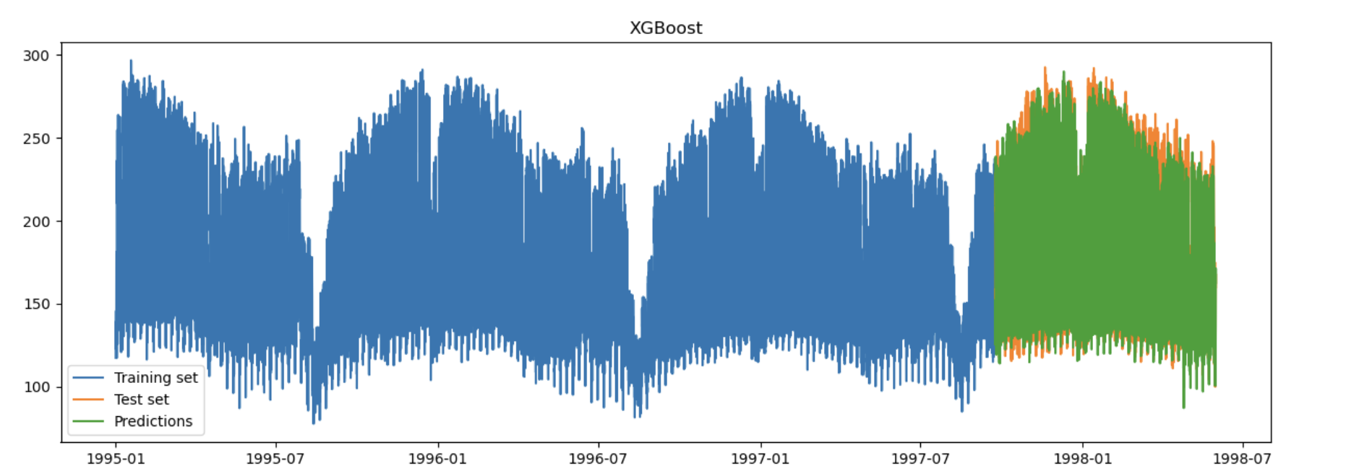
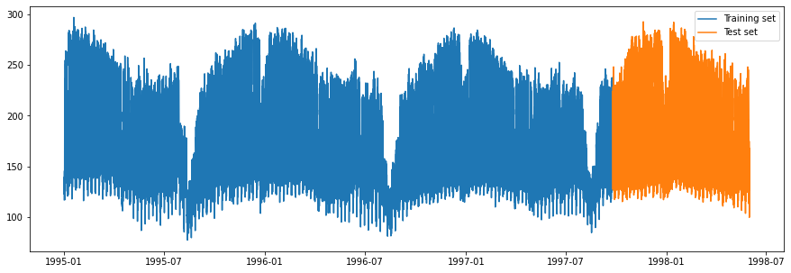
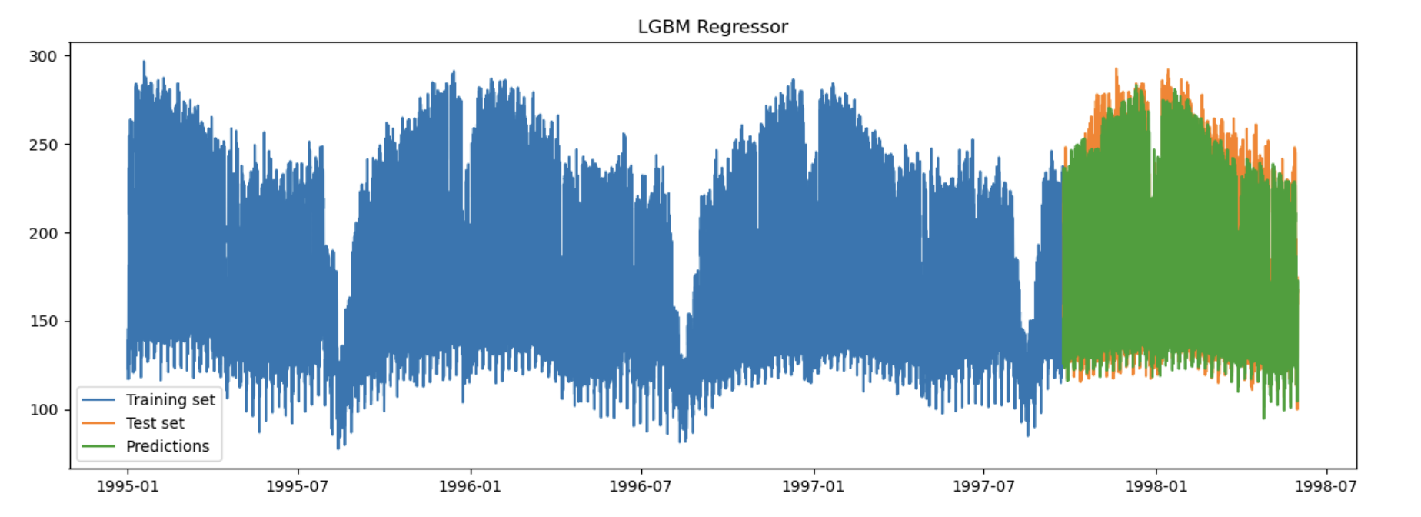
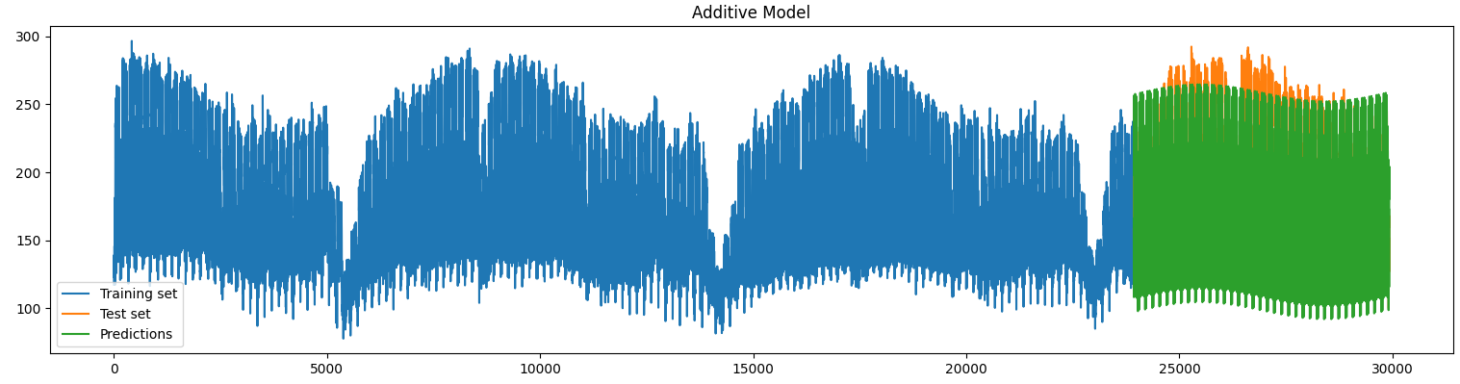
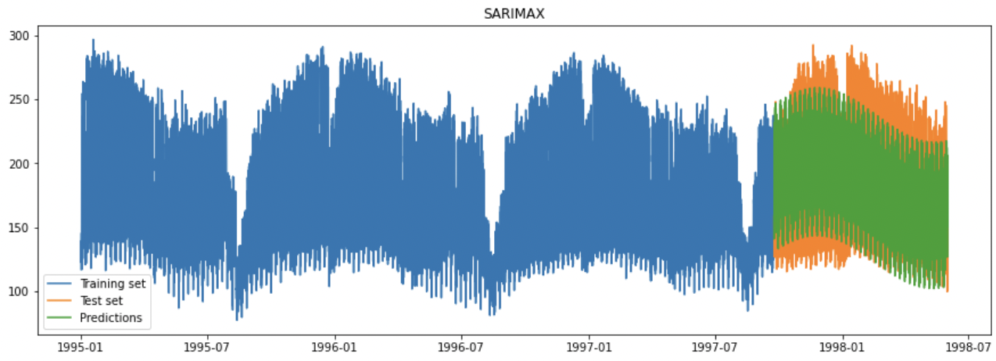
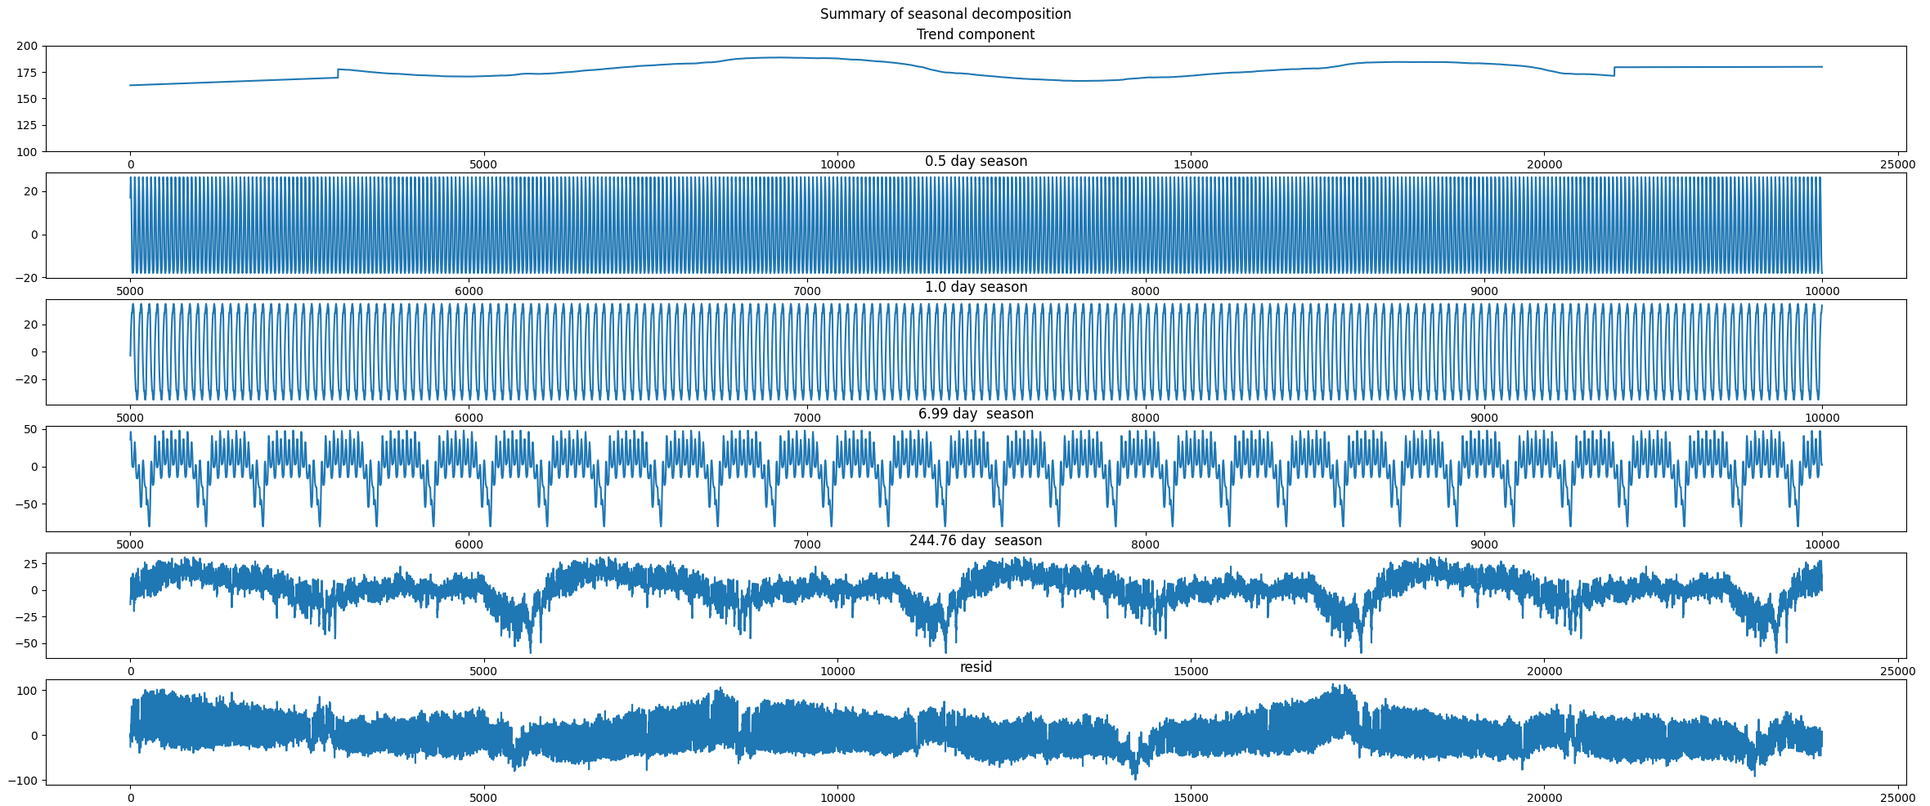

Time Series Forecasting of Power Supply Stream
Introduction
In forecasting tasks, the goal is to predict future values based on the previously observed values. Our dataset contains power supply hourly measurments of an Italian electricity company in a span of 3 years. There are two sources in these records, the main grid and the power transformed from other grids. In this work the focus is on the main grid. [1]
Forecasting
Different LSTM model architectures with different window sizes were tested for forecasting the noise data from the additive model. However, most of the LSTM models did not show good performance and the best model was with a window size of 5.
We also tried to enhance the LSTM models using Hypernetworks, but they do not perform well long term.
ARIMA and SARIMA were used to enhance the additive model by predicting leftover randomness after removing seasonalities and they showed slightly better results than LSTM.
XGBoost and LightGBM are gradient boosting methods that use tree structures. They are the best performing models.
Dataset Preprocessing
Dataset contains one more feature that represents the hour of the day when the data was recorded. During data cleaning only one error in the hour was found. Otherwise nothing spurrious was found.
The dataset description states that the data is collected from 1995 to 1998, so we assumed that it started in the beginning of the year. Timestamps were added from 01.01.1995 00:00 to 31.05.1998 23:00.
Stationarity test with Augmented Dickey-Fuller was done on the dataset with alpha value equal to 0.05. Which resulted in a p-value of 5.13 e-10, therefore stationarity can be assumed.
Analyzing the data visually, shows little to no trend, which was also found when fitting linear model to the data.
In the end we split the dataset into two sets, the training and the test set. The test set contains the last 20% of the data.
Baseline
Two simpe baseline models were created for refernce:
Mean baseline model [MBM]: Predicted values are equal to the mean of the training data
Random basline model [RBM]: Predicted values are uniformly sampled from range of training data
Additive Model [AM]
FFT analysis, to extract most present frequencies in the signal
Extract seasonal signals of found frequencies in the data using „signal_decompose“ (top 4 frequencies).
Model each component, 4 different Seasons [0.5, 1.0, 7.0, 245.0] days and Trend.
Combining models in additive fashion for predictions.
Model | MSE | MAE | RMSE | R2
RBM | 6168.746 | 64.824 | 78.541 | -2.007
MBM | 2172.005 | 40.396 | 46.605 | -0.059
AM | 557.02 | 18.421 | 23.601 | 0.745
LightGBM | 129.898 | 7.793 | 11.397 | 0.937
XGBoost | 129.701 | 7.825 | 11.389 | 0.937
SARIMAX | 1143.627 | 27.495 | 33.818 | 0.443
ARIMA | 1360.84 | 29.74 | 36.89 | 0.337
LSTM_W5 | 1218.558 | 28.531 | 34.908 | 0.406
Conclusion
Predicting with multiple seasonalities, was the main challenge with this dataset. Different models were created to test their behaviour in these settings.
LSTM models do not perform well in long term forecasting.
ARIMA and SARIMAX models performe better than LSTM in predicting randomness but do not show significant enhancement. SARIMAX performes better than ARIMA because it does not assume that all the seasonality is removed.
Additive Model achieves good performance when the most present seasonalities are removed.
Sources & Additional Information
https://github.com/as-cal8/KDDM2-2022 [1] https://www.cse.fau.edu/~xqzhu/stream.html
Authors: Alexander Seyr, Adam Mourad, Muhamed Ramić
TU Graz – Institute of ISDS
8010 Graz, Inffeldgasse 12/I, Austria

