Slide 1
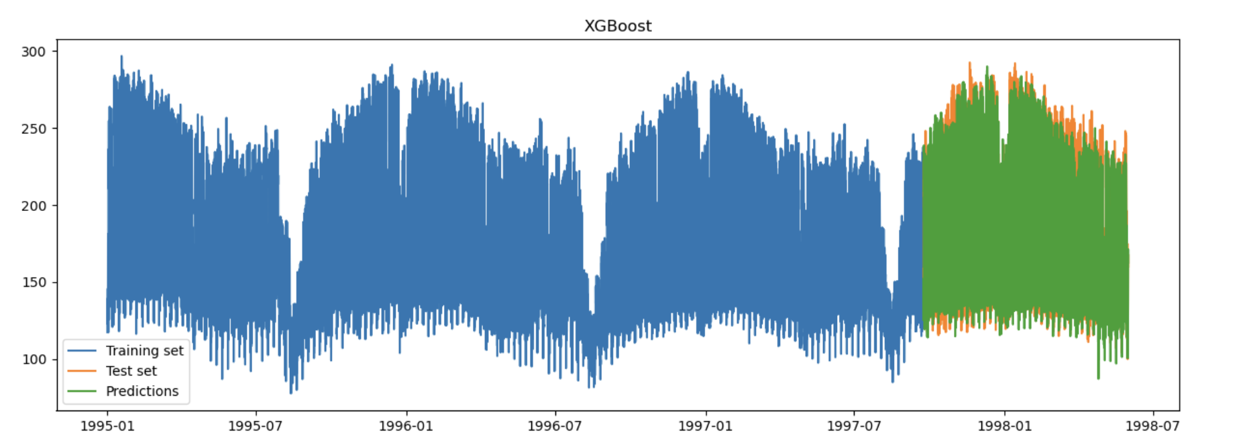
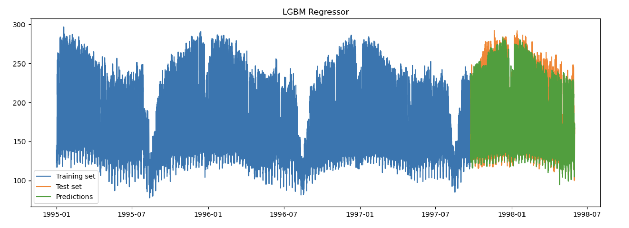
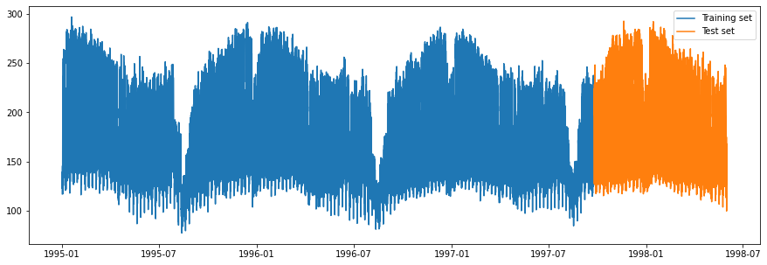
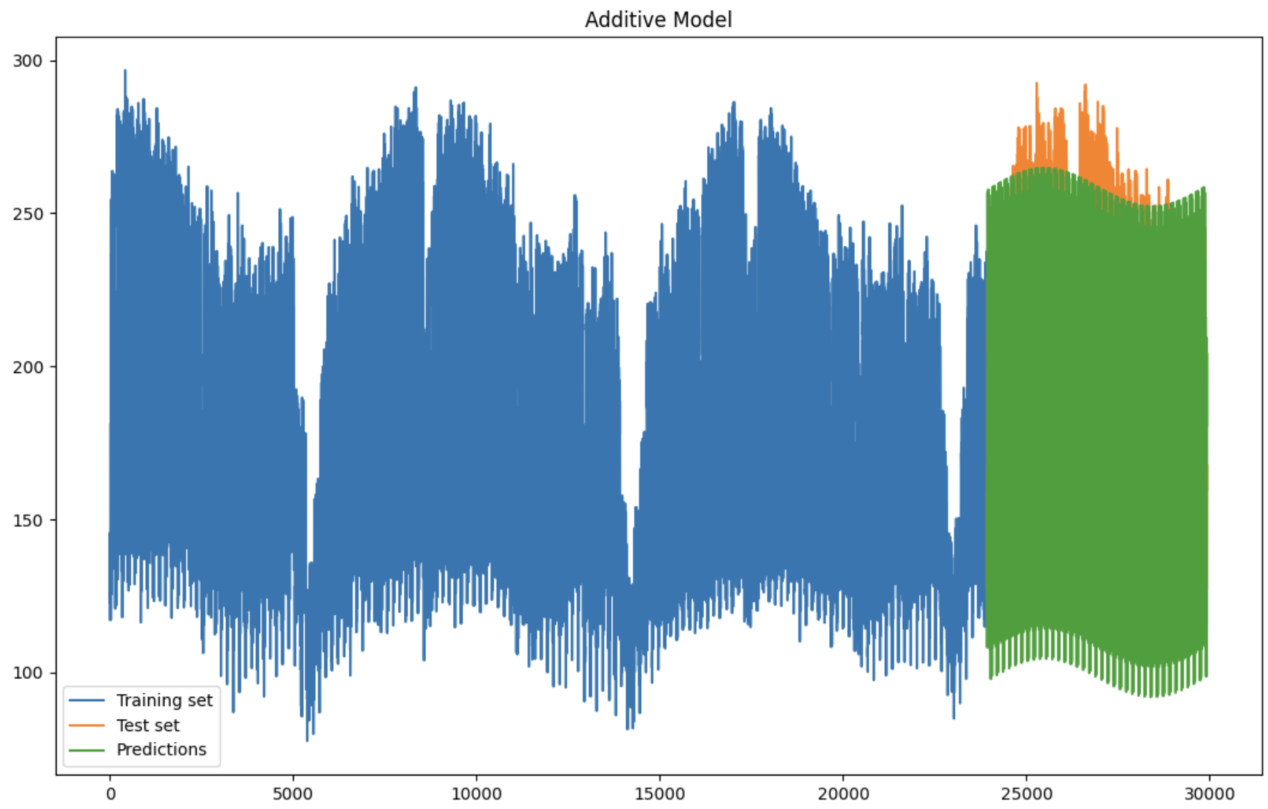
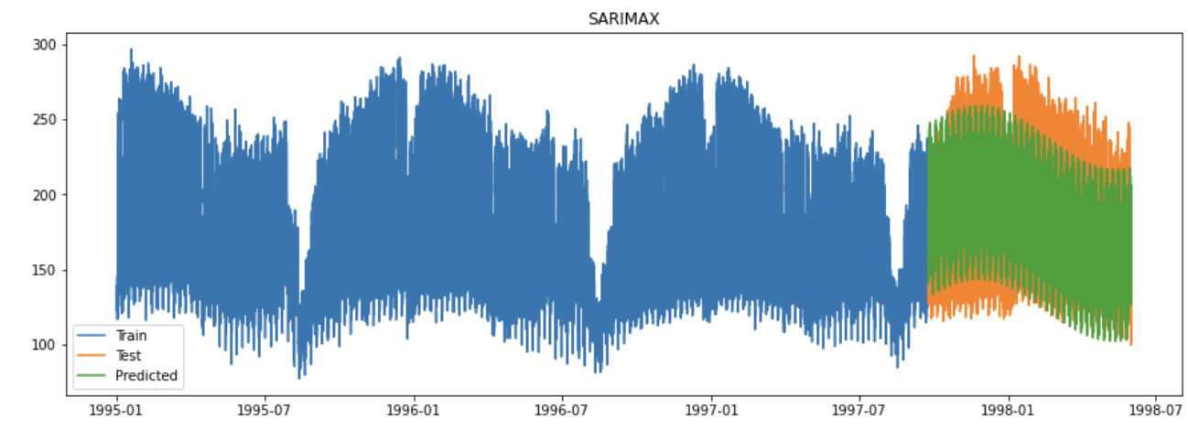
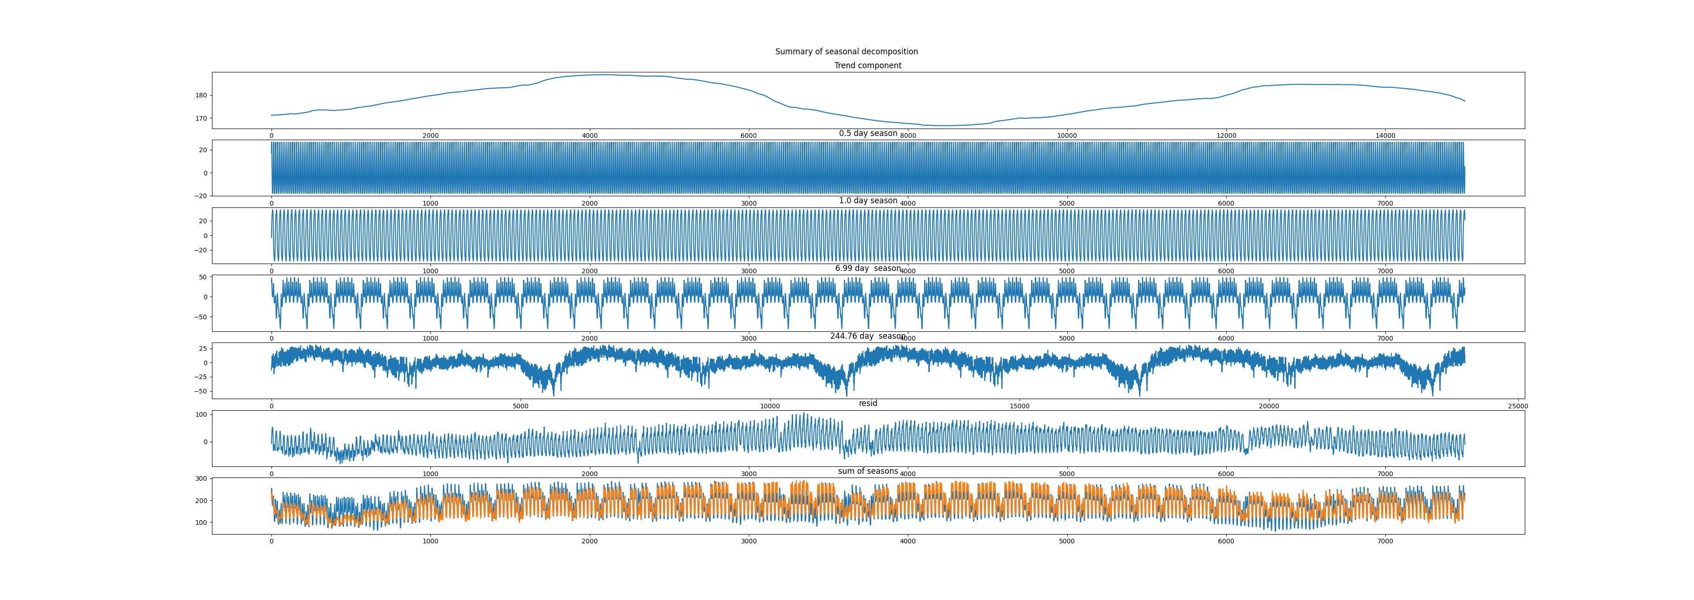

Time Series Forecasting of Power Supply Stream
Introduction
In the forecasting tasks, the goal is to predict future values based on the previously observed values. We use the power supply dataset that contains hourly measurements of the Italian electricity company in a span of 3 years. There are two sources in these records, the main grid and the power transformed from other grids. In this work the focus is on the main grid
Forecasting
Models that were tested XGBoost, LightGBM, Additive Model , SARIMAX, LSTM
Different LSTM Models architecture with different window sizes were tested for forecasting the noise data from the additive model. However, most of the LSTM models did not showed good performance and the best model was with a window size of 5. We also try to enhance the LSTM models using Hypernetworks, but they do not perform well long term.
ARIMA and SARIMA models showed better results than LSTM results. ARIMA and SARIMA were used to predict randomness after removing seasonality.
XGBoost and LightGBM are gradient boosting methods that use tree structures. They are the best performing models.
Dataset Preprocessing
Dataset contains one more feature that represents hours when the data was recorded. But this feature contains an error in one sample, the hour is set to 9 even though the right record is 6.
In the dataset description stands that the data is collected from 1995 to 1998, so we assume that it started in the beginning of the year and we add timestamps from 01.01.1995 00:00 until 31.05.1998 23:00.
We apply the Augmented Dickey-Fuller test on the dataset with alpha value equal to 0.05. We get the p value of 5.13 e-10, which tells us that the data is stationary.
With the assumption that the data can be expressed with an additive model, we apply FTF to the dataset to find the most common frequencies in the dataset and find the seasonality. Combining these findings with seasonal decompose we extract the seasons and found no trend in the dataset.
In the end we split the dataset into two sets, the training and the test set. The test set contains the last 20% of the data.
Baseline
Two simpe baseline models were created for refernce:
Mean baseline model [MBM]:
Predicted values are equal to the mean of the training data
Random basline model [RBM]: Predicted values are uniformly sampled from range of training data
Additive Model [AM]
FFT analysis, to extract most present frequencies in the signal
Extract found frequencies of the signal using „signal_decompose“, using top 4 frequencies.
Model each component, 4 different Seasons [0.5, 1.0, 7.0, 245.0] days and Trend.
Combining models in additive fashion
Model | MSE | MAE | RMSE | R2
RBM | 6168.746 | 64.824 | 78.541 | -2.007
MBM | 2172.005 | 40.396 | 46.605 | -0.059
AM | 557.02 | 18.421 | 23.601 | 0.745
LightGBM | 129.898 | 7.793 | 11.397 | 0.937
XGBoost | 129.701 | 7.825 | 11.389 | 0.937
SARIMAX | 1143.627 | 27.495 | 33.818 | 0.443
ARIMA | 1360.84 | 29.74 | 36.89 | 0.337
LSTM_W5 | 1218.558 | 28.531 | 34.908 | 0.406
Conclusion
Predicting multiple seasonalities, whithout the noise, was the main challenge with this dataset. Therefore the goal was to create models, which perform well in these settings.
LSTM with windows did not perform well in forecasting. ARIMA and SARIMAX models performed better than LSTM in predicting randomness noise but did not show significant enhancement.
SARIMAX performed better than ARIMA because not all seasonailties were reomved.
Additive Model using the 4 most occuring frequencies performed best.
Sources & Additional Information
https://github.com/as-cal8/KDDM2-2022
Authors: Alexander Seyr, Adam Mourad, Muhamed Ramić
TU Graz – Institute of ISDS
8010 Graz, Inffeldgasse 12/I, Austria

