Slide 1
Feasibility of Using Large Language Models for Requirement-Based Software Testing
Alexander Seyr

Slide 2
Outline
Software testing overview
Focus of this project
Experimental Setup
Evaluation Procedure
Dronology Dataset
Prompt engineering techniques
Results

Slide 3
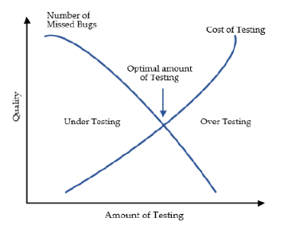
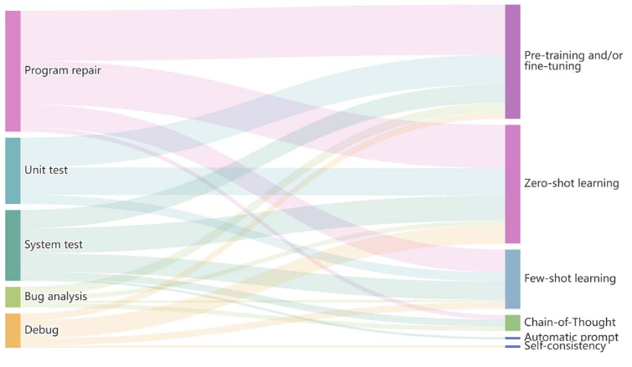
Software testing overview
Quality assurance through testing
Strategies
Unit testing
Integration testing
Acceptance/Validation testing
System testing
Most of LLM research on System and Unit testing
Wang, Junjie / Huang, Yuchao / Chen, Chunyang / Liu, Zhe / Wang, Song / Wang, Qing, Software testing with large language models: Survey, landscape, and vision 2024 IEEE Transactions on Software Engineering
Anwar, Nahid / Kar, Susmita, Review paper on various software testing techniques &amp; strategies, 2019, Global Journal of Computer Science and Technology , Vol. 19, No. 2 p. 43-49
Notes:
Quick refresher of software testing.
Needed to verify and validate developed software to meet specifications (describe picture)
Prevent and find errors in a system
Analyze for usability, compatibility, reliability, integrity, efficiency, security, portability, maintainability, …
In general there are four types of testing strategies.
Unit testing: smallest testable part (done by developer)
Integration testing: integrate unit tested component and test them as a group – interfacing
Acceptance/Validation testing: authenticate whether product is developed as per standards and detailed criteria and meets all requirements specified by the user
System testing: testing done on complete integrated system
This requires a lot of resources, human, costs, time … usually separate test team
If you have experience many tests are pretty basic from a complexity perspective.
Especially in the industry -> fast development cycle for new products / projects are essential to stay competitive
Recent years with upcoming powerful LLM’s there are now many possibilities to change the classic approach and potentially minimize or optimize testing efforts.
Overview of areas of research where LLM’s are applied most:
Large amount of research in recent years focuses mainly on utilizing LLM for automating unit test generation for high coverage. (-> generating tests for code snippets)
Generating test scenarios for system tests.

Slide 4
Focus of this study – Acceptance Testing
Ensuring project meets base requirements
Requirements highly dependent on domain and project leads
Notes:
I found little research trying to utilize directly the software requirements as a resource to generate testcases.
Falling more in the category of acceptance testing
Especially when tests can be related to requirements this usually is a complete process (describe picture) to exactly track the process.
And generally
- Management Defines Product Requirements in combination with Customers
- Technical Leads derive Software Requirements
- Separate test team:
Initial Tests are derived from Requirements
(later system tests)
High confidence that requirements are met is required at an early stage.
Biggest factor therefore are definitions of requirements
how detailed requirements are defined – usually using natural language
room for interpretation – possible conflicts, … but definition is another topic (verifying requirements for completeness, integrity, …. Is another story)
requirements define what the system must to but not how.
basic functionality of a system shall be tested through simple testcases that relate to at least one requirement.
Requirements usually short precise definition of expected behaviour.
I am interested in how capable LLM’s are in generating structured test case description out of natural language requirements.
Especially in techincal domains.
Idea that in the future the approach would be a semi automatic acceptance testing pipeline with human in the loop.
requirements -> LLM -> TC’s + Human verification -> LLM -> implementation + Human verification
First we need to get an impression of how capable the models are to understand the requirements.

Slide 5
Experimental Setup
Evaluation Procedure
Use prompt engineering techniques to generate testcases
Simple validation structure for initial quality estimate of model output + prompt
Basic Test Description structure shall be enforced
Requirement, test objective, preconditions, test steps, expected result
Human verification as final evaluation
Notes:
As an experimental setup I created a framework for structured test descriptions.
As the difficulty is not to generate output, but to evaluate the quality of the output
General structure shall be enforced using JSON which is a common way to get structured output from a LLM.
Requirement, test objective, preconditions, test steps, expected result
Using prompt engineering techniques to generate testcase for each requirement.
Simple validation structure for each component for a first quality estimate of model and prompt.
Describe few rules….
As a last step human verification
Implementation:
OLLAMA API, focus on local models?, …

Slide 6
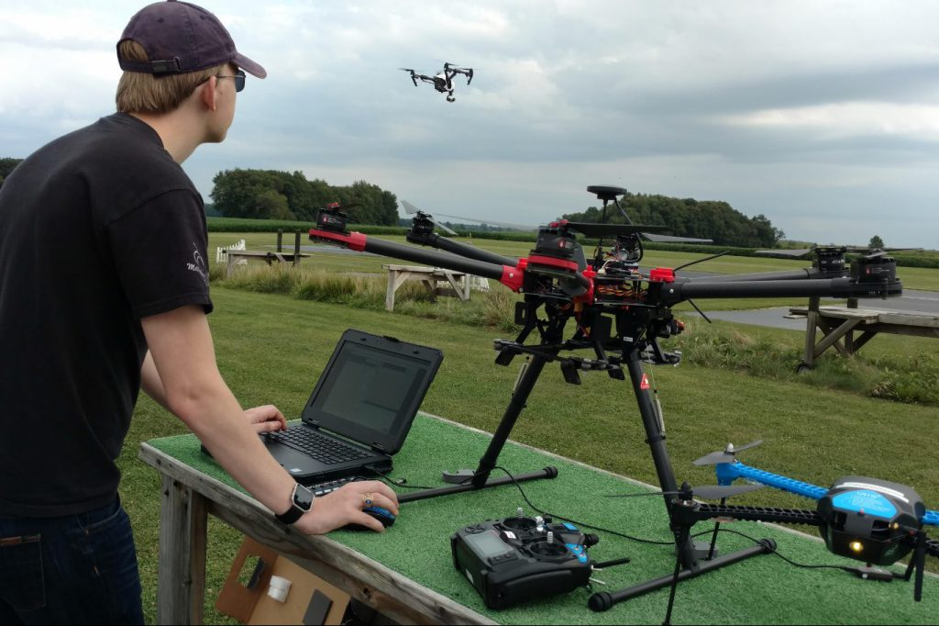
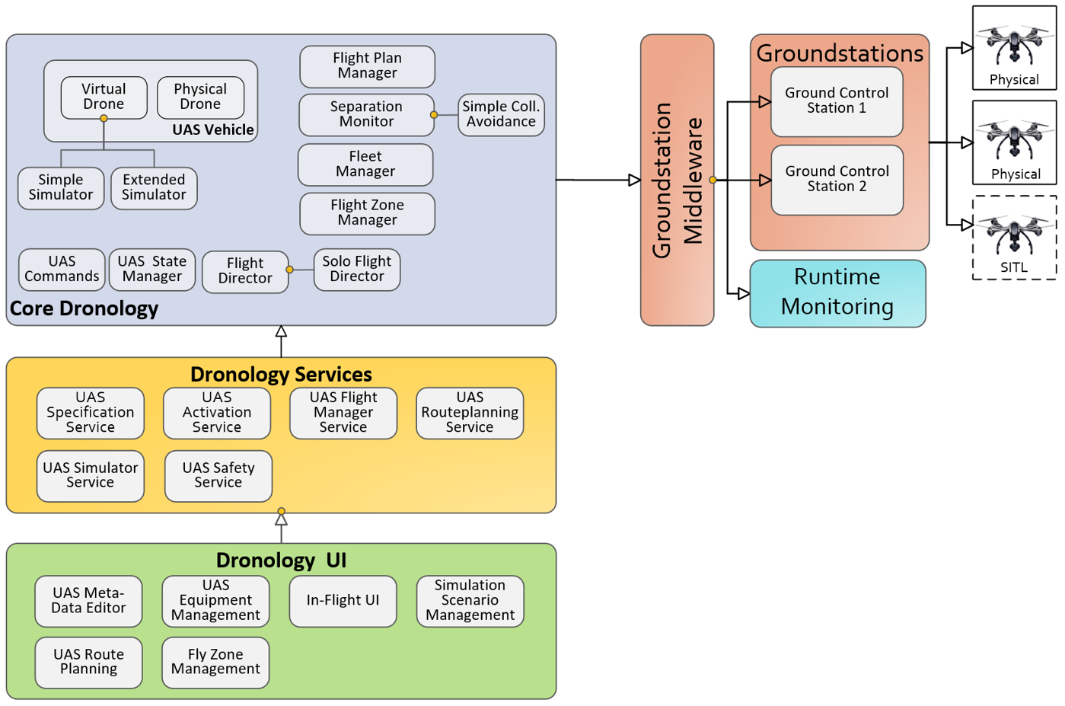
Experimental Setup
Evaluation on Dronology
Unmanned Aerial Systems Management and Control
research environment
framework for controlling and coordinating the flight
https://dronology.info/
Notes:
Domain specific application chosen:
Dronology is an Open-Source Unmanned Aerial System (UAS) developed at the University of Notre Dame. The project has two main objectives:
First, to establish a research environment for studying various aspects of software and systems engineering for cyber-physical systems -- e.g., runtime monitoring, safety analysis, and product line development.
Second, to provide a framework for controlling and coordinating the flight of individual UAS, formations, and swarms in order to to support applications such as search-and-rescue, surveillance, and scientific data collection.
The Dronology Architecture is designed to deliver a multi-platform solution. It is designed around the concept of a Dronology Core with Services middleware that support UI development and Groundstation middleware that supports communication with diverse UAS. Here we describe each core component and provide links to other pages containing further details. Dronology Core provides features for coordinating the flights of multiple sUAS in a shared airspace. This includes centralized collision avoidance, fleet management, internal simulator, and management of vehicle status. Click here to learn more about key components in the Dronology core.
Dronology services are used by various clients to construct user interfaces. The services can be used to perform tasks such as upload flight plans, activate UASs, observe and visualize UAS flights, and register equipment to individual UAS. Vaadin is an open-source web framework that supports development of rich user interfaces. It has a server-side architecture, which allows most of the logic to run on the server, while Ajax technology on the client side ensures a rich and highly interactive UI. In Dronology, we run Vaadin on TomCat — which can be deployed either centrally or locally. The web-based approach enables our goal of platform portability. The ground station middleware provides a bridge between the Dronology core and a diverse set of ground stations. It is designed to allow future developers to build their own ground stations. The middleware allows registration of a new ground station. It passes directives from the Dronology core to UAVs registered through their respective ground stations, and forwards UAV data, such as their GPS coordinates from the ground station back to the the core. Groundstations are responsible for communicating directly with the physical or externally simulated UAVs. Our current ground station is developed in Python using Dronekit Python — and is capable of communicating with UAVs that run ArduPilot. The runtime monitoring component allows constraints to be defined and various values to be monitored. The monitored variables include UAV specific values such as coordinates, velocity, and battery power, as well as external variables read from sensors on the UAV.

Slide 7
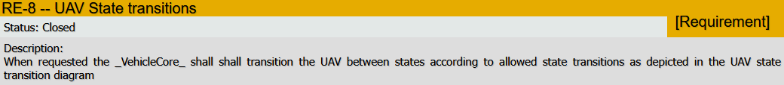
99 Requirements

Slide 8
Prompt Engineering techniques
Zero shot learning
Chain of thought prompting
Personas
Providing context
Multimodality
Tree of thought
Chain of density

Slide 9
Results
Prompts examples …
Models …
Quality of output visualization
Performance of different prompts …

Slide 10
Q & A

