Slide 1


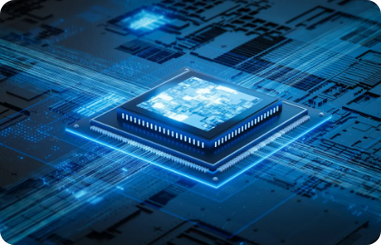










Neural Processing Unit (NPU) & SoC: System on Chip
Next-Generation Hardware Acceleration & Deep Learning System Architecture
PRESENTED BY TEAM MEMBERS
Lamia Ahmed Team Lead
Afrin Sultana Presenter
Fahim Abrar Mahir Presenter
Asem Hamid Presenter

Slide 2

Neural Processing Unit (NPU)
An overview of NPU architecture, core capabilities, key advantages over traditional CPUs, and real-world AI applications.

Slide 3


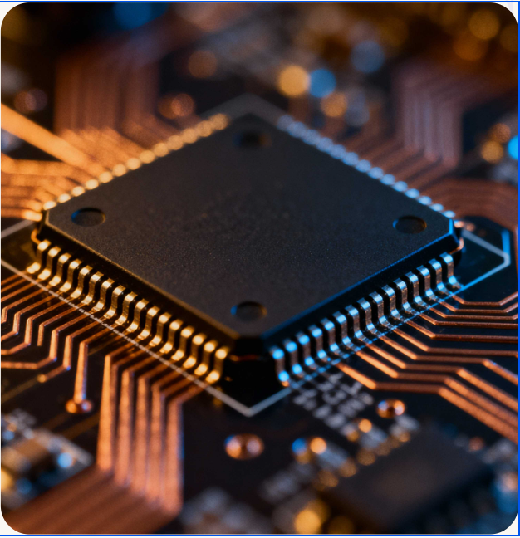


What is a Neural Processing Unit (NPU)?
Specialized AI Accelerator
An NPU is a dedicated microprocessor designed specifically to accelerate Artificial Intelligence (AI) and Machine Learning (ML) tasks efficiently.
Matrix & Tensor Optimization
Unlike general-purpose processors, NPUs are engineered specifically for mathematical operations essential to neural networks, such as complex matrix calculations.
System Integration
NPUs are commonly integrated directly into modern System-on-Chips (SoCs) alongside CPUs and GPUs to power intelligent features seamlessly.

Slide 4
Feature / Metric | Central Processing Unit (CPU) | Neural Processing Unit (NPU)
Primary Focus | General-purpose computing tasks | Specialized AI & ML computations
Execution Style | Sequential execution / Few complex cores | Massively parallel / Tensor matrix engines
AI Efficiency | Lower efficiency for neural networks | Ultra-high throughput & optimized performance
Power Consumption | Higher energy draw under heavy AI load | Low power draw optimized for battery devices
Primary Workloads | OS operations, logic, web browsing, apps | Facial recognition, speech, generative AI
NPU vs. CPU: Architectural Comparison

Slide 5






Key Features & Technical Advantages
Optimized for AI
Parallel Processing
Designed with dedicated hardware architecture specifically tuned for neural network algorithms, deep learning layers, and tensor operations.
Executes thousands of matrix math calculations simultaneously, providing the extreme data throughput essential for real-time AI workloads.
Low Power Consumption
On-Device Privacy
Delivers significantly higher performance-per-watt, dramatically saving battery life in mobile devices like smartphones and laptops.
Enables local AI processing directly on the hardware. Reduces latency and keeps sensitive personal data on the device without cloud dependency.

Slide 6






Real-World Applications of NPUs
Smartphones
Computer Vision
Voice Recognition
Powers biometric face recognition, computational camera enhancements, scene detection, and virtual assistants.
Enables real-time visual analysis, object detection, spatial tracking, and automated image segmentation.
Accelerates on-device speech-to-text conversion, real-time audio translation, and noise suppression.
Generative AI
Autonomous Vehicles
Security Systems
Runs local Large Language Models (LLMs) and image generation tools directly on user hardware.
Processes real-time camera feeds and sensor arrays for instantaneous intelligent driving decisions.
Drives smart surveillance systems with real-time video analytics and instant threat detection.
SoC Integration Note: NPUs rarely operate in isolation. They are integrated alongside CPUs and GPUs into a single chip known as a System on Chip (SoC).

Slide 7
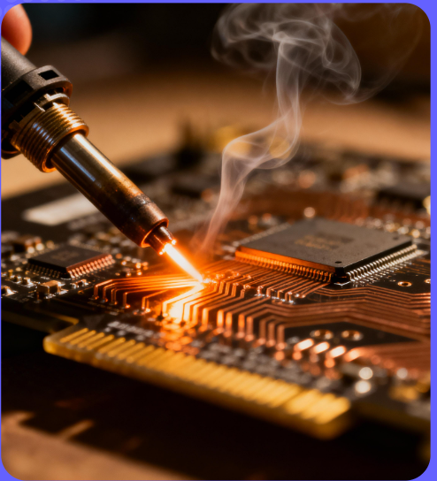


SoC: System on Chip
Integrating CPUs, NPUs, and System Controllers into a single, high-efficiency silicon platform for modern AI workloads.

Slide 8





Slide 9













SYSTEM ON CHIP
A System on Chip (SoC) is an integrated circuit that combines most of the major components required to perform a computing system's functions onto a single chip.
CPU
ISP
NPU
GPU
Memory
Bus / I/O
Central Processing
Image Signal
Neural Processing
Graphics Engine
RAM Controller
Peripherals

Slide 10
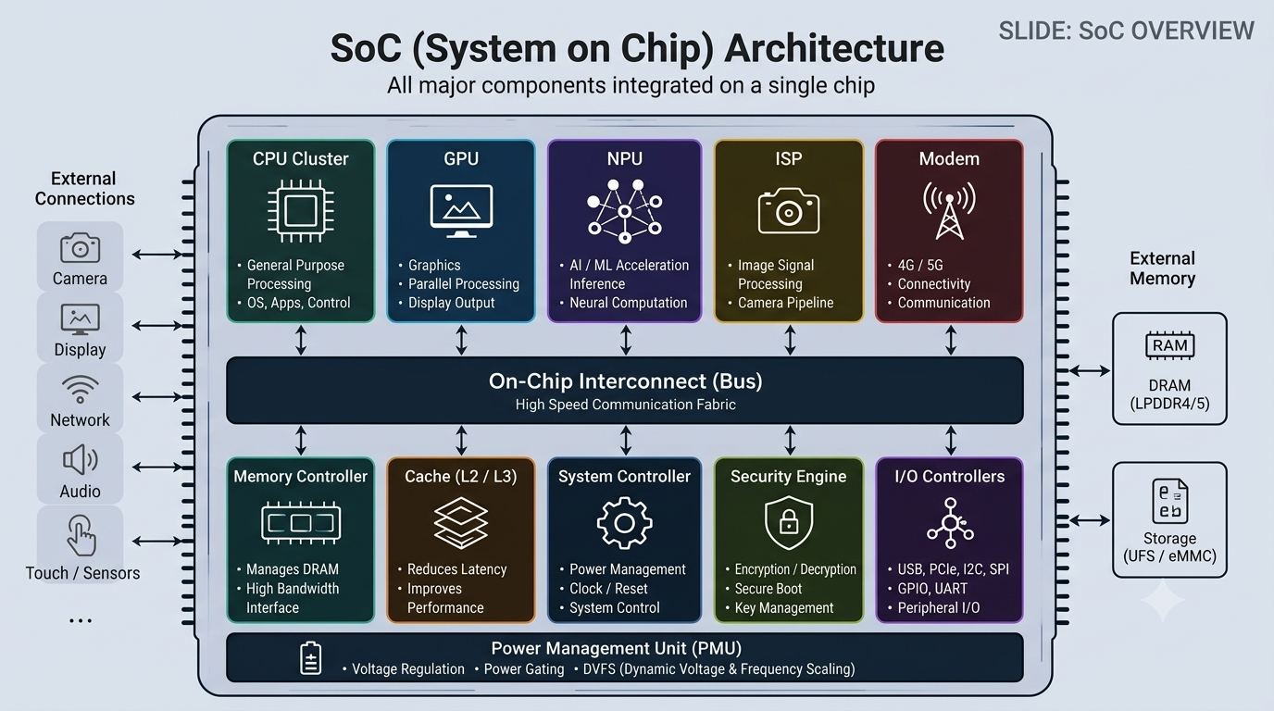


Slide 11


Core Modules within an SoC
CPU Core
GPU Unit
NPU Accelerator
Handles general-purpose computing tasks, executing OS instructions and sequential workload logic.
Accelerates complex 2D/3D graphics rendering, video decoding, and parallel math processing.
Dedicated neural engine optimized for low-power machine learning models and AI inferencing tasks.
ISP Module
Memory Controller
Security & I/O
Processes raw camera sensor data in real-time, handling auto-focus, noise reduction, and HDR imaging.
Manages high-speed data flow between system caches and unified system RAM (LPDDR memory).
Houses hardware security enclaves, cryptographic engines, and external bus interfaces.

Slide 12

?
BUT
WHY
Why Integrate Everything Into One Chip?

Slide 13







Efficiency
Ultra-Low Power Consumption
Sub-nanosecond Latency
Smaller Size
Shorter physical wire traces eliminate signal resistance and reduce dynamic power dissipation across motherboard traces.
High-speed on-chip interconnect buses allow CPU, GPU, and NPU to share data near-instantly without memory bottlenecking.
Miniaturized Form Factor
Cost-Effective Mass Production
Combining multiple chips into a single package saves critical board space in smartphones, wearables, and thin laptops.
Lower overall bill-of-materials (BOM) cost by reducing discrete component assembly, testing, and packaging steps.

Slide 14
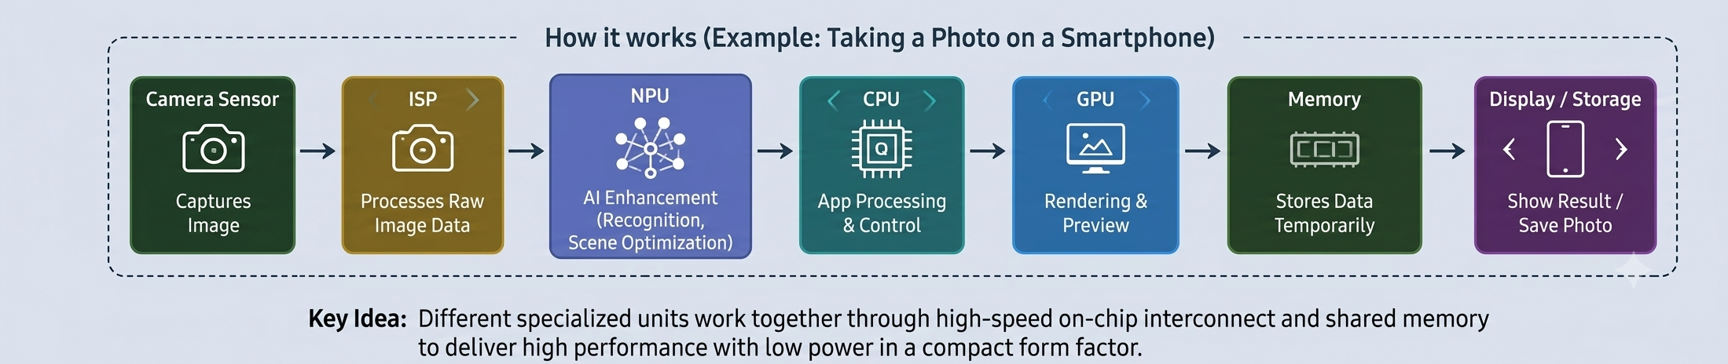
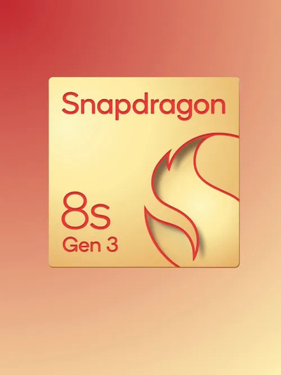
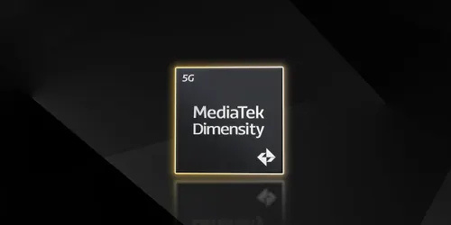
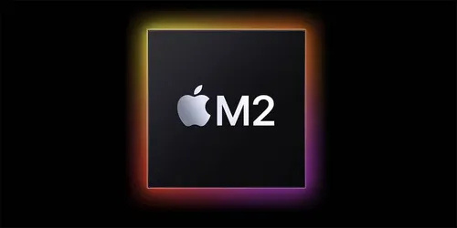
ARM architectures define the mobile SoC landscape
In smartphones, chips based on the ARM architecture are all built on this SoC concept.

Slide 15





Desktop CPU Evolution & APUs
Integration Evolution
APU & Integrated GPUs
Core-Only Era: Early Intel and AMD processors provided only CPU processing cores on the die.
Unified Chip Design: APUs (Accelerated Processing Units) and iGPUs integrate both CPU and GPU computational cores onto a single silicon die.
On-Die Cache: Intel pioneered adding high-speed Cache memory directly into the CPU chip.
Workload Versatility: Excellent performance for low to medium-level graphics tasks without requiring a dedicated discrete graphics card.
Integrated Memory Controller: AMD moved the memory controller off the motherboard directly onto the CPU silicon.
Key Applications: Video editing, file compression, mid-level gaming, and light numerical simulations.
Core Benefit: Dramatically increased output, boosted overall system efficiency, and significantly reduced memory access latency.
Space & Power Saver: Reduces overall power draw, heat generation, and physical space within computing hardware.

Slide 16
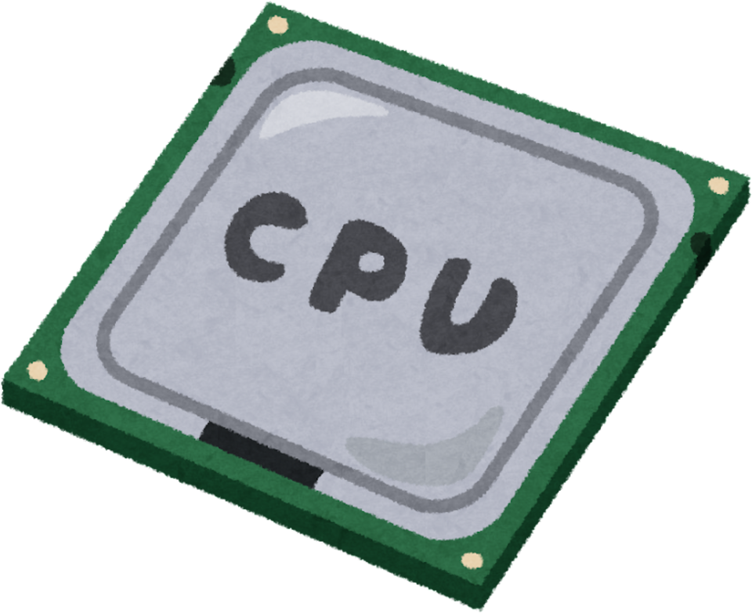




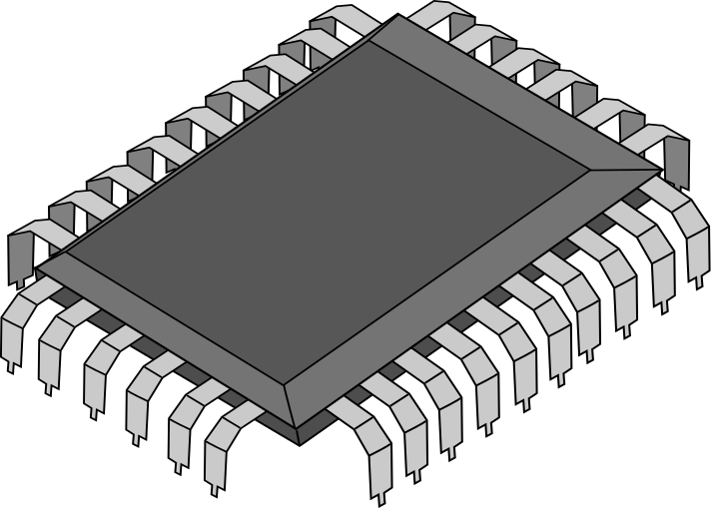

NPU Integration inside the SoC
SINGLE SILICON DIE (SOC SYSTEM)
CPU Cores
GPU Engine
Orchestration & Logic
Rendering & Graphics
NPU (Neural Processing Unit)
Specialized On-Die Hardware for Real-Time AI & Machine Learning
An NPU does not have to be a separate chip. It operates directly inside the SoC alongside the CPU & GPU as one unified, high-efficiency system.

Slide 17




Thank You Everyone
for Your Attention
“Attention Is All You Need”
— Vaswani et al. (Google Research, 2017)

