Slide 1
FITNESS CALCULATOR A GUI PROJECT
COUSE CODE : INT 213
SUBMITTED TO : Ms. GAGANDEEP KAUR
SUBMITTED BY: SONALIKA PORWAL (11705857)
PRASHANT SINGH (11700932)
ASHUTOSH BAJPAI (11704819)

Slide 2

CONTENTS
OBJECTIVE
DESCRIPTION OF THE PROJECT
WORK DIVISION
ABOUT THE PROJECT
CONCLUSION AND RESULTS
BIBLIOGRAPHY

Slide 3
OBJECTIVES
To Create a GUI of Fitness Calculator and understand its working.
To create a user friendly interface which can be accessed by everyone easily.
To understand the working of various modules which are being used to create this interface.
To gather the information related to Fitness and implementing in our real lives.

Slide 4
DESCRIPTION OF THE PROJECT
The project includes the following:
• Attractive Welcome Interface
• Display of Different Modules
• The Info Buttons of Each Module
• A Report Generator
An Exit Button

Slide 5
WORK DIVISION
MEMBER 1
PRASHANT
MEMBER 2
SONALIKA
MEMBER 3
ASHUTOSH
BMI
And
Report Generator
Welcome Interface, BMR Calculator
And
BFC
VO2 Max
and
Calorie Calculator

Slide 6
ABOUT FITNESS CALCULATOR
Let’s start with the set of slides to know more about the Project …

Slide 7
WHAT EXACTLY THE PROJECT DOES…?
Calculate the fitness levels of an individual, and also suggests methods to improve it.
Coded in python and comes with a graphical user interface to facilitate the users.
Include 6 different modules BMI Calculator, Vo2 Max Calculator, Report Generator, BMR Calculator, BFC Calculator and Calorie Calculator.
Includes SQL database connectivity that helps the use to store the report and then fetch it

Slide 8

Let’s get a look towards the Project through some of the snapshots of it…

Slide 9
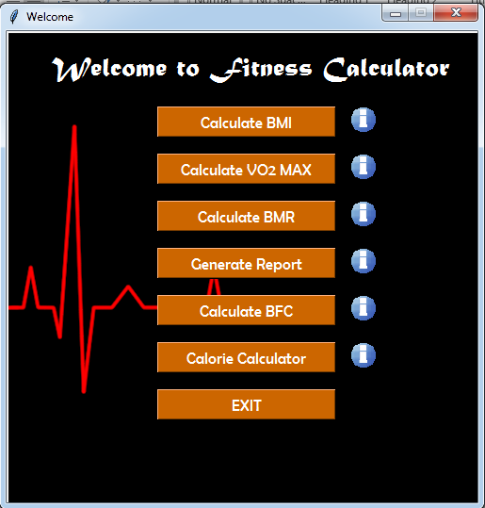
1. Our Welcome Interface

Slide 10
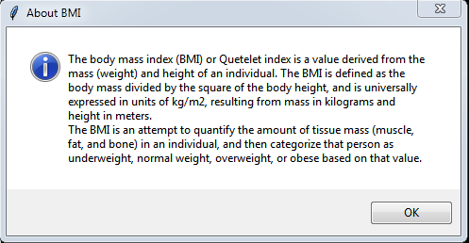
2. Info Button

Slide 11
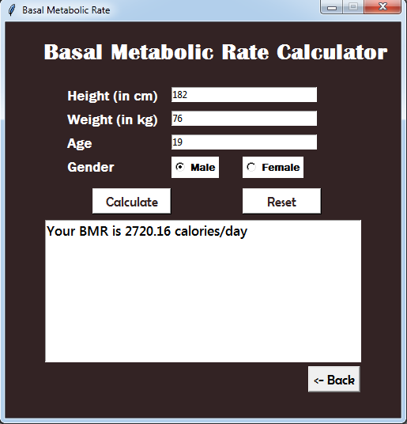
3. BMR Calculator

Slide 12
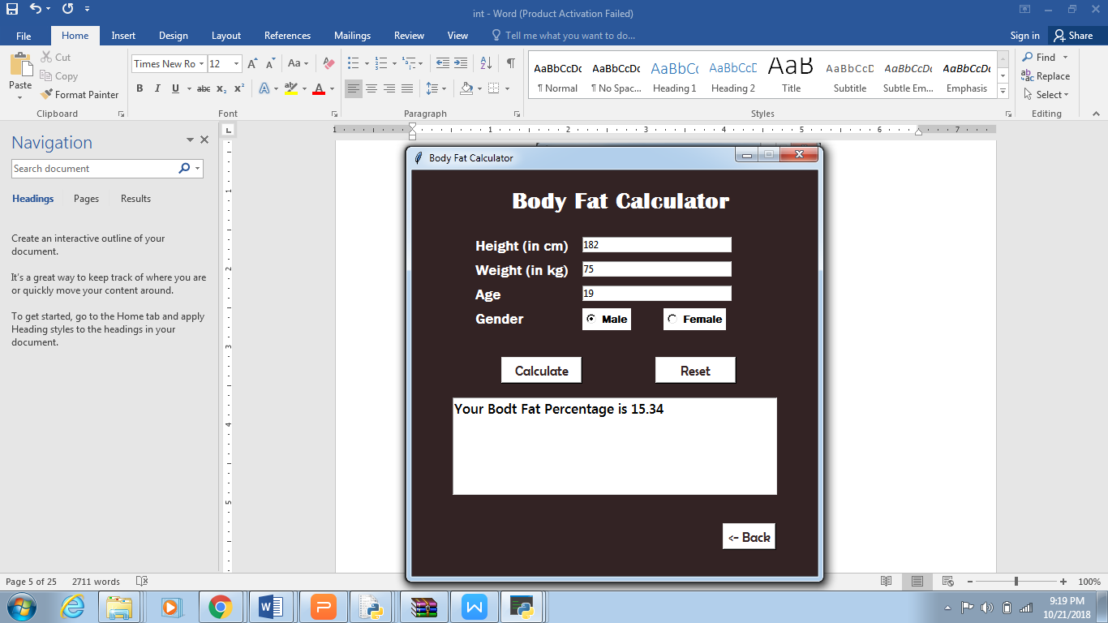
4. Body Fat Calculator

Slide 13
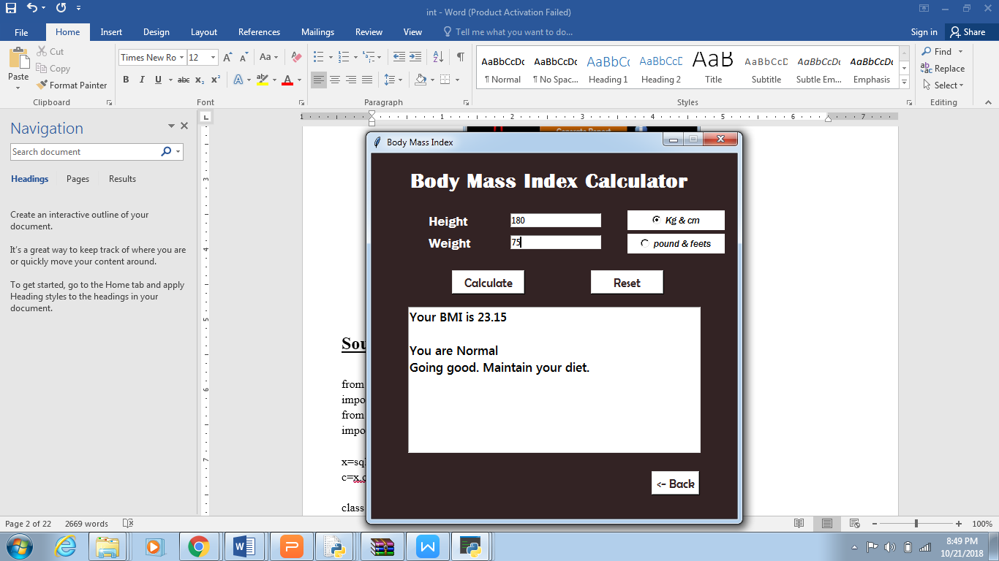
5. BMI Calculator

Slide 14
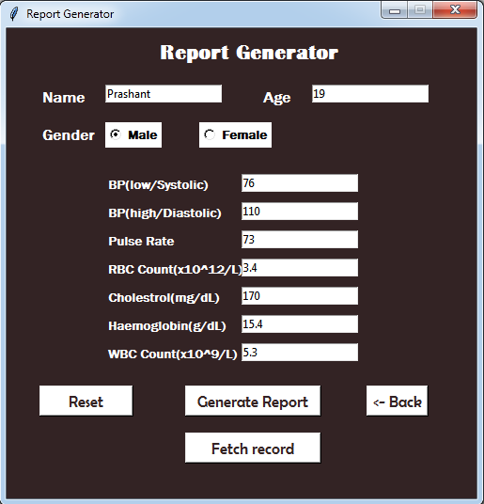
6. Report Generator

Slide 15
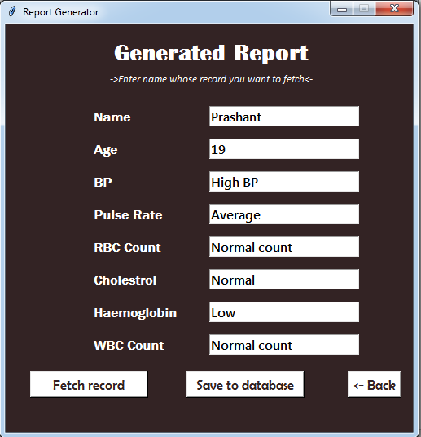
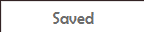

Slide 16
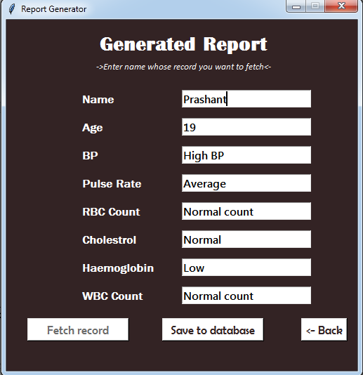

Slide 17
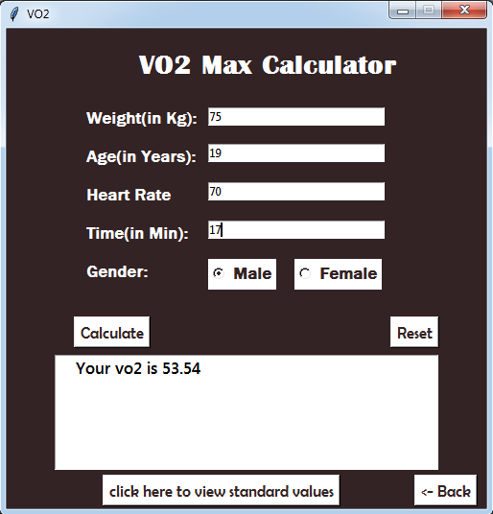
7. VO2 Calculator

Slide 18
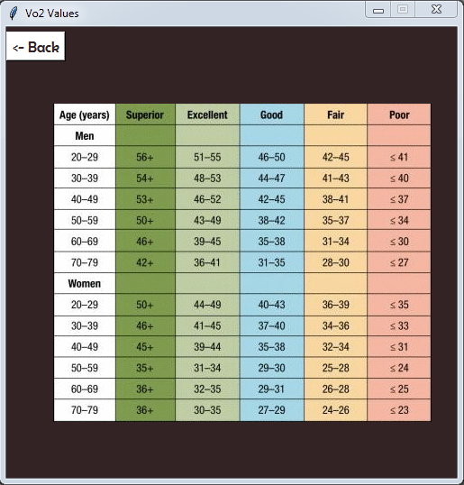
VO2 Standard Values

Slide 19
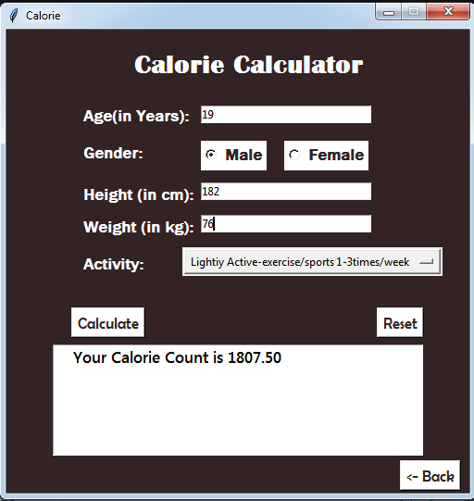
8. Calorie Calculator

Slide 20
CONCLUSION AND RESULTS
The end product is obtained that includes all the mentioned modules discussed earlier.
Learnt to make a GUI using Tkinter in Python.
Learnt to implement database connectivity using sqlite3.
The Project is capable of calculating the required fitness details such as VO2, BMR, BMI and so on.

Slide 21
BIBLIOGRAPHY
https://www.calculator.net/fitness-and-health-calculator.html
https://www.python-course.eu/index.php
www.blog.pythonlibrary.org
http://effbot.org/tkinterbook/
http://www.dealingdata.net/2016/08/21/Python-MySQL-GUI/
https://python-forum.io/index.php
https://www.w3schools.com/python/
https://www.geeksforgeeks.org/sql-using-python/
https://stackoverflow.com/
www.tutorialspoint.com
www.reddit.com
www.google.co.in
www.quora.com

Slide 22
THANKS!

