Slide 1


Social Buzz
Analysis

Slide 2


Today's agenda
Project recap
Problem
The Analytics team
Process
Insights
Summary

Slide 3

Social Buzz is a fast growing technology
unicorn that need to adapt quickly to it's global scale.
Accenture has begun a 3 month POC focusing on these
tasks:
An audit of Social Buzz's big data practice
Recommendations for a successful IPO
Analysis to find Social Buzz's top 5 most popular
categories of content
Project Recap

Slide 4

Problem
Every day over 100,000 pieces of content, ranging from text, images, videos and GIFs are posted
Maintain and get useful insights from this massive amount of data
Analysis to find Social Buzz's top 5 most
popular categories of content

Slide 5



ANDREW FLEMING
Chief Technology Architect
The Analytics team
MARCUS ROMPTON
Senior Principal
MD Arsalan Rasheed
Data Analyst

Slide 6
Process
1
Data Collection
Data Cleaning
2
Data Modelling
3
Data Analysis
4
5
Insights & Conclusion

Slide 7

Insights
16
Unique
Categories
1897
Reactions to
‘Animal’ Posts
May
Month with
most posts

Slide 8
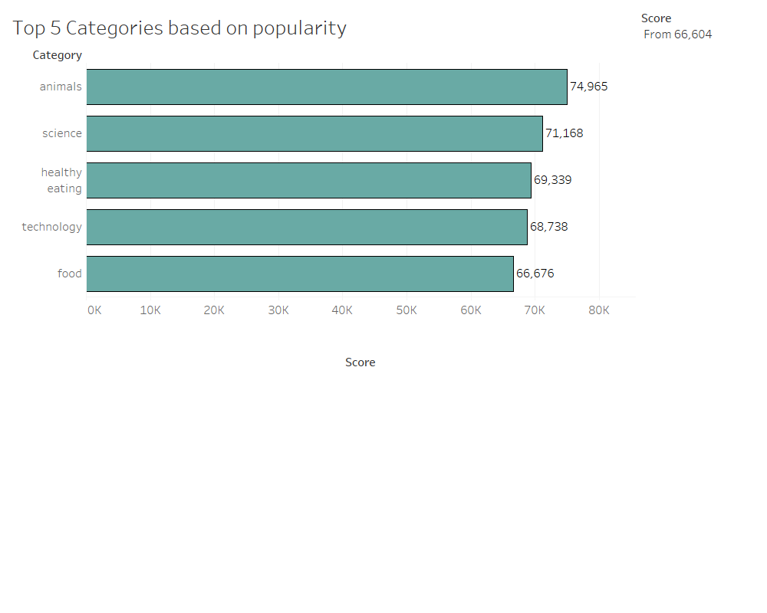

Slide 9
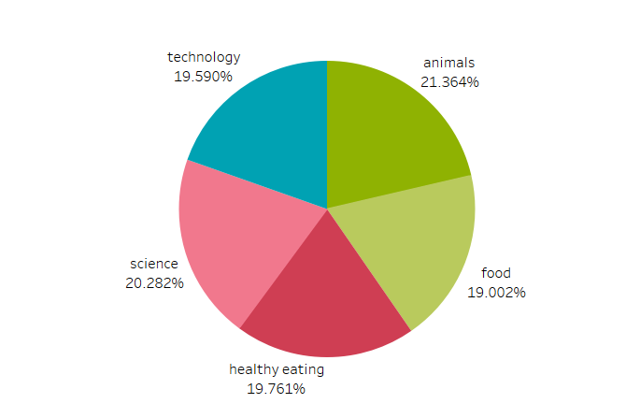
Top 5 Categories Popularity by percentage

Slide 10

ANALYSIS
Animals are the most popular category, followed by science, healthy eating, technology and food
INSIGHTS
Peoples love for adorable animals are showing in the results.
With all the fascinating things like Chat GPT, AI buzz around, people are more interested in the new things happening in Science and Technology world.
One of the basic needs, Food is in the top list. Also people have become more conscious about their health and interested in knowing healthy foods habits.
Social Buzz can use the above insights and campaign accordingly with brands to increase the user engagement
Summary
NEXT STEPS
This ad-hoc analysis is insightful, but it’s time to take this analysis to large scale production for real time understanding of your business. We can help you achieve this.

Slide 11
Thank you!
ANY QUESTIONS?

