Slide 1
Project 1
FlashBack

Slide 2
Project Purpose
Create a card game that has transitions, transforms & animations
The game needs to be fun and exciting.
Lastly to present a demo of the game for presentation.

Slide 3
How to play game
There are 24 cards in the game. The player has 4 tries. When the player clicks or hovers on one of the cards, the card reveals its identity and remains so for a few seconds till the player is able to find a similar card under the allotted time.
If the player is not able to find the card before the time is over, the player can click another card and follow the same process up until 4 tries are over. After which the player loses the game.

Slide 4
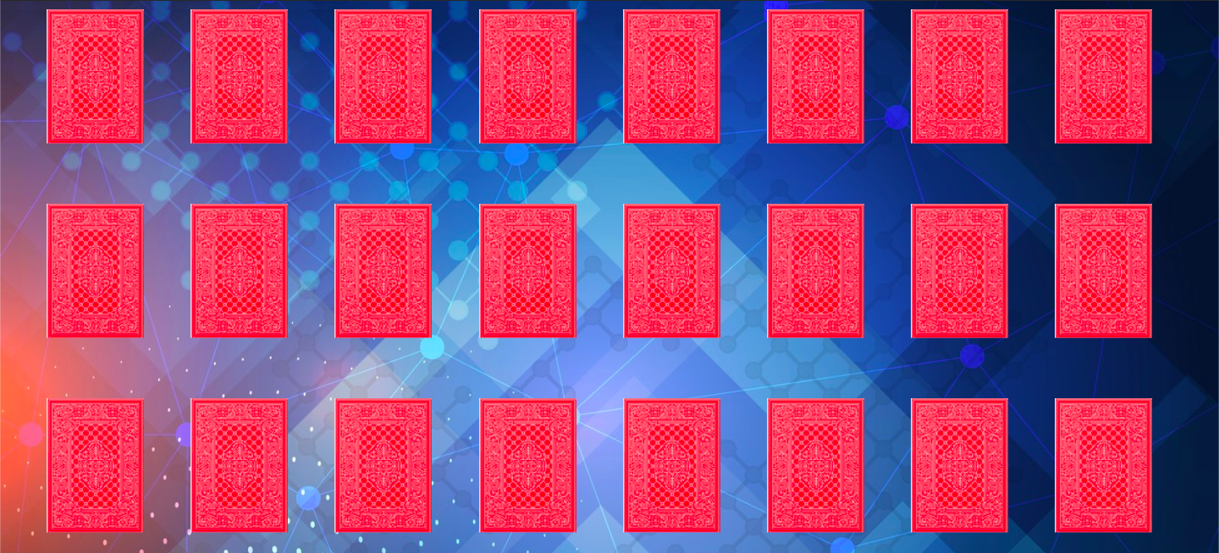
Sample of the cards used
Insert cards used here.

Slide 5
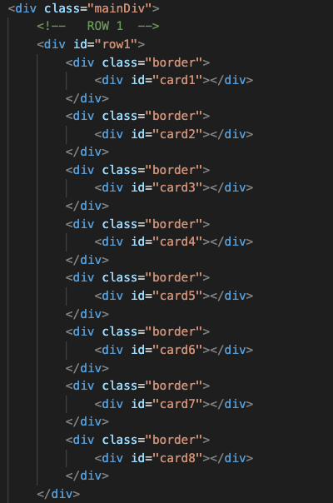
Code Snippets
Rows layout:
Row1 contains set number of cards each in its own “border”<div> and a another <div> “card” inside “border” <div>
We have total of 3 rows

Slide 6

Code Snippets Contd.
At the end we have a <div> “exit” that has <a> tag reference to exit the game.

Slide 7
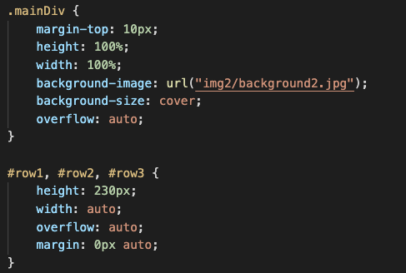
More Code Snippets
mainDiv is the overall container of the whole board.
We have total of 3 rows on the screen that display multiple cards

Slide 8
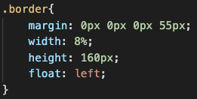
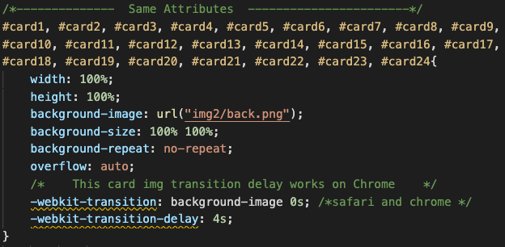
Code Specifics
Our border is the setting the size of each card space/position
Using the float left, all the <divs> move to the left but not overlapping one another because of the margin.
Each card is unique, however they do share similar features.
“-webkit” is specific to safari and Chrome browsers.
“transition” specifying which transitions will take place and the duration is set to zero seconds.
“transition-delay” is set to 4s to give user time to guess the matching card.

Slide 9
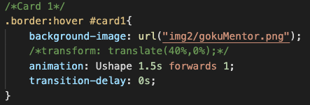
The hovers
When the user hovers over the card position, the card reveals its image.
This also triggers animation,transition, and transform to activate.
Ushape is the keyframe name given to this animation.
The animation speed is 1.5 seconds.
“forwards” is the direction.
“1” is the iteration of the animation movement.

Slide 10
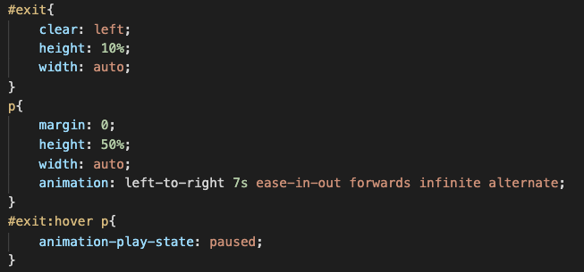
How Come It Doesn’t Stop?
“exit”
Using “clear”, detaches from divs left side and renders statically on the very next line in web page.
“p”
Uses animation keyframe left-to-right
Set for 7s duration
“ease-in-out” eases as it starts and eases as it reaches the end
“forwards” is the direction
Runs infinitely until hovered over it.
Alternate, as it sounds alternates just traces its steps.

Slide 11
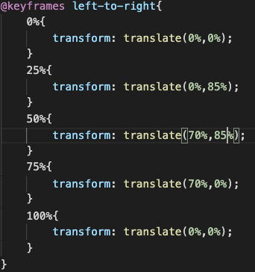
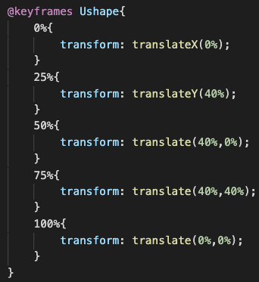
Keyframes What Are They?
Keyframes are ways to define your animations.
Transform uses translate to move an element in specified directions using (x,y) values.

Slide 12
Demo of the game
Insert link

Slide 13
Project Collaborators
Abdullah Shehata
Rachid Bodson
Michael Oroyo
Umang Choudhari

Slide 14
Closing Remarks
Thank you for watching!

