Slide 1

School of Computer Science and Engineering
Department of Computer Science and Engineering
Student Performance Analysis Using Data Analytics
Submitted By: Ananya Shukla
Registration No. - 2427030029
Supervised By - Dr. Onkar Singh

Slide 2
Introduction –
Education plays a critical role in shaping future generations.
Analyzing student performance using data analytics helps:
Identify key factors affecting academic success
Understand socio-economic impact on education
Improve institutional decision-making
Provide targeted academic support
The project uses an authentic dataset from Kaggle:
Students Performance in Exams Dataset

Slide 3
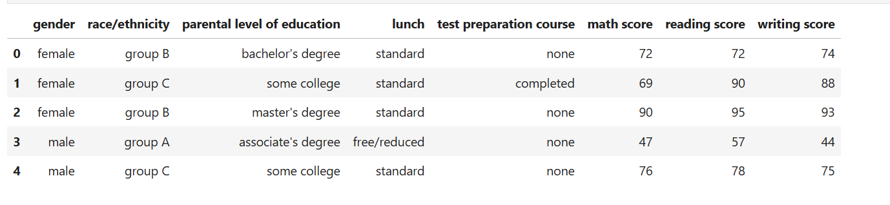
The dataset contains:
1000 student records
Academic scores in Math, Reading, Writing
Demographic & socioeconomic factors
Test preparation information
This analysis aims to derive meaningful insights using exploratory data analysis and statistical techniques.

Slide 4
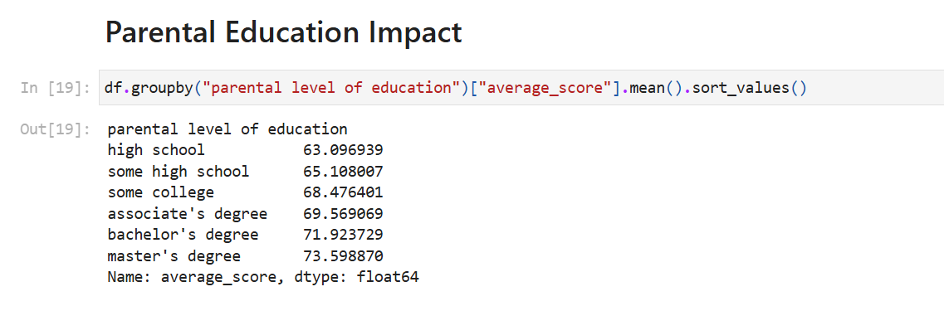
Literature Review -
Previous research in Educational Data Mining shows:
Parental education significantly influences academic achievement.
Socioeconomic status affects student performance.
Test preparation improves academic outcomes.
Reading and writing scores are highly correlated.
Researchers have used statistical analysis and predictive analytics to evaluate student
success patterns.

Slide 5
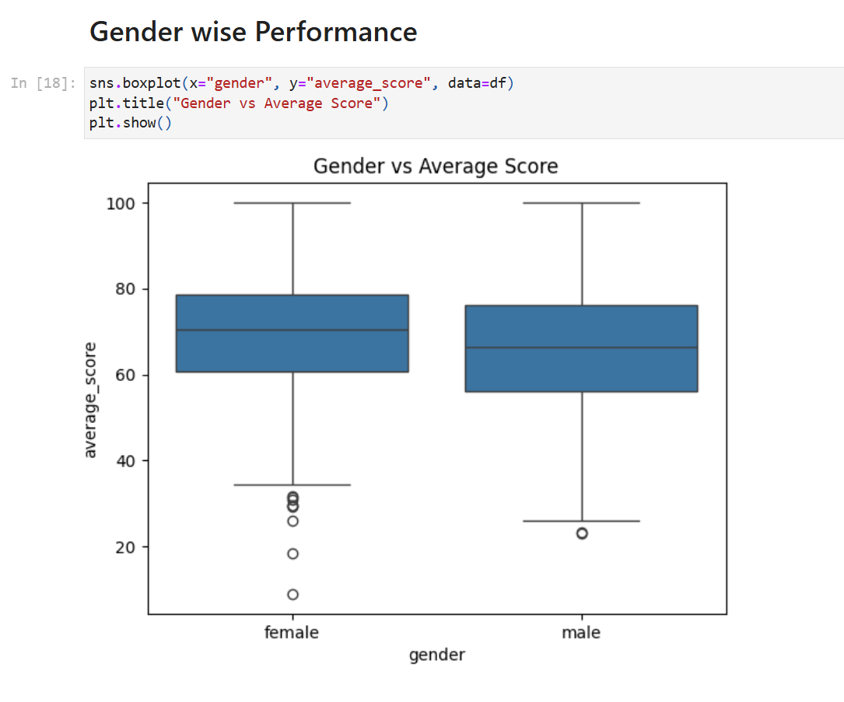
Studies indicate that:
Gender differences exist in subject-wise performance.
Students from financially stable backgrounds perform better.
Data-driven interventions improve academic outcomes.
This project builds upon these findings using real-world student exam data.

Slide 6
Problem Statement -
To analyze student academic performance and identify the key demographic and socioeconomic factors that significantly influence examination outcomes.
Objectives –
To explore the distribution of student scores.
To analyze the impact of parental education and socioeconomic factors.
To evaluate the effect of test preparation on performance.
To identify correlations among subjects.

Slide 7
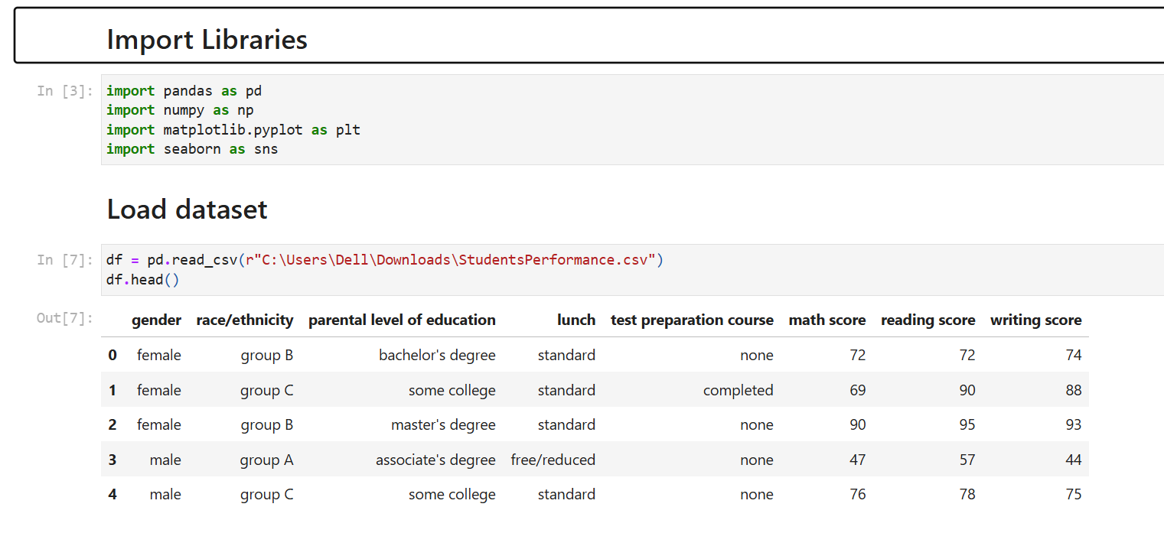
Proposed Methodology -
Step 1: Data Collection
Dataset obtained from Kaggle
CSV format (StudentsPerformance.csv)
Step 2: Data Preprocessing
Checked for missing values
Created Total Score & Average Score
Structured data for analysis

Slide 8
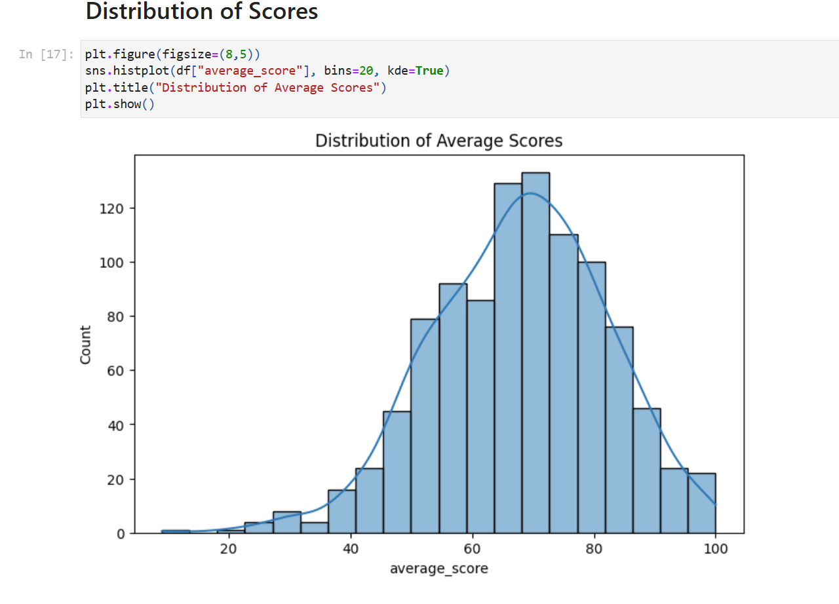
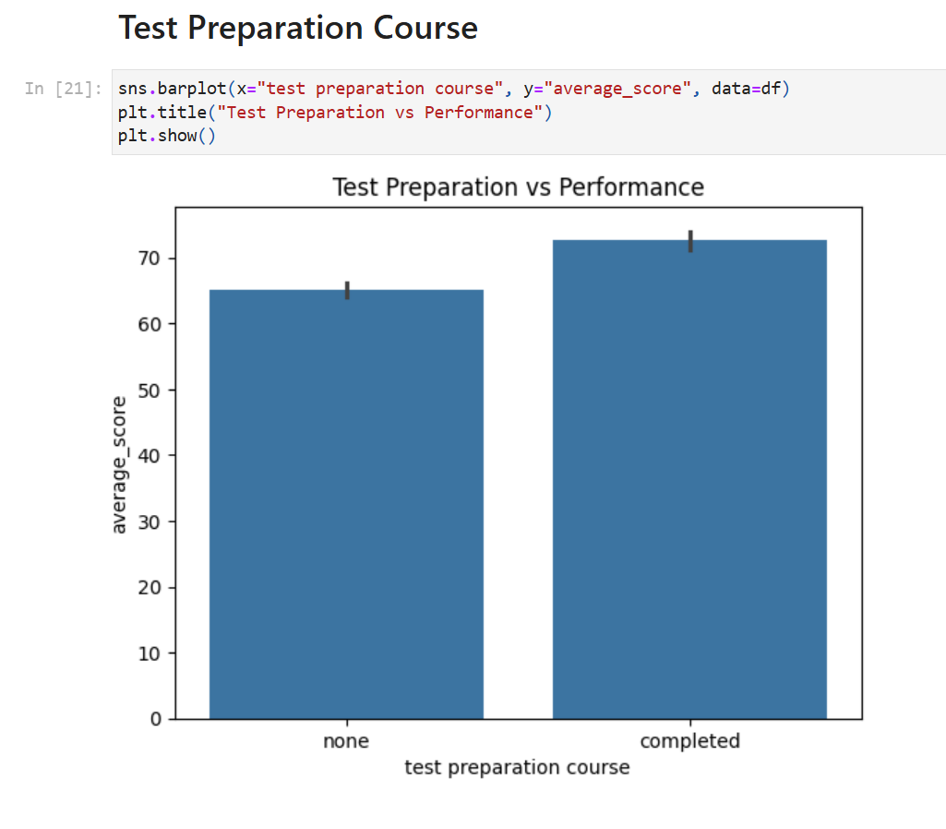
Step 3: Exploratory Data Analysis (EDA)
Score distribution analysis
Gender-wise performance comparison
Parental education impact analysis
Lunch type impact study

Slide 9
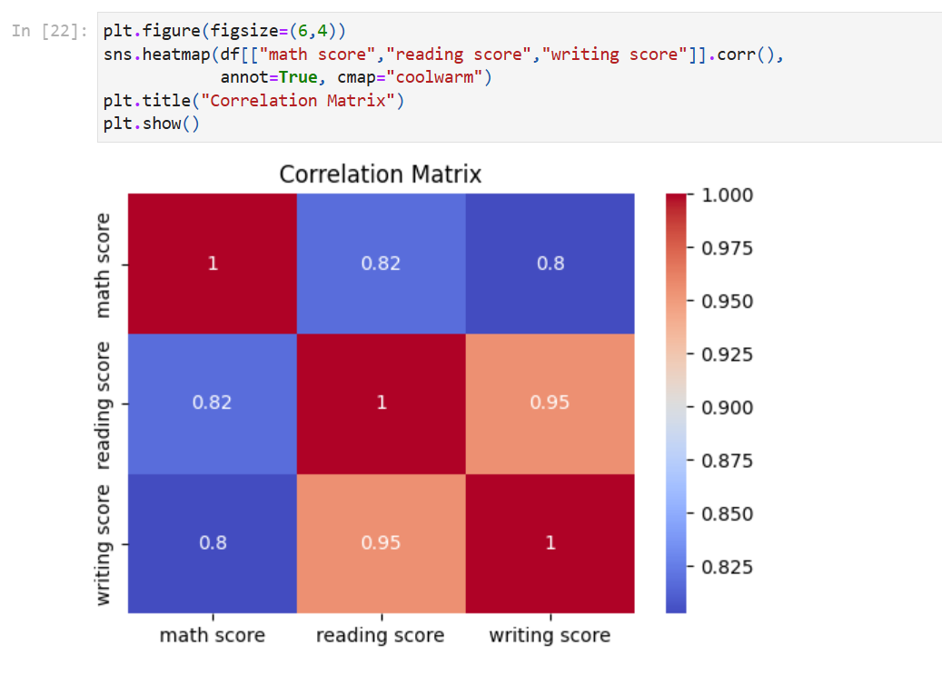
Tools Used:
Python
Pandas
NumPy
Matplotlib
Seaborn
Jupyter Notebook
Flow:
Data Collection → Cleaning → EDA → Statistical Testing → Interpretation

Slide 10
Results -
Major Observations:
Students with test preparation scored significantly higher.
Higher parental education correlates with better performance.
Standard lunch students performed better than free/reduced lunch students.
Reading & Writing scores show very strong positive correlation.

Slide 11
References –
Educational Data Mining Research Papers
Statistical Methods in Educational Research
Python Data Analysis Documentation
Kaggle Dataset – Students Performance in Exams

Slide 12
THANK YOU

