Slide 1


GOODCABS: PERFORMANCE METRICS AND INSIGHTS

Slide 2
INTRODUCTION
Goodcabs is a fast-growing cab service focused on tier-2 cities in India
The company empowers local drivers and fosters community development
Operations spans 10 cities, delivering excellent service
In 2024, Goodcabs aims to achieve ambitious growth and satisfaction goals

Slide 3
PROBLEM STATEMENT
Key challenges include: Understanding repeat passenger dynamics, Optimizing trip distribution across regions, Enhancing satisfaction for new and repeat passengers
Management seeks to evaluate current performance and identify improvement areas

Slide 4
OBJECTIVE
To analyze Goodcabs’ performance in Transportation and Mobility sector across key metrics
Provide actionable insights to the Chief of Operations

Slide 5
DATASET OVERVIEW
Databases and Tables:
trips_db : Detailed and Aggregated trip data analysis.
Tables:
dim_date: Date, month, and day type (weekday/weekend)
dim_city: City details (ID and name).
fact_trips: Trip details (ID, city, passenger type, ratings, etc.).
fact_passenger_summary: Monthly summary of passengers (total, new, repeat).
dim_repeat_trip_distribution: Frequency of trips by repeat passengers.

Slide 6
2. targets_db : Detailed and Aggregated trip data analysis.
Tables:
city_target_passenger_rating: City-wise target for average passenger ratings
monthly_target_new_passengers: Monthly goals for new passenger acquisition
monthly_target_trips: Monthly trip count targets by city.

Slide 7
KEY METRICS OVERVIEW
TOTAL TRIPS
426 K
TOTAL FARE
108 M
TOTAL DISTANCE
8.1M km
AVG PASSENGER RATING
7.66
AVG DRIVER RATING
7.83
AVG TRIP COST
₹ 254.02

Slide 8
KEY METRICS OVERVIEW
AVG FARE PER KM
₹ 13.28
AVG TRIP DISTANCE
19.13 km
TOTAL PASSENGERS
238 K
NEW PASSENGERS
177 K
REPEAT PASSENGERS
61 K
REPEAT PASSENGER RATE
25.7%

Slide 9
ANALYSIS HIGHLIGHTS

Slide 10
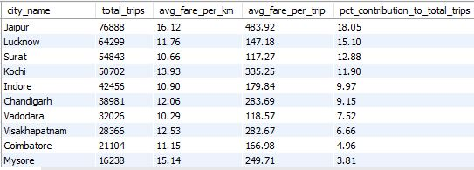
CITY-LEVEL FARE AND TRIP SUMMARY REPORT
Jaipur dominates with the highest trips (76,888) and 18.05% contribution to total trips

Slide 11
The average fare per trip is highest for Jaipur and lowest for Surat.

Slide 12
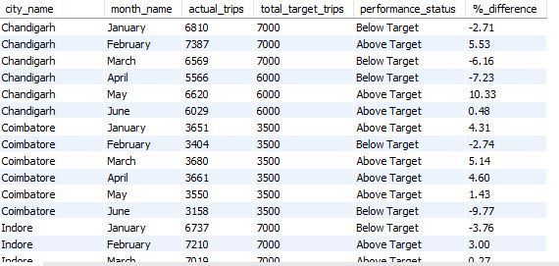
MONTHLY CITY-LEVEL TRIPS TARGET PERFORMANCE REPORT
Out of 426K actual trips, 215K exceeded the targeted trip count

Slide 13
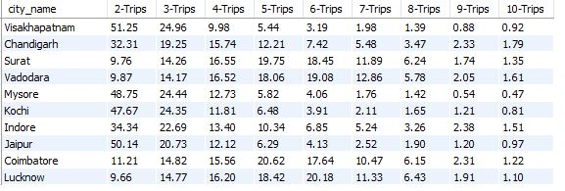
CITY-LEVEL REPEAT PASSENGER TRIP FREQUENCY REPORT
In Visakhapatnam, Jaipur, Mysore, and Kochi, over 50% of passengers take only 2 trips
In contrast, Coimbatore, Vadodara, Surat, and Lucknow show better loyalty, with higher percentages in the 4-6 trips range

Slide 14
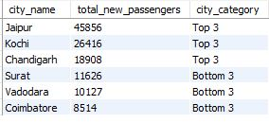
CITIES WITH HIGHEST AND LOWEST TOTAL NEW PASSENGERS
Jaipur records the highest number of new passengers while Coimbatore has the lowest

Slide 15
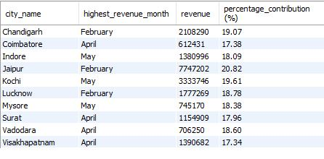
MONTH WITH HIGHEST REVENUE FOR EACH CITY
Jaipur leads with the highest revenue contribution followed by Kochi and Chandigarh

Slide 16
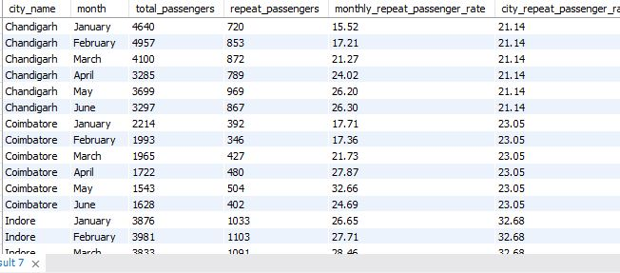
REPEAT PASSENGER RATE ANALYSIS
Surat, Lucknow, Indore has high repeat passenger rate while Jaipur, Mysore has low repeat passenger rate

Slide 17
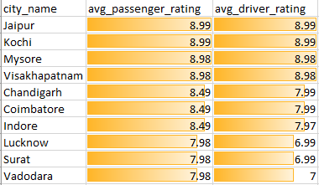
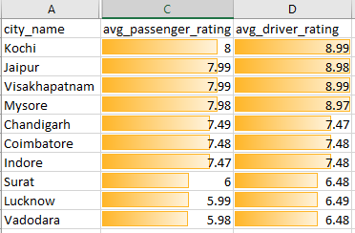
AVERAGE RATINGS BY CITY AND PASSENGER TYPES
BY NEW PASSENGERS
BY REPEATED PASSENGERS
Jaipur, Kochi, and Visakhapatnam have the best ratings for both passenger and driver
New passengers generally give higher ratings than repeat passengers
Vadodara: Shows a sharp drop in ratings for repeat passengers

Slide 18
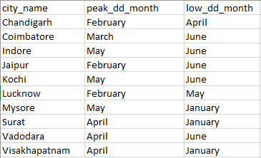
PEAK AND LOW DEMAND MONTHS BY CITY
The peak demand in most cities occurs in the months of February, May, or April

Slide 19
WEEKEND vs. WEEKDAY TRIP DEMAND BY CITY
Weekend Preference: Jaipur, Kochi and Mysore
Weekday Preference: Lucknow, Surat, Vadodara, Chandigarh, Visakhapatnam and Coimbatore

Slide 20
INSIGHTS
High and Low Trip Cities: Jaipur, Lucknow, and Surat lead in trips, while Visakhapatnam, Coimbatore, and Mysore have the lowest.
Fare and Revenue: Jaipur has the highest average fare per trip and revenue contribution, followed by Kochi and Chandigarh. Surat has the lowest average fare.
Peak Demand: Most cities experience peak demand in February, May, or April.
Passenger Loyalty: Surat, Lucknow, and Indore show high repeat passenger rates, while Jaipur and Mysore have lower loyalty.
Ratings: Jaipur, Kochi, and Visakhapatnam have the best passenger and driver ratings. New passengers tend to rate higher than repeat ones, with Vadodara showing a notable drop in repeat passenger ratings.
Passenger Behavior: Over 50% of passengers in Visakhapatnam, Jaipur, Mysore, and Kochi take only two trips, while cities like Coimbatore, Vadodara, Surat, and Lucknow demonstrate better loyalty with higher 4–6 trip percentages.
Target Achievement: Out of 426K trips, 215K exceeded the targeted trip count.

Slide 21
RECOMMENDATIONS
Enhance Customer Experience
Provide personalized offers and promotions for repeat passengers.
Address driver and passenger feedback to improve service quality.
Optimize Marketing Efforts
Focus campaigns around local events, festivals, and tourism seasons to boost demand in high-potential cities.
Expand Eco-Friendly Initiatives
Introduce electric or hybrid vehicles to attract eco-conscious customers and reduce operating costs.
Strengthen Partnerships
Collaborate with hotels, airports, and event venues to increase visibility and drive demand in tourism-heavy areas.

Slide 22
Improve Driver Performance
Implement a reward system for high-performing drivers and offer training for better customer interaction.
Leverage Data for Strategic Insights
Collect detailed customer behavior, vehicle performance, and local demand patterns to make data-driven decisions.
Boost Repeat Passenger Rates
Implement loyalty programs and subscription models to encourage repeat usage, especially in cities with low retention.

Slide 23
THANK YOU

