Slide 1
Video Compression Optimization using Machine Learning
First Stage Evaluation
Prepared by:
Alkesh Vaghela – U15CO039
Jay Dudhat – U15CO048
Priyansh Zalavadiya – U15CO050
Apurva Tripathi – U15CO097
Guided by:
Rupa G. Mehta

Slide 2
Introduction
Video
Compression
Optimization

Slide 3
Size
Why?
Traffic
Video
Quality
Type

Slide 4
Video
Codec
Container
AVI
MKV
H.264
AV1
MP4
H.265
VP9

Slide 5
Why?
Compression
Available Tools
Best Encoder

Slide 6
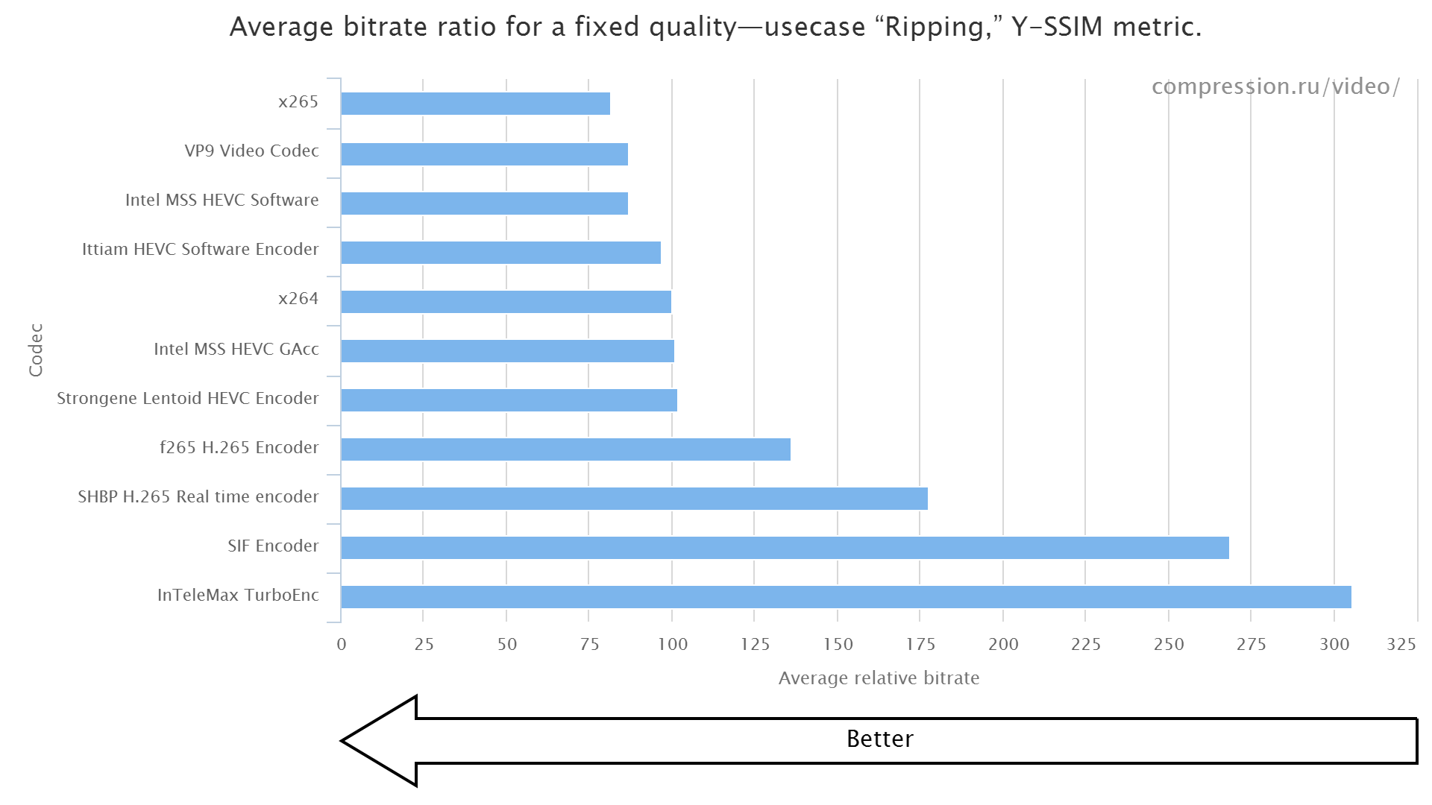

Slide 7
Need of Optimization?

Slide 8
Existing methods using Machine Learning
Mode Decision (MD) Problem
Motion Compensation through Machine Learning
Motion Estimation through Machine Learning

Slide 9
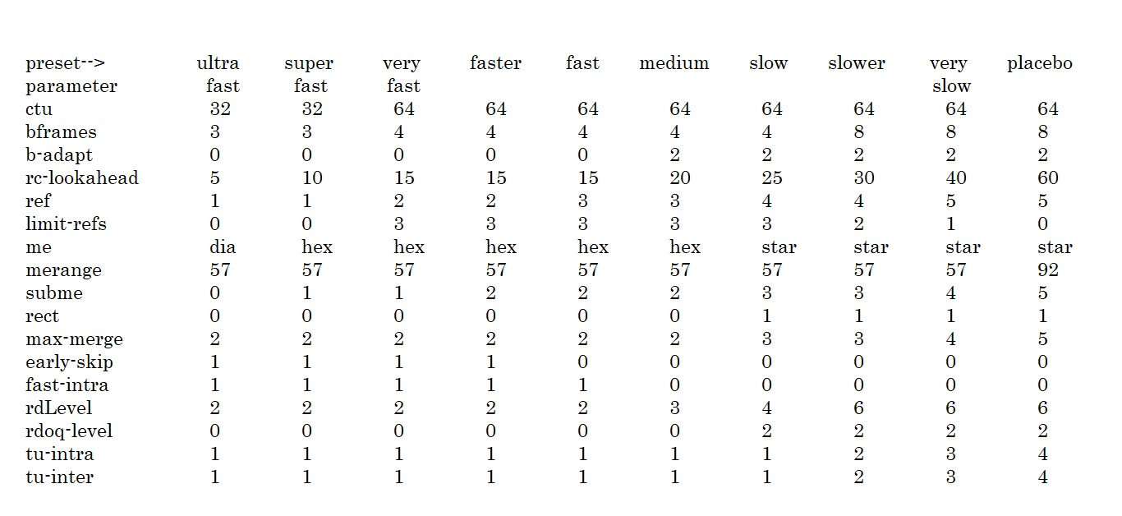
X265 Encoder

Slide 10
Video Quality Measurement
PSNR
SSIM
VIFP

Slide 11
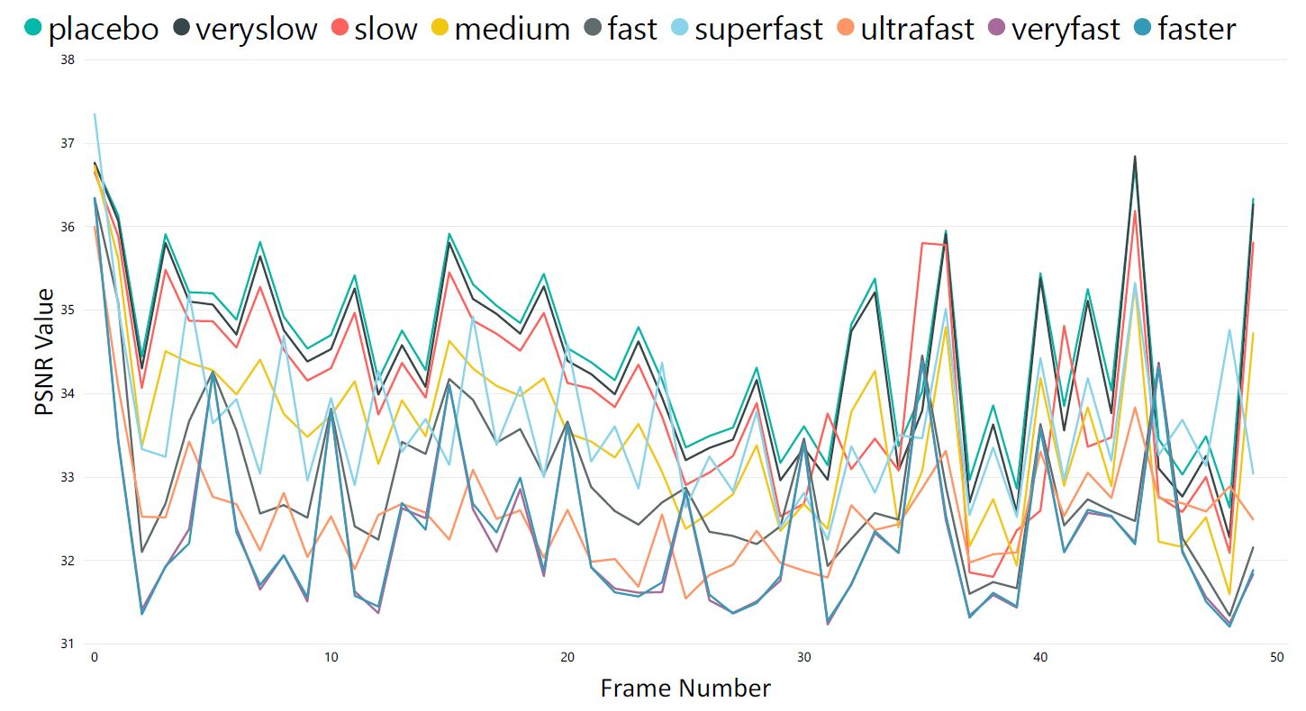
Experiment

Slide 12
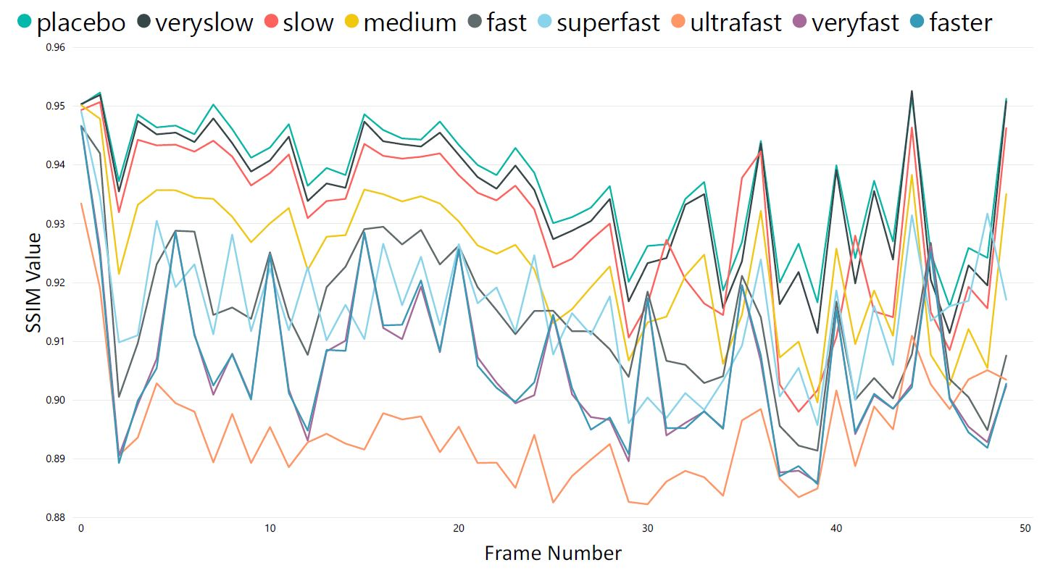

Slide 13
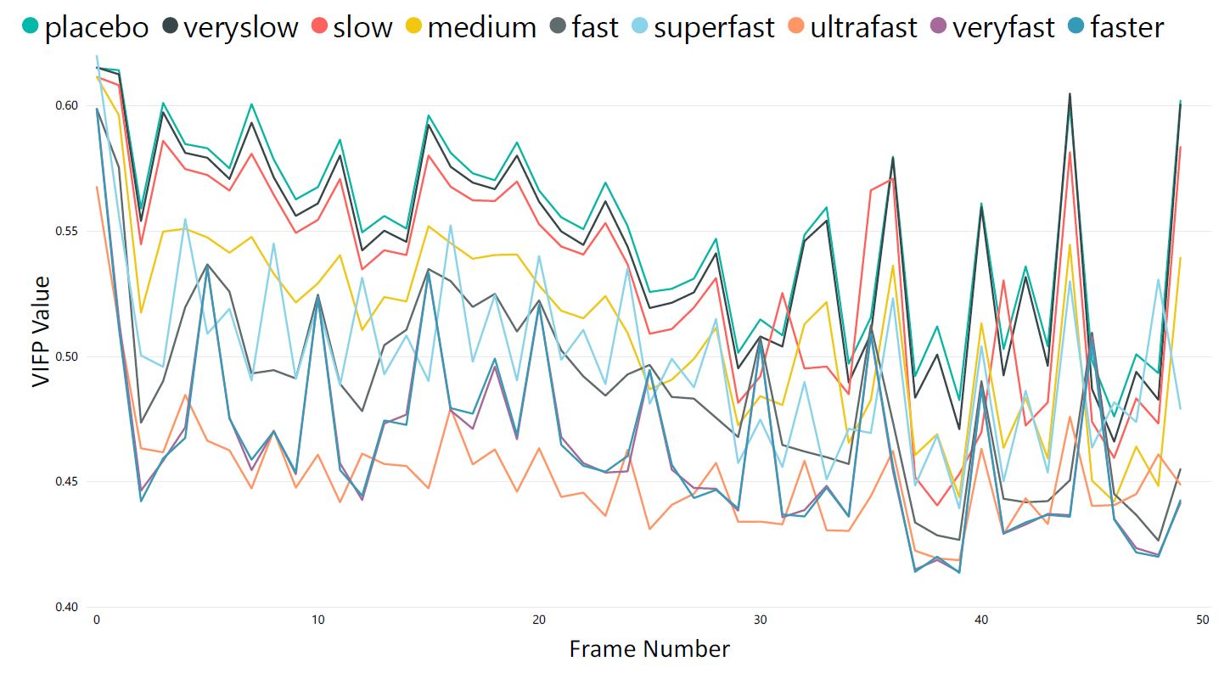

Slide 14
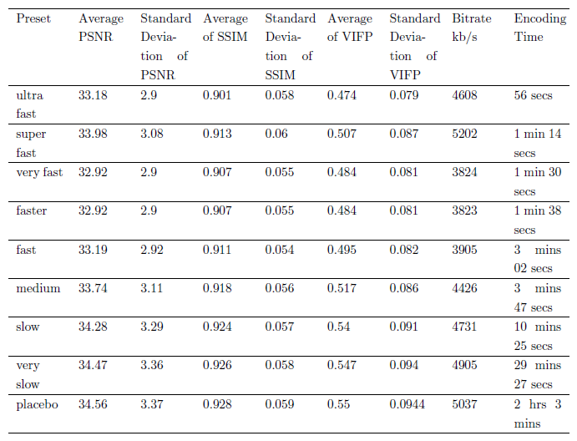
Results

Slide 15
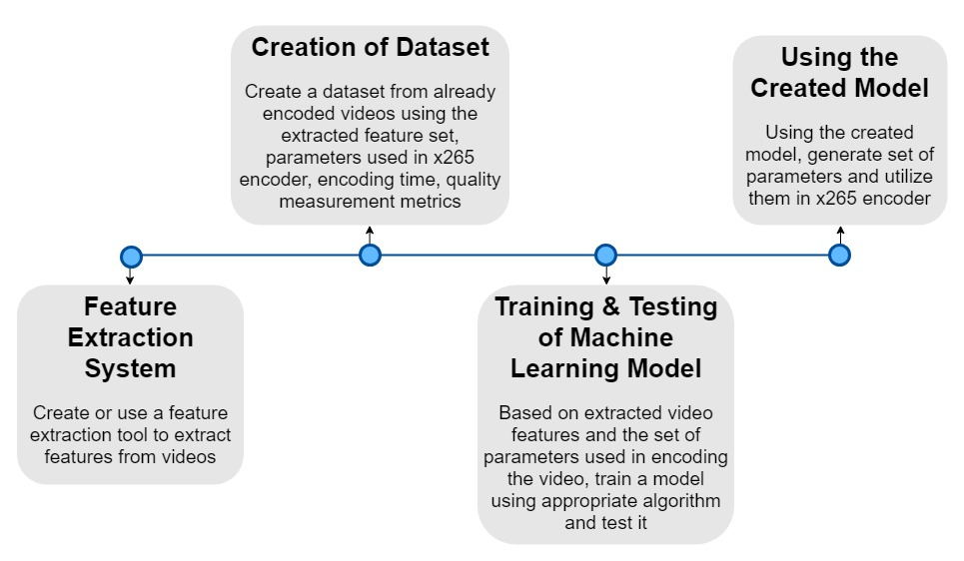
Proposed Framework

Slide 16
Future Work
Feature extraction system with broad video classification.
Create optimal datasets to train the model.
By comparing and evaluating optimal machine learning approach for finding parameters of x265 encoder.
Training of machine learning model based on obtained dataset.

