Slide 1



PROJECT NAME
AI for Second-Order Victims
TAGLINE
Ripple: who gets hurt next when disaster strikes
TEAM NAME
Keep It Simple
TRACK
Smart Cities & Disaster Response
ORGANISED BY
Department of Computer Science & Engineering
Chandigarh University

Slide 2
Team Introduction & Contributions
01 · TEAM INTRODUCTION & CONTRIBUTIONS
AS
Aditya Sharma
TECH LEAD · BACKEND
BS
Bhavya Srivastava
RESEARCH · CONTENT
PK
Piyush Kumar
FRONTEND · DEPLOYMENT
AB
Arnav Baheti
TEAM LEAD · PRODUCT
SKILLS
Python, FastAPI, NetworkX graph algorithms, local LLMs (Ollama)
RESPONSIBILITIES
Built the cascade engine and impact scoring
Wrote the APIs and AI briefings
Built the learning loop from outcomes
SKILLS
Domain research, OpenStreetMap data, UX writing, documentation
RESPONSIBILITIES
Researched dependencies and past disasters
Sourced map data and wrote the drill cases
Made public alerts plain and trustworthy
SKILLS
JavaScript, HTML/CSS, Leaflet maps, responsive design, cloud hosting
RESPONSIBILITIES
Built the map dashboards and citizen page
Built the official console and drill screens
Deployed Ripple online and tested on phones
SKILLS
Planning, product design, integration testing, pitching
RESPONSIBILITIES
Designed the news-verification workflow
Coordinated integration and testing
Leads the final pitch and judge Q&A
Notes:
Four-member team with clear ownership: Aditya builds the engine and AI, Bhavya owns research, data and wording, Piyush builds the interface and deployment, Arnav designs the workflow and leads the pitch.

Slide 3
Problem Statement
02 · PROBLEM STATEMENT
PROBLEM DEFINITION
When a bridge collapses, a flood hits or a factory shuts, response focuses on the visible first-order damage: the blocked road or the closed building.
Everything that depends on that damage goes unnoticed. A blocked road is also an ambulance route, a school-bus path and a medicine supply line. These second- and third-order effects are found only after they cause harm.
IMPORTANCE OF THE PROBLEM
Response is reactive and siloed: traffic, hospitals and schools each manage their own problem without seeing how it is about to become someone else's.
The cost falls on the most vulnerable: patients waiting for ambulances, elderly residents relying on medicine delivery, and daily-wage workers cut off from work.
THE UNANSWERED QUESTION
“Who will be affected next?”
TARGET AUDIENCE
City disaster-management and emergency control rooms
Hospitals and ambulance services
Schools and public-transport operators
Delivery networks, NGOs and city planners
Notes:
No system today answers the question that matters in the first hours after an event.

Slide 4
Problem Context & Existing Solutions
03 · PROBLEM CONTEXT & EXISTING SOLUTIONS
Background: Cities are tightly interconnected systems, yet disruption tools model each service on its own. Our research looked at what responders use today and where it stops.
CURRENT SOLUTION
WHAT IT DOES
WHAT IT MISSES
Traffic and navigation apps
Report congestion and reroute drivers
Cannot see which ambulance or supply route depended on that road
Hospital management systems
Track admissions and bed capacity
Work in isolation; overload is visible only once patients arrive
Disaster-mapping and GIS tools
Assess damage and map the affected area
Stop at first-order damage; no prediction of downstream effects
Identified gap: no cross-domain model treats the city as one system and asks what happens two and three steps downstream.
Notes:
Existing tools are first-order. We shift the question from 'map the damage' to 'map the consequences'.

Slide 5
Proposed Solution
04 · PROPOSED SOLUTION
Core idea: Ripple takes a disruptive event (found in trusted news or logged by an official) and outputs a ranked, time-ordered map of who is affected next, how badly and how soon.
EVENT
FIRST ORDER
SECOND ORDER
THIRD ORDER
Ambulance route cut
Nearby hospital overloaded
Bridge collapse
Main road blocked
School-bus path lost
Students miss classes
Medicine supply line delayed
Elderly miss medicines
Commute to work broken
Daily-wage income lost
How it addresses the problem: response becomes preventive: officials see the cascade before it lands, and citizens get a plain answer to “Is my area affected, and what do I do?”
Notes:
Illustrative cascade for one event. The system predicts every column after the first automatically.

Slide 6
Key Features & Innovation
05 · KEY FEATURES & INNOVATION
Innovation: we shift crisis response from “map the damage” to “map the consequences”.
1
Cross-domain dependency graph
2
Cascade engine
3
Vulnerability-weighted scoring
OpenStreetMap-based roads with hospitals, schools, depots and 11 residential zones in one graph
Re-routes on the damaged road graph and compares with normal, finding who is hit next in ~2 ms
Ranks impacts by severity, people reached, how vulnerable they are and how soon they land
4
Verified news monitoring
5
Three dashboards
6
Learns from outcomes
Scans news every 15 min; checks source trust, corroboration and an AI check before an official approves
Officials verify and act, citizens get plain alerts with steps and numbers to call, responders train
After-action reports re-weight each type of prediction; public feedback is logged for training
Notes:
USP: cross-domain, predictive and vulnerability-aware, with verified news in and plain-language alerts out.

Slide 7
Proposed Workflow
06 · PROPOSED WORKFLOW
WORKING MECHANISM · FIVE-STAGE PIPELINE
1
2
3
4
5
Event ingestion
Dependency graph
Cascade engine
Impact scoring
Alert dashboard
Found in trusted news every 15 min, or logged by an official
OpenStreetMap locations and OSRM road travel times
Cuts or slows roads, reroutes, finds who is hit next
Ranks by severity, reach, vulnerability and timing
Officials act; citizens get plain alerts and steps
↺ Feedback loop: after-action reports re-weight the scoring and become drills; public feedback is logged for training
USER JOURNEY · NEWS → OFFICIAL → CITIZEN
News scan flags a bridge collapse
Official verifies, sets gravity and time to fix
Citizens see “Is my area affected?”
After-action report improves the next prediction
Notes:
Walk through the Sukhna Choe bridge collapse: news scan, official approval, public page, after-action report.

Slide 8
Proposed Tech Stack
07 · PROPOSED TECH STACK
FE
BE
DB
AI
API
Frontend
Backend
Database
AI / ML Tools
APIs & Data
HTML, CSS, JavaScript
Leaflet map layers
OpenStreetMap tiles
Mobile-friendly pages
Python 3.12
FastAPI + Uvicorn
NetworkX cascade engine
Pydantic validation
JSON file store
Incidents, reports, feedback
Cached OSM road data
PostgreSQL + PostGIS next
Local LLM: Ollama + Qwen 2.5
AI news check and briefings
Groq / Gemini / template fallback
OSM Nominatim geocoding
OSRM road routing
Google News RSS
Render cloud hosting
Why this stack: free and open-source, runs on a laptop with a local AI, and is live on a free cloud host.
Notes:
Everything is free: open map data, a free news feed, a local open-source AI and free hosting.

Slide 9
Feasibility & Execution Plan
08 · FEASIBILITY & EXECUTION PLAN
DEVELOPMENT APPROACH
Built and live for the Chandigarh tricity: 36 road links timed with real OSRM data, 6 hospitals, 6 schools, 11 zones.
TECHNICAL CHALLENGES → MITIGATION
Fake news and rumours
→ Source tiers, corroboration, AI check, human approval
MILESTONES
1
Data and graph Bhavya + Aditya
OSM locations and OSRM road times; build the dependency graph
Hidden links missing from data
→ LLM-assisted enumeration plus domain rules
2
Cascade engine and scoring Aditya
Damaged-graph routing, vulnerability scoring, AI briefings
Campus Wi-Fi blocked our share link
→ Moved to free cloud hosting on Render
3
Dashboards and maps Piyush
Control room, citizen page, official console; cloud deploy
EXECUTION STRATEGY
Four parallel tracks (engine, data, interface, operations) merged on GitHub, with checkpoints after each milestone.
4
News, verification and drills Arnav + Bhavya
News checks, official workflow, real past-disaster drills
Notes:
Not just feasible: it is built, on GitHub and live online at ripple-2vx1.onrender.com.

Slide 10
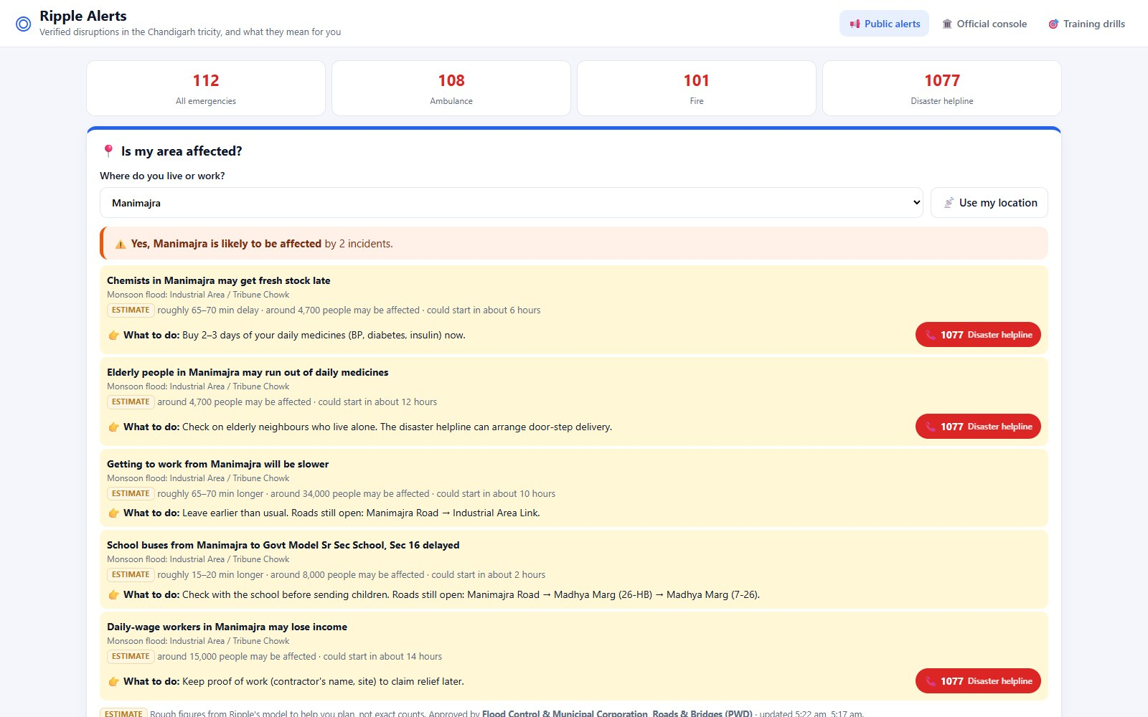
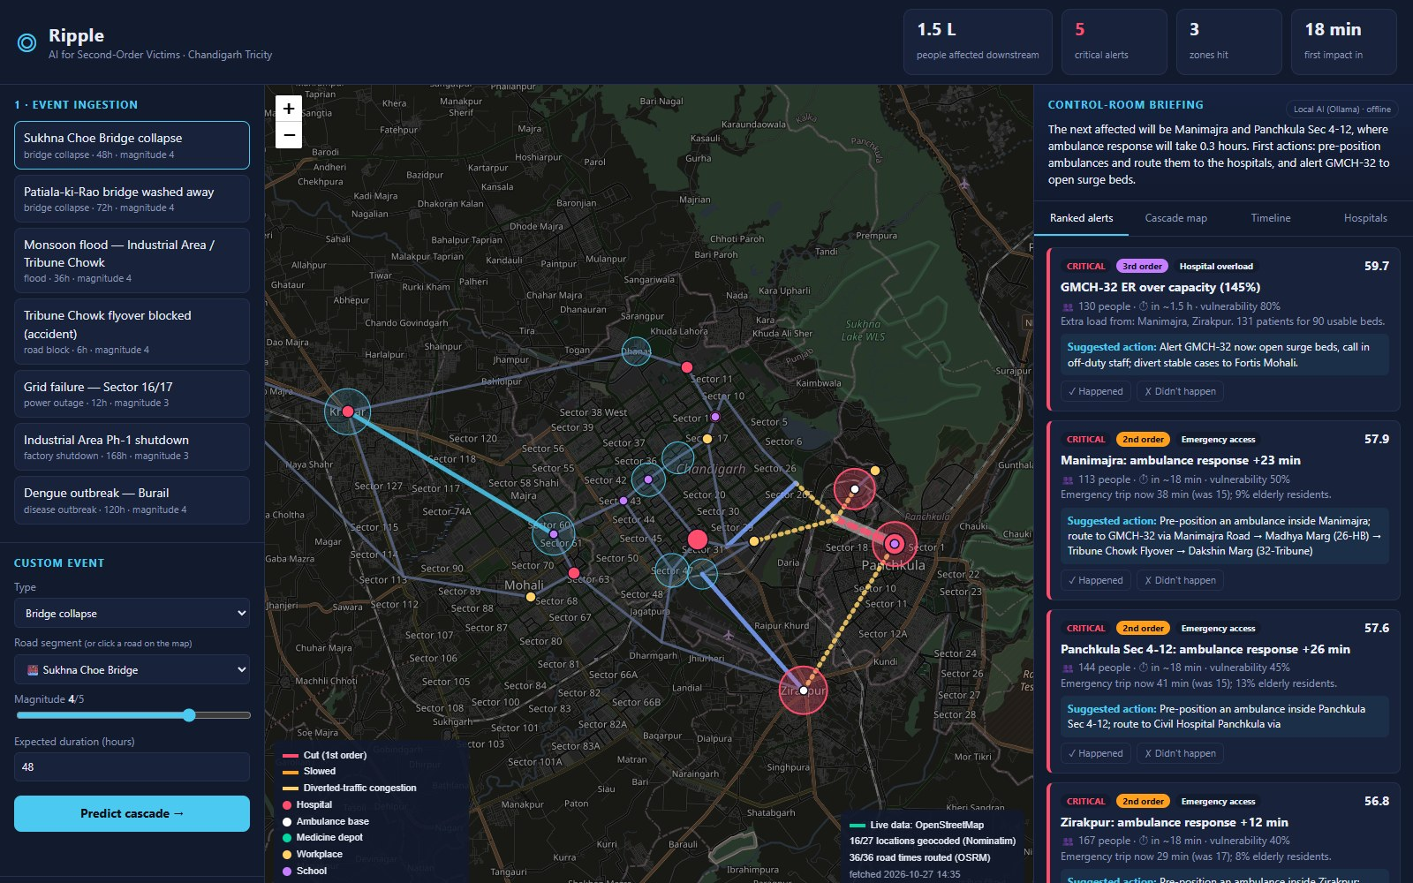
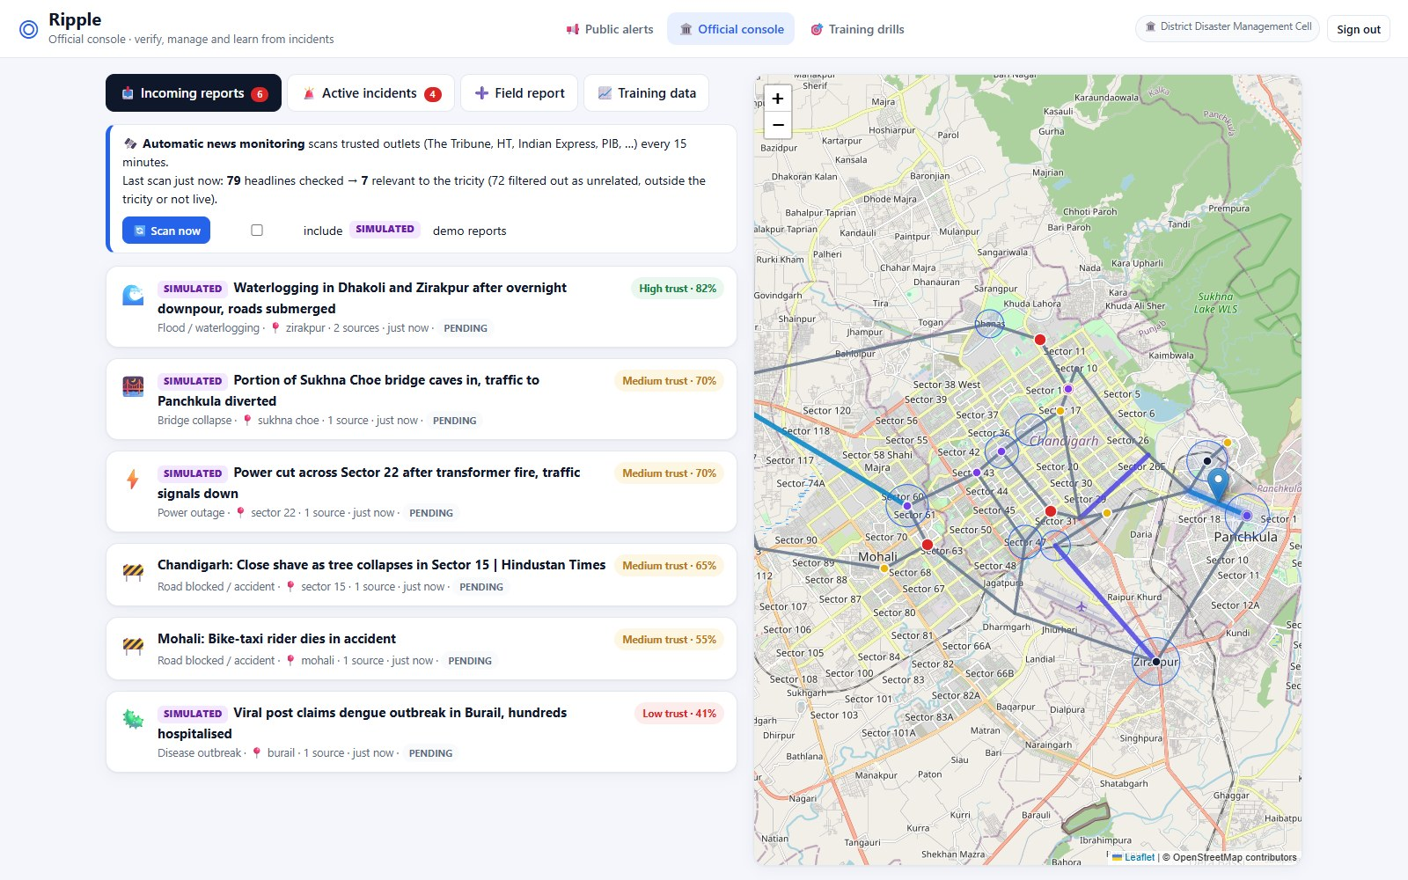
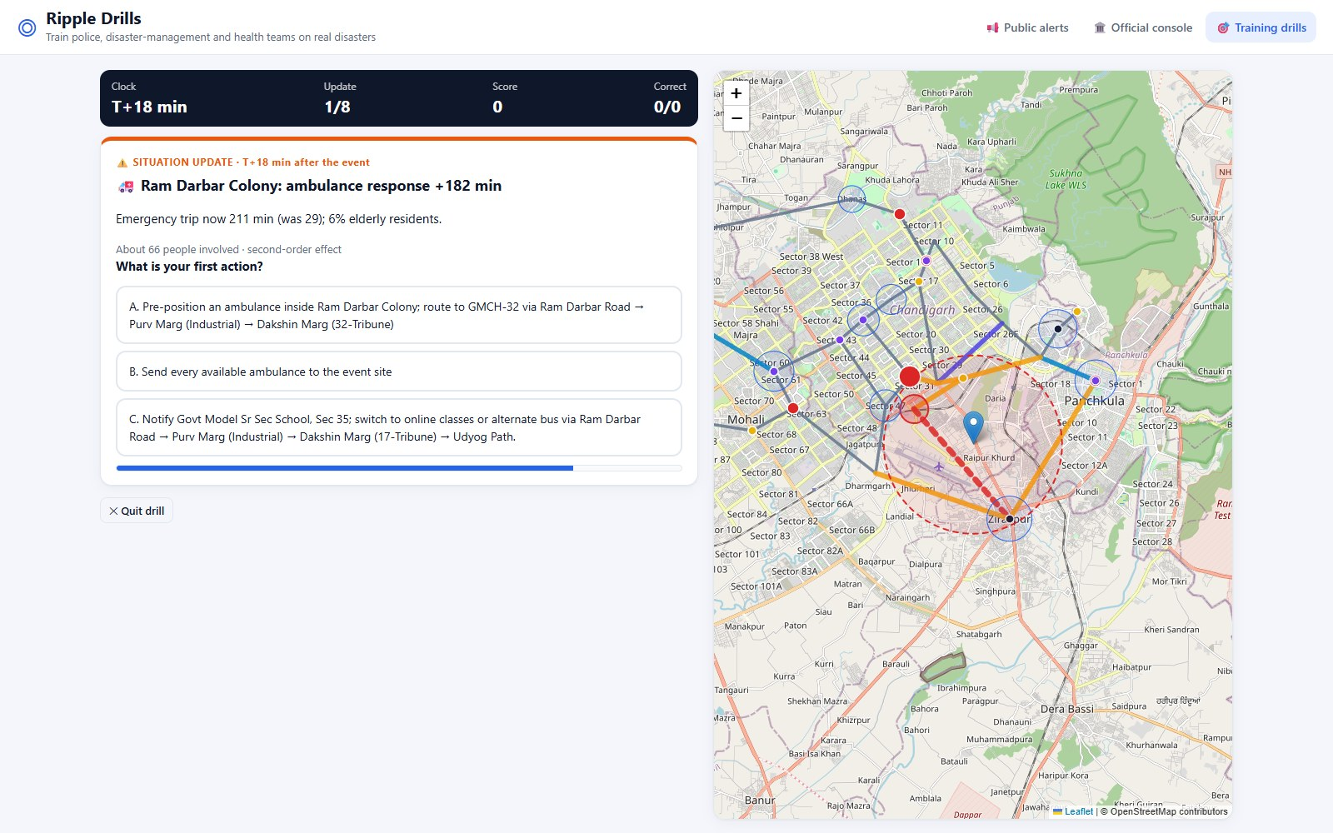
Prototype & Live Demo
09 · PROTOTYPE & LIVE DEMO
TRY IT YOURSELF
Live demo
→ ripple-2vx1.onrender.com/public
Source code on GitHub
→ github.com/as3601/ripple-second-order-victims
Citizens: “Is my area affected?” with steps and numbers to call
Control room: cascade map, ranked alerts, AI briefing
Officials’ console access code
→ codeyudh2026 (also shown on the sign-in page)
GOOD TO KNOW
Tip: pick Manimajra under “Is my area affected?”. Free hosting sleeps when idle, so the first visit can take a minute.
Officials: news inbox with trust scores; the fake post scores Low
Drills: replaying the July 2023 tricity floods against the clock

Slide 11
Expected Impact & Future Scope
10 · EXPECTED IMPACT & FUTURE SCOPE
TARGET IMPACT & BENEFITS
SCALABILITY & FUTURE SCOPE
1
Hackathon MVP · built
Tricity · roads, health, schools, jobs; live online
Hours of early warning
Act before ambulances get stuck or hospitals overflow
◆
2
City pilot
Live data with one disaster-management cell
Vulnerable people first
Patients, the elderly and low-income workers are prioritised
◆
3
Multi-channel
Social media scanning, SMS and WhatsApp alerts
Silos broken down
One shared picture for traffic, health, schools and logistics
◆
4
Learning model
Census and hospital data; ML trained on after-action reports
Notes:
Goal: move resources toward second-order victims before they become the story.

Slide 12
Thank You
Keep It Simple · Ripple
ORGANISED BY
Department of Computer Science & Engineering
Chandigarh University
CODE YUDH HACKATHON · CHANDIGARH UNIVERSITY

