Slide 1
智慧型汽車期末專題
R08922113 鄭詠鏹
R08922114 黃君儒

Slide 2
Overview
Introduction
Preliminary
Modulation Fromat
System design
Implementation

Slide 3
Introduction
隨著自駕車的普及, 如何利用自駕車使交通變得更有效率逐漸開始被人們重視, 透過這次期末專題, 我們想利用光通訊的技術來建立號誌與車輛間的通訊, 傳達號誌的相關訊息(ex: 燈號, 秒數, etc), 使自駕車能夠更有效率的通過路口。

Slide 4

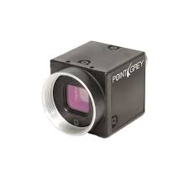
Preliminary
Rolling shutter :

Slide 5
Preliminary
Rolling shutter :

Slide 6
Preliminary
Rolling shutter :

Slide 7
Preliminary
Rolling shutter :

Slide 8
Preliminary
Rolling shutter :

Slide 9
Preliminary
Rolling shutter :

Slide 10
Preliminary
Rolling shutter :

Slide 11
Preliminary
Rolling shutter :

Slide 12

Preliminary
Rolling shutter :

Slide 13
Preliminary
Rolling shutter :

Slide 14

Preliminary
Rolling shutter :

Slide 15
Preliminary
Rolling shutter :

Slide 16
Preliminary
Rolling shutter :

Slide 17
Preliminary
Rolling shutter :

Slide 18
Preliminary
Rolling shutter :

Slide 19
Preliminary
Rolling shutter :

Slide 20
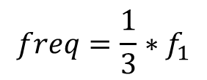

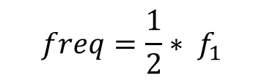
Modulation Format
Frequency shift keying (FSK) :
$$freq={\frac{1}{3}∗f}_{1}$$
$$freq=\frac{1}{2}{∗ f}_{1}$$
$$freq={ f}_{1}$$

Slide 21
Modulation Format
Frequency Bandwidth : 250Hz ~ 2000Hz
Frequency : [258, 285, 320, 421, 615, 800, 1142, 2000, 363, 500]
Symbol per second : 100
Frame rate : 11
Frequency (Hz) | Stripe Length (pixels) | Index | Symbol
258 | 93 | 0 | 000
285 | 84 | 1 | 001
320 | 75 | 2 | 010
421 | 57 | 3 | 011
615 | 39 | 4 | 100
800 | 30 | 5 | 101
1142 | 21 | 6 | 110
2000 | 12 | 7 | 111
363 | 66 | 8 | Green Light
500 | 48 | 9 | Red Light

Slide 22
Modulation Format
G
111
111
G
111
110
G
111
…

Slide 23

Modulation Format
Stripes length
( pixels )
Symbol
21.0588
110
66.1667
Green
Green Light
remains
011110
seconds
57.1250
011
21.0952
110
Green Light
remains
30
seconds
66.6667
Green

Slide 24
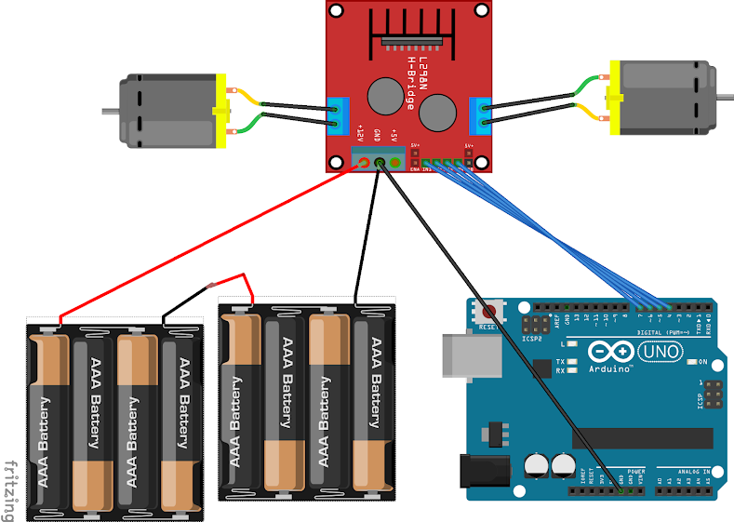
Arduino 遙控汽車
L298N
馬達驅動模組
直流減速馬達
直流減速馬達
接線圖
MEGA
12V 電池供電
Arduino Mega 2560

Slide 25
Flow Chart
Matlab 影像處理:
根據畫面中觀察到的亮帶寬度判斷頻率，藉此解譯出訊息
怎麼控制?
是否有充足時間能過路口
No
Yes
LED 訊號
產生訊息:
(紅/綠),(秒數)
停在路口
通過路口
相機接收訊號
透過 Serial port 傳送到 Arduino
Notes:
黃色部分看你要改成什麼

Slide 26
References
https://sites.google.com/site/zsgititit/home/arduino/arduino-shi-yongl298n-qu-dong-liang-ge-ma-da
http://cyyang12345.blogspot.com/2015/05/arduino.html

