Slide 1




Aegis & Aegis
Wound Closure
Strategy
Johnson & Johnson Case Competition
Team 9
April 2026

Slide 2
A&A leads in traditional sutures but lacks presence in the fast-growing barbed suture market, while competitors are already gaining traction with FDA-approved products. With its current plant at full capacity, A&A must rapidly enter the market with a differentiated, high-quality solution that aligns with its Credo and supports future scalability.
Challenge Overview

Slide 3

Recommendation
A&A should pursue a premium leadership strategy by acquiring barbed suture IP, developing spiral sutures internally, and supporting this with high pricing, gold marketing.
Key Decisions
  R&D: Purchase symmetrical IP + develop spiral internally
  Pricing: High
  Marketing: Gold (drive adoption)
  Supply Chain: New Plant Construction
  Human Capital: Full-Time Employees
Key Results
  Market Share: 56.4% → ~90%
  NPV: ~$24–25M
  Gross Profit: $8.3M → $91.4M (~75%–77% margin)
  Net Income: ~$39M (33% margin)
Strategy:
Build a premium, differentiated portfolio supported by strong marketing and in-house capabilities.
Executive Summary

Slide 4

Market Overview
Market Size & Growth
  CAGR: ~6.5–7.8%
  Barbed sutures growing fastest (9–12% CAGR)
Key Drivers
  More surgeries + aging population
  Improved efficiency with lower infection risk
Adoption Insight
  Not automatic; surgeons require training and trust

Slide 5

Market Position
56.4%
A&A holds 56.4% market share in traditional sutures
A&A Market Position
  Market leader in traditional sutures with strong hospital relationships
  High brand trust and established surgeon usage
  Large installed base across high-volume procedures
Strategic Gap
  Opportunity to lead the market with a first-to-market spiral.
  Potential to strengthen premium positioning in barbed sutures.
  Room to expand capacity to support next-generation growth.

Slide 6
Competitive Landscape
Crius (Poseidon)
Athena (Kronos)
Emerging / Adjacent Players
  $11.9B revenue, global scale (55% U.S.)
  FDA-approved barbed suture (since 2010)
  Strong device portfolio (68% of revenue)
  Proven clinical performance and adoption
Takeaway:
Dominant incumbent with scale and credibility
  $221M revenue, smaller but specialized
  Early patent (1999) + FDA approval (2005)
  Advanced product design (bi/unidirectional sutures)
  Competes through differentiation, not scale
Takeaway:
Niche innovator with strong product design
  Smaller firms (e.g., Hades Medical) → niche innovations
  Adjacent tech (Apollo & Nyx) → alternative wound care
  Increasing innovation pressure in wound closure
Takeaway:
Market becoming more competitive and innovation-driven

Slide 7
Threats | Strengths | Weaknesses | Opportunities
A&A SWOT Analysis
  First-mover potential in spiral sutures
  Ability to grow beyond 56.4% share with premium innovation
  New marketing channels (conferences, demos, training)
  Outsourcing enables immediate revenue
  Market leader with 56.4% share in traditional sutures
  Global scale: 128k employees, 250 companies
  Leadership in 80% of MedTech platforms
  Strong quality, reliability, and patient outcome reputation
  No barbed sutures; competitors already FDA-approved
  Plant at 100% capacity limits growth
  High capital needs for expansion/new plant
  3–5 year internal manufacturing timeline
  Strong competitors (Crius Poseidon, Athena Kronos)
  Substitute tech (staples, adhesives)
  Regulatory complexity & cost
  Pricing pressure + rising material costs
  Disruptive innovation from smaller players
Notes:
Ayan

Slide 8

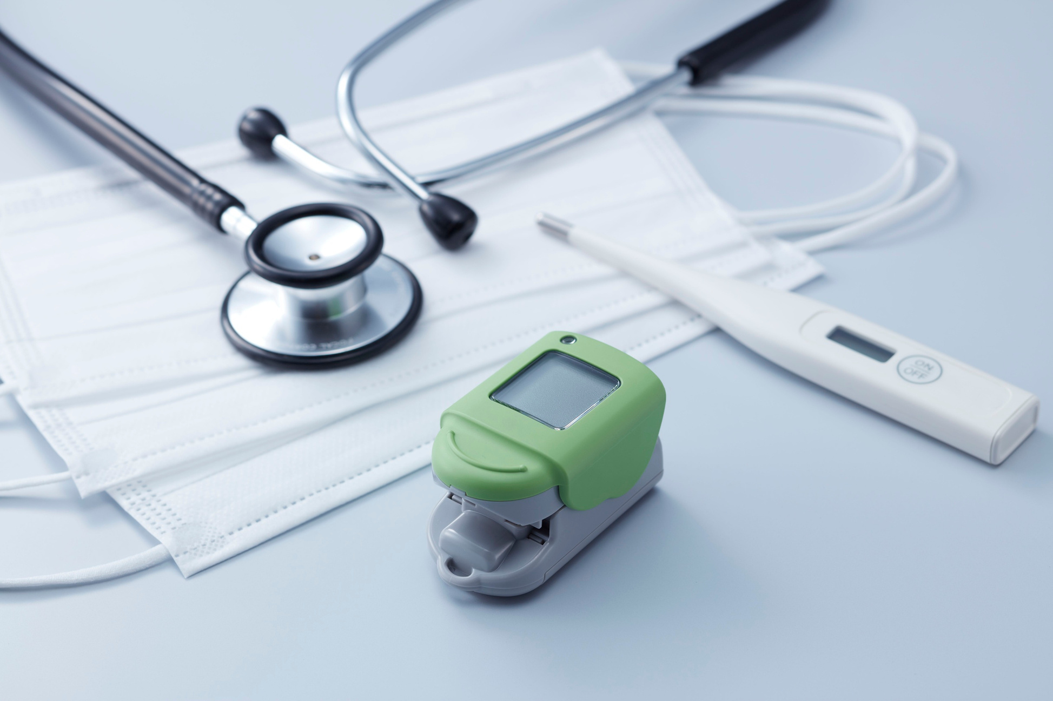



Credo Alignment
Patient Value & Quality
  Reduces surgery time → improves outcomes and lowers total cost of care
  Lowers infection risk → reduces complications and readmissions
  Premium pricing aligned with clinical value, not cost alone
Access & Innovation
  IP acquisition → enables immediate market entry and broader access
  Gold marketing accelerates adoption and expands hospital access
  Scalable capacity from new plant supports growing demand
Stakeholder Impact
  Patients: Better outcomes, fewer infections
  Employees: Workforce stability
  Community: Greater surgical access
  Stockholders: NPV $24.7M
Notes:
Ayan

Slide 9



Strategy Overview
Symmetrical sutures
  Purchase IP for symmetrical sutures
  Factory in Georgia
  Defensive product
Spiral sutures
  Internally develop spiral sutures
  Capture premium pricing
  Differentiated demand
Combined strategy
  Pair fast entry with long-term innovation
  High pricing → maximize margins
  Gold marketing → drive adoption

Slide 10


R&D + Price Strategy
R&D Strategy:
  Symmetrical (IP) → immediate revenue + market defense
  Spiral (internal) → first-mover advantage + premium growth
Financial Impact:
  Protects Current Marketshare
  Stronger long-term profitability
  Supports reinvestment into innovation
Tradeoff:
  Lower adoption initially → mitigated by marketing

Slide 11

Marketing Strategy
Recommendation: Gold-tier marketing
Why it matters:
  Surgeons are resistant to change
  Adoption requires training + trust
Execution:
  Conferences
  Live demonstrations
  Direct surgeon engagement
Impact:
  Accelerates adoption curve
  Increases market penetration
  Justifies premium pricing
In healthcare, credibility drives demand

Slide 12




Supply Chain Strategy
Recommendation: New Plant Construction
Why
  Highest product quality + consistency
  Purpose-built for barbed sutures
  Maximizes scalability + reliability
Financial Advantage
  Leads to ~90% market share
  Enhances profitability + financial strength
  Enables efficient future expansion
Notes:
Ayan

Slide 13
Human Capital
Stable workforce → higher manufacturing expertise & product consistency
  Aligns with Credo's focus on patient safety and quality
Supports long-term employee development & retention
  Reinforces responsibility to employees and job stability
Improves operational reliability & execution consistency
  Enables premium positioning in a high-quality product market
Balanced approach to quality, people, and long-term growth
  Fully aligned with Credo-driven strategy

Slide 14



Implementation Roadmap
  Expand symmetrical suture adoption and surgeon training
  Continue plant build-out and supply chain setup
  Strengthen sales force and hospital penetration
  Open and scale new plant (full production ramp)
  Launch spiral suture and expand dual-product portfolio
  Accelerate global growth and maximize profitability
Year 1-2: Enter
Year 4-5: Develop
  Acquire IP & secure outsourcing partner
  Launch marketing + surgeon training
  Enter barbed suture market (first revenue)
  Deepen market share with symmetrical product
  Finalize spiral suture development (internal R&D)
  Complete plant readiness and validation
Year 2-3: Build
Year 6+: Lead

Slide 15
Sensitivity Analysis
NPV Effect | Scenario | Change | Key Impact
↓ NPV (volume doesn't offset) | Pricing Sensitivity | High → Medium/Low | ↑ Adoption Initially ↓ Margins
Weakens long-term position | Marketing Sensitivity | Gold → Medium/Low | ↓ Surgeon adoption ↓ Market share
~Same NPV | Supply Chain Sensitivity | New Plant → Outsource | ~Same share ↓ CapEx

Slide 16

Key Assumptions & Tradeoffs
Strategy Assumptions
Tradeoffs
  Premium Pricing: Clinical value outweighs price sensitivity
  Gold Marketing: Training drives surgeon adoption
  New Manufacturing Plant: More control but high CapEx + delayed returns
  IP + Internal R&D: Immediate entry + long-term differentiation
  Lower Pricing: Higher adoption but lower margins & NPV
  Reduced Marketing: Lower cost but slower adoption & weaker share
  Outsourcing: Speed + capital efficiency > control
  Full Internal Development: Strong differentiation but delayed entry & lost early share

Slide 17


Financial Analysis
Financial Performance Summary
  Strong performance driven by:
    Early market entry
    Premium pricing
    Production-efficient sourcing
  Result: High market share growth + superior returns
Financial Metrics
Value Drivers
  Market Share: 56.4% → ~90% (peak)
  NPV: ~$24–25M (highest among strategies)
  Cumulative Net Income: ~$39M
  Industry Growth: ~7.5%
  Outperformance driven by barbed segment entry
  Premium Pricing → Higher margins per unit
  Gold Marketing → Faster adoption & share gain
  New Plant → Highest CapEx + long-term cost efficiency
  IP + Internal R&D → Immediate revenue + long-term growth
Notes:
Ayan

Slide 18
Why this Strategy WINS
01
Capture High-Growth Segment
02
Drive Early Adoption & Share
  Focus on barbed sutures (shifting demand)
  Positions A&A in fastest-growing segment
  Immediate entry via IP + outsourcing
  Gold marketing → faster surgeon adoption
  Builds long-term customer stickiness
03
Maximize Profitability
04
Capital Efficient & Scalable
  Premium pricing → stronger margins
  Product supports premium positioning
  New plant → dedicated facility ensures quality control & IP protection
  Full-time workforce → lower turnover costs improve cash flow & NPV over time

Slide 19
Aegis & Aegis
Wound Closure
Strategy
Johnson & Johnson Case Competition
Team 9
Thank you
Any questions?

