Slide 1
Access Control & Authentication in ICS
基礎設施安全 第六組

Slide 2
Problem Definition
In ICS security, lack of authentication is a root cause for many attacks
Command Injection Attacks
Response Injection Attacks
Man-In-The-Middle

Slide 3
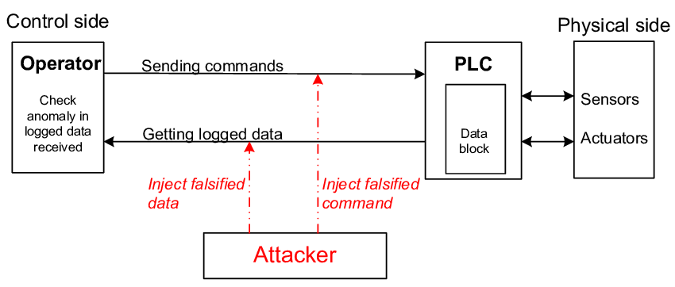

Slide 4
Problem Definition
Most security problems’ root cause is human
Misbehavior/secret leakage of inexperienced workers
No access control of who can do what
Unaccountable behaviors

Slide 5
Problem Definition
In ICS security, lack of authentication is a root cause for many attacks
Propose an availability-preserving authentication scheme using MAC and a firewall before PLC
Most security problems’ root cause is human
Propose an access control scheme using a centralized token-granting server

Slide 6
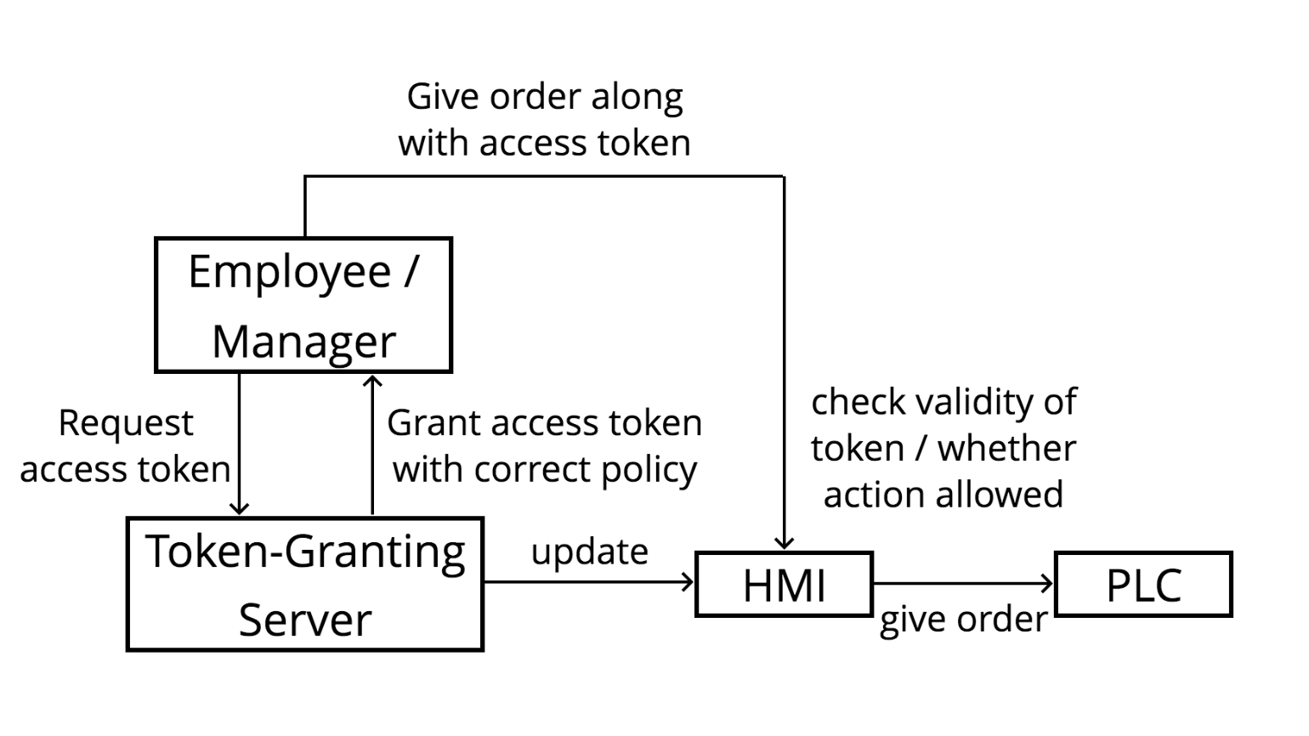
Access Control Scheme

Slide 7
Access Control Scheme
A centralized token-granting server
Concept borrowed from secure deployment
Token-granting server need to be very secure
It is assumed trustworthy for the scheme to work

Slide 8
Access Control Scheme - Advantages
Attacker can’t directly tell HMI what to do even if he can access it
If HMI is not compromised
Misbehavior of low-privileged employee won’t lead to severe attack
Secret leakage of a employee who can only control the fan won’t lead to attacker shutting down the factory’s power

Slide 9
Access Control Scheme - Advantages
Persistent attack is harder
Tokens expire after a period of time
Incidents are more accountable
Little delay, since users can request their new tokens prior to the token refresh time

Slide 10
Authentication Scheme - Problems
If attacker can somehow reach the internal network of the PLCs, he can bypass all defenses prior to the HMI
Since Modbus is a plaintext protocol without authentication functionality
Encryption and decryption between HMI and PLC cause delay and affect availability, which is probably unacceptable
We don’t actually need encryption for authentication
Use Message Authentication Code (MAC) with pre-installed key!

Slide 11
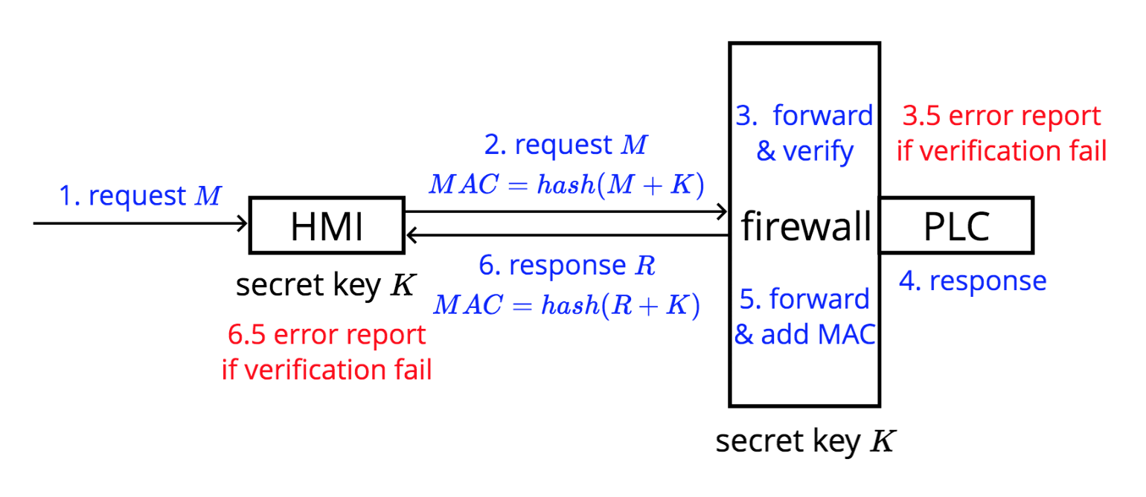
Authentication Scheme

Slide 12
Authentication Scheme
We use MAC for authentication
The secret key can be pre-installed
Only a single hash calculation is needed, very efficient
Attacker cannot forge commands without secret key
Timestamp should be included and checked in payload to avoid replay attack
Unlike decryption, MAC verification can be delayed and separately handled, payload can be immediately forwarded to preserve availability

Slide 13
Demo

Slide 14
Conclusion & Discussion
Lack of access control and authentication methods is root cause of many security problems in ICS
We proposed an access control scheme prior to HMI, using a centralized token-granting server
We proposed an authentication scheme between HMI and PLC, using MAC verification
Critical point of failure: token-granting server and HMI

Slide 15
Q&A

