Slide 1
Access Control & Authentication in ICS

Slide 2
Problem Definition
In ICS security, lack of authentication is a root cause for many attacks
Command Injection Attacks
Response Injection Attacks
Man-In-The-Middle

Slide 3
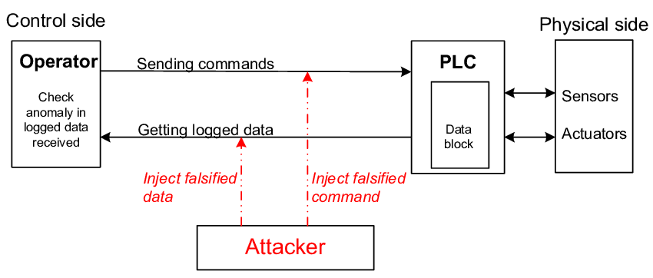

Slide 4
Problem Definition
Most security problems’ root cause is human
Misbehavior/secret leakage of inexperienced workers
No access control of who can do what
Unaccountable behaviors

Slide 5
Problem Definition
In ICS security, lack of authentication is a root cause for many attacks
Propose an availability-preserving authentication scheme using MAC and a firewall before PLC
Most security problems’ root cause is human
Propose an access control scheme using a centralized token-granting server

Slide 6
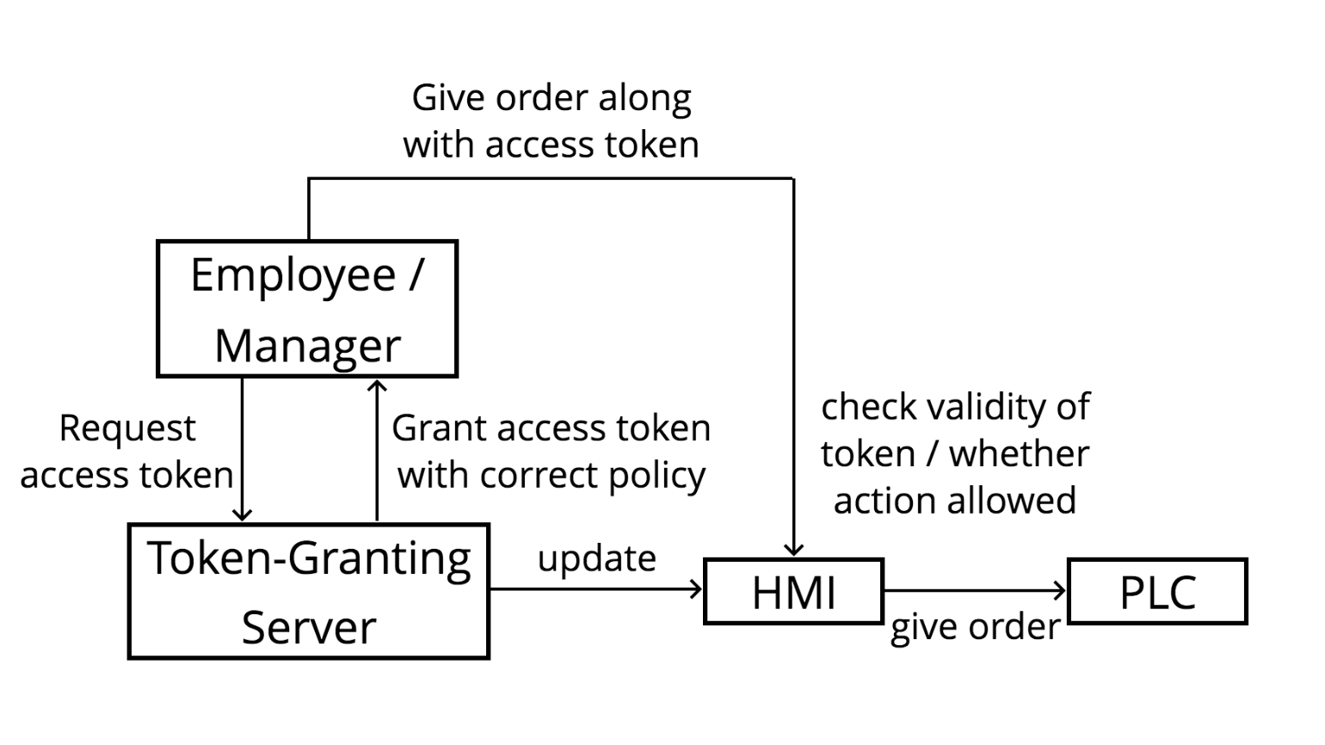
Access Control Scheme

Slide 7
Access Control Scheme
A centralized token-granting server
Concept borrowed from secure deployment
A user needs a access token with enough privilege level to perform each action
Solution of who can do what
HMI checks the token

Slide 8
Access Control Scheme
Request access tokens from a central token-granting server periodically
Token expires after a period of time
Need to authenticate to the server (e.g. TLS certificate)
Token-granting server periodically sends update message to HMI
Token-granting server need to be very secure
It is assumed trustworthy for the scheme to work

Slide 9
Access Control Scheme - Advantages
Attacker can’t directly tell HMI what to do even if he can access it
If HMI is not compromised
Misbehavior of low-privileged employee won’t lead to severe attack
Secret leakage of a employee who can only control the fan won’t lead to attacker shutting down the factory’s power

Slide 10
Access Control Scheme - Advantages
Persistent attack is harder
Tokens expire after a period of time
Incidents are more accountable
No delays, since users can request their new tokens prior to the token refresh time

Slide 11
Authentication Scheme - Problems
If attacker can somehow reach the internal network of the PLCs, he can bypass all defenses prior to the HMI
Since Modbus is a plaintext protocol without authentication functionality
Encryption and decryption between HMI and PLC cause delay and affect availability, which is probably unacceptable
We don’t actually need encryption for authentication
Use Message Authentication Code (MAC) with pre-installed key!

Slide 12
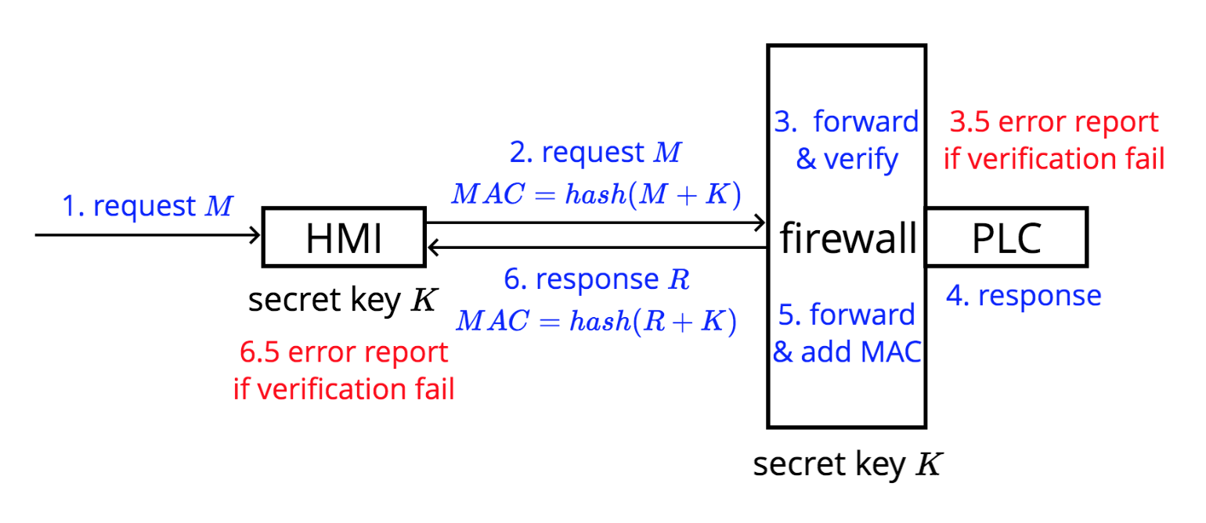
Authentication Scheme

Slide 13
Authentication Scheme
We use MAC for authentication
The secret key can be pre-installed
Only a single hash calculation is needed, very efficient
Attacker cannot forge commands without secret key
Timestamp should be included and checked in payload to avoid replay attack
Unlike decryption, MAC verification can be delayed and separately handled, payload can be immediately forwarded to preserve availability

Slide 14
Demo

Slide 15
Conclusion & Discussion
Lack of access control and authentication methods is root cause of many security problems in ICS
We proposed an access control scheme prior to HMI, using a centralized token-granting server
We proposed an authentication scheme between HMI and PLC, using MAC verification
Critical point of failure: token-granting server and HMI

Slide 16
Future Works
Setup a more complete implementation
Experiments to choose the most suitable parameters
To know whether the proposed schemes are practical, they need to be tested in real ICS environment, or a good simulation of it

Slide 17
Q&A

