Slide 1
Java Conceptual Aspects
Ayan Sengupta

Slide 2
Evolution

Slide 3
Java 9 to 11 (LTS)
Java 9:
Modules (Jigsaw Project): Introduces a modular system to improve application scalability, security, and maintainability.
JShell: An interactive Read-Eval-Print Loop (REPL) for experimenting with Java code.
Private Methods in Interfaces: Allows interfaces to contain private helper methods.
Java 10:
Local-Variable Type Inference (var): Enables the use of var for local variable declarations, reducing boilerplate code.
Java 11:
HTTP Client (Standard): A new, modern HTTP client API supporting HTTP/1.1, HTTP/2, and WebSockets.

Slide 4
Java 12 to 17 (LTS)
Java 12:
Switch Expressions (Preview): Allows switch to be used as an expression, returning a value.
Java 13:
Text Blocks (Preview): Simplifies the creation of multi-line string literals.
Java 14:
Records (Preview): Provides a concise syntax for defining immutable data classes.
Pattern Matching for instanceof (Preview): Simplifies conditional logic involving type checking and casting.
Java 15:
Sealed Classes (Preview): Restricts which classes or interfaces can extend or implement a sealed class or interface.
Java 16:
Records (Standard), Pattern Matching for instanceof (Standard), Sealed Classes (Second Preview): Finalization and further development of these features.
Java 17 (LTS):
Sealed Classes (Standard): Finalization of sealed classes.

Slide 5
Java 18 to 21(LTS)
Java 18:
Simple Web Server: A minimal HTTP server for static files.
Java 19:
Virtual Threads (Preview): A lightweight thread implementation for high-throughput concurrency.
Pattern Matching for switch (Preview): Extends pattern matching capabilities to switch statements and expressions.
Java 20:
Virtual Threads (Second Preview), Pattern Matching for switch (Second Preview): Further development of these features.
Java 21 (LTS):
Virtual Threads (Standard), Pattern Matching for switch (Standard), Record Patterns (Standard), Sequenced Collections (Standard): Finalization of these major features, enhancing concurrency, data handling, and pattern matching capabilities.

Slide 6
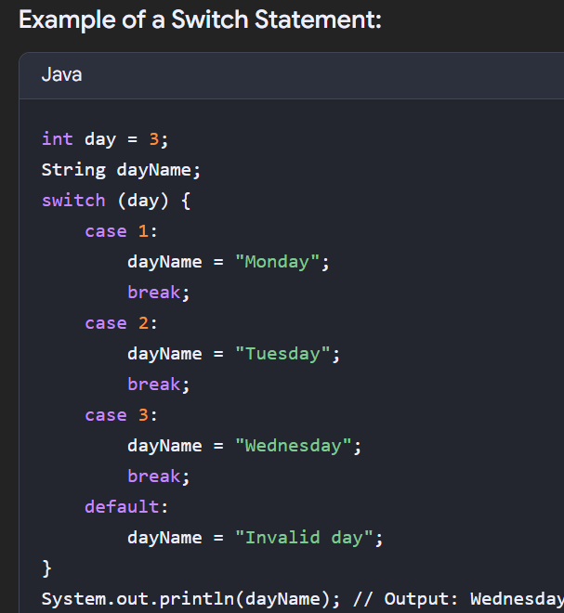
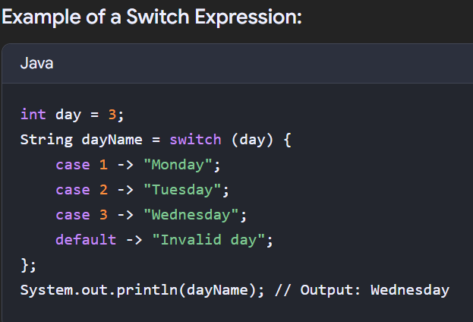
Switch statement vs Switch Expression
Feature | Switch Statement | Switch Expression
Purpose | Executes code blocks based on a value | Returns a value based on a value
Syntax | Colon (:) for case labels | Arrow (->) for case labels
Fall-through | Allowed (requires break) | Not allowed (implicit break behavior)
Return Value | No | Yes (using -> or yield)
Null Handling | Throws NullPointerException (before Java 17) | Can handle null as a case (Java 17+)
Pattern Matching | No | Yes (Java 17+)

Slide 7
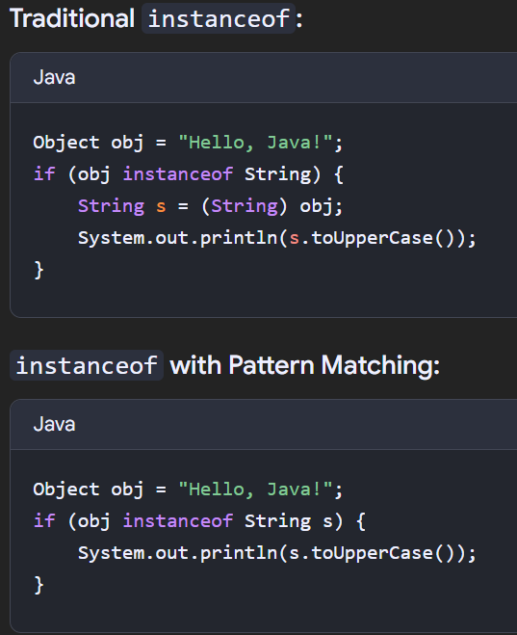
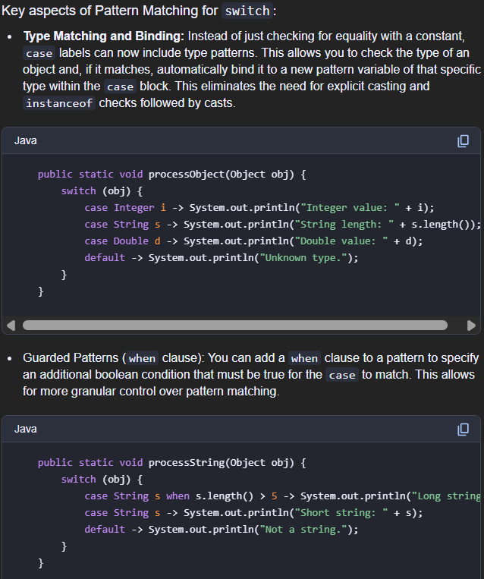
Pattern Matching for instanceof and switch

Slide 8
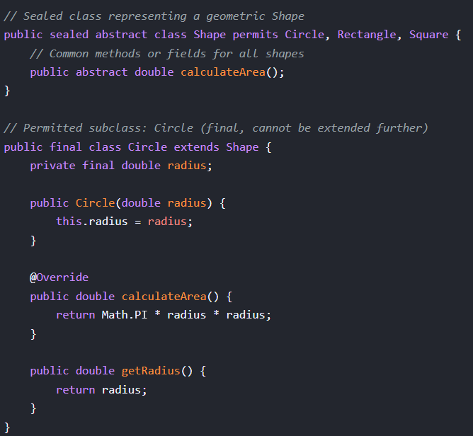
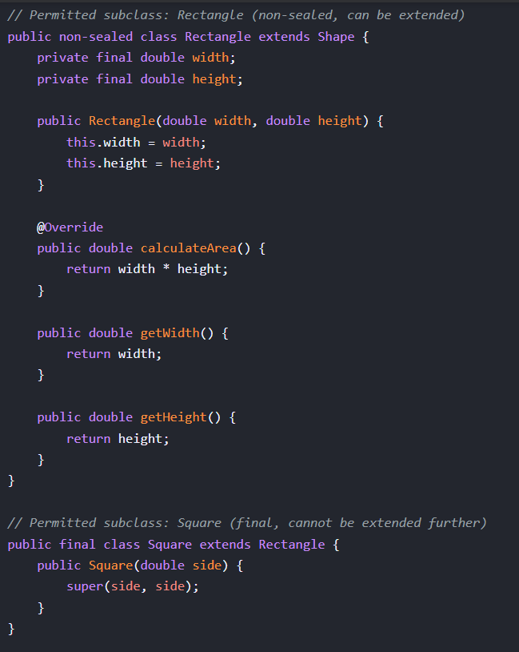
Sealed classes
A sealed class or interface in Java restricts which other classes or interfaces can extend or implement it. This provides more control over inheritance hierarchies and can be useful for modeling closed sets of types.

Slide 9
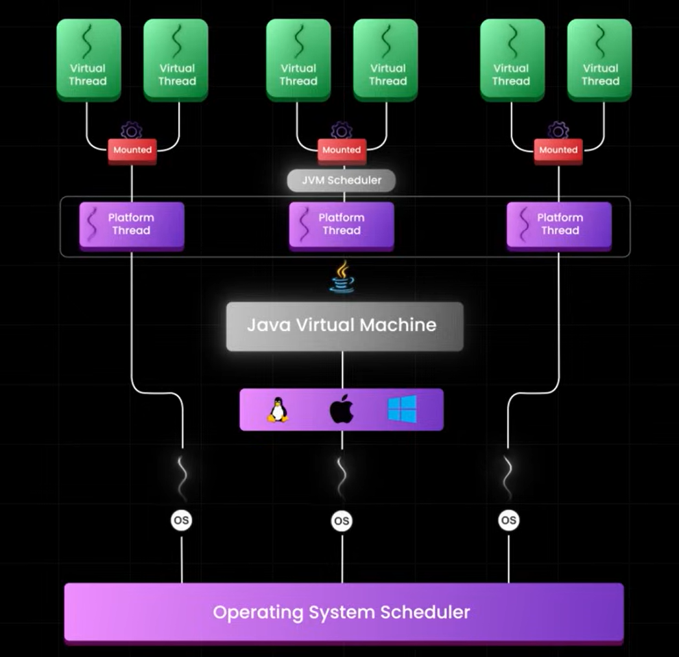
Virtual threads
What?
Platform threads are Java threads that are directly tied to operating system (OS) threads. Virtual threads, in contrast, are lightweight threads managed entirely by the Java Virtual Machine (JVM)
Advantages : scalability, simplified concurrency compared to reactive frameworks (not necessarily better than them in terms of throughput though), debugging
When to use virtual threads
large number of concurrent tasks that spend most of their time waiting for I/O operations, file records or https requests
Pitfalls
Thread pinning: Blocking operations within synchronized blocks or native code can pin a virtual thread to its carrier thread, negating some of the performance benefits.
Thread-local variables: Since the underlying carrier thread can change, thread-local variables might lead to unexpected behavior. Consider using alternatives like scoped values or explicit context passing.
CPU-bound workloads: Virtual threads do not inherently speed up CPU-intensive tasks. For such workloads, traditional thread pools might still be a better choice.
https://www.youtube.com/watch?v=zPhkg8dYysY

Slide 10
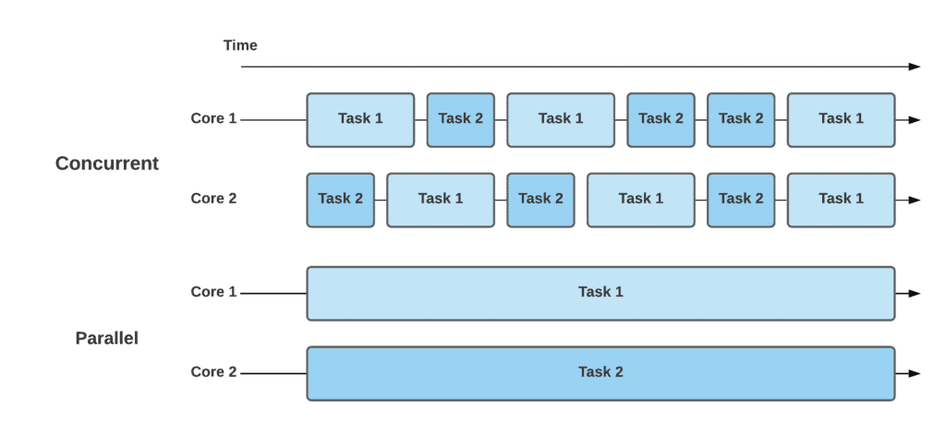
Concurrency, parallelism and async
Concurrency: is about dealing with multiple tasks at once ( managing their progress, but not necessarily simultaneously). The whole shebang of Java concurrency techniques
Parallelism: is about doing multiple tasks at once (simultaneous execution). ExecutorService (When the underlying ExecutorService implementation (e.g., ThreadPoolExecutor) utilizes multiple threads and the system has multiple CPU cores, tasks can execute in parallel, truly simultaneously) and ForkJoinPool are commonly used for parallel task execution.
Asynchronous Programming: is a technique to achieve concurrency, especially for non-blocking I/O and improving responsiveness. Future represents the result of an asynchronous computation, while CompletableFuture provides a more powerful and flexible API for composing and chaining asynchronous operations, handling completion, and managing exceptions in a non-blocking manner

Slide 11
Functional Programming

Slide 12
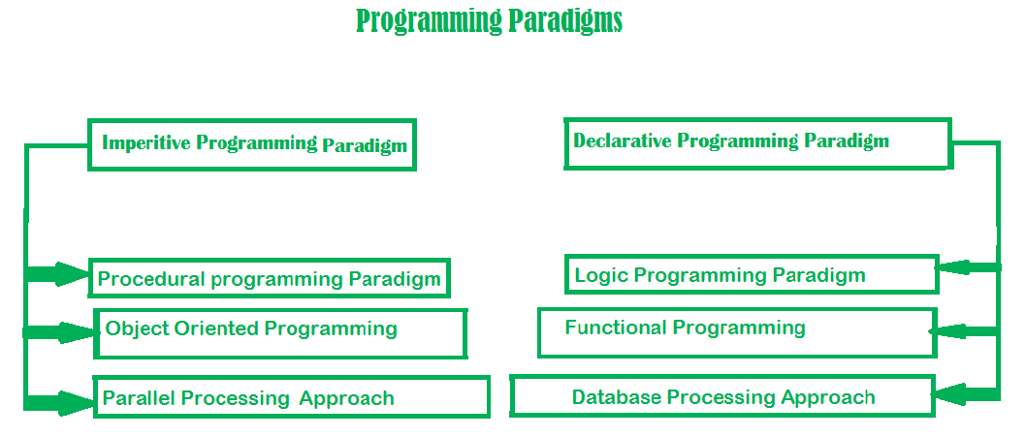
imperative approach defines a program as a sequence of statements that change the program’s state until it reaches the final state. Focuses on HOW
In contrast, the declarative approach expresses the logic of a computation without describing its control flow. Focuses on WHAT

Slide 13
Fundamentals
In functional programming, functions are first-class citizens, meaning that they can be passed around as values, stored in variables or data structures, and used as arguments or return values of other functions.
The function interface provides a way to define and manipulate functions in Java code. Any interface with a single abstract method can serve as a functional interface
Higher-order functions are capable of receiving functions as arguments and returning a function as a result.
a pure function should return a value based only on the arguments and should have no side effects. (i.e.) modifying global or local state or saving data to a database or disk. Pure functions can be run in parallel without race condition or data corruption. See here
An expression is referentially transparent if it can be replaced with its corresponding value without changing the program's behavior. If all functions involved in the expression are pure and immutable functions, then the expression is referentially transparent See here

Slide 14
Functional Programming Paradigm | Object-Oriented Programming Paradigm
Functional programming follows declarative programming paradigm. | Object-Oriented programming follows imperative programming paradigm.
Functional programming uses immutable data. | Object-Oriented programming uses mutable data.
Functional programming supports parallel programming. | Object-Oriented programming doesn't support parallel programming.
Functional programming operates on variables and functions. | Object-Oriented programming operates on objects and methods.
Functional programming uses recursion for iteration. | Object-Oriented programming uses loops for iteration.
Functional programming is stateless. | Object-Oriented programming is stateful.

Slide 15
Advantages of the Functional Programming
Functional programming uses pure functions, which only depend on the input parameters passed to the function and always produced the same output for the given input.
Functional programming deals with immutable data (i.e.) the state doesn't change, so it is easier to debug.
Functional programming supports parallel programming because pure functions don't change the state and operate exclusively on the input parameters.
Functional programming supports lazy evaluation, which avoids unwanted and repeated computations and saves time.
Functional programming is thread-safe because pure functions don't modify the state of a program, and there is no shared state.
In functional programming, functions can be stored in variables and passed to other functions. This enhances the readability of code.

Slide 16
Functional Interfaces in Java
A functional interface is an interface that contains single abstract method. They can have only one functionality to exhibit. From Java 8 onwards, lambda expressions can be used to represent the instance of a functional interface. A functional interface can have any number of default methods
Consumer : accepts only one argument and returns nothing.
Variants : BiConsumer, DoubleConsumer, IntConsumer, and LongConsumer
Example : Consumer<Integer> display = a -> System.out.println(a);
display.accept(10);
Supplier : does not take any input or argument and yet returns a single output
Variant : BooleanSupplier, DoubleSupplier, LongSupplier, and IntSupplier
Example : Supplier<Double> randomValue = () -> Math.random();
System.out.println(randomValue.get());
Predicate : accepts an argument and, in return, generates a boolean value
Variants : BiPredicate, IntPredicate, DoublePredicate, and LongPredicate
Example : Predicate<Integer> lesserthan = i -> (i < 18);
System.out.println(lesserthan.test(10));
Function : receives only a single argument and returns a value after the required processing
Variants : BiFunction, Operator (UnaryOperator and BinaryOperator) extends Function and must return the same data type
Example : Function<Integer, Integer> square = x -> x*x;

Slide 17
Lambdas
Lambda Expression basically expresses an instance of the functional interface, in other words, you can say it provides a clear and concise way to represent a method of the functional interface using an expression.
1. Lambda Expression with Zero parameter
() -> System.out.println("Zero parameter lambda");
2. Lambda Expression with Single parameter
p -> System.out.println("One parameter: " + p);
3. Lambda Expression with Multiple parameters
(p1, p2) -> System.out.println("Multiple parameters: " + p1 + ", " + p2);

Slide 18
Monad and Optional
Monad is a key concept of Functional Programming. A Monad is a design pattern which helps to represent a missing value. It allows to wrap a potential null value, allows to put transformation around it and pull actual value if present
Key Operations
Left Identity − If a function is bind on a monad of a particular value then its result will be same as if function is applied to the value.
Right Identity − If a monad return method is same as monad on original value.
Associativity − Functions can be applied in any order on a monad.
Optional Class
Java 8 introduced Optional class which is a monad. It provides operational equivalent to a monad.

Slide 19
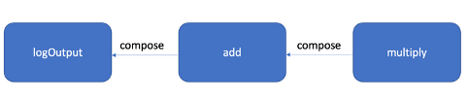
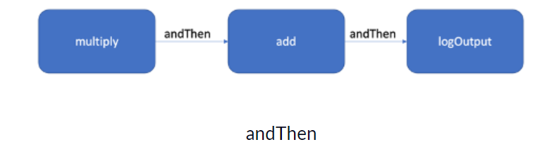
Function Composition and Chaining
Function chaining is a technique in functional programming that involves composing multiple functions into a single pipeline or chain.
private static Function<Integer, Integer> multiply = x -> x * 2;
private static Function<Integer, Integer> add = x -> x + 2;
private static Function<Integer, Unit> logOutput = x ->{ logger.info("Data:" + x); return Unit.unit(); };
public static Unit execute(Integer input) {
Function<Integer, Unit> pipeline = multiply
.andThen(add)
.andThen(logOutput);
return pipeline.apply(input);
}
public static Unit compose(Integer input) {
Function<Integer, Unit> pipeline = logOutput
.compose(add)
.compose(multiply);
return pipeline.apply(input); }

Slide 20
Customized Functional Interface
Function<String, String> toUpper = str -> str.toUpperCase();
BiFunction<Integer, Integer, Integer> sum = (a, b) -> a + b;
The Function interface takes a single input and produces an output, whereas the BiFunction interface takes two inputs and produces an output.
if we need a function that takes three inputs, we must construct our own customized function.
@FunctionalInterface
public interface TriFunction<A, B, C, O> {
O apply(A a, B b, C c);
default <R> TriFunction<A, B, C, O> andThen(TriFunction<A, B, C, O> after)
{
return (A a, B b, C c) -> after.apply(a,b,c);
}
}

Slide 21
Function Currying
Currying is converting a function with multiple arguments into multiple functions with a single argument.
public static void main(String[] args) {
//using java.util.function.BiFunction
BiFunction<String, String, String> concatWithBiFunction = (a,b) -> a+b;
//Currying is converting a function with multiple arguments into multiple functions with a single argument.
Function<String, Function<String, String>> concatCurried = a -> b -> a + b;
System.out.println("concatWithBiFunction: " + concatWithBiFunction.apply("A", "B"));
System.out.println("concatCurried: " + concatCurried.apply("A").apply("B"));
}

Slide 22
References
https://medium.com/java-and-beyond/modern-java-an-in-depth-guide-from-version-8-to-21-by-akiner-alkan-f89b50e13c72
https://www.tutorialspoint.com/functional_programming_with_java/index.htm
https://www.freecodecamp.org/news/functional-programming-in-java/#:~:text=In%20functional%20programming%2C%20functions%20are,manipulate%20functions%20in%20Java%20code.
https://www.baeldung.com/java-functional-programming
https://www.geeksforgeeks.org/functional-programming-in-java-with-examples/
https://www.scaler.com/topics/java/functional-programming-in-java/

