Slide 1
Load Balancer
Ayan Sengupta

Slide 2
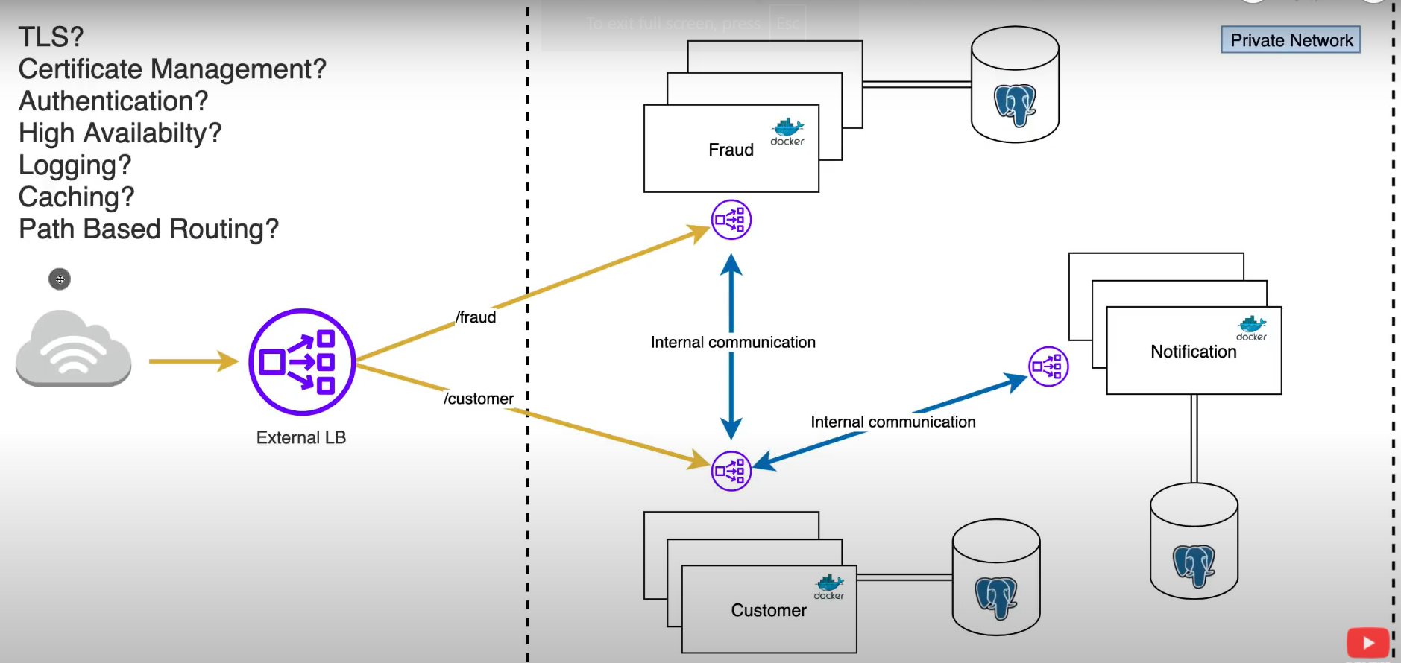
External vs Internal Load Balancer

Slide 3
Types of Load Balancers
Infra Perspective
Hardware Load Balancers : Expensive
Software Load Balancers : Based suited for on-prem apps and data. Maybe implemented using Spring Cloud Load Balancers (need to check)
Cloud Load Balancers / Load Balancer-as-a-Service : Managed options from various cloud providers. Discussed in subsequent slides
Geo Perspective
Regional Load Balancer
Global Load Balancer
DNS-based.
Anycast-based.
https://www.redhat.com/en/blog/global-load-balancer-approaches

Slide 4
AWS Elastic Load Balancer
Elastic Load Balancing (ELB) is a fully managed load balancing service. It automatically distributes incoming application traffic to multiple targets and virtual appliances across Amazon Web Services (AWS) and on-premises resources. In addition, it supports cross-zone load balancing across AWS Regions. You can use ELB to set up ALB, NLB, or GLB according to your requirements.
ALB is one component of ELB. ELB also supports NLB, GLB, and Classic Load Balancer. These load balancers are client contact points and help improve application scalability with secure management. You can choose one or multiple load balancers and configure them when you’re setting up ELB for your cloud environment

Slide 5
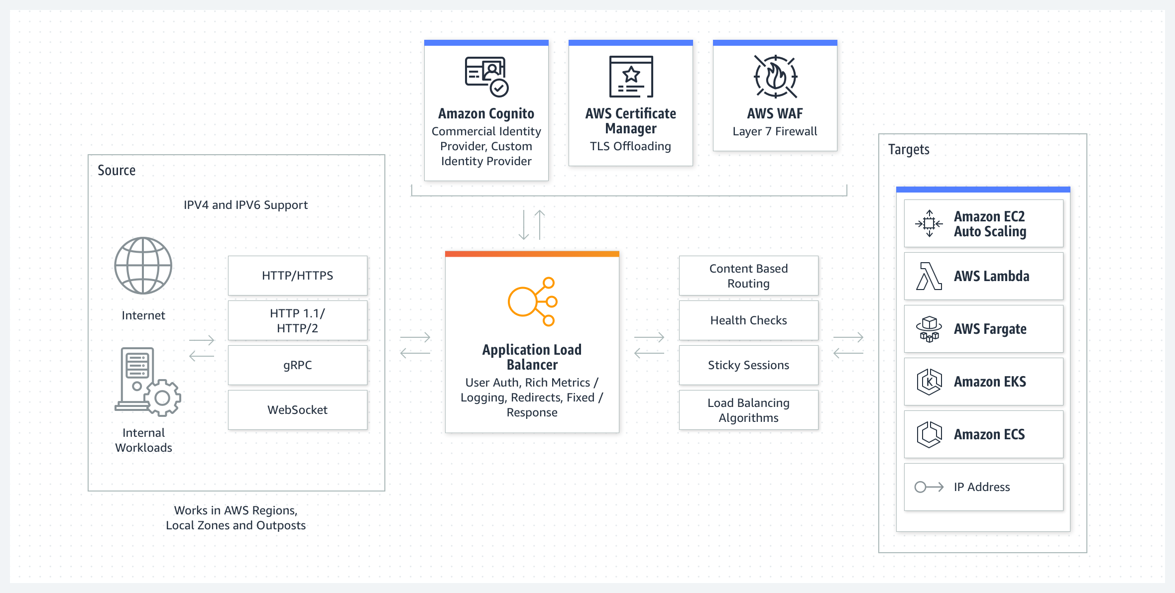
AWS Application Load Balancer
Purpose
ALBs distribute incoming traffic across multiple targets based on functionality. For example, an ecommerce application has a product directory, a shopping cart, and checkout functions.
Use case
An ALB is a good choice when you need flexible application-level traffic management and routing. It’s best with microservices, containerized environments, and web applications. Its features—such SSL termination, session persistence, and content-based routing—enable it to offer assistance with complex routing scenarios.

Slide 6
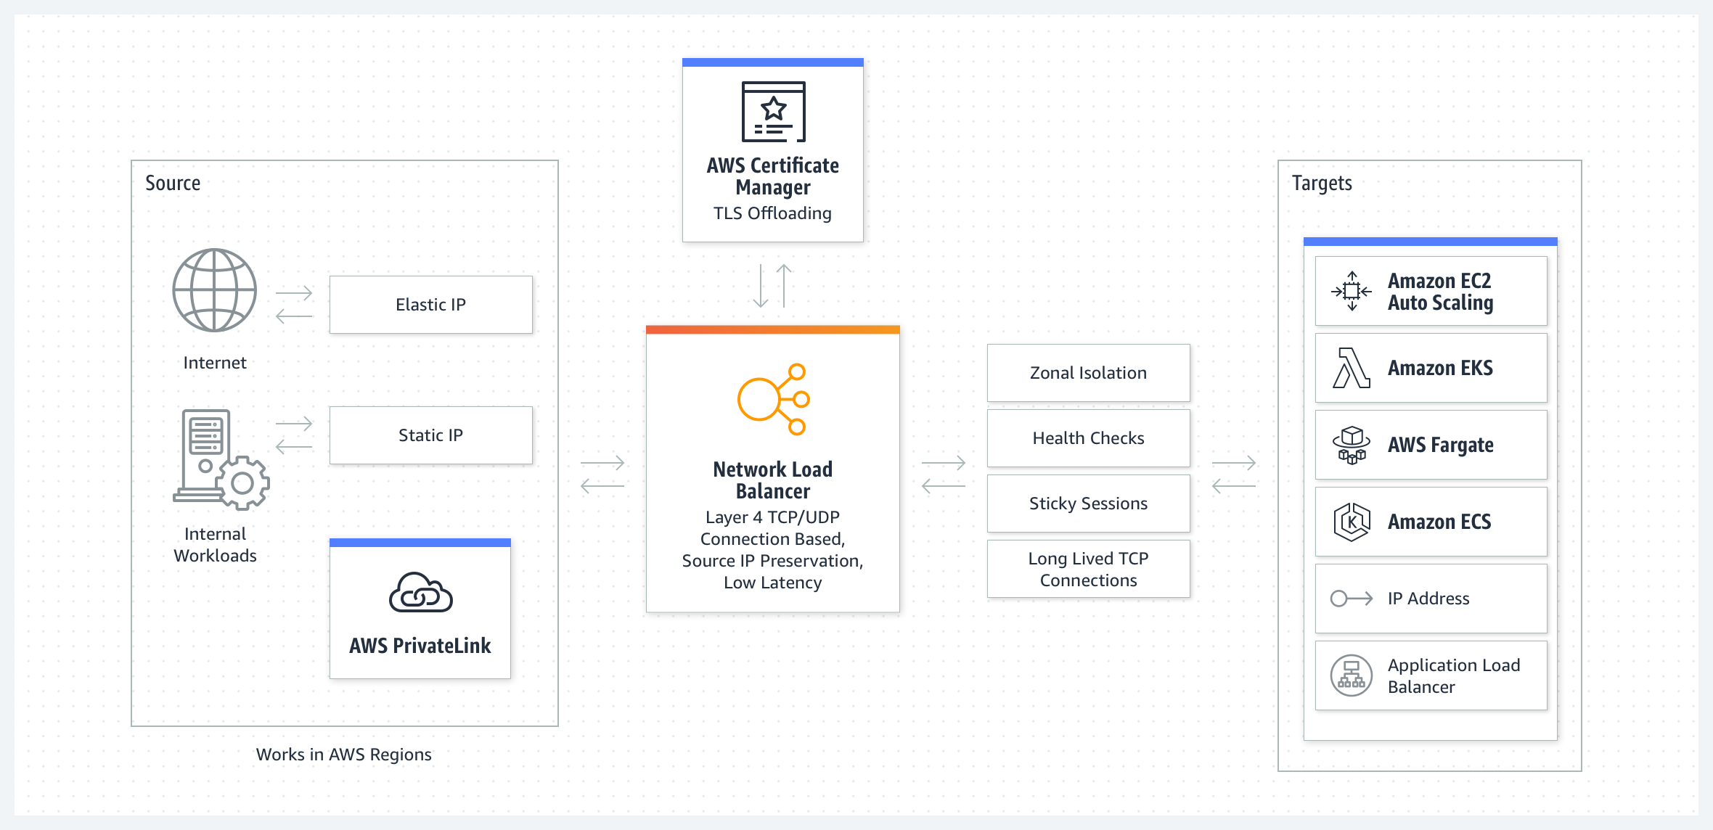
AWS Network Load Balancer
Purpose
NLB routes traffic based on predetermined server IP addresses or server availability.
Use Case
An NLB is best for high-performance, low-latency, and scalable network-level balancing. Applications that distribute traffic on the transport layer use NLBs, especially considering its reliability. Gaming systems, media streaming services, and major IoT systems use NLBs.

Slide 7
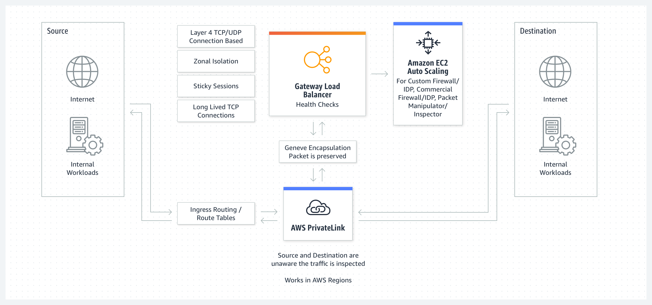
AWS Gateway Load Balancer
Purpose
A GLB is ideal when you’re balancing on the network gateway level.
Use case
For example, a GLB works well if you manage traffic between cloud and on-premises environments or across different regions. Because it combines OSI layers 3 and 4 balancing, it can route traffic between distinct regions and networks. Because it supports IP-based routing, it can distribute traffic across virtual gateways, so it can offer high scalability and availability.

Slide 8
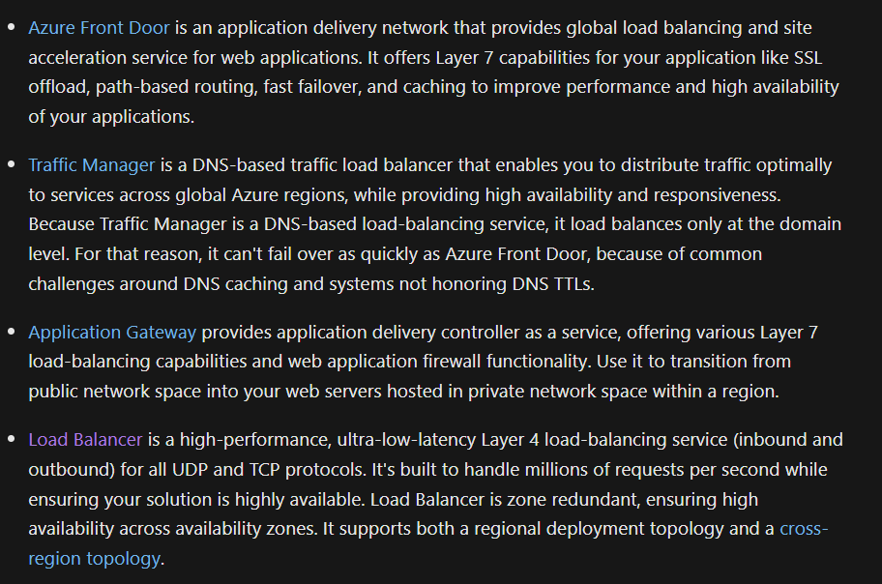
Azure load-balancing services

Slide 9
Google Cloud Load Balancer
Application Load Balancers
External Application Load Balancers
Internal Application Load Balancers
Network Load Balancers
Proxy Network Load Balancers
Passthrough Network Load Balancers

Slide 10
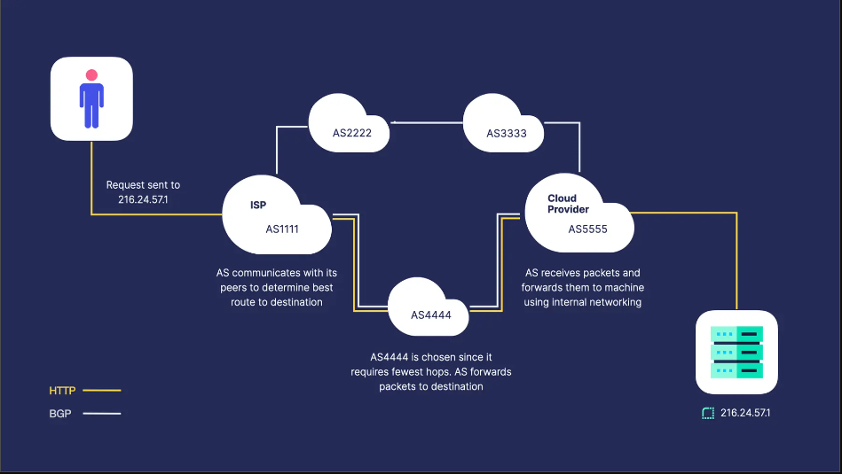
A brief overview of the internet
1. The Internet is the greatest decentralized network in the history of mankind. There is no central authority that controls who is allowed to connect or how you can use it. How do we manage billions of internet-connected devices without any single organization in charge of maintaining the system? This is accomplished through the coordination of many independent entities called Autonomous Systems (AS). ASs are the networking backbone of the internet. These entities, often managed by ISPs or large technology organizations, are responsible for handling traffic for the IP addresses they manage and advertising the paths to all other IP prefixes of which they are aware. Connections between ASs, also known as peers, are established through the manual configuration of connections between routers
2. Once a connection has been established, ASs use the Border Gateway Protocol (BGP) to coordinate with each other. BGP carries the information necessary for ASs to determine the optimal path to a target. Many factors can be used to define "optimal", but the most common heuristic used is choosing the path with the fewest number of "hops" between ASs before reaching the destination. Each AS will store the best path for all IP prefixes in its routing table. When a route is added or removed, the AS will update its routing table, if necessary, and advertise the change to its peers so they can do the same. Each peer sends keep-alive messages to each other at regular intervals. If an AS does not send a keep-alive message before the configured timeout, the peer will stop advertising the AS as a reachable hop and packets will use a different path to reach the target if it exists.

Slide 11
What is Anycast?
An anycast network is two or more servers advertising the same IP address from different locations.
Why would we want to do this? Serving traffic from a single location often lacks the redundancy required for critical or latency-sensitive applications that serve users around the world. In the worst case of a global round-trip request, you can expect 300 ms of latency just in transit time. This doesn't account for the time it takes the server to process the request. Chain a few of these requests together and you're looking at a very sluggish application and a frustrating user experience. For applications that require high availability and low latency, you will want an architecture that has the following characteristics:
Globally distributed
Automatically routes traffic to the optimal server
Tolerates failures of individual servers
We can leverage the advanced routing capabilities of BGP to create a fault-tolerant, low-latency system by building an anycast network. By advertising an IP from many servers around the world, we can rely on BGP to route users' requests to the nearest Point of Presence (PoP) -- or server, in other words -- that advertises the IP. When one of those PoPs fails, it will stop sending keep-alive messages to its peers, connected ASs will stop advertising the path, and traffic will reroute to a healthy PoP.

Slide 12
https://render.com/
We provide a single IP address (our anycast IP address) to use in your DNS settings.
When a request reaches one of the servers advertising that IP, we will forward it to one of possibly several origins around the world, depending on where your site is hosted and whether it's a web service or a static site.
we advertise our IP from anycast servers worldwide, which inspect each request and forward it to a server capable of responding. So, the server that serves a request is one of hundreds of geographically distributed CDN edge servers containing a cached copy of your static site. If one of those servers fails, its peers will stop advertising the route and the traffic will be sent elsewhere.
Building an Anycast Network
Obtain an Autonomous System Number
Acquire an IP Address
Find a Hosting Provider
Configure BGP

Slide 13
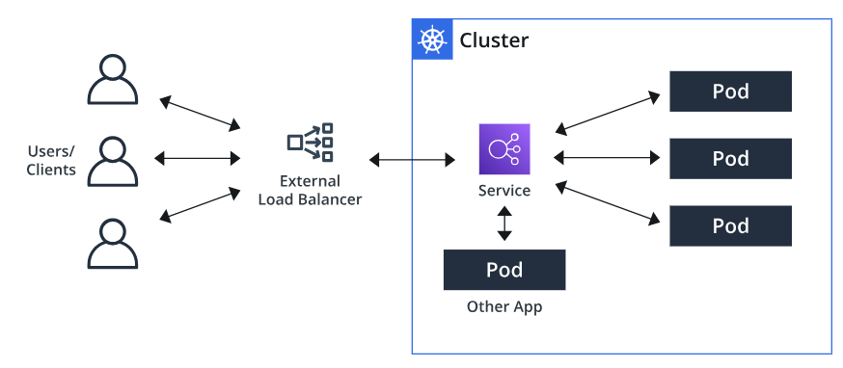
Load Balancing in Kubernetes - Service
Service :
In the Kubernetes world, the pods, where the application lives, are temporary and get a new IP address every time they are launched. The pods are usually dynamically destroyed and recreated with each deployment.
The Kubernetes service creates an abstraction that maps to one or more pods. This abstraction allows other applications to reach the service by simply referring to the service name.
Service survives even if the container dies.
In a way it acts as load balancer and routes to live containers
Types
ClusterIP : Accessible within the cluster. Dependent applications can interact with other applications internally using the ClusterIP service.
LoadBalancer : This service type creates load balancers in various Cloud providers like AWS, GCP, Azure, etc., to expose our application to the Internet.
NodePort services are accessible outside the cluster. It creates a mapping of pods to its hosting node/machine on a static port.
https://www.densify.com/kubernetes-autoscaling/kubernetes-service-load-balancer/

Slide 14
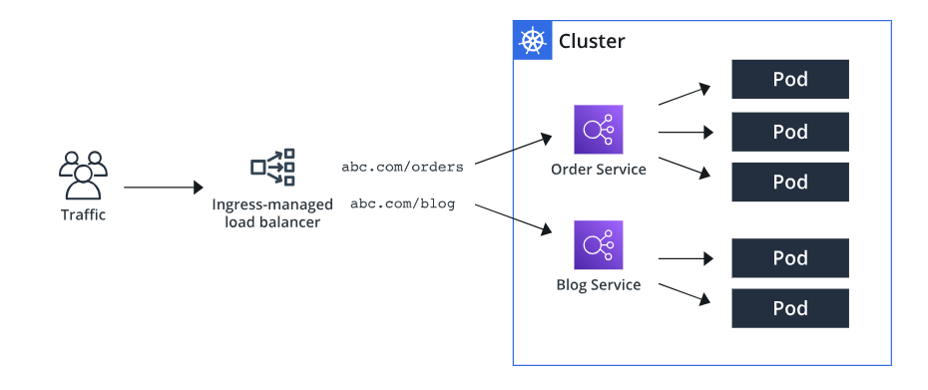
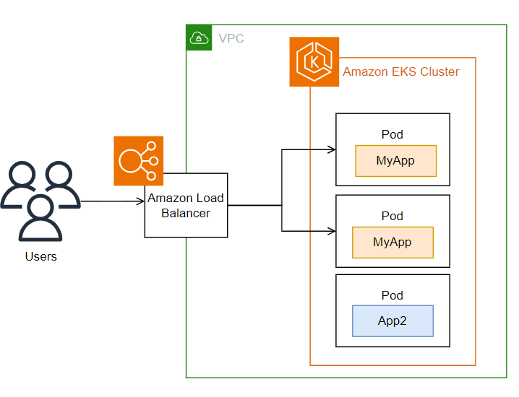
Load Balancing in Kubernetes - Ingress
We saw that the LoadBalancer service type creates an Application/Network Load Balancer for each service. It is fine as long as we have few services to expose. However, it could be expensive as well as hard to manage multiple services. Also, the LoadBalancer type doesn’t support URL routing, SSL termination, etc.
Consider Ingress as an extension of the NodePort or LoadBalancer service type. It sits between the external traffic and the Kubernetes Cluster, processing the traffic internally to determine which pods or services to forward. The main features of Ingress are load balancing, name-based virtual hosting, URL routing, and SSL termination.
For Ingress to work, the cluster needs an Ingress Controller. Some of the well-known Ingress Controllers are:
AWS Load Balancer Controller: manages AWS Elastic Load Balancers for a Kubernetes cluster. The controller watches for Kubernetes Ingress or Service resources. In response, it creates the appropriate AWS Elastic Load Balancing resources.
Nginx Ingress Controller
On AWS
https://www.densify.com/kubernetes-autoscaling/kubernetes-service-load-balancer/
https://docs.aws.amazon.com/eks/latest/userguide/aws-load-balancer-controller.html

Slide 15
References
https://www.youtube.com/watch?v=C2NLPQTvO9M
https://aws.amazon.com/what-is/load-balancing/
https://aws.amazon.com/elasticloadbalancing/
https://cloud.google.com/load-balancing/docs/load-balancing-overview
https://www.redhat.com/en/blog/global-load-balancer-approaches (great article)
https://render.com/blog/how-to-build-an-anycast-network
https://labs.ripe.net/author/samir_jafferali/build-your-own-anycast-network-in-nine-steps/
https://www.densify.com/kubernetes-autoscaling/kubernetes-service-load-balancer/
https://docs.aws.amazon.com/eks/latest/userguide/aws-load-balancer-controller.html

